Slide 1

MAD Project Presentation
on
“FLAVIUM SPORTS FEST PORTAL”
(Tournament & Fixture Management Android App)
By
Shaurya Pratap Singh
Third Year B. TECH Computer Engineering - DIV B
Department of Computer Engineering
MPSTME, SVKM’s NMIMS Shirpur Campus
Academic Year 2026-27

Slide 2
Outline
  Introduction
  Problem Statement
  Objective of Project
  Sample Screenshot
  GitHub Link
  References

Slide 3
Introduction
About Flavium Sports Fest
• Flavium is the premier annual inter-departmental college sports festival uniting students across multiple sports disciplines.
• Managing hundreds of student athletes, 18 distinct sports categories, pool distributions, and match schedules demands high coordination.
Application Overview
• A native Android mobile application built using core Java and standard Android SDK components.
• Provides end-to-end tournament administration: team registrations, player candidate rosters, match fixtures generation, live scoring, and pool standings.
• Designed strictly following textbook syllabus concepts (Activities, SQLite, Intents, Custom Adapters, and File I/O).

Slide 4
Problem Statement
Traditional Festival Coordination Issues
  Manual paper sheets and disconnected messaging groups lead to fixture scheduling errors and duplicate entries.
  Difficulty in tracking participant eligibility, jersey numbers, and captain contact records in real-time.
Delayed Standings & Score Updates
  Calculating pool points tables, goal differences, and knockout brackets manually takes hours and causes disputes.
  Coordinators cannot instantly contact team captains or direct visiting teams to sport venues.
Need for an Offline-Capable Mobile Solution
  Campus sports grounds often have weak cellular network connectivity, making cloud-only apps impractical during live games.
  Requires a standalone, lightweight, on-device SQLite database system.

Slide 5
Objective of Project
Automated Tournament & Match Scheduling
  Implement algorithmic fixture generation supporting both Round-Robin League and Knockout elimination pools.
  Guarantee zero clash pairings and transparent match scheduling.
Complete Roster & Participant Management
  Maintain structured records of 18 sports disciplines, participating teams, and candidate player profiles.
  Validate player jersey numbers and captain contact details using Regex and input filters.
Live Scorekeeping & Dynamic Standings
  Record match scores on field with automatic calculation of Won/Lost/Draw status and pool points table.
  Export tournament summaries to device internal storage (File I/O) and integrate device sensors/hardware (Camera, Maps, Dialer).

Slide 6
Architecture & Syllabus Concepts Used
User Interface & Layout Containers
  Pure Android Views & ViewGroups: LinearLayout (Horizontal/Vertical with layout_weight) and ConstraintLayout.
  Standard widgets: TextView, EditText, Button, Spinner, RadioGroup, CheckBox, ListView, and WebView.
Inter-Component Communication & Intents
  Explicit Intents for multi-screen activity navigation with Bundle data transfer (putExtra / getExtra).
  Implicit Intents for system apps: Google Maps (geo:), Phone Dialer (tel:), and Camera (ACTION_IMAGE_CAPTURE).
Data Persistence & Dialogs
  Local SQLite Database (SQLiteOpenHelper) with transactional queries and multi-table relational schema.
  DatePickerDialog & TimePickerDialog for scheduling, plus Internal Storage (FileOutputStream) for report export.

Slide 7
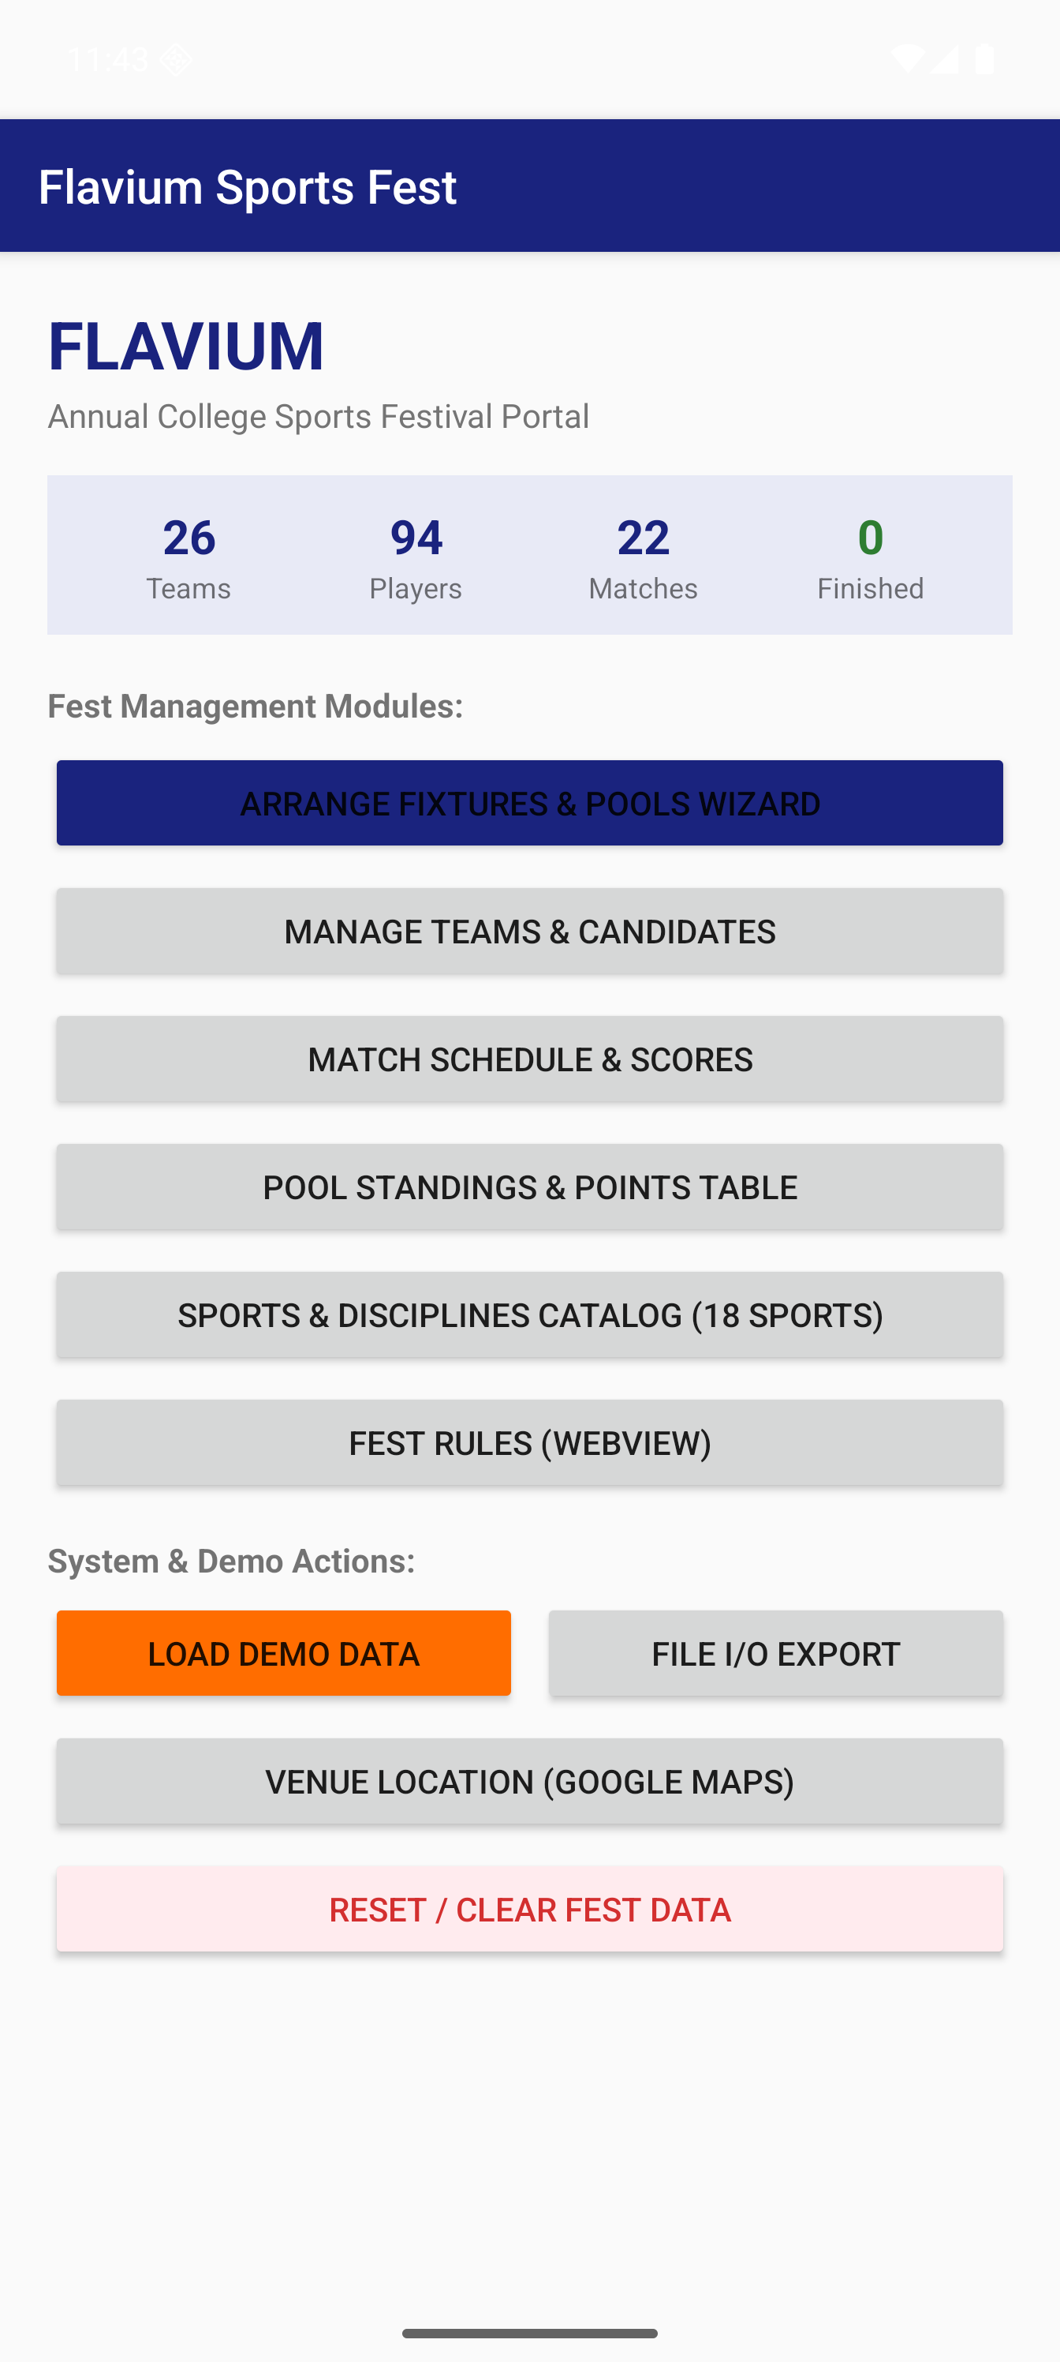
Sample Screenshot: Main Dashboard
Dashboard Features & Workflow:
• Dynamic Live Counters: Displays real-time counts of Teams, Players, Matches, and Completed games queried from SQLite.
• Central Navigation Hub: Direct access to Fixture Wizard, Team Management, Match Schedules, and Points Table.
• System & Demo Operations: 1-click Demo Seeder for testing, File I/O tournament exporter, and Clear Fest database reset.
• Google Maps Integration: Launches stadium coordinates directly in system Maps via Implicit Intent.

Slide 8

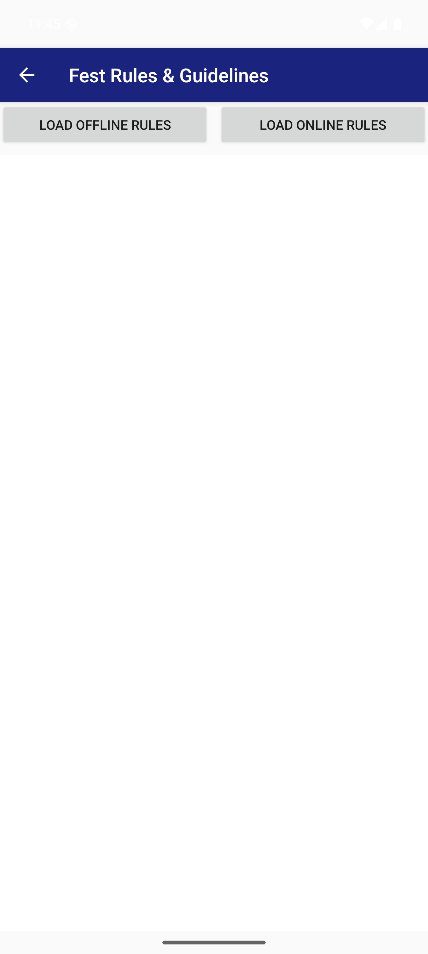
Sample Screenshot: Core Modules
Key Functional Modules:
• Teams & Rosters:
Custom ArrayAdapter with ListView rendering team details, pool badges, and captain actions.
• Official Rules (WebView):
Renders embedded HTML rules and remote fest regulations seamlessly.
• Fixture Wizard:
Generates Round-Robin pairings and auto-populates schedule tables.

Slide 9
GitHub Link & Repository
Source Code & Version Control
GitHub Repository URL:
https://github.com/kunwarsps5455-ui/FLAVIUM-SPORTSAPP
• Complete Android Studio project tree with clean Gradle build configuration.
• Full Java source files: 11 Activity screens, 5 custom ArrayAdapters, SQLite DatabaseHelper, and Fixture Engine.
• All XML resources: declarative layouts, custom shape drawables, strings, colors, and manifest declarations.
• Documented README with installation guide, module breakdown, and technical documentation.

Slide 10
References
Academic Course Materials
  Mobile Application Development (MAD) Laboratory Manual & Curriculum Guidelines, SVKM’s NMIMS MPSTME.
  Lecture Notes on Android Architecture, Activity Lifecycle, Layout Containers, and SQLiteOpenHelper.
Official Technical Documentation
  Android Developers Official Documentation & API Reference (https://developer.android.com).
  Android SQLite Database & Content Provider Architecture Guide.
  W3C and Google Material Design Color & Typography Specifications.
Tools & Environment
  Android Studio Ladybug | 2024.2+ (Gradle 8.x / Java 17).
  Google Pixel 8 Pro Android Virtual Device (API Level 34).

Slide 11
THANK YOU
Questions & Answers / Project Demonstration

