Slide 1
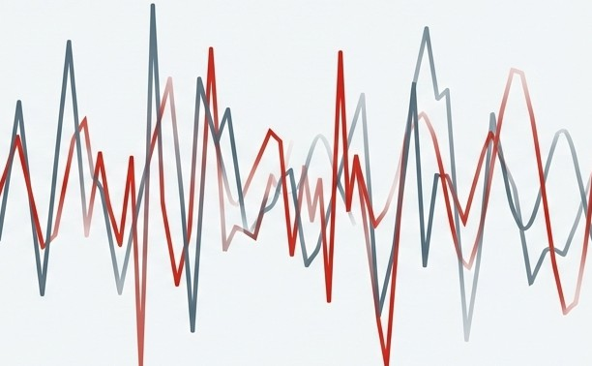
PhD Interview Presentation
Motivational Dynamics and Fluctuating Readiness to Change in Addiction Treatment
A Multi-Dimensional Framework for PhD Inquiry Integrating Neurobiology, Non-Linear Dynamics, and Adaptive Technology.
Candidate Presentation Deck

Slide 2


The Paradigm Shift: From Static Traits to Dynamic States
Traditional View Modern View
•
•
•
• •
• • •
• • •
:. . . ..
••
• ••••
• •
•
Static, Unmoving
Dynamic, Flux
Motivation viewed as a stable personality trait.
Relapse interpreted as a failure of 'willpower' or character.
Treatment model: Episodic, linear progression.
Motivation viewed as a dynamic, unstable state.
Relapse interpreted as a systemic collapse of 'Fluctuating Readiness'.
Rooted in neurobiological dysregulation and environmental pressure.
The challenge is not merely behavioral inconsistency; it is the interplay of neurobiological dysregulation, psychological ambivalence, and socio-environmental pressures.

Slide 3
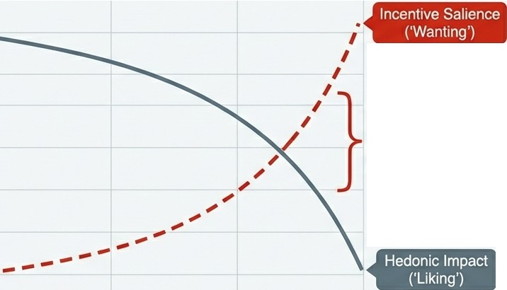

The Architecture of Ambivalence:
The Dissociation of Wanting and Liking
Ambivalence
Not merely indecision, but "Decisional Conflict''-the simultaneous presence of contradictory minds.
Cl)
(J)
C
⁰a.
Mechanism
Neural circuits for craving (Wanting) become hypersensitized to cues, while pleasure circuits (Liking) desensitize.
Implication
A patient can be cognitively ready to quit (low Liking) yet overpowered by cue-triggered compulsion (high Wanting).
(J)
The Paradox: Lusting while Loathing
-0
Cl)
a:
Cl)
--
-0
·-
::J
progression of Addiction

Slide 4
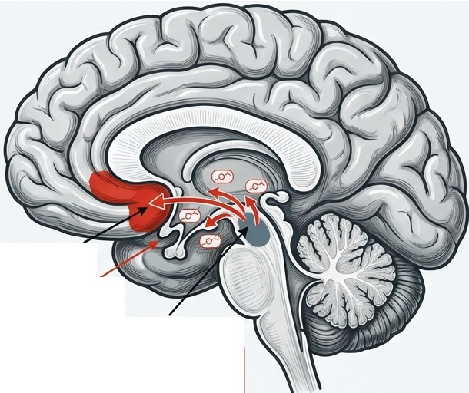

Neurobiological Underpinnings: The Hijacked Reward System
Spike Trains
A Phasic Firing (Cue Response)
Rapid bursts signal 'Reward Prediction Error'.
Stamps in drug memories.
B
Tonic Firing (Baseline)
Nucleus Accumbens(NAc)
Mesolimbic Dopamine Pathway
Ventral Tegmental Area (VTA)
,l l r 11l I
Jt [
I
.. Incentive Sensitization:•• Cues acquire disproportionate motivational power, persisting long after abstinence begins.
Dopaminergic Hypofunction (Anhedonia).
Chronic reduction in D2 receptors.

Slide 5
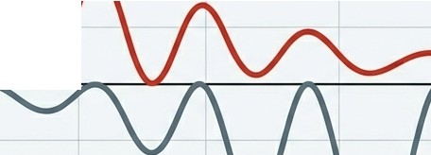
The Allostatic Shift:
Recruitment of the Anti-Reward System
Concept:
Based on Opponent Process Theory.
The Motivational Shift
From: Positive Reinforcement (Seeking Pleasure/High)
►
To: Negative Reinforcement (Seeking Relief/Normalcy)
Positive Affect
u
Q)
�
Mechanism: Recruitment of Corticotropin-Releasing Factor (CRF) and Dynorphin in the extended amygdala.
�
� , ,.....�_,,
⁻..^{g}...
·_{C}-
g> Negative Affect I
Withdrawal
�
Clinical Consequence: During stress, the biological need for relief supersedes long-term recovery goals.
Allostatic Load /
The "Anti-Reward" State
Progression of Addiction

Slide 6
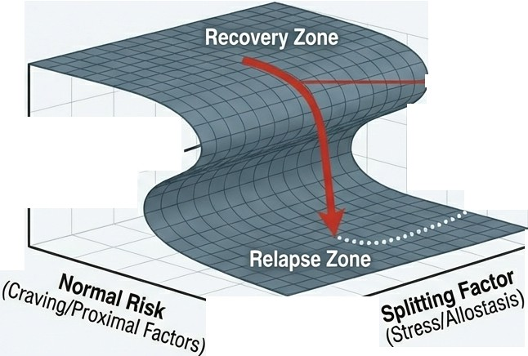
-Q)
Non-Linear Dynamics: The Cusp Catastrophe Model of Relapse
V)
1--- The Drop
_{c}Cl_{o}.
...
(Sudden Relapse)
Q)
0::
Behavior
•
••••
(Abstinence vs. g
Q)
g? The Bifurcation
Point
·-;•••......•••••.... Hysteresis
·� (Path of Inaccessibility)
en
••
C
•
-
..c
<l::
Key Insight: When distal risk (stress) is high, the system enters a fold. A minor trigger causes a discontinuous, catastrophic drop in behavior. Relapse is sudden, not gradual.

Slide 7

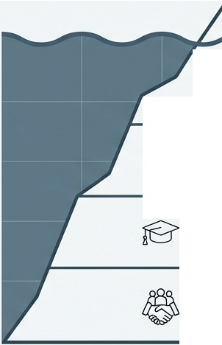


Socio-Ecological Constraints: The Role of Recovery Capital
Academic Editorial
Motivation & Readiness
1. Social Capital �-
1 I
(Support networks, family) A-@
The Impact of Low SES:
Depletion of reserves leads to "survival stress," fueling the negative reinforcement loop. This acts as a "Splitting Factor" in the
Catastrophe Model.
G 2. Physical Capital
(Housing, finance, transport)
Q
�
3. Human Capital
(Skills, health, education)
4. Cultural Capital
(Values, community norms)

Slide 8







Clinical Management: Navigating the Flux with Motivational Interviewing
Academic Editorial
Rolling with Resistance
Viewing "sustain talk" not as a challenge, but as a normal part of the process. "Agreement with a twist" moves with the energy rather than opposing it.
Express Empathy
(Validation of ambivalence)
Develop Discrepancy
(Highlighting gap between behavior and values)
OARS
�
Trauma Integration (IFS/DBTI
Sequencing is Critical: Safety and sobriety must be established before deep trauma processing to prevent destabilization.
Support Self-Efficacy
(Building confidence)

Slide 9




The Measurement Problem: Why Traditional Methods Fail
' ■ Clinical Visit 2
Clinical Visit 1
Clinical Visit 3
The Blind Spots
The Blind Spots
Recall Bias: Patients in a safe clinical setting often underestimate the intensity of "hot cognition" cravings experienced in the wild.
Static vs. Dynamic: Standard surveys miss the "critical fluctuations" that precede a bifurcation event.

Slide 10
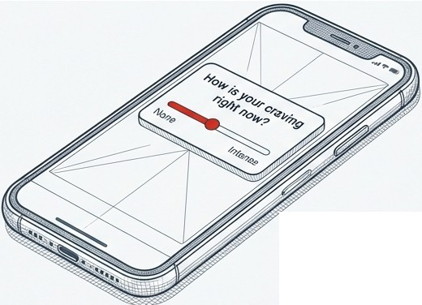
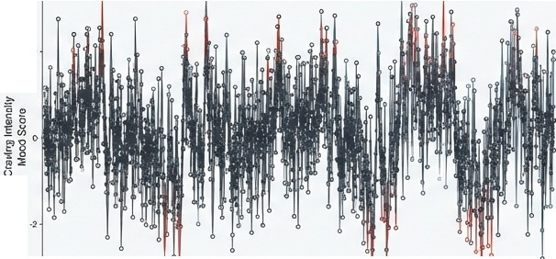
The Technological Solution:
Ecological Momentary Assestment (EMA)
High Frequency Data
2
Methodology
Prompting individuals to report mood, craving, and context multiple times a day via smartphone.
--�---------1----1----
o,y, o,y•
0oy2 D,y3 Doy•
Benefits
Minimizes recall bias.
Maps the "ebb and flow" with high temporal precision.
Identifies "moments of vulnerability" (e.g., specific times or social contexts).
Research Value
Allows observation of "critical fluctuations"-increased variability predicting system transition.
I'S\ NotebookLM

Slide 11
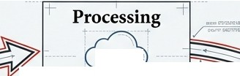






Closing the Loop: Just-In-Time Adaptive
Interventions (JITAI)
-
·------·+
.
+-------.
!;⁺!: ^{-�-}·�t
•
f-·- •I
+ + I -+ +
+ Sensing +
Decision Rules & Risk A.nalysis
+ Actu�tion +
t: .r - _{I}
:
+=�
•r
(··6·· )
-
:.
.····l+F-<>--li·I ➔ !
:
_;_ o �
+ User Da�a Stream + -'-
I
+lnterventi�n Delivery+
1=
I
-I_{I}
-
.....,. JCIIO.'K�
I
+----· ·----+
Concept: Leveraging EMA data to deliver therapeutic support exactly when it is needed (Person-in-Context).
Goal: Stabilizing motivation in the short term to prevent a «catastrophic shift" during high-risk windows.

Slide 12



Algorithmic Architecture: Decision Rules and Tailoring Variables
""""
Tailoring Variable Input -1¹71
·^{i}'^{T}L L (e.g.. Craving Score+ GPS Location)
1h11:�hold Chetk
NO
Is Risk> Threshold?
YES
![ : Continue Monitoring:
. ... .;;=; Select Intervention Strategy= Ji
�-
:
if-Cognitive Reappraisa17
r Distress T�lerance
⁷·ri
·'J L
Prompt
-1
L
Exercise
.J lb
I
I I
^{I}: _^{I}:_ ►r
�----...---�t.
Proximal Outcome , -r1
L (e.g., Reduce craving by 2 points in IS mins)J . !;
Decision Rules: The logic that determines IF and WHAT intervention is sent.
Significance: Automating the delivery of support (like 'rolling with resistance') without the immediate presence of a clinician.

Slide 13



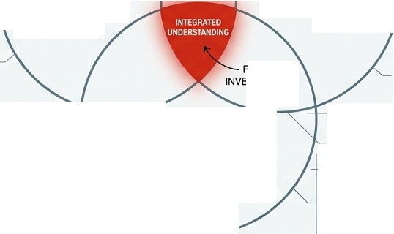

Identified Research Gaps and Future Inquiry
-•-^{I}
-·^{I}-
I
f
f
I
PRECISION
LIMITS
BIOMARKER ANALYSIS
Measurement
The Discordance ofSelf-Report:
Neurobiology
Neuroinflammation: The overlooked barrier. Does ⁰sickness behavior'' (driven by cytokines) mimic low motivation?
Why isthe relationship between
reported readiness and behavior
+-1- modest?
(Investigation: False Hope
Syndrome vs. Measurement Error)
DATA RELIABILITY
UTURE STIGATION
PHYSIOLOGICAL PATHWAYS
_,!_
..±... l-�-----
Optimization
Optimal Timing: Avoiding "Reactance."
When is an intervention helpful
support vs. an annoying burden?
TIMING ALGORITHMS
USER ENGAGEMENT WINDOW
-·-
-·^{I}-
I
I
I
Research Horizon: Bridging these disparate fields to develop highly personalized, biologically-informed, and temporally-preciseJITAI models
Isl\ NotebookLM

Slide 14
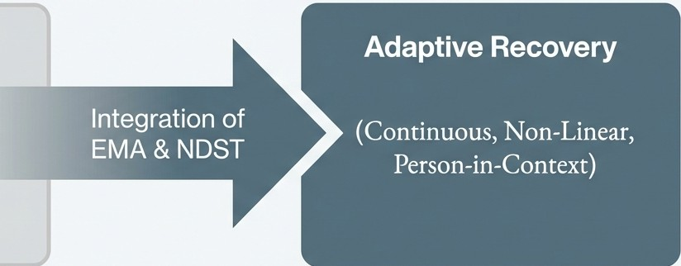
Synthesis: Toward a Dynamic, Data-Driven Model of Recovery
Academic Editorial
Future Roadmap
Standardized Care
(Episodic, Linear Models, One-size-fits-all)
Readiness to change is not a static trait but the surface manifestation of a non-linear system driven by sensitized neurobiology.
By integrating high-frequency data with non-linear modeling, we can identify "windows of opportunity" to intervene, stabilizing the foundation for long-term recovery capital.

Slide 15
Key Literature & References
Psychology & Motivational Interviewing
Prochaska,]. 0., & DiClemente, C. C. (1983).
Stages and processes of self-change of smoking.
Miller, W.R., & Rollnick, S. (2012). Motivational interviewing: Helping people change.
Neurobiology & Allostasis
Volkow, N. D., et al. (2016). Neurobiologic Advances from the Brain Disease Model of Addiction.
Koob, G. F., & Le Moal, M. (2001). Drug
addiction, dysregulation of reward, and allostasis.
Non-Linear Dynamics & Mathematics
Witkiewitz, K., & Marlatt, G. A. (2004). Relapse prevention for alcohol and drug problems.
Hufford, M. R., et al. (2003). The nonlinear dynamics of mood and relapse.
Technology (EMA/JITAI)
Nahum-Shani, I., et al. (2018). Just-in-Time Adaptive Interoentions (!ITAis) in Mobile Health.
Shiffman, S., et al. (2008). Ecological momentary assessment.

