Slide 1
Secure Causal Atomic Broadcast, Revisited
Sisi Duan
Michael K. Reiter
Haibin Zhang
Oak Ridge National Lab
UNC Chapel Hill
University of Connecticut

Slide 2
Single Server Architecture
State Machine Replication

Slide 3
Single Server Architecture
State Machine Replication
A single point of failure!

Slide 4
State Machine Replication
State Machine Replication
Interactive protocol among servers
State machine replication gives safety and liveness.

Slide 5
State Machine Replication (SMR)
State Machine Replication
Replicas maintain the same state
Replicas start in the same state
Operations are deterministic
Replicas execute operations in the same order (i.e., total order)
Replicas send replies to clients
Clients vote on replica replies

Slide 6
State Machine Replication (SMR)
State Machine Replication
Total order
$100
$100
$100

Slide 7
State Machine Replication (SMR)
State Machine Replication
Total order
$100
$100
$100

Slide 8
State Machine Replication (SMR)
State Machine Replication
Total order
Client 1:
“Deposit $100”
$100
$200
Client 1:
“Deposit $100”
$100
$200
$100

Slide 9
State Machine Replication (SMR)
State Machine Replication
Total order
Client 1:
“Deposit $100”
Chase:
“Charge 10%”
$100
$200
$180
Client 1:
“Deposit $100”
Chase:
“Charge 10%”
$100
$200
$180
$100

Slide 10
State Machine Replication (SMR)
State Machine Replication
✓
Total order
Client 1:
“Deposit $100”
Chase:
“Charge 10%”
$100
$200
$180
Client 1:
“Deposit $100”
Chase:
“Charge 10%”
$100
$200
$180
$100

Slide 11
State Machine Replication (SMR)
State Machine Replication
✓
Total order
Chase:
“Charge 10%”
Client 1:
“Deposit $100”
$100
$90
$190
Chase:
“Charge 10%”
Client 1:
“Deposit $100”
$100
$90
$190
$100

Slide 12
State Machine Replication (SMR)
State Machine Replication
✘
Total order
Chase:
“Charge 10%”
Client 1:
“Deposit $100”
$100
$90
$190
Client 1:
“Deposit $100”
Chase:
“Charge 10%”
$100
$200
$180
$100

Slide 13
Crash Fault-Tolerant SMR
State Machine Replication
2f+1 replicas to tolerate f failures
Example:
Paxos: SMR for crash failures
The “most” important backbone architecture
Each major service
BigTable, Chubby, Spanner, Azure, Amazon Web Services, Ceph, IBM SAN, VMware NSX, …
[Lamport, ACM TOCS 1998]; going back to 1989

Slide 14
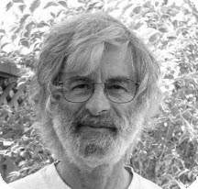
Paxos
State Machine Replication
[Lamport, ACM TOCS 1998]; going back to 1989
[Lamport. Paxos made simple. ACM SIGACT News 2001]
“For fundamental contributions to the theory and practice of distributed and concurrent systems, notably the invention of concepts such as causality and logical clocks, safety and liveness, replicated state machines, and sequential consistency.”
Turing Award 2013

Slide 15
Byzantine Fault-Tolerant SMR (BFT Protocols)
State Machine Replication
Traditionally important
Powerful: Byzantine/arbitrary failures & attacks
Systems, distributed systems, theory, crypto, security, …
Recently gain prominence
Real threats to real systems
Cryptocurrencies/Blockchains
Mission-critical systems
…

Slide 16
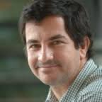
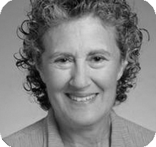
PBFT
State Machine Replication
3f+1 replicas to tolerate f Byzantine failures
[Castro and Liskov, OSDI 1999]
“For contributions to practical and theoretical foundations of programming language and system design, especially related to data abstraction, fault tolerance, and distributed computing.”
Turing Award 2008

Slide 17
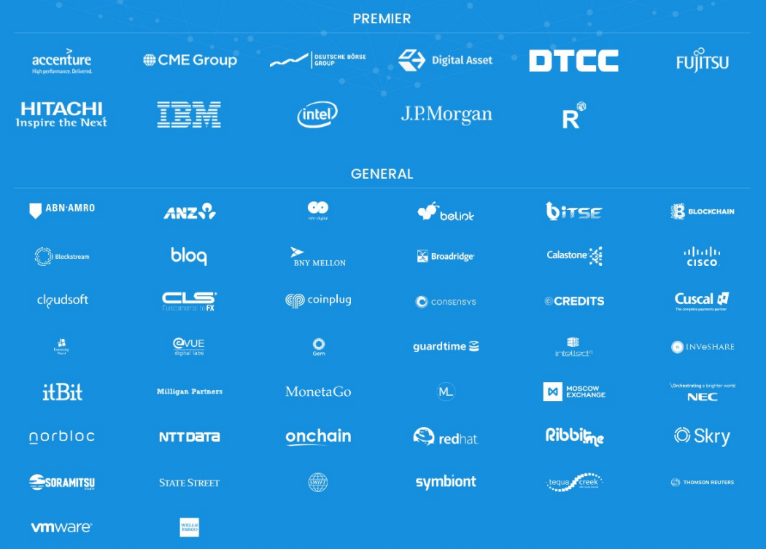

One Blockchain Project Using PBFT
State Machine Replication

Slide 18
Atomic Broadcast
Secure Causal BFT
Atomic broadcast
State machine replication (Crash failures)
BFT (Byzantine failures)

Slide 19
This Talk
[Duan, Reiter, and Zhang, DSN 2017]
Secure causal atomic broadcast (BFT)
Atomic broadcast (BFT) + Causal Order

Slide 20
Secure Causal BFT
Secure Causal BFT
The “strongest” consensus protocol in distributed systems literature
Hard problem
No practical solution for more than 30 years
[Reiter and Birman, TOPLAS 94]

Slide 21
Secure Causal BFT Overview
Secure Causal BFT
Definition
Examples (DNS, Transaction, Cloud)
CP0 (The existing protocols)
CP1 (Byzantine clients + Byzantine servers)
CP2 + CP3 (Semi-honest clients + Byzantine servers)
Evaluation (Latency, throughput, scalability, and performance under failures)

Slide 22
Causal Order
Secure Causal BFT
[Lamport, Comm. ACM 1978]
[Lamport, Distrib. Comput. 1986]
Causal order
If the broadcast of message m₁ "happens before" or "causally precedes" the broadcast of message m₂, then no correct process delivers m₂ before it delivers m₁.
m₂ “That is outrageous!”
m₁ “Chase charges 10%!”

Slide 23
Causal Order
State Machine Replication
✓
Causal order
Chase:
“Charge 10%”
Outrageous!
$100
$90
Chase:
“Charge 10%”
Outrageous!
$100
$90
$100

Slide 24
Causal Order
State Machine Replication
✘
Causal order
Chase:
“Charge 10%”
Outrageous!
$100
$100
$90
Chase:
“Charge 10%”
Outrageous!
$100
$90
$90
$100

Slide 25
Causal Order Total Order
State Machine Replication
⇏
✓
✘
Causal order Total order
Chase:
“Charge 10%”
Client 1:
“Deposit $100”
Outrageous!
$100
$90
$190
Client 1:
“Deposit $100”
Chase:
“Charge 10%”
Outrageous!
$100
$200
$180
$100

Slide 26
Total Order Causal Order
State Machine Replication
⇏
✓
✘
Total order Causal order
Chase:
“Charge 10%”
Outrageous!
$100
$100
$90
Chase:
“Charge 10%”
Outrageous!
$100
$100
$90
$100

Slide 27
Total Order + Causal Order
State Machine Replication
✓
✓
Total order Causal Order
Chase:
“Charge 10%”
Client 1:
“Deposit $100”
Outrageous!
$100
$90
$190
Chase:
“Charge 10%”
Client 1:
“Deposit $100”
Outrageous!
$100
$90
$190
$100

Slide 28
Crash Failure Model
Secure Causal BFT
ZooKeeper

Slide 29
Byzantine Failure Model
Secure Causal BFT
[Lamport, Shostak, and Pease, TOPLAS 82]
a.k.a. BFT protocols
[Not formally studied]
[Reiter and Birman, TOPLAS 94]
Basically satisfying everything; strongest

Slide 30
Name Registration
Secure Causal BFT

Slide 31
Name Registration
Secure Causal BFT

Slide 32
Name Registration
Secure Causal BFT

Slide 33
Name Registration
Secure Causal BFT

Slide 34
Name Registration
Secure Causal BFT

Slide 35
Name Registration
Secure Causal BFT

Slide 36
Name Registration
Secure Causal BFT

Slide 37

Name Registration
Secure Causal BFT

Slide 38

Name Registration
Secure Causal BFT

Slide 39
Another Example—Trading Service
Secure Causal BFT
Consider a trading service that trades stocks
A client issues a request to purchase stock shares.
A corrupt replica could collude with a corrupt client to issue a request for the same stock.
If the new request is processed earlier than the original request, this may adjust the demand for the stock.

Slide 40
Secure Causal BFT
Secure Causal BFT
Existing Constructions
Use threshold encryption.
Schedule the ciphertext before revealing decryption shares.
[Reiter and Birman, TOPLAS 94]
[Cachin, Kursawe, Petzold, and Shoup, CRYPTO 2001]
[Cachin and Portiz, DSN 2002]

Slide 41
CP0—Using Threshold Encryption
Secure Causal BFT
A public key is associated with the system and a decryption key is shared among all the servers.

Slide 42
CP0—Using Threshold Encryption
Secure Causal BFT

Slide 43
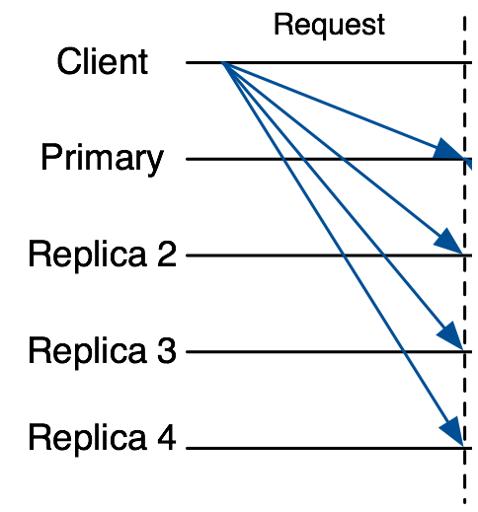
CP0—Using Threshold Encryption
Secure Causal BFT
M
M
M
Any BFT protocol
R
M
Assign a sequence number N to M
R
R
R
C
C = ThresEnc(pk, M)
C
C
Any BFT protocol
C
Assign a sequence number N to C

Slide 44
CP0—Using Threshold Encryption
Secure Causal BFT
Use tagged threshold encryption
To distinguish instances of the protocol.
Drawbacks
Threshold encryption is really expensive
Only from a handful of number-theoretical assumptions
Trusted setup (or expensive interactive setup)

Slide 45
A New Look
Secure Causal BFT
Key observation
Unnecessarily coupled with threshold encryption
A novel framework
Non-malleable commitment with associated-data
Fair BFT
Benefits
General constructions
Efficient instantiations

Slide 46
Our Protocol Uses Commitment Scheme
Secure Causal BFT
Hiding: M is hidden given C.
Binding: C can be only opened to M.
Commit
Phase
C =
M
Sender
M
Receiver
Reveal
Phase
Sender
M
Receiver

Slide 47
Non-malleable commitment with associated-data (NM-CAD)
Secure Causal BFT
Syntax
Associated-data as an additional input
Security
Additionally ask for non-malleability w.r.t. opening and associated-data (NM-OAD)
M
tag
2M
tag
M
tag
M
tag’

Slide 48
Non-malleable commitment with associated-data (NM-CAD)
Secure Causal BFT
Generality
Any (adaptive) one-way function
Efficiency
(tag, C) =(tag, H(tag, r, M)), where M is the message, C is the commitment, r is a random coin.

Slide 49
Our First Protocol CP1
Secure Causal BFT
First schedule the commitment
Then schedule the opening M
Phase 1
M
tag
Phase 2

Slide 50
Our First Protocol CP1
Secure Causal BFT
Phase 1

Slide 51
Our First Protocol CP1
Secure Causal BFT
Phase 1
M

Slide 52
Our First Protocol CP1
Secure Causal BFT
Phase 1
M
M = client request, e.g., “Register UConn”
Tag = a unique identifier of the message

Slide 53
Our First Protocol CP1
Secure Causal BFT
Phase 1
Agree on a sequence number to
M

Slide 54
Our First Protocol CP1
Secure Causal BFT
Phase 1
M

Slide 55
Our First Protocol CP1
Secure Causal BFT
Phase 2
M

Slide 56
Our First Protocol CP1
Secure Causal BFT
Phase 2
Assign the same sequence number to the opening

Slide 57
Our First Protocol CP1
Secure Causal BFT
Phase 2

Slide 58
Our First Protocol CP1
Secure Causal BFT
Above, Gracious Execution!
Without failures and attacks

Slide 59
What Could Go Wrong Under Attacks?
Secure Causal BFT
Malicious clients
May fail to send opening to replicas.
Malicious replicas
May delay/drop opening.

Slide 60
1) Malicious clients
Secure Causal BFT
Malicious clients fail to send opening?

Slide 61
☛ Cleaning Committed but Unopened Requests
Secure Causal BFT
Agree on which requests should be cleaned

Slide 62
2) Malicious Replicas
Secure Causal BFT
Drop/Delay openings from correct clients
s.t. the requests from correct clients from being incorrectly cleaned.

Slide 63
☛ Fair BFT
Secure Causal BFT
Fair BFT
prevents the BFT service from unfairly delaying or dropping some clients’ requests but not others.
[Clement, Wong, Alvisi, Dahlin, and Marchetti, NSDI 2009]
[Duan, Levitt, Meling, Sean, and Zhang, SRDS 2014]

Slide 64
Another Framework
Secure Causal BFT
Handling the case of semi-honest clients and Byzantine replicas (as in many BFT protocols)
Novel asynchronous robust secret sharing (ARSS)
Two instantiations
Any commitment scheme and secret sharing (CP2)
Information secure (CP3)

Slide 65
Implementation and Evaluation
Secure Causal BFT
Using 15 virtual nodes (5 of which are client nodes)
LAN: 100 MB bandwidth, 0.1 ms latency
WAN: 1 MB bandwidth, 120 ms latency

Slide 66
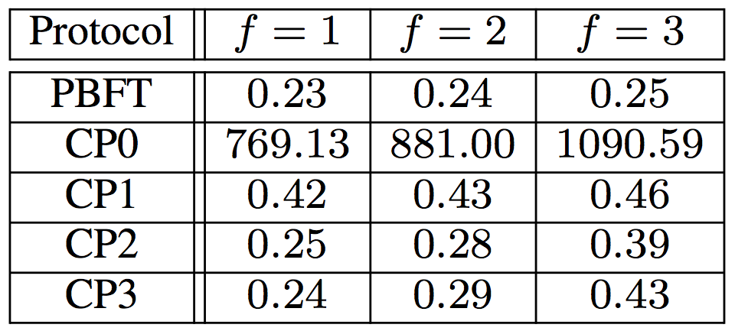
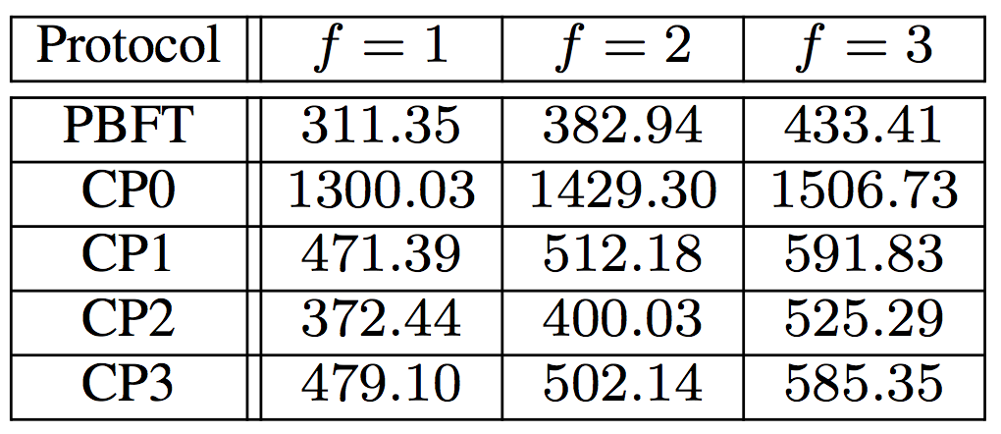
Evaluation
Secure Causal BFT
Latency in LAN (in ms)
Latency in WAN (in ms)

Slide 67
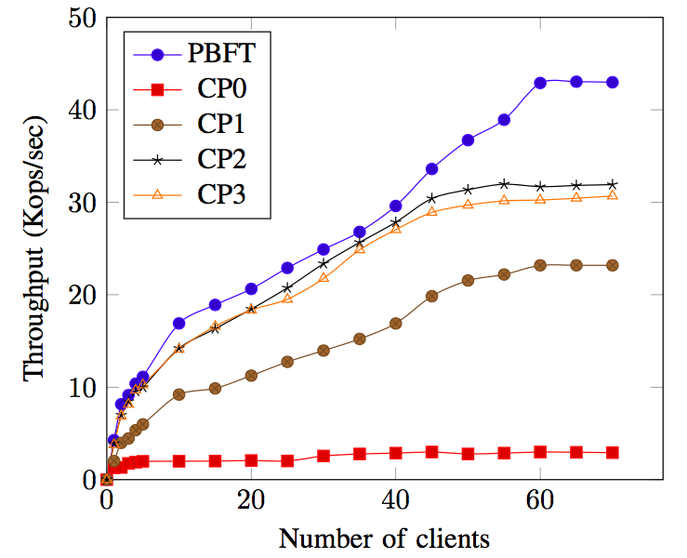
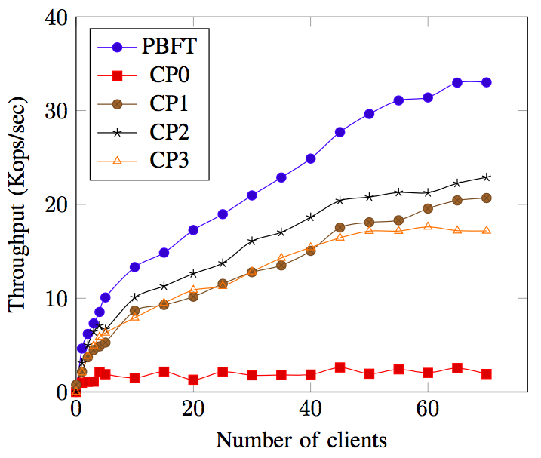
Evaluation
Secure Causal BFT
Throughput
LAN
WAN

Slide 68
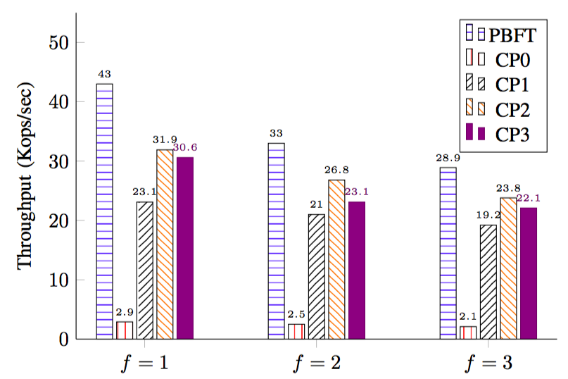
Evaluation
Secure Causal BFT
Scalability (in LAN)

Slide 69
Improving Failures Scenarios
Secure Causal BFT
Free amplification
Ordering tentative requests

Slide 70
Improving Failures Scenarios
Secure Causal BFT
Free amplification
Ordering tentative requests

Slide 71
Improving Failures Scenarios
Secure Causal BFT
Free amplification
Ordering tentative requests

Slide 72
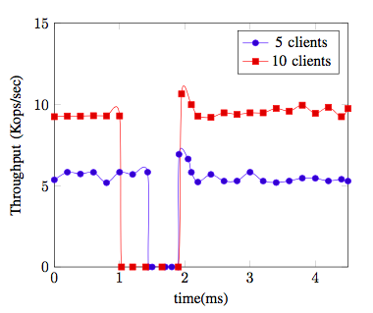
Improving Failures Scenarios
Secure Causal BFT
Free amplification
Ordering tentative requests

Slide 73
Thank you!
Secure causal atomic broadcast paper:
http://cs.unc.edu/~haibin/cpbft.pdf

