Slide 1
Differentially Private Spatial Decompositions ICDE 2012
2020 01 30 박근령

Slide 2
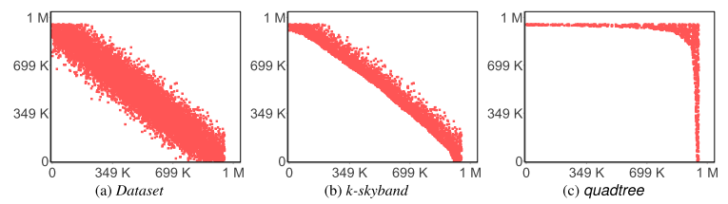
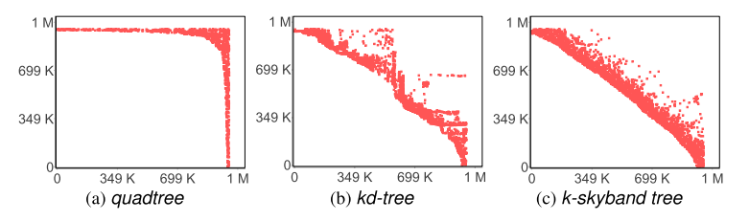
Introduction
“K-Skyband query answering with differential privacy”, Journal of Computer Security, 2018 : novel spatial decomposition technique.

Slide 3
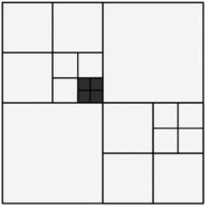
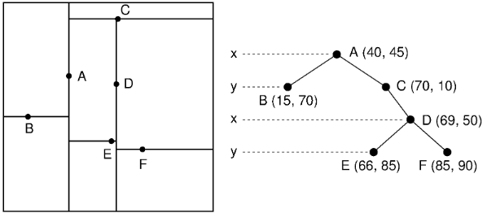
Introduction
Basis: to know how many individuals fall within a given region.
Favored definition: it ensures that what can be learned from the released data does not substantially differ whether or not any given individual’s data is included.
Spatial decompositions
Data-independent
Quad-trees
Data-dependent
Kd-trees
The description of the regions must also be differentially private.
→ Using non-uniform noise parameters.
How to answer queries given a PSD.
→ By post-processing the noisy counts.

Slide 4
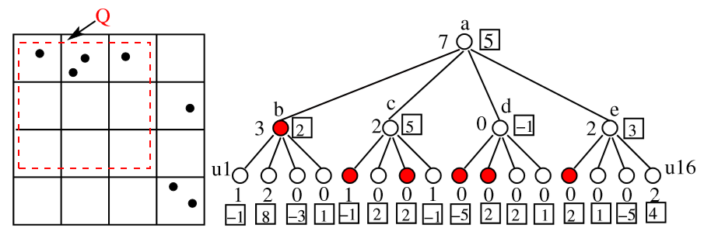
Building Private Spatial Decomposition
Data-independent trees
Compute counts for each node via the Laplace mechanism.
Adding or deleting a single tuple changes the counts of all the nodes on the path from the root to the leaf containing that tuple.
To obtain a tree that satisfies e-differential privacy as a whole, we node to combine the privacy guarantees of individual node counts.
 | b | u5 | u7 | u9 | u10 | u13 | sum
Real counts | 3 | 1 | 0 | 0 | 0 | 0 | 4
Noisy counts | 2 | -1 | 2 | -5 | 2 | 2 | 2
Noisy counts

Slide 5
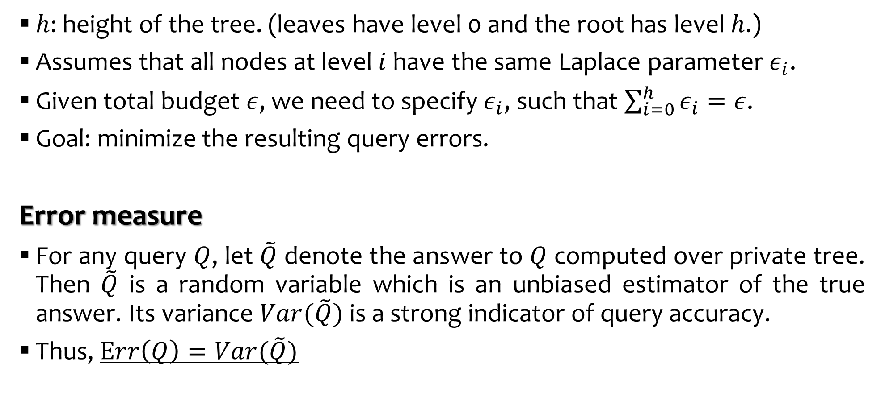
Allocating Noise Parameters
$h$: height of the tree. (leaves have level 0 and the root has level $h$.)
Assumes that all nodes at level $i$ have the same Laplace parameter $ε_{i}$.
Given total budget $ε$, we need to specify $ε_{i}$, such that $\sum_{i=0}^{h}{ε_{i}}=ε$.
Goal: minimize the resulting query errors.
Error measure
For any query $Q$, let $\tilde{Q}$ denote the answer to $Q$ computed over private tree. Then $\tilde{Q}$ is a random variable which is an unbiased estimator of the true answer. Its variance $Var(\tilde{Q})$ is a strong indicator of query accuracy.
Thus, $Err\left(Q\right)=Var(\tilde{Q})$

Slide 6

Allocating Noise Parameters
Query Processing
Noise가 독립적이고 Q를 union / difference 로 표현하는 데에 있어 다양한 방법이 존재 하므로 $Err\left(Q\right)를 분석하기 위해서는 \tilde{Q}$를 계산하는 standard method가 필요하다.
 | b | u5 | u7 | u9 | u10 | u13 | sum
Union of Children | 5 | 4 |  | -4 |  | 3 | 8
Noisy counts | 2 | -1 | 2 | -5 | 2 | 2 | 2

Slide 7
Optimizing Query Accuracy

Slide 8
Data-Dependent And Hybrid Trees

Slide 9
Experimental Study

