Slide 1
DynLoco demo

Slide 2
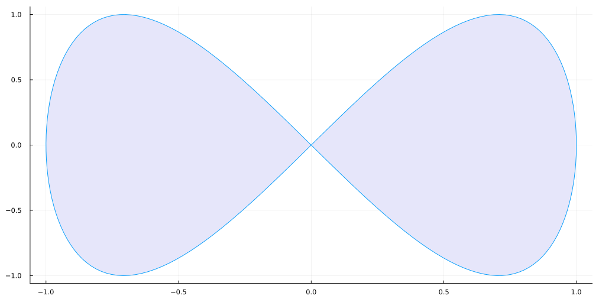
Parametric plots
Plot function pair (x(u), y(u)). See Figure 1 for an example.
Figure 1: Parametric plots

Slide 3
Wow that is cool
I tried rendering to PDF, docx, and html and it worked.

