Slide 2
Privé Financial - The Brand
Fuses IT and financial expertise
Founded in 2011 by senior managers with over 50 years of experience in investment banking, backed by a dedicated international team of software developers
Global focus - main office is in Hong Kong with European sales office in Vienna, Munich and London
Auto Allocate
Risk profiling
Optimizes across a product universe set by Citibank
Fast, easy and efficient

Slide 3













CRM
Business Processes and Workflows
Client Portal
Client Fees and Commissioning
Onboarding
Explore and Understand
Portfolio Construction
Portfolio Implementation
Analytics
vFunds
Risk Profiling
Investment Proposal
Consolidated Reporting
Model
Portfolios
Investment Explorer
Rebalancing Engine
Alerts
Genetic Optimizer

Slide 4

Auto Allocate
The Auto Allocator is designed to be accessible by advisors and investors.
Each type of user can choose among the various type of optimizations available
1) Risk Profile
2) White list
3) Recommended
4) Favourites
What separates Privé’s Auto Allocate technology from other Auto Allocators in the market is the ability to offer completely customized portfolios to each individual client, whereby the system can trade off between competing targets.
From Currency, Geographic Preference to Asset Classes, each facet of a client’s portfolio can be tailored made.
Multiple Optimization
Risk Profile
White List
Recommended
Favourites
Efficient Frontier
Across multiple asset types
Customised for every client
Execution Ready
Complete Backtesting
Full Risk Analytics
Auto Allocate

Slide 5
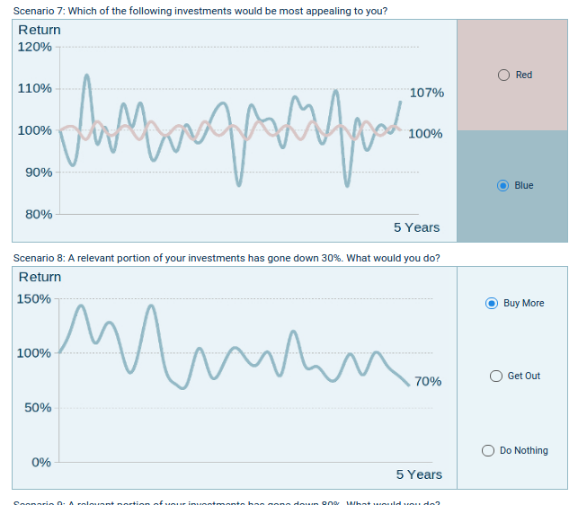
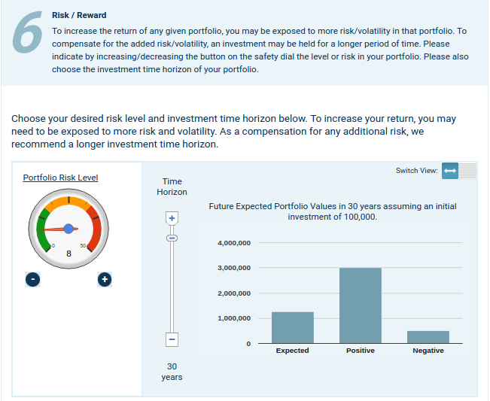
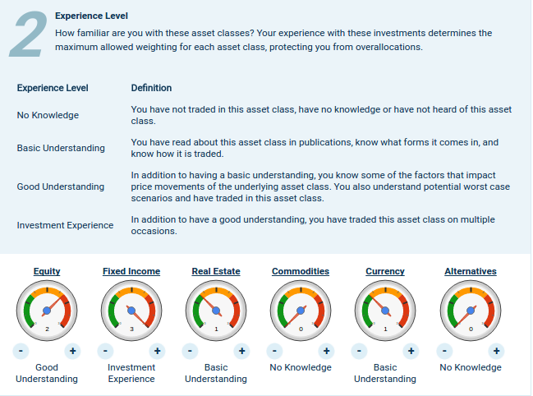
Privé’s Risk Profiling Solution:
Privé’s Smart Risk Profiling uses a behavioral finance to understand the investor’s true risk appetite.
Based on client’s risk preference, the system automatically selects the best product/allocation mix.
The optimizer can be further tuned to accommodate the Citi’s investment universe, product suitability and other requirements.

Slide 6
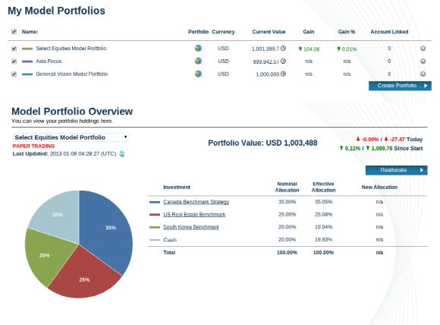
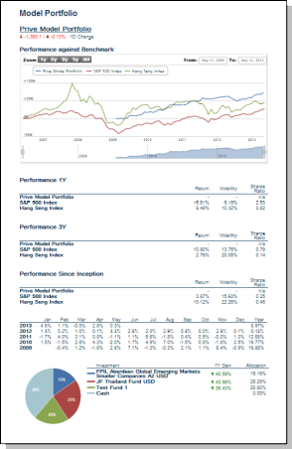
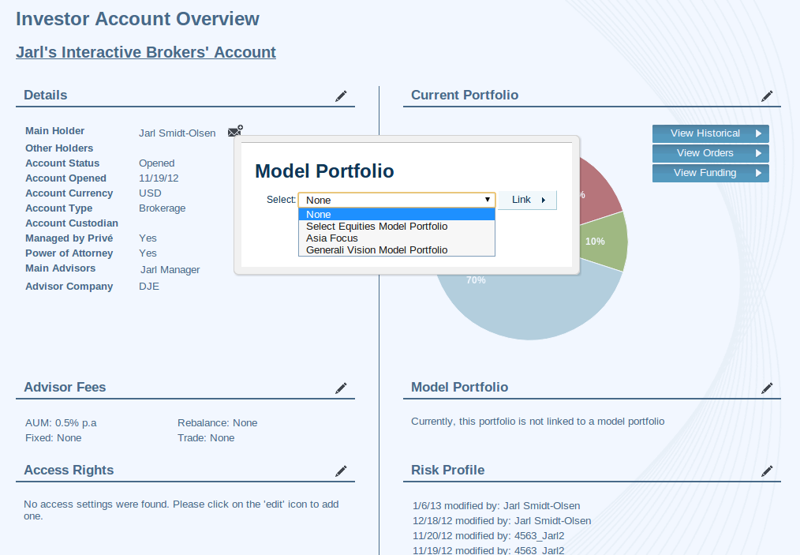
Model Portfolios
Managers can design Model Portfolios using Indices which represent each Citi Asset Class.
Advisors can set any of their clients to follow the Model Portfolio.
All followers can have a portfolio recommended that in accordance with their selected Model Portfolio - the client’s recommended portfolio can also be backtested against the model portfolio.
Prive’s Model Portfolios are currently being used by Citi’s Portfolio 360.

Slide 7
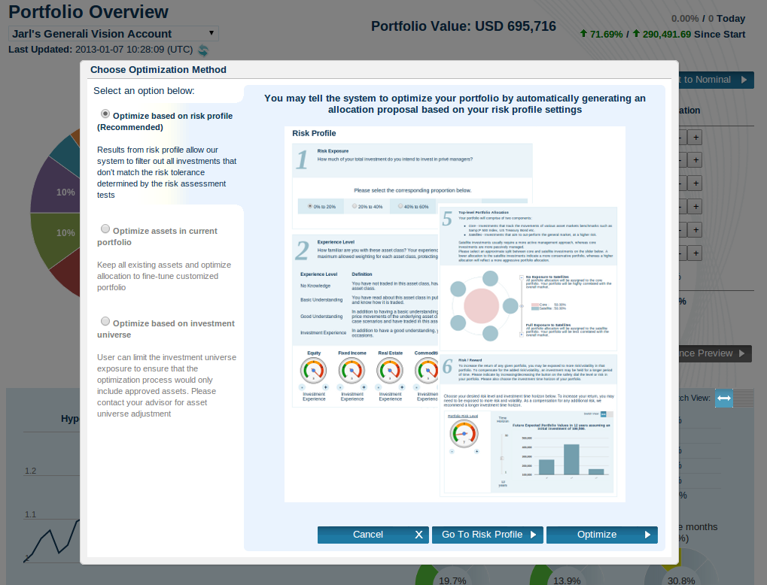
Optimizer
The Optimizer allows Citi to optimize a client’s portfolio - to seek the most suitable client portfolio which optimizes the risk-return profile.
It can take various aspects, including a model portfolio, reduction of commissions, client’s currency preference or risk/return into account when creating the client portfolio.
The optimizer can work on an asset universe defined by Citi

Slide 8
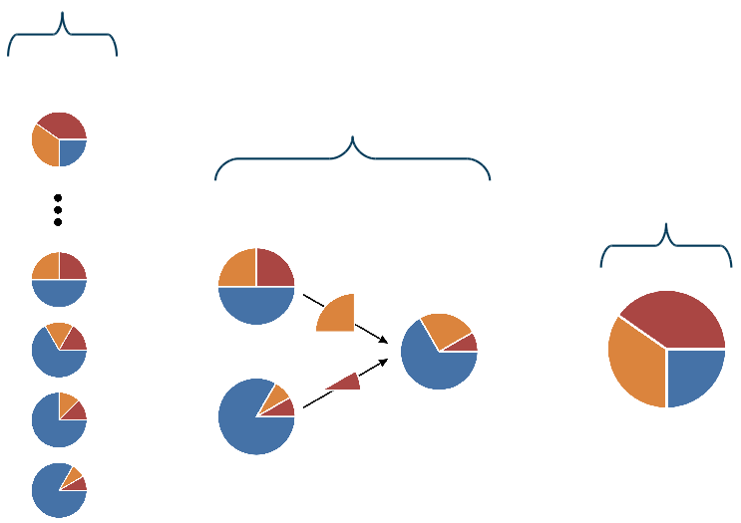
Survival of the fittest
Randomly
generated
portfolios with
specified
constraints
Optimizer Methodology
Genetic Optimization is a search heuristic that aims to pair the strongest “genes” through a process of natural evolution. The system generates a population of portfolios with random underlying allocations (genes) and finds the most optimal combination.
Based on client’s current situation, goals and risk preference, Prive Genetic Optimizer constructs the most personalized and suitable portfolio.
Evolution process where strongest portfolios are more likely to pass on their allocations on to next generation
Evolution continues until most optimal portfolio is found

Slide 9
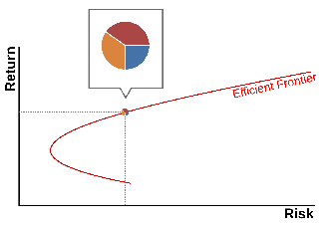
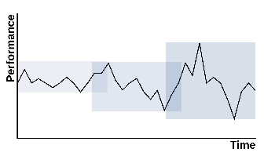
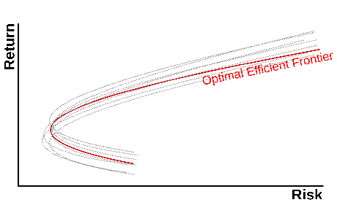
Re-sampling
Re-sampled Optimization is a portfolio optimization technique that aims to find the most optimal portfolio combination for each level of risk given historical risk and returns. The system re-samples the optimization calculation through multiple rolling timeframes which generates a more consistent result than traditional Markowitz.
Markowitz methodology generates a portfolio for every risk/return. Plotting it on a graph generates a line called the Efficient Frontier.
Re-sampled methodology fixes some of the flaws in the traditional model by taking multiple optimization calculations on different time-frames.
The result of the re-sampled methodology are multiple Efficient Frontiers. The Optimal Efficient Frontier offers portfolios that are offer more consistent allocations along the risk axis.

