Slide 1
Black-Litterman Model
An Alternative to the Markowitz Asset Allocation Model
Allen Chen
Pui Wah (Emily) Tsui
Patrick Peng Xu
Notes:
Allen

Slide 2
What is the Black-Litterman Model?
The Black-Litterman Model is used to determine optimal asset allocation in a portfolio
Black-Litterman Model takes the Markowitz Model one step further
  Incorporates an investor’s own views in determining asset allocations
Notes:
Allen

Slide 3
Two Key Assumptions
Asset returns are normally distributed
  Different distributions could be used, but using normal is the simplest
Variance of the prior and the conditional distributions about the true mean are known
  Actual true mean returns are not known
Notes:
Allen

Slide 4
Basic Idea
Find implied returns
Formulate investor views
Determine what the expected returns are
Find the asset allocation for the optimal portfolio
Notes:
Allen

Slide 5
Implied vs. Historical Returns
Analogous to implied volatility
CAPM is assumed to be the true price such that given market data, implied return can be calculated
Implied return will not be the same as historical return
Notes:
Patrick

Slide 6
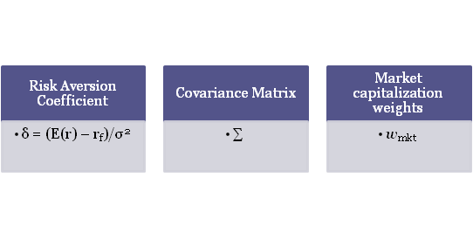
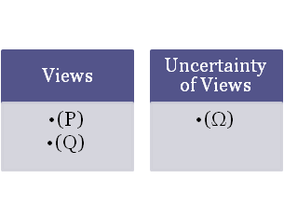
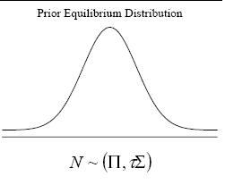
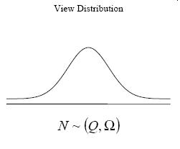
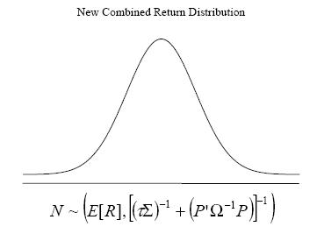

Implied Returns + Investor Views = Expected Returns
Notes:
Allen

Slide 7

Bayesian Theory
Traditionally, personal views are used for the prior distribution
Then observed data is used to generate a posterior distribution
The Black-Litterman Model assumes implied returns as the prior distribution and personal views alter it
Notes:
Allen
Intuitively, the model is for people who know more (or think they know more) than others
The model allows personal views to be considered in constructing a portfolio
P(A) <- prior

Slide 8
Expected Returns
E(R) = [(τ Σ)⁻¹ + P^{T} ΩP]⁻¹ [(τ Σ)⁻¹ Π + P^{T} ΩQ]
Assuming there are N-assets in the portfolio, this formula computes E(R), the expected new return.
τ = A scalar number indicating the uncertainty of the CAPM distribution (0.025-0.05)
Notes:
Emily

Slide 9
Expected Returns: Inputs
Π= δ Σ w_{mkt}
Π = The equilibrium risk premium over the risk free rate (Nx1 vector)
δ = (E(r) – r_{f})/σ² , risk aversion coefficient
Σ = A covariance matrix of the assets (NxN matrix)
Notes:
Emily

Slide 10
Expected Returns: Inputs
P = A matrix with investors views; each row a specific view of the market and each entry of the row represents the portfolio weights of each assets (KxN matrix)
Ω = A diagonal covariance matrix with entries of the uncertainty within each view (KxK matrix)
Q = The expected returns of the portfolios from the views described in matrix P (Kx1 vector)
Notes:
Emily

Slide 11
Breaking down the views
Asset A has an absolute return of 5%
Asset B will outperform Asset C by 1%
Omega is the covariance matrix

Slide 12
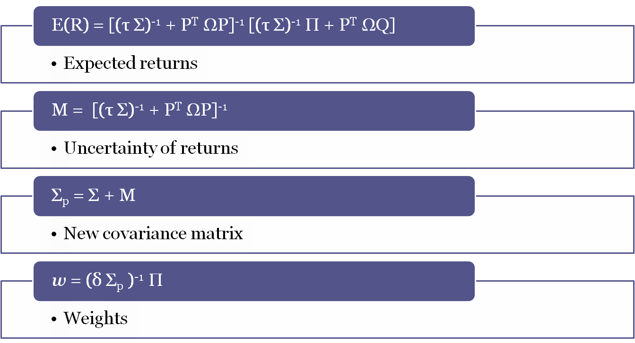
From expected returns to weights
Notes:
Emily

Slide 13
Example 1
Using Black-Litterman model to determine asset allocation of 12 sectors
  View: Energy Sector will outperform Manufacturing by 10% with a variance of .025^2
      67% of the time, Energy will outperform Manufacturing by 7.5 to 12.5%
Notes:
Patrick

Slide 14
Complications
Assets by sectors
  We did not observe major differences between BL asset allocation given a view and market equilibrium weights
  Inconsistent model was difficult to analyze
    There should have been an increase in weight of Energy and decrease in Manufacturing
Notes:
Patrick

Slide 15
Example 2
Model in Practice
Example illustrated in Goldman Sachs paper
Determine weights for countries
  View: Germany will outperform the rest of Europe by 5%
Notes:
Patrick

Slide 16
Statistical Analysis
Country Metrics
Country | Equity Index Volatility (%) | Equilibrium Portfolio Weight (%) | Equilibrium Expected Returns (%)
Australia | 16.0 | 1.6 | 3.9
Canada | 20.3 | 2.2 | 6.9
France | 24.8 | 5.2 | 8.4
Germany | 27.1 | 5.5 | 9.0
Japan | 21.0 | 11.6 | 4.3
UK | 20.0 | 12.4 | 6.8
USA | 18.7 | 61.5 | 7.6
Covariance Matrix
 | AUS | CAN | FRA | GER | JAP | UK | USA
AUS | 0.0256 | 0.01585 | 0.018967 | 0.02233 | 0.01475 | 0.016384 | 0.014691
CAN | 0.01585 | 0.041209 | 0.033428 | 0.036034 | 0.027923 | 0.024685 | 0.024751
FRA | 0.018967 | 0.033428 | 0.061504 | 0.057866 | 0.018488 | 0.038837 | 0.030979
GER | 0.02233 | 0.036034 | 0.057866 | 0.073441 | 0.020146 | 0.042113 | 0.033092
JAP | 0.01475 | 0.013215 | 0.018488 | 0.020146 | 0.0441 | 0.01701 | 0.012017
UK | 0.016384 | 0.024685 | 0.038837 | 0.042113 | 0.01701 | 0.04 | 0.024385
USA | 0.014691 | 0.029572 | 0.030979 | 0.033092 | 0.012017 | 0.024385 | 0.034969
Notes:
Patrick

Slide 17

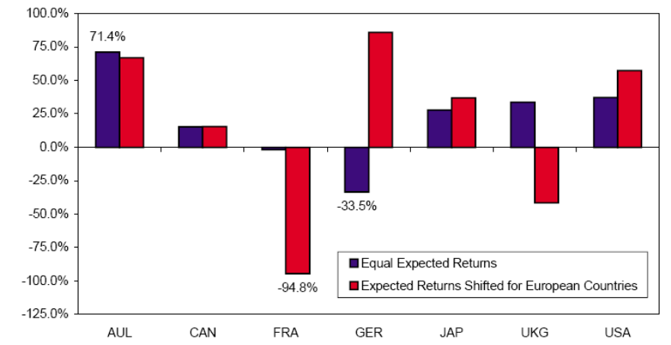
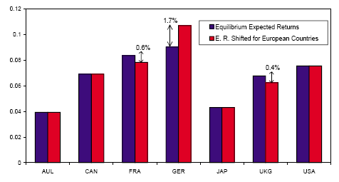
Traditional Markowitz Model
Portfolio Asset Allocation
Expected Returns

Slide 18
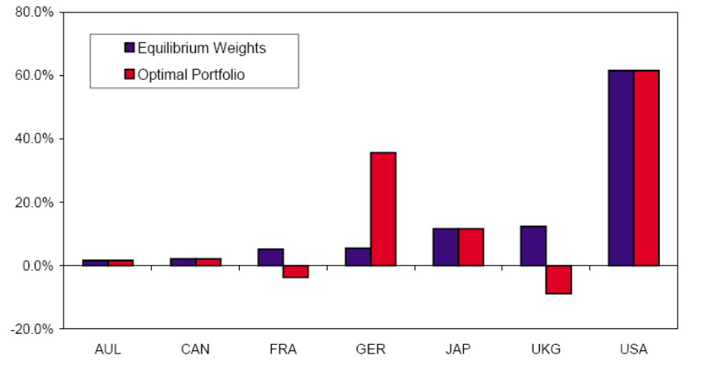
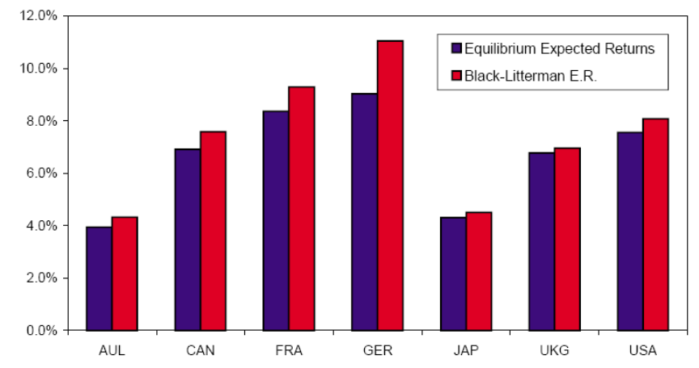
Black-Litterman Model
Portfolio Asset Allocation
Expected Returns

Slide 19
Advantages and Disadvantages
Advantages
  Investor’s can insert their view
  Control over the confidence level of views
  More intuitive interpretation, less extreme shifts in portfolio weights
Disadvantages
  Black-Litterman model does not give the best possible portfolio, merely the best portfolio given the views stated
  As with any model, sensitive to assumptions
    Model assumes that views are independent of each other
Notes:
Allen/Patrick

Slide 20
Conclusion
Further Developments
Author(s) | τ | View Uncertainty | Posterior Variance
He and Litterman | Close to 0 | diag(τPΣP) | Updated
Idzorek | Close to 0 | Specified as % | Use prior variance
Satchell and Scowcroft | Usually 1 | N/A | Use prior variance
Table obtained from http://blacklitterman.org/methods.html
Notes:
Emily
Further discussion on τ
Further readings suggested

Slide 21
Bibliography
Black, F. and Litterman, R. (1991). “Global Asset Allocation with Equities, Bonds, and Currencies.” Fixed Income Research, Goldman, Sachs & Company, October.
He, G. and Litterman, R. (1999). “The Intuition Behind Black-Litterman Model Portfolios.” Investment Management Research, Goldman, Sachs & Company, December.
Black, Fischer and Robert Litterman, “Asset Allocation: Combining Investor Views With Market Equilibrium.” Goldman, Sachs & Co., Fixed Income Research, September 1990.
Idzorek, Thomas M. “A Step-by-Step Guide to the Black-Litterman Model.” Zehyr Associates, Inc. July, 2004.
Satchell, S. and Scowcroft, A. (2000). “A Demystification of the Black-Litterman Model: Managing Quantitative and Traditional Construction.” Journal of Asset Management, September, 138-150.

