Slide 1
Investment Strategies
Propose by Plutus Asset Management
Dianna Chen Xiali Lin Qiurui Ma Huiyi Ou

Slide 2
RISK PROFILING
Client’s needs:
Cash flow projection
加cash flow的图，two stages
(conservative+agressive)

Slide 3
ACTIVE OR PASSIVE INVESTING
ETF?
Explain current trend

Slide 4













CRM
Business Processes and Workflows
Client Portal
Client Fees and Commissioning
Onboarding
Explore and Understand
Portfolio Construction
Portfolio Implementation
Analytics
vFunds
Risk Profiling
Investment Proposal
Consolidated Reporting
Model
Portfolios
Investment Explorer
Rebalancing Engine
Alerts
Genetic Optimizer

Slide 5
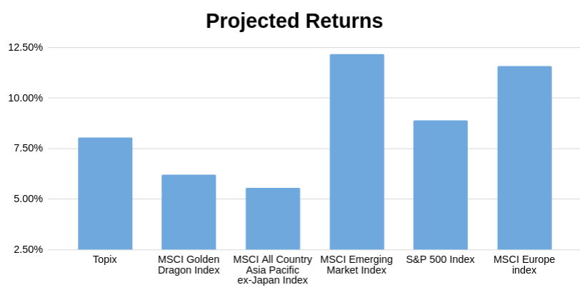





OPTIMIZED STRATEGIC PORTFOLIO with Black-Litterman model using Python
Minimize:
Systematic Risk: Beta
Unsystematic Risk: Volatility
Max Loss: drawdown
Maximize:
Gains: Return
Prior Weights & Returns
Implied Equilibrium Return with Market Cap
Optimization is needed
Views for future outlooks, backed up by macro analysis
Low sensitivity on input data
Involve forward looking views for prediction
Using confidence level to weight the history return and views.
Multilinear optimization & data mining with python
1. The process is different from original Black-Litterman
Model because there is no risk-free assets in this portfolio
2. Data Source: Bloomberg, Google Finance API

Slide 6
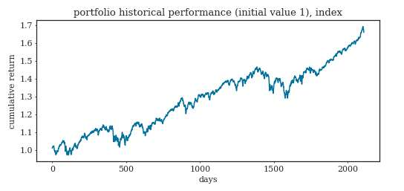
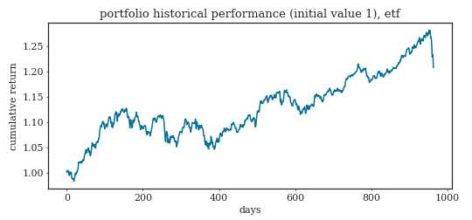
Annual return: 6% Maximum drawdown: 12%

Slide 7
DEVIATE FROM 60/40 ALLOCATION
Use 2008 scenario to compare our optimal portfolio and tranditional 60/40 allocation
Add 60/40 allocation (historical data)
Macro outlook，client’s needs,
expected return(forward-looking)
Allocation proportion disparity
Use graphs to compare

Slide 8
SCENARIO ANALYSIS
Fund (USD) | Equity up 10% | Equity down 10% | EUR up 10% | Libya Oil Shock | Lehman default | Debt Ceiling
JPM Japan Equity X (acc) | 11.34% | -11.34% | 1.25% | -0.16% | -13.05% | -7.35%
JPM Greater China C (acc) | 12.20% | -12.20% | 0.45% | -3.20% | -15.03% | -9.81%
JPM Asia Growth X (acc) | 11.69% | -11.69% | -1.35% | -2.55% | -17.15% | -9.49%
JPM Emerging Markets Small Cap C (perf) (acc) | 9.29% | -9.29% | 3.77% | -1.49% | -21.74% | -9.95%
JPM US Equity X (acc) | 11.05% | -11.05% | -0.55% | -2.27% | -20.57% | -17.07%
JPM Europe Equity C (acc) | 12.52% | -12.52% | 5.36% | -0.69% | -5.36% | -18.02%
JPM Emerging Markets Debt X (dist | 0.99% | -0.95% | 0.85% | 0.11% | -9.89% | 0.80%
JPM Global Strategic Bond C (perf) (dist | 0.35% | -0.35% | 1.62% | 0.85% | -9.69% | 0.59%
JPM US Aggregate Bond X (dist) | -1.02% | 1.1% | 0.3% | 0.6% | -12.23% | 2.08%
Portfolio performance | 5.99% | -5.98% | 1.09% | -0.65% | -13.64% | -5.57%
How do we mitigate risk?
Change format
Underlying reasons
Change weights to mitigate risk
Source: Bloomberg

Slide 9
MACRO OUTLOOK
Asset classes

Slide 10
MACRO OUTLOOK

Slide 11
TACTIC PORTFOLIO

Slide 12
LONGER INVESTMENT HORIZON
second 10 years: new target return, add alternative assets

Slide 13
APPENDIX
Fund from JPM
Fund
References
Python codes

