Slide 1
Pivot to Future —— An Algo approach for portfolio allocation
Propose by Plutus Asset Management
Flora Chen | Shirley Lin | Karen Ou | Gary Ma

Slide 2





RISK PROFILING
We help to concentrate on building the life you wish through a goal-based investment strategy
Currency Risk
Liquidity Risk
Sovereign Credit Risk
Interest Rate Risk
General Market Risk
Adjusted portfolio embedded with 2018 macro outlook
Scenario analysis with selected best performance investment strategies
Risk Exposure
Tactic asset allocation
Lee’s family goal
All weather strategy
Dynamic future investing
High net worth family with initial cash contribution of 100M
Slightly high risk aversion expecting stable annual distribution to cover living expenses and provide for future generation’s education needs
Global asset allocation to safeguard family wealth against market uncertainties
Forward-looking investment vehicle based on market consensus and black-litterman probability models
Algo-based optimizing engine to minimize risk with target return
Longer investment horizon with capital accumulation needs in the early stage and more flexibilities in the later half
Dynamic investment strategy of 10 year optimized conservative plan plus 10 year slightly aggressive plan

Slide 3





OPTIMIZED STRATEGIC PORTFOLIO with Black-Litterman model using Python
Market Capitalization
Optimization
Implied Equilibrium Return and Weights
Minimize
Systematic Risk: Beta
Unsystematic Risk: Volatility
Max Loss: drawdown
Maximize
Gains: Return
Prior Portfolio Performance
Expected Return: 5.99%
Beta: 0.51
Volatility: 7.99%
Historical Max Loss: 12.00%
Strategic Portfolio
Optimization
Views from Analysing Macro Outlook
Posterior Portfolio Performance
Expected Return: 6.00%
Beta: 0.39
Volatility: 6.84%
Historical Max Loss: 9.99%
Low sensitivity on input data
forward looking views for prediction
Weight the Equilibrium Return and Views with Confidence Level
Multilinear optimization & data mining with python
Build upon model, not simply following it (1)
1. The process is different from original Black-Litterman
Model because there is no risk-free assets in this portfolio
2. Data Source: Bloomberg, Google Finance API

Slide 4
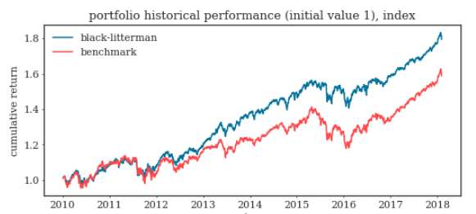
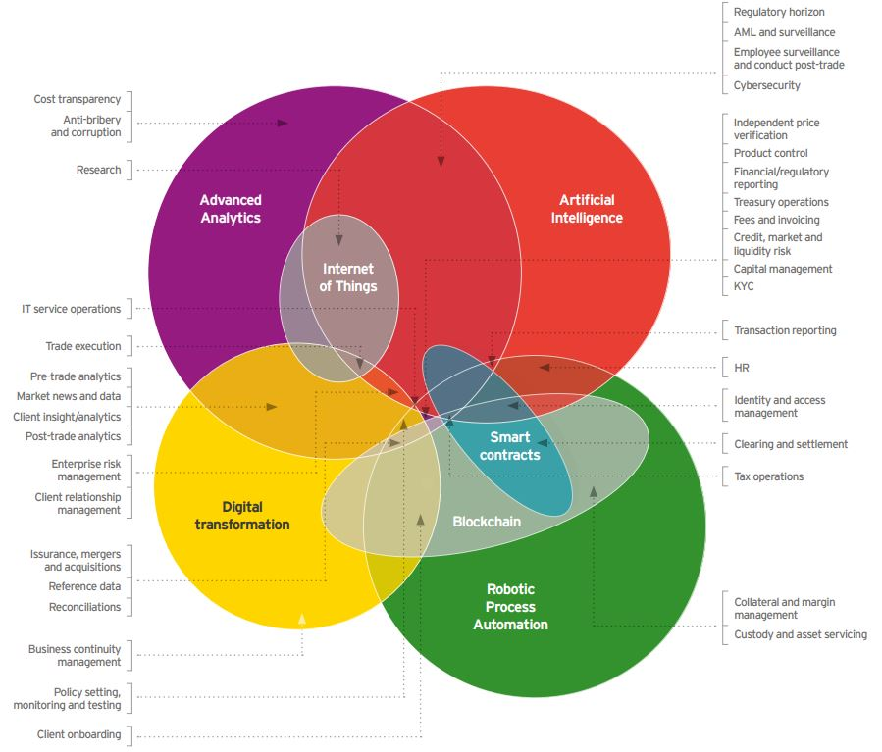
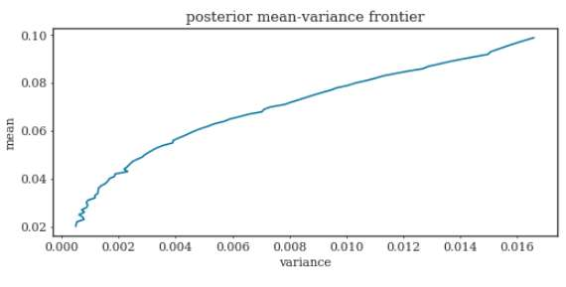
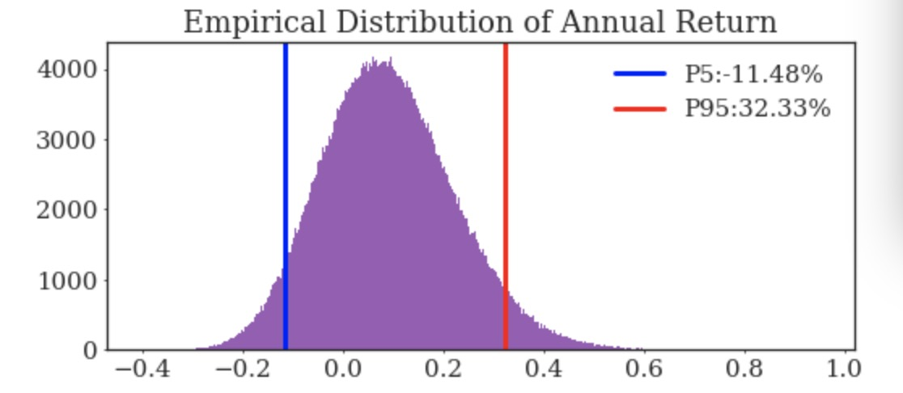
Plutus Optimizer vs Traditional 60/40 allocation
Lee’s family needs vs general rule of thumb
Customized Wealth Planning
Dynamic All Weather Strategy
Expected education expenses approximately 1 million (discounting 60k/year × 3 kids × 4Y)
Maximum drawdown requirement
Expected fixed cash dividend 1M/Y
Lower risk tolerance at early/mid career due to family needs
Portfolio Historical Performance
Traditional investment vehicle 60% equity+ 40% bonds vs full risk diversification by exploring alternative assets investment opportunities
E.g. Larger portion into fintech and blockchain technology(fintech global ETF is growing rapidly, driving the upward trend in S&P technology index); short-term risk hedging by holding VIX futures
1.8
Black-Litterman
Benchmark
1.6
.
Cumulative return
1.4
1.2
1.0
2010 2011 2012 2013 2014 2015 2016 2017 2018
Optimized portfolio
Posterior mean-variance frontier
Performance Proven
60/40 being a general investment guideline
Fully diversified through multi-currency and multi-asset allocation
Maximizing sharpe ratio while lowering volatility.
Macro explained: safer investments into larger portion of bonds
Empirical Distribution of Annual Return
0.10
4000
3000
2000
1000
0
Outperforming 60/40 traditional investment in scenario analysis(explained later)
Outstanding results in stress tests
95% confidence interval that our portfolio will generate a return between -11% and 32%
0.08
0.06
Mean
0.04
0.02
0.000 0.002 0.004 0.006 0.008 0.010 0.012 0.014 0.016
Variance
-0.4 -0.2 0.0 0.2 0.4 0.6 0.8 1.0
Notes:
cash flow 图
risk profiling(max drawdown, AR...优化条件)

Slide 5
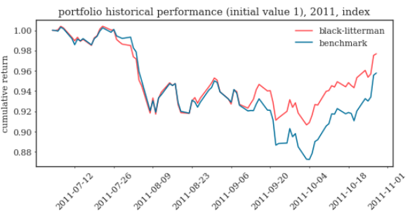
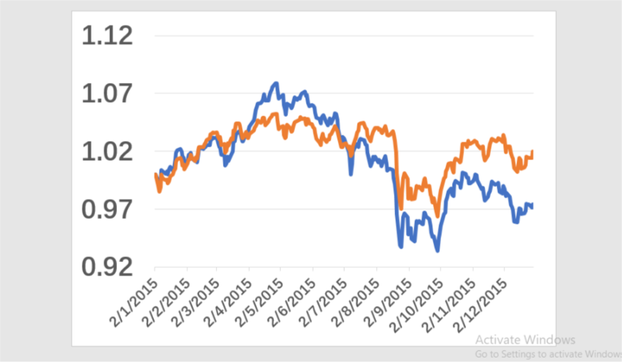
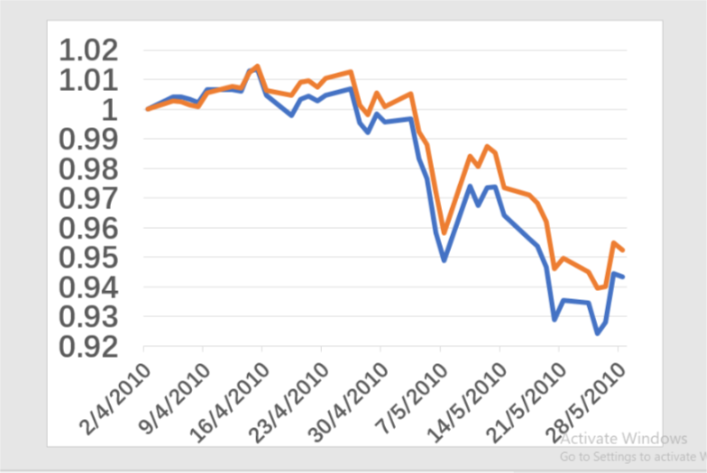
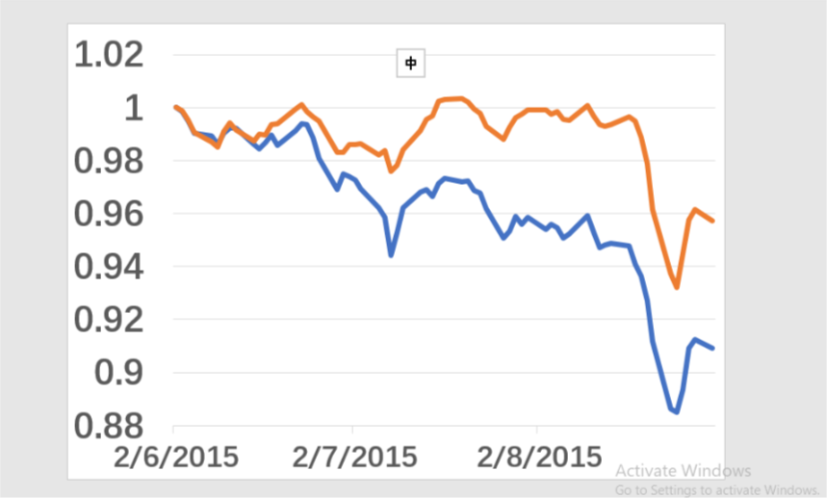
Plutus Optimizer vs Traditional 60/40 allocation
Stock Market Fall
Greece Financial Crisis 2.0
Causes: private debts arising from a property bubble were transferred to sovereign debt due to banking system bailouts and government responses to slowing economies post-bubble.
Mitigation: buy credit default swap in case of perceived risk of non-payment increased.
Causes: encouraged by falling borrowing costs as the central bank loosened monetary policy, more individuals invested in and inflated the stock market bubble
Mitigation:
2010
2015
2011
2015
Causes: fears of contagion of the European sovereign debt crisis; concern over US economy growth slow down and US credit rating downgrade
Mitigation: Buy VIX index in case of market selloff and increase exposure to safe asset including gold and foreign currency like Swiss franc
Causes: Greek’s rising government spending and reduced tax revenue forced the government to issue massive sovereign debt to support economic recovery in the aftermath of 2008 financial crisis
Mitigation: Buy credit default swap of European bond to transfer risk in case that governments with high debt-to-GDP ratio are likely to default
Europe Sovereign debt crisis
China stock market turbulence
— benchmark — black litterman
Notes:
cash flow 图
risk profiling(max drawdown, AR...优化条件)

Slide 6
ACTIVE OR PASSIVE INVESTING
Actively investing in emerging market
Emerging market is less developed with lower liquidity in terms of trading volume
Due to information asymmetry and market friction, there are greater arbitrage opportunities to explore
More established institutional investors in the developed markets compared to the larger portion of retail investors, such market inefficiency entails growth potential and more investment opportunities
Under this condition, active investment may have greater chance to capture possible wealth planning opportunities
Possible Defensive Measures
No Guarantee
On Picking a
Winner
Passively investing in developed market
Opportunities
for Beating
The Market
Higher
Fee
Active investing
There are more passive investment vehicles in the developed market and these are usually well managed with lower management fee
Active strategies are less likely to outperform the market due to market efficiency
More established players already in the playing field with many investment strategies, e.g. smart beta.
More
diversified & higher accessibility
Passive investing
Total
Market
Risk
Lower
Cost
Lack of
Flexibility
1. Morningstar Direct. Data as of 30 Sep.2017, excluding money market funds and funds of funds in the U.S. and Europe, but excluding only money market funds in Japan

Slide 7
TACTICAL ALLOCATION BY SECTOR
Consumer discretionary
Financial
Higher interest rates boost bank net interest margins. Amid a positive macro-economic environment, financials sector will benefit from greater client activity, higher loan demand, and good credit quality
Lower inﬂation and interest rates in Latin America and improved credit growth and consumption should support consumer discretionary and ﬁnancials
Healthcare
Rising middle-class in EM boosts demand in higher-quality consumable products. Consumption upgrade demand across food, beverages, household products and personal care
Technology
The rising life expectancy and historically low birth rate lead to aging population which means significant demand in healthcare treatment
Personalized treatment including genetic sequencing and immunotherapy and biosimilar mark the area of potential growth
Innovation will fuel Asia growth in following years. Contributing factors include: rise in tertiary educated worker, greater R&D spending and pro-innovation policy
In long term, the development in automation and artificial intelligence may fills labor force shortfalls, boosting supply side potential of developed markets with aging populations
Fintech
Financial technology is expected to distort market further in the coming years, with Blockchain likely to attract more investment in 2018.
Financial technology already spread out to all financial service sector, peer-to-peer lending, crowd funding and robot advisory likely to weight in.
CEIC. Data as of March 31,2017
JPM Long term capital market assumption

Slide 8
TACTICAL ALLOCATION BY ASSET CLASSES
Global outlook
Positive economy backdrop: Synchronized growth across the globe with expected real GDP growth around 1.5% and 4.5% in DM and EM respectively ¹
Tightening monetary policy: global GDP expanding at the fastest pace in the past 6 years, central banks across the global will gradually withdraw fiscal stimulus
Higher volatility: change in monetary policy, rising inflation level, political flux and technological disruption
Emerging market
Tactic Asset Allocation
U.S.
Bond market
China weight in: financial market liberation and launch of Bond Connect. Ownership by foreign investors may increase significantly with the inflow boost currency and support lower yield
Low external debt: improving current account position for the fragile 5 EM countries ²
Continual investment: higher margin, proactive government initiative (China’s Belt and Road), and recovery in infrastructure investment in South Asia (India $106bn infrastructure investment program) may fuel further outperformance.
Equity market
Brightening fundamentals: expected growth driven by long term structural improvement and cyclical uplift. Relative higher growth to DM stems from
Better demographic picture (higher population growth and higher growth in labor quality)
Higher TPF growth driven by a tech catch-up
Cheaper valuation: cyclically-adjusted P/E ratio is 16, 40% lower than that of US equity.
Bond market
Interest rate hike and wider spread: Fed delivers projected three rate increases in 2018, leading to a flattened yield curve and wider spread of corporate bonds
Equity market
Tax reform: fiscal stimulus from tax cut strengthen corporate earing
High valuation: headwinds from high valuation and Fed’s normalization subdue bond market returns
Europe
Bond market
End of QE in Sep.2018: reduction in global net securities purchases will exert modest upward pressure on Eurozone bond yields
Equity market
Government supports: expanded Investment Plan for Europe supports investment in transportation and energy networks
Lead economies: continental GDP growth is driven by France and Germany
EUR appreciation: Although an appreciating euro may affect exporters’ earning, currency strength has encouraged cash inflows
Asset Classes | Strategic | Tactical | Position
US equity | 24% | 24% | Neutral
Europe Equity | 14% | 15% | Overweight
Sovereign Bond | 16% | 14% | Underweight
Global High Yield Bond | 19% | 17% | Underweight
EM Equity | 5% | 8% | Overweight
EM Bond | 11% | 11% | Neutral
JPM Long term capital market assumption
Based on the “fragile 5” of Brazil, India, Indonesia, South Africa and Turkey

Slide 9
LONGER INVESTMENT HORIZON
AUM($Million)
Annual return 8% volatility
10%
Retirement target 300m
Cash Flow and risk analysis
Dynamic wealth plan overview
Later Stage (Aggressive)
US Equity 40%
DM Equity 20%
EM Debt 14%
√ Less stable cash return demand
√ Legacy planning
√ Travel the world(retirement plan)
Early Stage (Conservative)
√ Stable Annual CF Stream
√ Mid Career
√ Special Education Savings
10 Years(Estimate)
Investment horizon(years)

Slide 10
APPENDIX
Fund from JPM
Fund
References
Python codes

