Slide 1
Investment Strategies
Propose by Plutus Asset Management
Dianna Chen Xiali Lin Qiurui Ma Huiyi Ou

Slide 2
RISK PROFILING
Client’s needs:
Cash flow projection
加cash flow的图，two stages
(conservative+agressive)

Slide 3
ACTIVE OR PASSIVE INVESTING
Actively investing in developed market
Active investing in DM helps to capture short-term opportunities as DM is entering late-cycle stage with long term return limited by modest baseline growth
US market is expected to be more volatile in the coming year due to growing inflation expectation and projected rate hikes. As central bank withdrawing support, equity market may be more responsive to idiosyncratic factors, giving active managers chances to capture volatility opportunities
Possible Defensive Measures
No Guarantee
On Picking a
Winner
Passively investing in emerging market
Opportunities
for Beating
The Market
Higher
Fee
Active investing
Adopt buy-and-hold strategy to benefit from the long-term growth potential of the EM and reduce the average volatility.
Asia market in its mid-cycle with growth potential continues to beat its counterparts in DM. Growth rate levels out and focus is shifted from trade recovery to investment and domestic consumption.
More
diversified & higher accessibility
Passive investing
Total
Market
Risk
Lower
Cost
Lack of
Flexibility
1. Morningstar Direct. Data as of 30 Sep.2017, excluding money market funds and funds of funds in the U.S. and Europe, but excluding only money market funds in Japan

Slide 4
DEVIATE FROM 60/40 ALLOCATION
Use 2008 scenario to compare our optimal portfolio and tranditional 60/40 allocation
Add 60/40 allocation (historical data)
Macro outlook，client’s needs,
expected return(forward-looking)
Allocation proportion disparity
Use graphs to compare

Slide 5
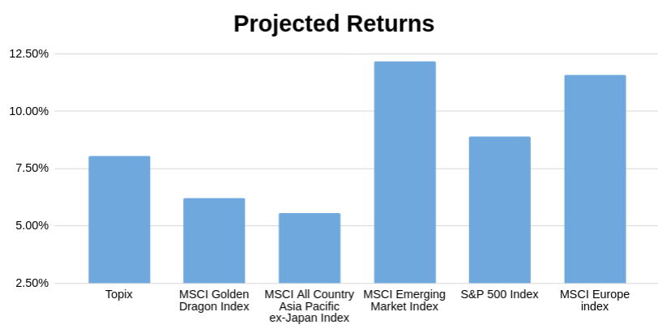

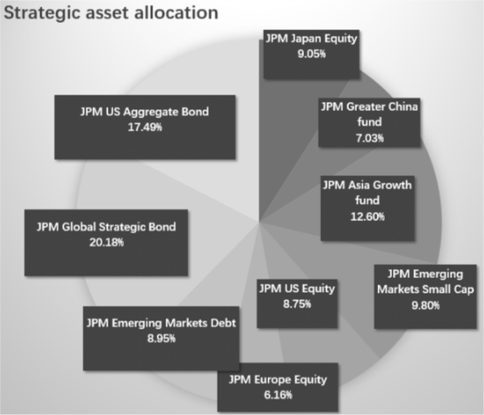




OPTIMIZED STRATEGIC PORTFOLIO with Black-Litterman model using Python
Minimize:
Systematic Risk: Beta
Unsystematic Risk: Volatility
Max Loss: drawdown
Maximize:
Gains: Return
Prior Weights & Returns
Implied Equilibrium Return with Market Cap
Optimization is needed
Views for future outlooks, backed up by macro analysis
Low sensitivity on input data
Involve forward looking views for prediction
Using confidence level to weight the history return and views.
Multilinear optimization & data mining with python
1. The process is different from original Black-Litterman
Model because there is no risk-free assets in this portfolio
2. Data Source: Bloomberg, Google Finance API

Slide 6
OPTIMIZED STRATEGIC PORTFOLIO
Minimize:
Systematic Risk: Beta
Unsystematic Risk: Volatility
Max Loss: drawdown
Maximize:
Gains: Return
Prior Weights & Returns
Implied Equilibrium Return with Market Cap
Optimization is needed
Views for future outlooks, backed up by macro analysis
Low sensitivity on input data
Using confidence level to weight the history return and views.
Involve forward looking views for prediction
Multilinear optimization & data mining with python
Minimize:
Systematic Risk: Beta
Unsystematic Risk: Volatility
Max Loss: drawdown
Maximize:
Gains: Return
Optimization is needed
Annual return: 6% Maximum drawdown: 12%
Source: Bloomberg, Google Finance

Slide 7
TACTICAL ALLOCATION BY SECTOR
Consumer discretionary
Rising middle-class boost demand
Technology
ECB
IT
ECB
.
Financial
E
.

Slide 8
SCENARIO ANALYSIS
Fund (USD) | Equity up 10% | Equity down 10% | EUR up 10% | Libya Oil Shock | Lehman default | Debt Ceiling
JPM Japan Equity X (acc) | 11.34% | -11.34% | 1.25% | -0.16% | -13.05% | -7.35%
JPM Greater China C (acc) | 12.20% | -12.20% | 0.45% | -3.20% | -15.03% | -9.81%
JPM Asia Growth X (acc) | 11.69% | -11.69% | -1.35% | -2.55% | -17.15% | -9.49%
JPM Emerging Markets Small Cap C (perf) (acc) | 9.29% | -9.29% | 3.77% | -1.49% | -21.74% | -9.95%
JPM US Equity X (acc) | 11.05% | -11.05% | -0.55% | -2.27% | -20.57% | -17.07%
JPM Europe Equity C (acc) | 12.52% | -12.52% | 5.36% | -0.69% | -5.36% | -18.02%
JPM Emerging Markets Debt X (dist) | 0.99% | -0.95% | 0.85% | 0.11% | -9.89% | 0.80%
JPM Global Strategic Bond C (perf) (dist) | 0.35% | -0.35% | 1.62% | 0.85% | -9.69% | 0.59%
JPM US Aggregate Bond X (dist) | -1.02% | 1.1% | 0.3% | 0.6% | -12.23% | 2.08%
Portfolio performance | 5.99% | -5.98% | 1.09% | -0.65% | -13.64% | -5.57%
How do we mitigate risk?
Source: Bloomberg

Slide 9
TACTICAL ALLOCATION BY ASSET CLASSES
Global outlook
Positive economy backdrop: Synchronized growth across the globe with expected real GDP growth around 1.5% and 4.5% in DM and EM respectively ¹
Tightening monetary policy: global GDP expanding at the fastest pace in the past 6 years, central banks across the global will gradually withdraw fiscal stimulus
Higher volatility: change in monetary policy, rising inflation level, political flux and technological disruption
Emerging market
U.S.
Bond market
China weight in: financial market liberation and launch of Bond Connect. Ownership by foreign investors may increase significantly with the inflow boost currency and support lower yield
Low external debt: improving current account position for the fragile 5 EM countries ²
Continual investment: higher margin, proactive government initiative (China’s Belt and Road), and recovery in infrastructure investment in South Asia (India $106bn infrastructure investment program) may fuel further outperformance.
Equity market
Brightening fundamentals: expected growth driven by long term structural improvement and cyclical uplift. Relative higher growth to DM stems from
Better demographic picture (higher population growth and higher growth in labor quality)
Higher TPF growth driven by a tech catch-up
Cheaper valuation: cyclically-adjusted P/E ratio is 16, 40% lower than that of US equity.
Bond market
Interest rate hike and wider spread: Fed delivers projected three rate increases in 2018, leading to a flattened yield curve and wider spread of corporate bonds
Equity market
Tax reform: fiscal stimulus from tax cut strengthen corporate earing
High valuation: headwinds from high valuation and Fed’s normalization subdue bond market returns
Europe
Bond market
End of QE in Sep.2018: reduction in global net securities purchases will exert modest upward pressure on Eurozone bond yields
Equity market
Government supports: expanded Investment Plan for Europe supports investment in transportation and energy networks
Lead economies: continental GDP growth is driven by France and Germany
EUR appreciation: Although an appreciating euro may affect exporters’ earning, currency strength has encouraged cash inflows
JPM Long term capital market assumption
Based on the “fragile 5” of Brazil, India, Indonesia, South Africa and Turkey

Slide 10
LONGER INVESTMENT HORIZON
second 10 years: new target return, add alternative assets

Slide 11
APPENDIX
Fund from JPM
Fund
References
Python codes

