Slide 1
Investment Strategies
Propose by Plutus Asset Management
Dianna Chen Xiali Lin Huiyi Ou Qiurui Ma

Slide 2





RISK PROFILING
We help to concentrate on building the life you wish through a goal-based investment strategy
Currency Risk
Liquidity Risk
Sovereign Credit Risk
Interest Rate Risk
General Market Risk
Adjusted portfolio embedded with 2018 macro outlook
Scenario analysis with selected best performance investment strategies
Risk Exposure
Tactic asset allocation
Dynamic future investing
Lee’s family goal
All weather strategy
High net worth family with initial cash contribution of 100M
Slightly high risk aversion expecting stable annual distribution to cover living expenses and provide for future generation’s education needs
Global asset allocation to safeguard family wealth against market uncertainties
Forward-looking investment vehicle based on market consensus and black-litterman probability models
Algo-based optimizing engine to minimize risk with target return
Longer investment horizon with capital accumulation needs in the early stage and more flexibilities in the later half
Dynamic investment strategy of 10 year optimized conservative plan plus 10 year slightly aggressive plan
Management Challenge (AWMC)

Slide 3





OPTIMIZED STRATEGIC PORTFOLIO with Black-Litterman model using Python
Market Capitalization
Optimization
Implied Equilibrium Return and Weights
Minimize
Systematic Risk: Beta
Unsystematic Risk: Volatility
Max Loss: drawdown
Maximize
Gains: Return
Prior Portfolio Performance
Expected Return: 5.99%
Beta: 0.51
Volatility: 7.99%
Historical Max Loss: 12.00%
Strategic Portfolio
Optimization
Views from Analysing Macro Outlook
Posterior Portfolio Performance
Expected Return: 6.00%
Beta: 0.39
Volatility: 6.84%
Historical Max Loss: 9.99%
Low sensitivity on input data
forward looking views for prediction
Weight the Equilibrium Return and Views with Confidence Level
Multilinear optimization & data mining with python
Build upon model, not simply following it (1)
Strategic Assets Allocation
1. The process is different from original Black-Litterman
Model because there is no risk-free assets in this portfolio
2. Data Source: Bloomberg, Google Finance API

Slide 4
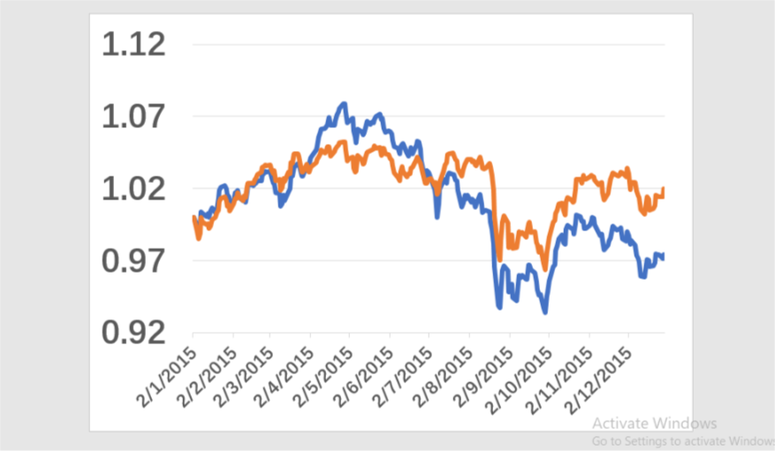
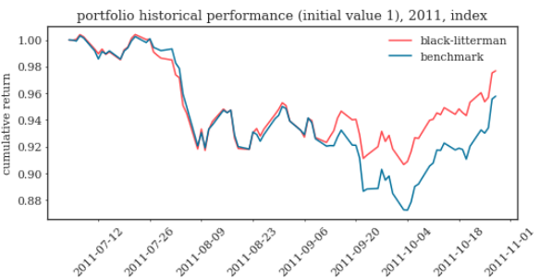
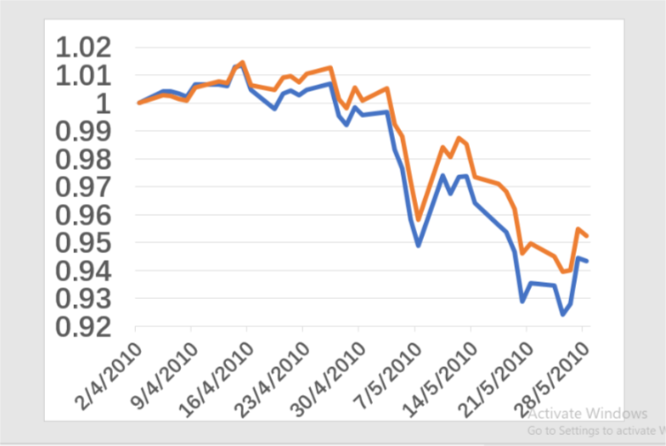
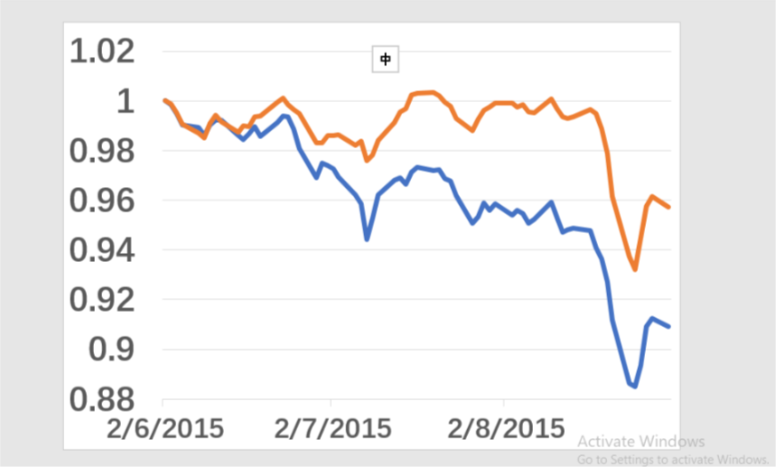
Plutus Optimizer vs Traditional 60/40 allocation
Stock Market Fall
Greece Financial Crisis 2.0
2010
2015
2011
2015
Europe Sovereign debt crisis
China stock crash
— benchmark — black litterman
Notes:
cash flow 图
risk profiling(max drawdown, AR...优化条件)

Slide 5
ACTIVE OR PASSIVE INVESTING
Actively investing in developed market
Active investing in DM helps to capture short-term opportunities as DM is entering late-cycle stage with long term return limited by modest baseline growth
US market is expected to be more volatile in the coming year due to growing inflation expectation and projected rate hikes. As central bank withdrawing support, equity market may be more responsive to idiosyncratic factors, giving active managers chances to capture volatility opportunities
Possible Defensive Measures
No Guarantee
On Picking a
Winner
Passively investing in emerging market
Opportunities
for Beating
The Market
Higher
Fee
Active investing
Adopt buy-and-hold strategy to benefit from the long-term growth potential of the EM and reduce the average volatility.
Asia market in its mid-cycle with growth potential continues to beat its counterparts in DM. Growth rate levels out and focus is shifted from trade recovery to investment and domestic consumption.
More
diversified & higher accessibility
Passive investing
Total
Market
Risk
Lower
Cost
Lack of
Flexibility
1. Morningstar Direct. Data as of 30 Sep.2017, excluding money market funds and funds of funds in the U.S. and Europe, but excluding only money market funds in Japan

Slide 6
SCENARIO ANALYSIS
Fund (USD) | Equity up 10% | Equity down 10% | EUR up 10% | Libya Oil Shock | Lehman default | Debt Ceiling
JPM Japan Equity X (acc) | 11.34% | -11.34% | 1.25% | -0.16% | -13.05% | -7.35%
JPM Greater China C (acc) | 12.20% | -12.20% | 0.45% | -3.20% | -15.03% | -9.81%
JPM Asia Growth X (acc) | 11.69% | -11.69% | -1.35% | -2.55% | -17.15% | -9.49%
JPM Emerging Markets Small Cap C (perf) (acc) | 9.29% | -9.29% | 3.77% | -1.49% | -21.74% | -9.95%
JPM US Equity X (acc) | 11.05% | -11.05% | -0.55% | -2.27% | -20.57% | -17.07%
JPM Europe Equity C (acc) | 12.52% | -12.52% | 5.36% | -0.69% | -5.36% | -18.02%
JPM Emerging Markets Debt X (dist) | 0.99% | -0.95% | 0.85% | 0.11% | -9.89% | 0.80%
JPM Global Strategic Bond C (perf) (dist) | 0.35% | -0.35% | 1.62% | 0.85% | -9.69% | 0.59%
JPM US Aggregate Bond X (dist) | -1.02% | 1.1% | 0.3% | 0.6% | -12.23% | 2.08%
Portfolio performance | 5.99% | -5.98% | 1.09% | -0.65% | -13.64% | -5.57%
How do we mitigate risk?
Source: Bloomberg

Slide 7
TACTICAL ALLOCATION BY SECTOR
Consumer discretionary
Financial
Europe banks
Higher interest rates boost bank net interest margins. Amid a positive macro-economic environment, financials sector will benefit from greater client activity, higher loan demand, and good credit quality
Lower inﬂation and interest rates in Latin America and improved credit growth and consumption should support consumer discretionary and ﬁnancials
Rising middle-class in EM boosts demand in higher-quality consumable products. Consumption upgrade demand across food, beverages, household products and personal care
Technology
Industrial
Financial
E
.
Innovation will fuel Asia growth in following years. Contributing factors include: rise in tertiary educated worker, greater R&D spending and pro-innovation policy
In long term, the development in automation and artificial intelligence may fills labor force shortfalls, boosting supply side potential of developed markets with aging populations
CEIC. Data as of March 31,2017
JPM Long term capital market assumption

Slide 8
TACTICAL ALLOCATION BY ASSET CLASSES
Global outlook
Positive economy backdrop: Synchronized growth across the globe with expected real GDP growth around 1.5% and 4.5% in DM and EM respectively ¹
Tightening monetary policy: global GDP expanding at the fastest pace in the past 6 years, central banks across the global will gradually withdraw fiscal stimulus
Higher volatility: change in monetary policy, rising inflation level, political flux and technological disruption
Emerging market
U.S.
Bond market
China weight in: financial market liberation and launch of Bond Connect. Ownership by foreign investors may increase significantly with the inflow boost currency and support lower yield
Low external debt: improving current account position for the fragile 5 EM countries ²
Continual investment: higher margin, proactive government initiative (China’s Belt and Road), and recovery in infrastructure investment in South Asia (India $106bn infrastructure investment program) may fuel further outperformance.
Equity market
Brightening fundamentals: expected growth driven by long term structural improvement and cyclical uplift. Relative higher growth to DM stems from
Better demographic picture (higher population growth and higher growth in labor quality)
Higher TPF growth driven by a tech catch-up
Cheaper valuation: cyclically-adjusted P/E ratio is 16, 40% lower than that of US equity.
Bond market
Interest rate hike and wider spread: Fed delivers projected three rate increases in 2018, leading to a flattened yield curve and wider spread of corporate bonds
Equity market
Tax reform: fiscal stimulus from tax cut strengthen corporate earing
High valuation: headwinds from high valuation and Fed’s normalization subdue bond market returns
Europe
Bond market
End of QE in Sep.2018: reduction in global net securities purchases will exert modest upward pressure on Eurozone bond yields
Equity market
Government supports: expanded Investment Plan for Europe supports investment in transportation and energy networks
Lead economies: continental GDP growth is driven by France and Germany
EUR appreciation: Although an appreciating euro may affect exporters’ earning, currency strength has encouraged cash inflows
JPM Long term capital market assumption
Based on the “fragile 5” of Brazil, India, Indonesia, South Africa and Turkey

Slide 9
LONGER INVESTMENT HORIZON
AUM($Million)
Cash Flow and risk analysis
Annual return 8% volatility
10%
Retirement target 300m
Dynamic wealth plan overview
Later Stage (Aggressive)
√ Less stable cash return demand
√ Legacy planning
√ Travel the world(retirement plan)
US Equity 40%
DM Equity 20%
EM Debt 14%
Early Stage (Conservative)
√ Stable Annual CF Stream
√ Mid Career
√ Special Education Savings
10 Yrs(Est)
Investment horizon(yrs)

Slide 10
APPENDIX
Fund from JPM
Fund
References
Python codes

Slide 11
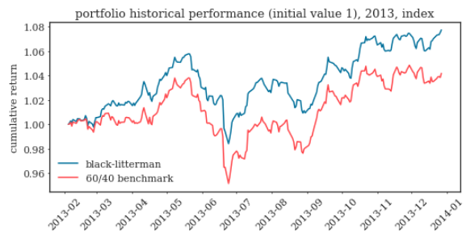
APPENDIX
Fund from JPM
Fund
References
Python codes

