Slide 1
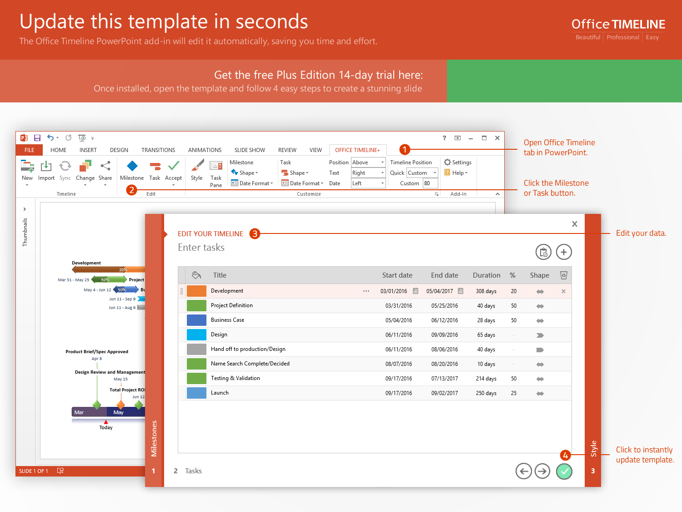
https://www.officetimeline.com/14-days-trial

Slide 2
Project approval and kickoff
Beta test 1.2 rollout, documentation and usability feedback
Final project checkpoint and close
Aug 2
Dec 15
Milestone and resource planning
Oct 22
Production cost study
Beta Test 2.2
Aug 19
Sep 27
Nov 12
2017
Week 1
3
5
7
9
11
13
15
17
19
2017
Today
Sep 7
Nov 1
SEO research, marketing analysis and business planning
Develop stage 2 program and certification process
Oct 9
Develop stage 1 funding plan and approval

