Slide 1
Pivot for Future —— an algo approach for portfolio allocation
Propose by Plutus Asset Management
Flora Chen | Shirley Lin | Karen Ou | Gary Ma

Slide 2





OPTIMIZED STRATEGIC PORTFOLIO with Black-Litterman model using Python
Market Capitalization
Optimization
Implied Equilibrium Return and Weights
Minimize
Systematic Risk: Beta
Total Risk: Volatility
Max Loss: drawdown
Target
Gains: Return
Prior Portfolio Performance
Expected Return: 5.99%
Beta: 0.51
Volatility: 7.99%
Historical Max Loss: 12.00%
Strategic Portfolio
Optimization
Views from Analysing Macro Outlook
Posterior Portfolio Performance
Expected Return: 6.00%
Beta: 0.39
Volatility: 6.84%
Historical Max Loss: 9.99%
Low sensitivity on input data
forward looking views for prediction
Weight the Equilibrium Return and Views with Confidence Level
Optimization & data mining with python
Build upon model, not simply following it (1)
1. The process is different from original Black-Litterman
Model because there is no risk-free assets in this portfolio
2. Data Source: Bloomberg, Google Finance API

Slide 3
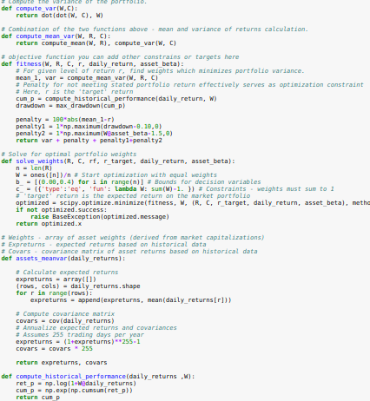
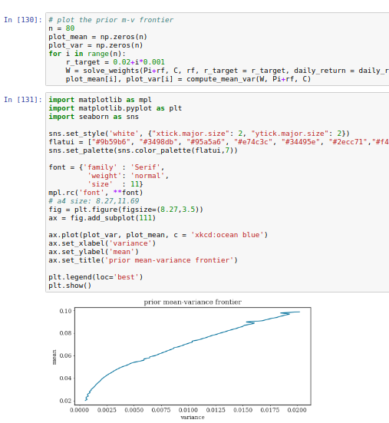

Slide 4
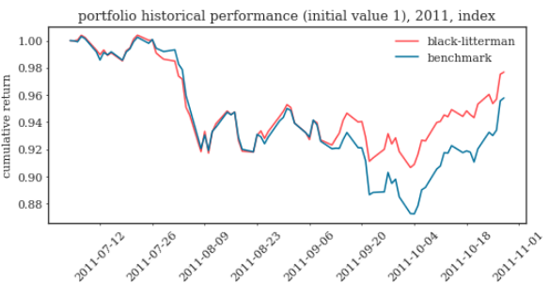
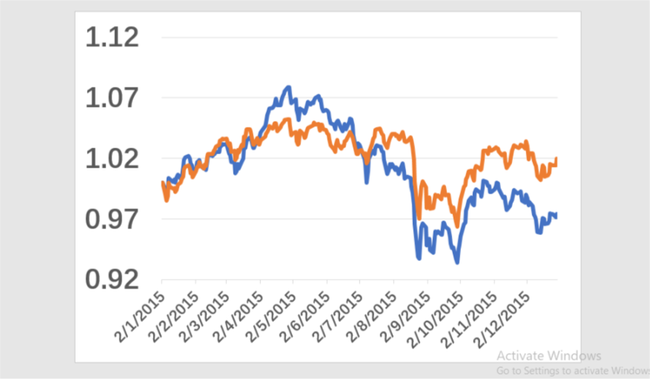
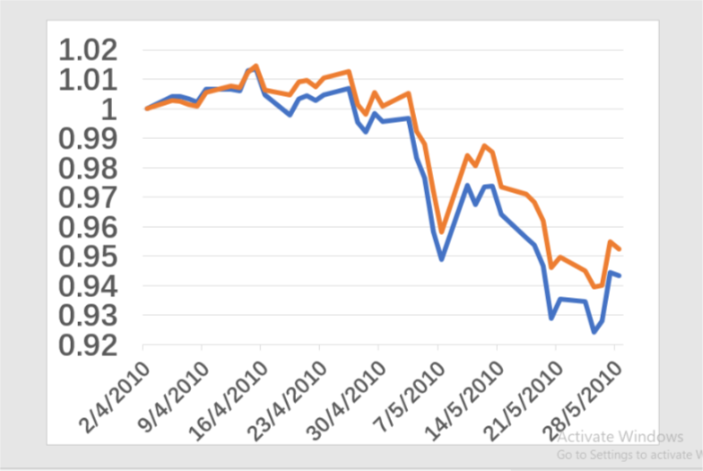
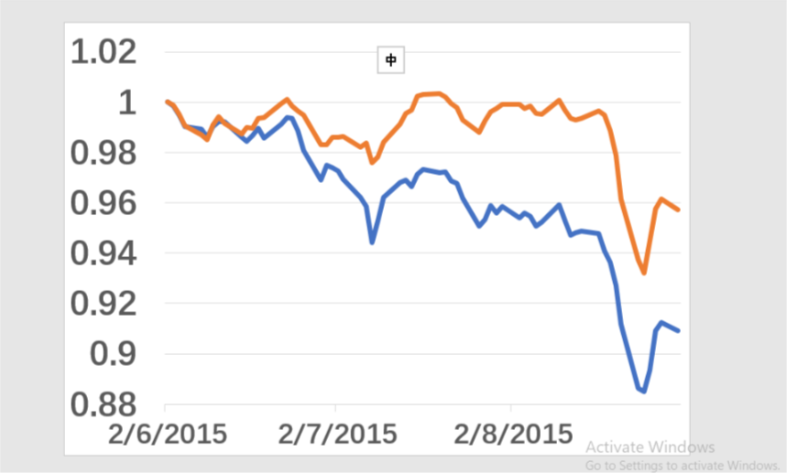
Plutus Optimizer vs Traditional 60/40 allocation
Stock Market Fall
Greece Financial Crisis 2.0
Causes: private debts arising from a property bubble were transferred to sovereign debt due to banking system bailouts and government responses to slowing economies post-bubble.
Mitigation: buy credit default swap in case of perceived risk of non-payment increased.
Causes: encouraged by falling borrowing costs as the central bank loosened monetary policy, more individuals invested in and inflated the stock market bubble
Mitigation:
2010
2015
2011
2015
Causes: fears of contagion of the European sovereign debt crisis; concern over US economy growth slow down and US credit rating downgrade
Mitigation: Buy VIX index in case of market selloff and increase exposure to safe asset including gold and foreign currency like Swiss franc
Causes: Greek’s rising government spending and reduced tax revenue forced the government to issue massive sovereign debt to support economic recovery in the aftermath of 2008 financial crisis
Mitigation: Buy credit default swap of European bond to transfer risk in case that governments with high debt-to-GDP ratio are likely to default
Europe Sovereign debt crisis
China stock market turbulence
— benchmark — black litterman
Notes:
cash flow 图
risk profiling(max drawdown, AR...优化条件)

