Slide 1
BTF Viewer
RTOS Scheduler Performance Analysis
A top-down guide: from system-level overview to root-cause diagnosis
1

Slide 2
Why Trace-Driven Analysis?
Real-time systems fail in subtle ways — a task that almost meets its deadline, cores that are almost balanced, a mutex that occasionally bounces across cores.
Static review and printf-debugging cannot reveal these patterns. Trace-driven analysis gives you evidence, not guesses.
The Top-Down Framework
System Overview
└── Core-Level Health ← Is the workload distributed correctly?
└── Task-Level Timing ← Are tasks executing within their budgets?
└── Scheduling Latency ← Why do tasks wait?
└── Concurrency Issues ← Locks, priority, migrations
└── Compliance & Regression ← Deadlines, diffs, CI
Every level narrows the search space before you zoom in further.
2

Slide 3
Step 1
System Overview — Orient Yourself
3

Slide 4
Load the Trace & Get Oriented
python btf_viewer.py your-trace.btf
Or drag-and-drop onto the window / File → Open (
Ctrl+O
).
First Things to Do
#
Action
Why
1
Press
Ctrl+0
Fit the entire trace on screen
2
Switch to Core View
See all cores at once — one row per core, expandable
3
Enable CPU Load Graph (toolbar Load)
Instant per-core utilisation bar chart below the timeline
4
Read the status bar
Task count, segment count, total trace span
5
Open Statistics panel
Summary, utilisation, and top tasks — no cursors needed
6
Check Trace Health (TICK) badge
Green = healthy tick; amber/red = jitter or missed ticks
Core View first, Task View later. On SMP traces, Core View immediately reveals which cores are busy and which are idle before you start looking for specific
tasks.
4

Slide 5
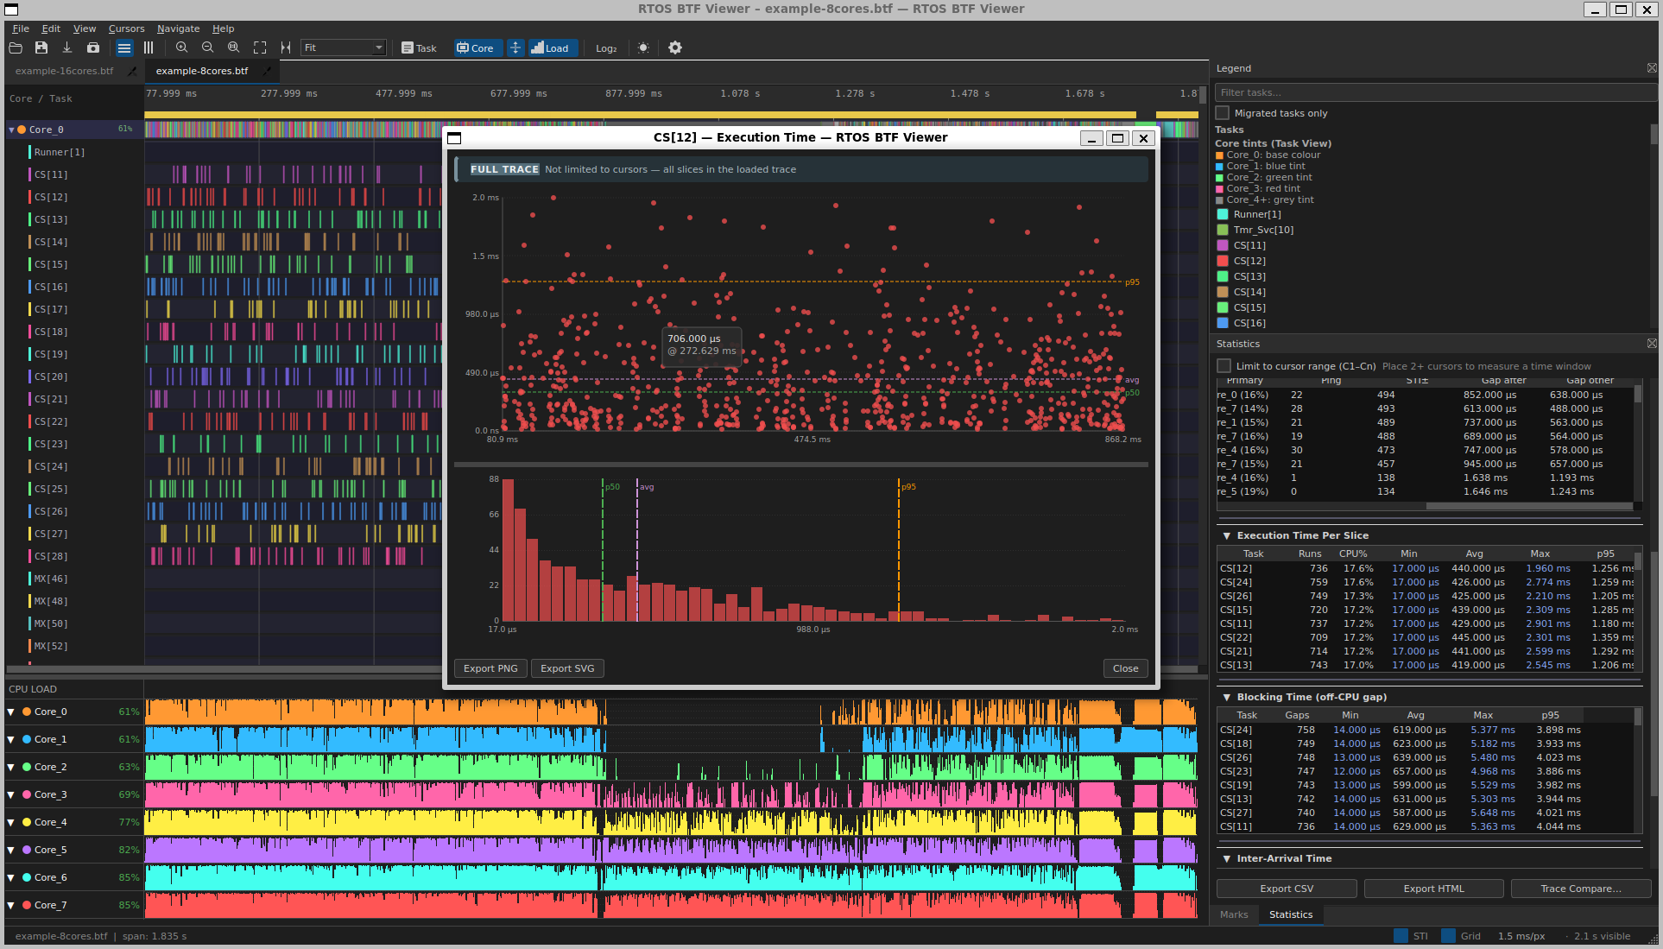
The BTF Viewer Interface
Core View with the CPU Load Graph enabled. The right panel shows Statistics → Execution Time Per Slice with a distribution chart opened.
5

Slide 6
Step 2
Core-Level Health — CPU Utilisation & Load Balance
6

Slide 7
Is the Workload Distributed Correctly?
What to Look For
Open Statistics → Core Utilisation. The Load Balance Score summarises the entire picture:
Score
Meaning
Badge
90–100
Well-balanced, σ < 30 %
Green
60–89
Moderate imbalance
Amber
< 60
Severe imbalance; one or few cores dominate
Red
Escalation Path
Symptom
Drill into
One core > 90 %, others near-idle
Core Affinity — tasks may be pinned
All cores high but one persistently low
Preemption Chain + Mutex/Semaphore — a lock serialises work
IDLE% unexpectedly high everywhere
Trace Health (TICK) — tickless idle may be active
7

Slide 8
Step 3
Task-Level Timing — Execution Time & WCET
8

Slide 9
How Long Do Tasks Actually Run?
Reading Execution Time Distributions
Open Statistics → Execution Time Per Slice → click any task row.
The distribution chart has two layers:
Scatter plot — each point is one slice; x = start time, y = duration.
An isolated outlier far above the cluster is a WCET candidate.
Histogram + CDF overlay — the blue CDF curve shows what fraction of slices finish within a given duration.
Finding the WCET
1. Sort by Max column — click the cell link to zoom the timeline to that exact slice
2. Compare Max vs p95: if they diverge significantly, the worst case is a rare spike, not a systematic issue
3. Use p95 (not Max) as the design-margin number when the max is an outlier
If Max >> p95, suspect an external interrupt or OS overhead — not a deterministic execution path.
9

Slide 10
Execution Time Distribution
CS[8] — Execution Time
Scatter: x = slice start time, y = slice duration · Histogram: distribution of slice durations · 346 points
975 µs
731 µs
p95
Duration
488 µs
244 µs
avg
p50
0 µs
215.502 ms
308.923 ms
402.343 ms
Time
log-scaled duration axis · full range 17 µs–975 µs
p50
avg
p95
19
100%
14
Count
10
50%
5
10
0
0%
20 µs
50 µs
100 µs
i
200 µs
500 µs

Slide 11
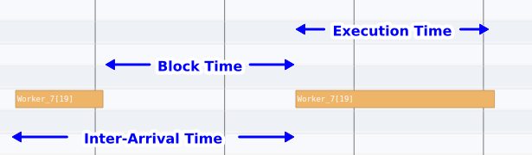
Task Timing Relationships
For consecutive activations of a task:
Execution Time = on-CPU slice duration
Block Time = off-CPU gap between the end of one slice and the start of the next (≡ Tracealyzer's Response Time)
Inter-Arrival Time = Execution Time + Block Time = gap between successive slice starts
These three metrics are linked. Understanding which one is inflated tells you where to look next.
11

Slide 12
Step 4
Scheduling Latency — Why Do Tasks Wait?
12

Slide 13
Diagnosing High Blocking Time
Blocking Time = the off-CPU gap a task waits before being allowed back on-CPU.
Open Statistics → Blocking Time, sort by Max or p95.
Decision Tree
Blocking pattern
Root cause
Next action
≈ tick period
Runnable but waiting for scheduler tick
Raise priority; check tickless config
Sporadic spikes correlated with one preemptor
Priority inversion or CPU hog
Preemption Chain Analysis
≈ mutex hold time
Lock contention; victim waits for holder
Mutex/Semaphore — reduce critical-section length
Constant across time
Periodic design — expected
Verify with inter-arrival vs. deadline
Drill-Down Steps
1. Click a task row → blocking-time distribution chart (scatter clusters = repeated contention events)
2. Click Max link → jump to the worst off-CPU gap on the timeline
3. Preemption Chain table → find the dominant preemptor during that gap
4. Cross-reference with Mutex/Semaphore object pointer to confirm lock contention
13

Slide 14
Blocking Time & Preemption Chain
CS[8] — Blocking Time
Scatter: x = resume time, y = off-CPU gap · Histogram: distribution of blocking gaps · 345 points
2.468 ms
1.851 ms
p95
Duration
1.234 ms
617 µs
avg
0 µs
p50
216.235 ms
309.289 ms
402.343 ms
Time
log-scaled duration axis · full range 13 µs–2.468 ms
p50
avg
p95
61
100%
46
Count
31
50%
15
0
0%
14
20 µs
50 µs
100 µs
Duration
200 µs
500 µs
1.000 ms
2.000 ms

Slide 15
Step 5
Concurrency Issues — Priority Inversion, Migrations & Mutex Health
15

Slide 16
Priority Inversion: The L/M/H Pattern
Classic priority inversion: a Low-priority holder (L) blocks a High-priority waiter (H) while Medium-priority tasks (M) run freely.
Detecting It
Open Statistics → Priority Inheritance (visible only when
priority_inherit
/
priority_disinherit
STI events are present).
Pattern column shows
Meaning
Mutex inherit
Kernel boosted holder — correct behaviour
L/M/H pattern
Inversion geometry detected — M ran while H waited
Boost only
Manual priority-set; no kernel inheritance involved
On the Timeline
Look for the red bottom stripe on the holder's task row — it marks the entire boost window from
priority_inherit
to
priority_disinherit
. Expand the core in
Core View to see L (boosted), M (running), and H (blocked) simultaneously.
16

Slide 17
Priority Inversion — Visual Evidence
Core / Task
702.463 ms
702.963 ms
703.463 ms
703.963 ms
704.463 ms
704.963 ms
705.463 ms
705.963 ms
706.463 ms
706.963 ms
707.463 ms
EV[95]
EV[96]
IL[150]: pri 2→4 — 3.956…
EV[97]
QP[108]
QP[109]
QP[110]
QC[111]
QC[112]
QC[113]
QC[114]
QC[115]
PS[128]
PF[131]
PF[133]
PF[134]
PF[135]
PF[137]
PF[138]
IL[150]
I…
IH[1…
IH[151]
idle0
idle1
idle1
idle1
idle2
idle2
idle3
idl…
▶
tag0_event
mutex
queue
sem
CPU LOAD
75
▼
Core_0
7%
50
25
0
75
▼
Core_1
0%
50
25
0
17
75
▼
Core_2
5%
50
25
0
75
▼
Core_3
63%
50
25
0

Slide 18
Priority Boost Distribution Chart
IL[150] — Priority Boost (base 2→peak 4)
Scatter: x = boost episode end time, y = boosted duration (red = L/M/H or mutex inherit) · Histogram: distribution of boost durations · 1 points
3.956 ms
avg
p50
p95
2.967 ms
Duration
1.978 ms
989 µs
0 µs
707.222 ms
707.223 ms
Time
707.223 ms
avg
linear scale · full range 3.956 ms–3.956 ms
p50
p95
111
Count
00
18
3.956 ms
3.956 ms
3.956 ms
Duration

Slide 19
SMP Core Migrations
Tasks that move between cores introduce cache-cold penalties and can cause lock-boundary races. Open Statistics → Core Migrations.
Key Metrics
Metric
What it means
Red flag threshold
Rate
Migrations per second of active time
High relative to execution frequency
Dwell
Average on-CPU slice before migrating
Very short dwell + high rate = ping-pong
Ping-pong
A→B followed immediately by B→A
Any non-zero count warrants inspection
Lock-bounce %
Migrations where mutex was held
> 5 % is a correctness risk on SMP
Migration Heatmap (toolbar Heatmap)
Level 1: directed core-pair rows × 32 time bins — dark cell = migration burst
Click a hot cell → Level 2: per-task sub-bins within that pair/window
Click a task cell → zoom timeline, place cursors, switch to Task View, filter to that task
19

Slide 20
Migration Heatmap — Two-Level Drill-Down
c0→c1
c0→c2
c0→c3
c1→c0
c1→c2
c1→c3
c2→c0
c2→c1
c2→c3
c3→c0
c3→c1
c3→c2
NW [71 ]
NW [70 ]
NW [72 ]
NW [67 ]
NW [75 ]
NW [76 ]
NW [68 ]
NW [69 ]
NW [73 ]
NW [74 ]
Left — Level 1: directed core-pair rows × 32 time bins. Darker = more migrations.
Right — Level 2: per-task sub-bins after clicking a hot cell. Click a task cell to zoom the timeline and filter to that task.
20

Slide 21
Mutex & Semaphore Correctness
Open Statistics → Mutex / Semaphore pairing. Each sync object is identified by its unique pointer.
Pairing Issues Table
Issue
Meaning
Risk
Orphan give
give
with no matching
take
Double-release bug
Cross-task give
give
by different task than
take
Valid for binary semaphores; bug for mutexes
Unmatched take
take
with no
give
at trace end
Leaked lock / deadlock risk
CORE_MIGRATION_WHILE_HELD
Task crossed core boundary holding the lock
Race condition on SMP
Click any issue row → timeline zooms to that event, segment is highlighted, annotation is added.
Core Bounce Investigation
High Core bounce on a mutex → cross-reference Core-Pair Migration Summary → zoom to that pair/window → decide if affinity pinning or critical-section
restructuring helps.
21

Slide 22
Step 6
Compliance & Regression — Deadlines, Scope, Compare & Export
22

Slide 23
Verifying Deadlines & CPU Budgets
Configure thresholds once in Settings (
Ctrl+,
) → Analysis thresholds:
CPU budget %: 25 ← flag any task using > 25 % CPU
Task deadlines: Worker[0]=500000
SensorTask[2]=250000 ← nanoseconds; one Name=ns per line
Reading Violations
Statistics → Deadlines / CPU budget:
Table
Shows
Slice over deadline
Every slice that exceeded its per-task threshold, sorted by excess
CPU budget exceeded
Tasks whose CPU% in the current scope exceeds the global limit
Click any Max link in the violation table → jump directly to that slice on the timeline.
Place cursors around a specific test phase and enable Limit to cursor range to validate compliance phase by phase, without noise from the rest of the trace.
23

Slide 24
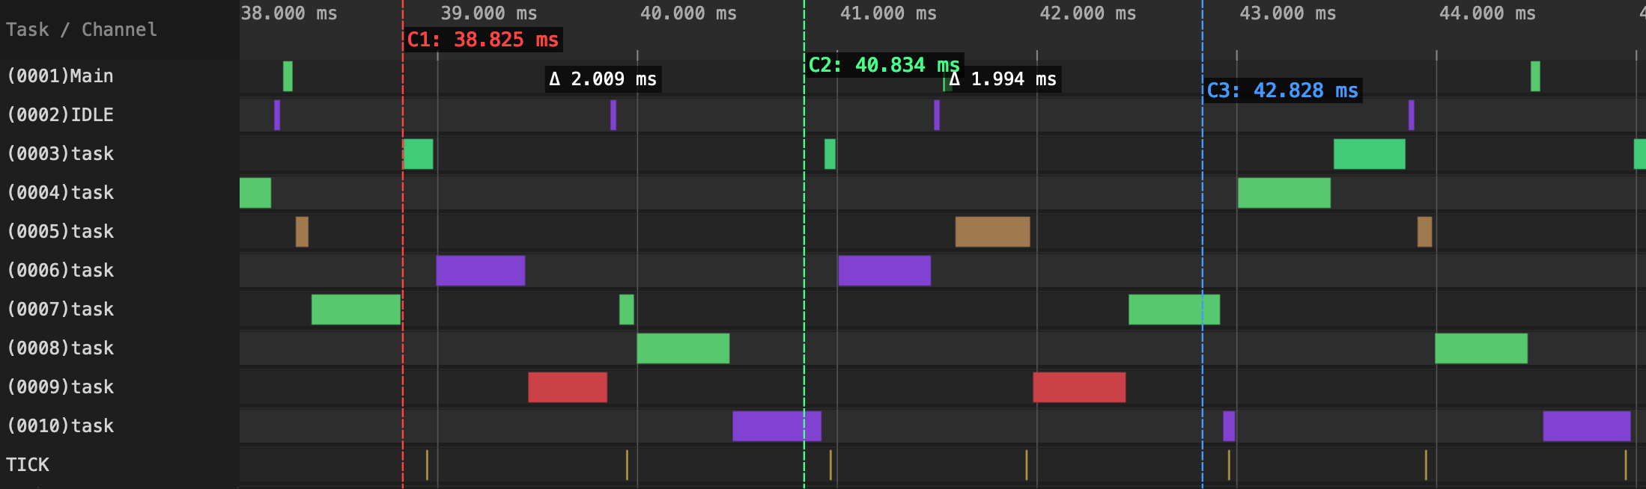
Scoping with Cursors
Three cursors C1, C2, C3 placed on the timeline. The Δ badges show elapsed time between consecutive cursors. Enable Limit to cursor range (C1–Cn) in Statistics
to restrict all metrics to the C1–C3 window.
Cursor Scope Rules
Metric
What counts as "inside" the range
Core & task CPU%
Overlapping active time ÷ range width
Execution / blocking time
Both slice endpoints fully inside
Inter-arrival
Activation start inside the range
Preemption chain
Victim gap and preemptor overlap both inside
24

Slide 25
Tick Health & Scheduler Timer
Statistics → Trace Health (TICK) — always check this before drawing timing conclusions.
Symptom
Interpretation
Action
TICKLESS badge + large gaps
Low-power tickless mode active
Confirm it's intentionally enabled
Max tick period >> average
Missed tick — blocked by long critical section or ISR
Find the long slice in Execution Time
High CoV of tick intervals
Jitter — ISR latency or SMP scheduler interference
Investigate Preemption Chain on the tick task
Missed-tick estimate > 0
Ring buffer saturated; events dropped
Increase ring buffer capacity
Click Tick Distribution… for a histogram of tick intervals.
A missed tick distorts all derived metrics (CPU%, blocking, inter-arrival). Resolve tick issues before trusting other numbers.
25

Slide 26
Build Comparison & Regression Testing
GUI Workflow
1. Open both traces in separate tabs
2. Statistics → Trace Compare… — select Trace A and Trace B
3. Browse: Summary · Top Tasks · Core Migrations · Blocking · Preemption · Sync
4. The Δ column = B − A: negative blocking Δ = improvement; positive CPU Δ = regression
Headless CLI — CI-Ready
# Before/after comparison
python btf_viewer.py compare before.btf after.btf \
--output compare.html --format html \
--name-a "v1.2" --name-b "v1.3"
# Full statistics report, scoped to a window
python btf_viewer.py report trace.btf \
--output report.html --format html \
--lo 100000 --hi 500000
# Core migration table as CSV
python btf_viewer.py migrations trace.btf -o migrations.csv
Headless commands exit 0 on success, non-zero on parse error — plug directly into CI pass/fail gates.
26

Slide 27
Custom Observability — Tags & Intervals
Tag Events — Scalar Metrics in the Trace
trace_tag_emit(0, (int)xPortGetFreeHeapSize()); /* channel 0–7, 32-bit payload */
Appears as a waveform row in the timeline. Open Statistics → Tag Analysis for min/avg/max/p95 per channel.
tag0_event
row expanded: heap bytes in use sampled on every RTOS tick. Drops = allocations freed; plateaus = steady-state consumption.
Interval Events — Code Region Timing
trace_interval_start(1); do_work(); trace_interval_stop(1);
Appears as Interval N bars in the timeline. Statistics → Interval Analysis gives min/avg/max/p95 and a distribution chart per interval ID.
27

Slide 28
Summary
Symptom → Metric Quick Reference
28

Slide 29
Symptom → Root Cause Map
Observed symptom
Start here
Then check
Task misses its deadline
Execution Time (WCET, p95)
Preemption Chain · Blocking · Priority Inheritance
Task waits too long between runs
Blocking Time (Max / p95)
Preemption Chain · Mutex/Semaphore · Inter-Arrival
SMP cores unevenly loaded
Core Utilisation (Load Balance Score)
Core Migrations · Core Affinity · Preemption Chain
Lock-related slowdown
Mutex/Semaphore (Issue count, Core bounce)
Blocking Time · Preemption Chain · Core Migrations
Priority inversion suspected
Priority Inheritance (L/M/H pattern)
Mutex/Semaphore pairing · Blocking Time
Tasks migrating excessively
Core Migrations (Rate, Ping-pong)
Migration Heatmap · Core Affinity violations
Tick irregularity / missed ticks
Trace Health (TICK)
Execution Time Per Slice (long slices blocking tick)
Memory or counter regression
Tag Analysis
Interval Analysis for the owning task
Code region too slow
Interval Analysis (WCET, p95)
Execution Time Per Slice for the owning task
29

Slide 30
Start at the Top
Work down the hierarchy — stop when you find the evidence
System → Core balance → Task timing → Latency → Concurrency → Compliance
Load a trace and open Statistics. Everything else follows.
30

Slide 31
Demo
31

