Slide 1
Applying Cilium at Edge with KubeEdge
Tomoya Fujita
Copyright 2024 Sony Corporation of America
Nov.12th.2024

Slide 2


Who am I?
Tomoya Fujita
Software Engineer, Sony R&D US Laboratory
ROS (Robot Operating System) Project Management Committee
IEEE Robotics and Automation Practice Senior Editorial Board
KubeEdge SIG Robotics Co-Chair
A couple of publishments at CNCF…
Edge Native Applications Principles Whitepaper
Edge Native Application Design Behaviors Whitepaper
fujitatomoya@github

Slide 3
Application at Edge Situation
Broad use cases. (live streaming, entertainment, car, end user device, robots…)
Distributed and Connected System.
Collaborative and Orchestrated Application.
Circulatory Functioning System and Development. (Edge AI, Modularity)
Specific Hardware Acceleration. (Platform Dependencies, Proprietary)
Network Connectivity. (Application Bridge and Proxy)

Slide 4
Application at Edge Situation
Broad use cases. (live streaming, entertainment, car, end user device, robots…)
Distributed and Connected System.
Collaborative and Orchestrated Application.
Circulatory Functioning System and Development. (Edge AI, Modularity)
Specific Hardware Acceleration. (Platform Dependencies, Proprietary)
Network Connectivity. (Application Bridge and Proxy)
But the truth is…
statically configured and integrated.

Slide 5
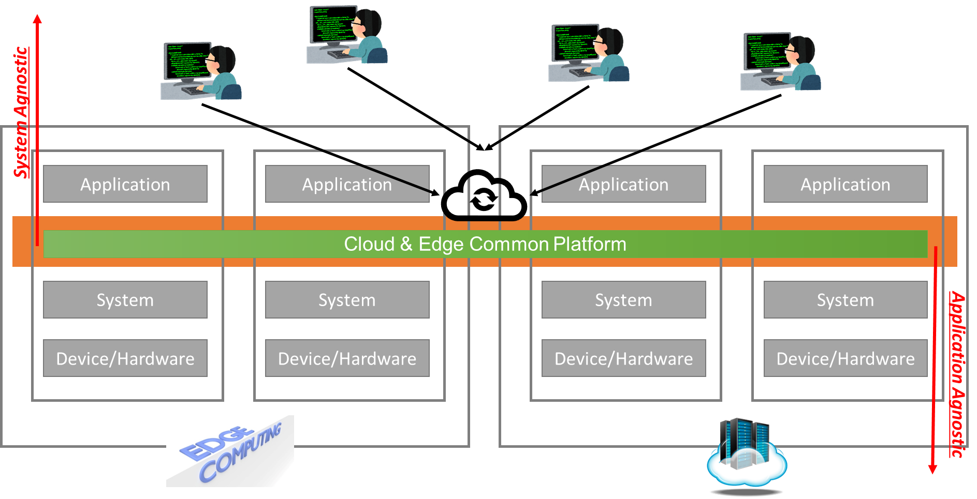
What we want at Edge?
Flexible and Configurable Application Deployment.
Application Agnostic Network Configuration.
Extend Device Capability. (More than it has)
System Global Observability.
Platform Agnostic Infrastructure.

Slide 6
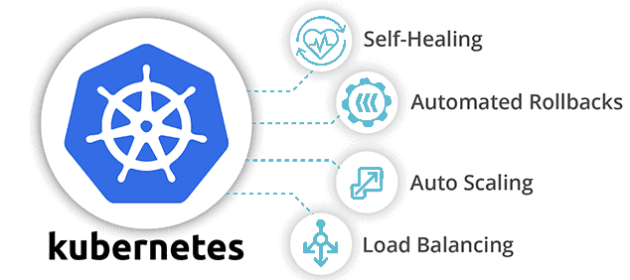
Kubernetes
Application Deployment and Orchestration.
Device Capability and Label Control.
Auto- Scaling and Healing.
Roll Up/Down, Canary Test.
Role Based Access Control.
Device-Plugin / Container Device Interfaces.
Container Network Interfaces. (Cilium)
Looks great, but missing edge specific environmental situation…
e.g) CPU consumption, edge autonomy, lossy network, local caching and synchronization…

Slide 7
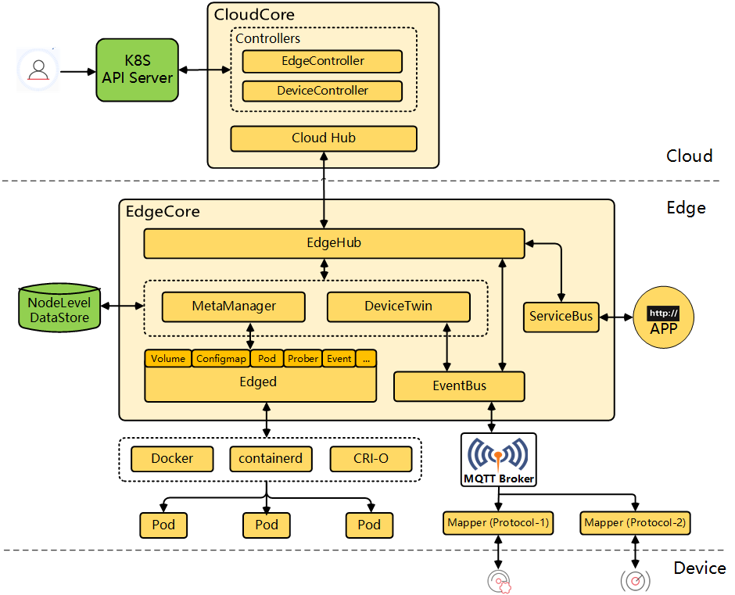
KubeEdge
is built upon Kubernetes and provides core infrastructure support for networking, application deployment and metadata synchronization between cloud and edge.
Cloud-Edge Coordination
Edge Computing
Edge Autonomy
Simplified Deployment
Kubernetes-native Support
Resource Efficient
CNI Unsupported…
https://kubeedge.io/docs/
Notes:
KubeEdge is an open source system extending native containerized application orchestration and device management to hosts at the Edge. It is built upon Kubernetes and provides core infrastructure support for networking, application deployment and metadata synchronization between cloud and edge. It also supports MQTT and allows developers to author custom logic and enable resource constrained device communication at the Edge. KubeEdge consists of a cloud part and an edge part. Both edge and cloud parts are now open-sourced.

Slide 8
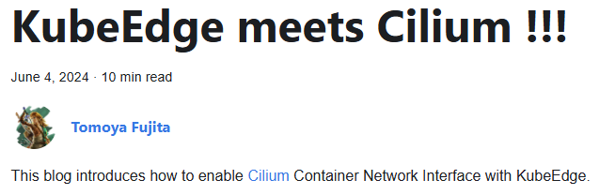
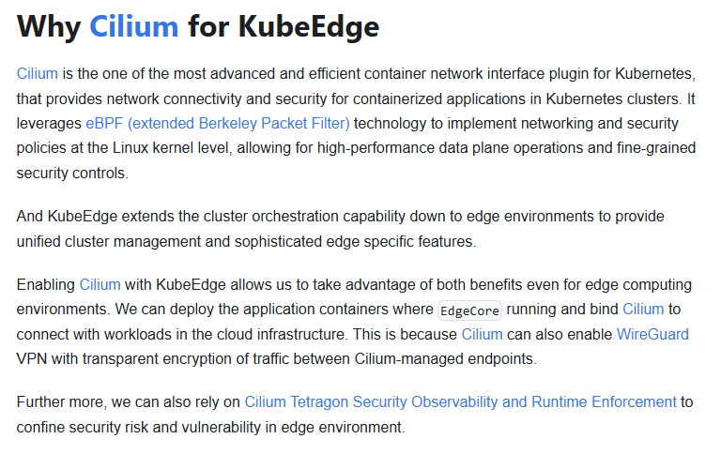


Slide 9






Cloud
Cloud Node
Cloud Node
k8s
App
App
App
App
k8s
Wireguard VPN
Wireguard VPN
Cilium
Cilium
VPC
Internet
Application
Data-Plane
Edge Node
Kube
Edge
App
App
Wireguard VPN
Edge
Cilium

Slide 10

Cloud
Cloud Node
Cloud Node
k8s
App
App
App
App
k8s
Wireguard VPN
Wireguard VPN
Cilium
Cilium
VPC
Internet
Edge Node
Edge Node
Kube
Edge
App
App
App
App
Kube
Edge
Wireguard VPN
Wireguard VPN
Edge
Cilium
Cilium
Edge

Slide 11
Open Discussion
Enable wireguard with different network topologies.
In default `point-to-point`
`Hub-and-spoke`, `point-to-site` and `site-to-site` can also be supported?
More Edge Features
Work In Progress with PoC environment.
More light-weight, less memory and less storage space?
…
Cilium goes everywhere like million devices at Edge?

