Slide 2
LLM-Driven Applications: Intro to LLM Agents in Kubernetes
Calum Murray, University of Toronto

Slide 3

Who am I?
Calum Murray
Engineering Science, University of Toronto
Research in LLMs for SWE, and Event-Driven and Serverless Systems
CNCF Ambassador
Knative Eventing Maintainer and UX Lead, CloudEvents contributor
Incoming SWE @ Red Hat

Slide 4
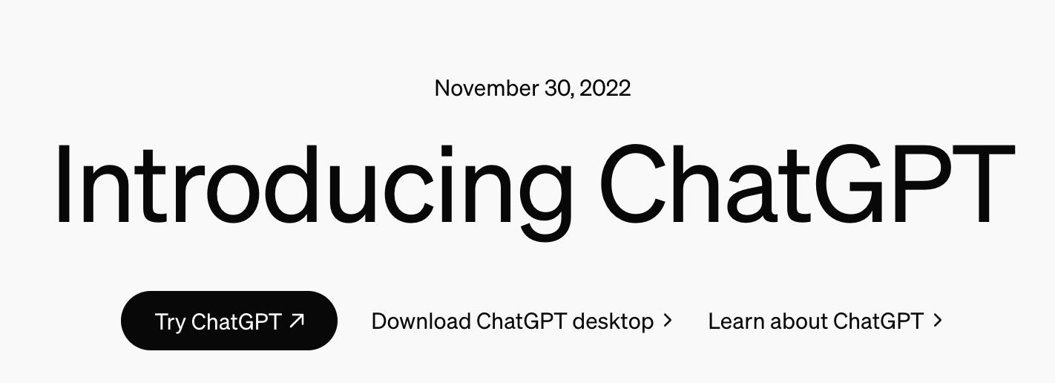

Slide 5
A new way for users to interact with applications

Slide 6
Challenges of LLM Apps
Many challenges when building this new type of interaction
How do we ensure information is correct?
How do we ensure information is up to date?
Can we go beyond “read” type interactions to include “write” type interactions?

Slide 7
Challenges of LLM Apps
“Read” type interactions
User is trying to get/summarize information, does not update state
E.g. “How has the trend in average resource consumption (CPU, GPU, memory) changed over the past two months for my application, and what impact might this have on my team’s cloud bill?
“Write” type interactions
An interaction which updates state
E.g. “Based on the average resource consumption (CPU, GPU, memory) over the past two months for my application, try and reduce my costs”

Slide 8
How can we improve LLM performance for our apps?

Slide 9
Retrieval Augmented Generation

Slide 10
Retrieval Augmented Generation
User Prompt
Information Retrieval
LLM
LLM Reponse

Slide 11
Retrieval Augmented Generation
RAG addresses many of the problem associated with LLM applications, particularly
How do we ensure information is correct?
How do we ensure information is up to date?

Slide 12
Retrieval Augmented Generation
However, RAG does not always sufficiently answer these challenges, especially when
The user is asking for compound information that the model does not have direct access to retrieve
E.g. model has price and usage, but not guaranteed to calculate price x usage correctly
Any “write” type interactions
The model only retrieves state, it does not update state

Slide 13
LLM Agents

Slide 14
LLM Agents
What is an Agent?
A system
Able to take in information about its environment
Use the information to take actions to accomplish a goal
What is an LLM Agent?
An agent that is powered by an LLM

Slide 15
LLM Agents - How do they Work?
LLM
Agent
Agent
Agent
Agent
Agent
Other Agents
Tools
END

Slide 16
LLM Agents - Tool Calling
We can use Tool Calling for
Retrieving Information (LLM-driven RAG)
E.g. get resource usage for my app over the past two months
Calculating Information
E.g. calculate the cost for the resource usage
Updating Information/State
E.g. store the cost in a db somewhere
Taking Actions
E.g. turn off a server that is underutilized

Slide 17
LLM Agents - Tool Calling
{
"type": "function",
"function": {
"name": "get_current_weather",
"description": "Get the current weather in a given location",
"parameters": {
"type": "object",
"properties": {
"location": {
"type": "string",
"description": "The city and state, e.g. San Francisco, CA",
},
"unit": {"type": "string", "enum": ["celsius", "fahrenheit"]},
},
"required": ["location"],
},
},
}

Slide 18
LLM Agents - Tool Calling
response_message = response.choices[0].message
tool_calls = response_message.tool_calls
tool_calls
[
{
"index": 0,
"id": "call_8AMm5UIGE8sjDCqxolhoSJ9z",
"function": {
"arguments": "{\"location\":\"New York, NY\"}",
"name": "get_current_weather"
},
"type": "function"
}
]

Slide 19
Building LLM-Driven Applications
Tool calls often are functions which make an API call and return the result to the LLM
A good path to adopting LLM Agents & Tools is to map your existing API endpoints into the tool call format
Only build new tools or endpoints if needed

Slide 20
Building LLM-Driven Applications
A simple design methodology for LLM Agents
Identify the use case
Which endpoints/services might be needed for this use case?
Build any new endpoints/services that are needed
Knative Services/other serverless offerings are a great fit for this type of workload
Map endpoints to tool calling format
Evaluate

Slide 21
Building LLM-Driven Applications
Test interacting with system with different prompts
Adapt tool descriptions as needed
Adapt tool parameter descriptions + which parameters are exposed to the LLM
Add new tools if there is information the LLM is missing or tasks it is failing

Slide 22
LLM Agents - Demo
A demo of LLM Agents with automatic tool registration based on Knative EventTypes
Want to find the trend in cost associated with the resource usage of my application over the past four months.

Slide 23
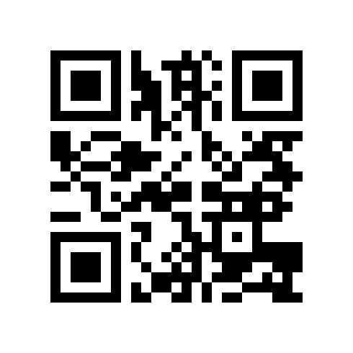

Thank You!
Feedback
Demo Repo

