Slide 2




Live Migrating Production Clusters From Calico to Cilium
November 12, 2024 Salt Lake City
Moh Ahmed Staff Developer, SRE SamsungAds
Raymond Maika Manager, Platform Engineering SamsungAds

Slide 3
Agenda
Objective
Purpose
Different Migration Methods
Running the Migration
Demo
Closing Thoughts

Slide 4
Objective
Calico is in-use across ~20 clusters in use by tenants
More than half are running production workload
Sizes vary from 10s to >500 nodes
We want to swap to Cilium
Gateway API support
Light service-mesh features
Hubble for network visibility
How do we minimize impact of this change and keep revenue-generating services running?
Secondary - limit effort required of tenants in particular
Notes:
Our platform is live, and used by applications that generate the significant majority of our revenue. It’s important to have a path that provides minimal downtime
We had ~20 clusters at the time, these are rancher-managed, and a mix of AWS and bare metal.
More than half of those clusters are running production workload
Sizes vary significantly based on use cases and environments. Some are small dev clusters, some are for product segments that need significantly less compute resources, but our largest clusters can be anywhere from 300 to a bit over 600 nodes
We made the decision that we want to swap to Cilium. I’ll talk a bit more about that in the next slide, but for now we’ll just say we’re looking forward to new features like Gateway API support, some light service-mesh features provided by Cilium, and the visibility that Hubble can provide for us
Our primary considerations when planning this migration centered around finding a path that has the following characteristics:
Ideally no impact to services generating revenue
We needed this migration to be largely transparent to end-users of our services (awareness, readiness for the changes is expected, because it’s a very significant change. But we didn’t want to impose any significant amount of manual work on end-users to accomplish this)
Lastly, for our own sake, not having to have the platform team perform some marathon migration, working overtime, high pressure, etc

Slide 5
Purpose
Swap to Cilium for the following improvements
eBPF forwarding, XDP datapath
Simplified network policies using Cilium nodePort implementation
Improved self-service capabilities and auditability for policies
New features
Gateway API
Enhanced load-balancing (Cilium service implementation)
Lightweight service mesh features
Notes:
eBPF forwarding - we know it works, know it’s performant.
XDP - we have a few latency sensitive apps (bidding layer for ad-tech, <40ms processing time in our infra) that we want to ensure have the lowest overhead in the Kubernetes layer
App is being migrated from bare metal without k8s, to AWS with k8s, and we need to maintain low latency performance
Using XDP for the networking stack helps keep latency as low as possible while enforcing policy
Cilium kube-proxy-replacement
If you’ve used k8s in AWS, you know that connecting to AWS LBs is a mess of nodePorts underneath it all. Being able to effectively apply policy at this layer is a bit challenging when your CNI defers the implementation of nodePorts to `kube-proxy`
Using Cilium kube-proxy-replacement allows us to apply policies using clearer identities for nodePort services
The improvements to our network policy layer also made it easier to provide self-service network policies in a way that is clearer what endpoints are being exposed through the IaC. This also makes it easier for our security team to review and audit our network policies
Gateway API support in Cilium is a feature that we are very interested in, as our SRE team is improving our deployment procedures, and having the ability to use Gateway API features to do traffic switching for canary and blue-green deployments has the potential to simplify that workflow significantly

Slide 6
Different Migration Methods
Deploy new clusters that come freshly made with Cilium
Rip out the old, deploy the new
Bind multiple network interfaces to a pod
Attempt a hybrid, per-node migration
Notes:
So, when we’re brainstorming, these were the main ways we came up with potentially running the migration. They’re fairly self-explanatory
Deploy new envs. Just create new clusters with the configuration we want. Easiest way for us, because we don’t have to do very much operational work on live envs. Pretty heavy for end-users
Just uninstall Calico, and install Cilium. Technically, could work. Has fairly unpredictable timing and poor failure scenarios
Run the two CNIs in parallel, using Multus
Attempt a hybrid migration, using Cilium’s per-node configuration feature (released in Cilium 1.13) https://isovalent.com/blog/post/cilium-release-113/

Slide 7
Deploy new clusters
Deploy a new cluster with Cilium as the default CNI
This removes the dependency on legacy components
Problems:
More work on the user side to migrate their workload and data
Stretches out the amount of time needed to complete the work
A long period of time where we’re running two different networking and security solutions
New clusters will be provisioned with Cilium, but can’t clean up old ones until everyone migrates
Notes:
So, I think most people here can understand that they key problem with this approach is a classic one: users.
While it’s not the most challenging thing (with deployment machinery our platform team has built) to deploy an application to a new cluster, every end-user’s application will have different deployment, rollout, and migration concerns
Having relatively high adoption is a good problem to have, but the volume of different teams and apps that would need to move from one env to another just made producing a minimally disruptive migration plan using this method unfeasible, it was likely to drag on for extended periods of time.

Slide 8
Rip out the old, deploy the new
Uninstall the old CNI plugin, install the new one
Problems:
Disrupts the existing workloads
Cluster-wide maintenance that can last a long time
Hard to revert back since it’s an all or nothing approach
We set out to find a solution that we can apply in a controlled way

Slide 9
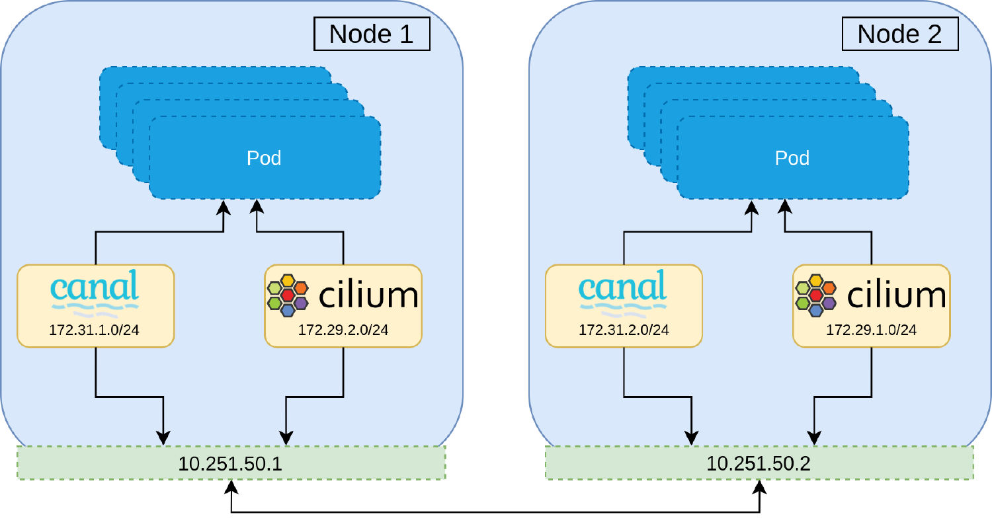
Bind multiple network interfaces to a pod
This idea came from a blogpost from Jetstack (now Venafi)
Using Multus, we should be able to have multiple network interfaces in a pod
source: https://venafi.com/blog/cni-migration/
Notes:
One of these interfaces will be created and managed by the first CNI (in our case, Calico)
The second interface would be created and managed by the Cilium CNI
In theory, traffic coming on either interface should be able to reach the pod successfully

Slide 10
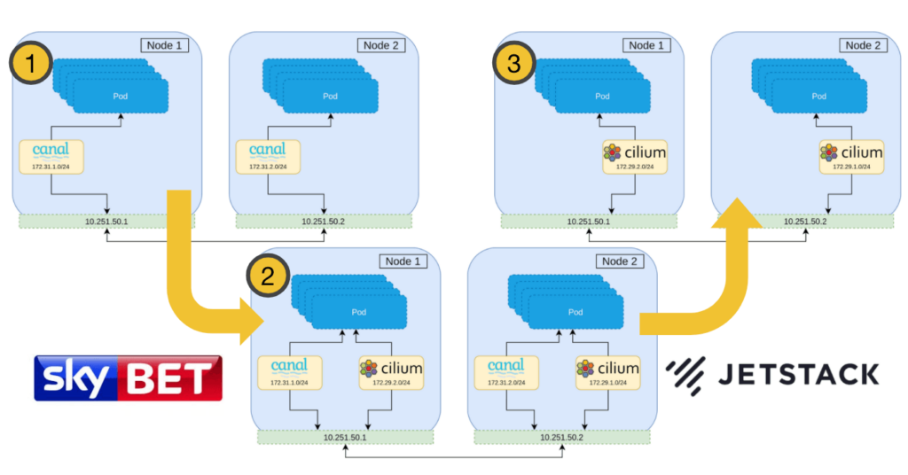
Bind multiple network interfaces to a pod
source: https://venafi.com/blog/cni-migration/

Slide 11
Bind multiple network interfaces to a pod
But we couldn’t get it to work:
Multus was installed and was set to be the default CNI
Pods had both interfaces configured (one interface serving Calico and the other serving Cilium)
Calico was set to be the primary CNI
However, we couldn’t get pods to talk to each other on either interfaces
There would be a period of time where workloads were unreachable
We also tried using the source based routing (SBR) meta plugin but saw:
If SBR was enabled, only Cilium interfaces worked
If SBR was disabled, only Calico interfaces worked

Slide 12
We learned a lot
We had a valid and reusable rollback strategy for when things didn’t work
We updated our Rancher cluster agents to use hostNetwork to maintain connection while the CNI was being upgraded
We understood CNI configuration in much more detail (/etc/cni.d/)
We learned about Cilium configuration taking over CNI path unless specifically disabled (--cni-exclusive=false)
Notes:
Using Multus helped us understand the CNI configuration structure - Multus manipulates configs in /etc/cni.d/ to manage config and priority when running multiple CNI plugins. We would make use of this knowledge when building our procedure

Slide 13
Hybrid, per-node migration
We took advantage of a new Cilium feature for per-node configuration
Allows for setting up a specific Cilium configuration on a per-node basis, using node labels
With this, we can have a CNI configuration that uses Calico as a default CNI
Once the node is labeled, Cilium takes over the CNI directory and becomes the default CNI
Whitelisting the two pod network CIDRs in both CNI firewalls allows for open communication between the two

Slide 14
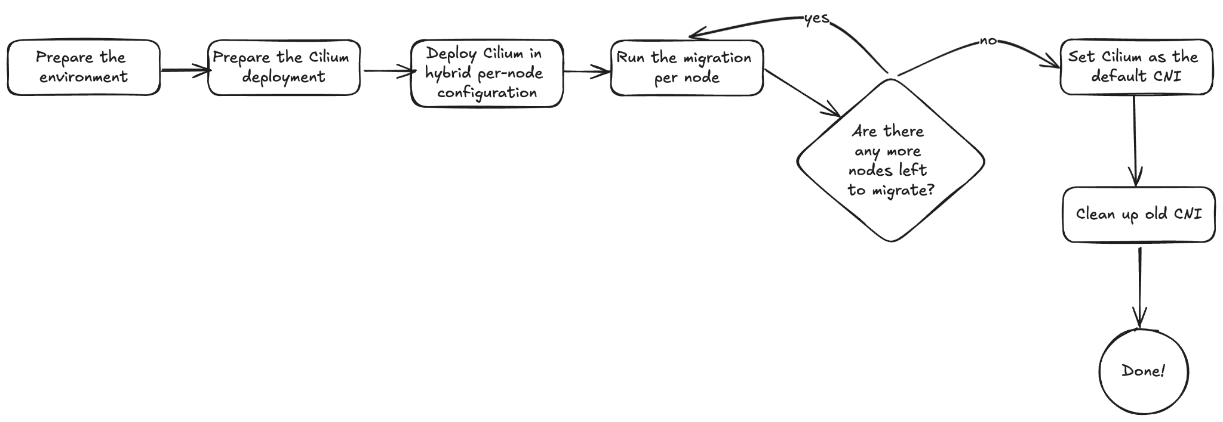
Running the Migration

Slide 15
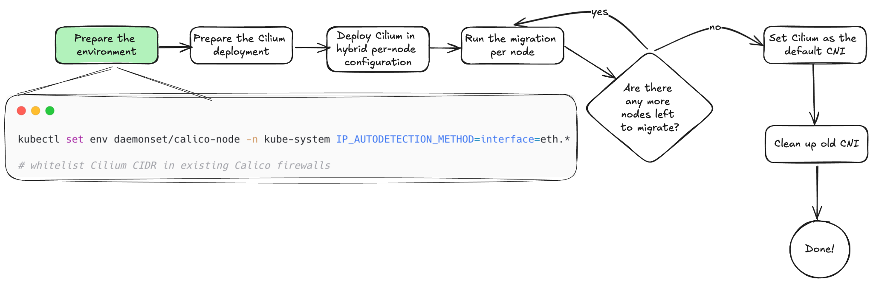
Running the Migration
Notes:
Ensure Calico doesn’t discover Cilium interfaces when they’re created

Slide 16
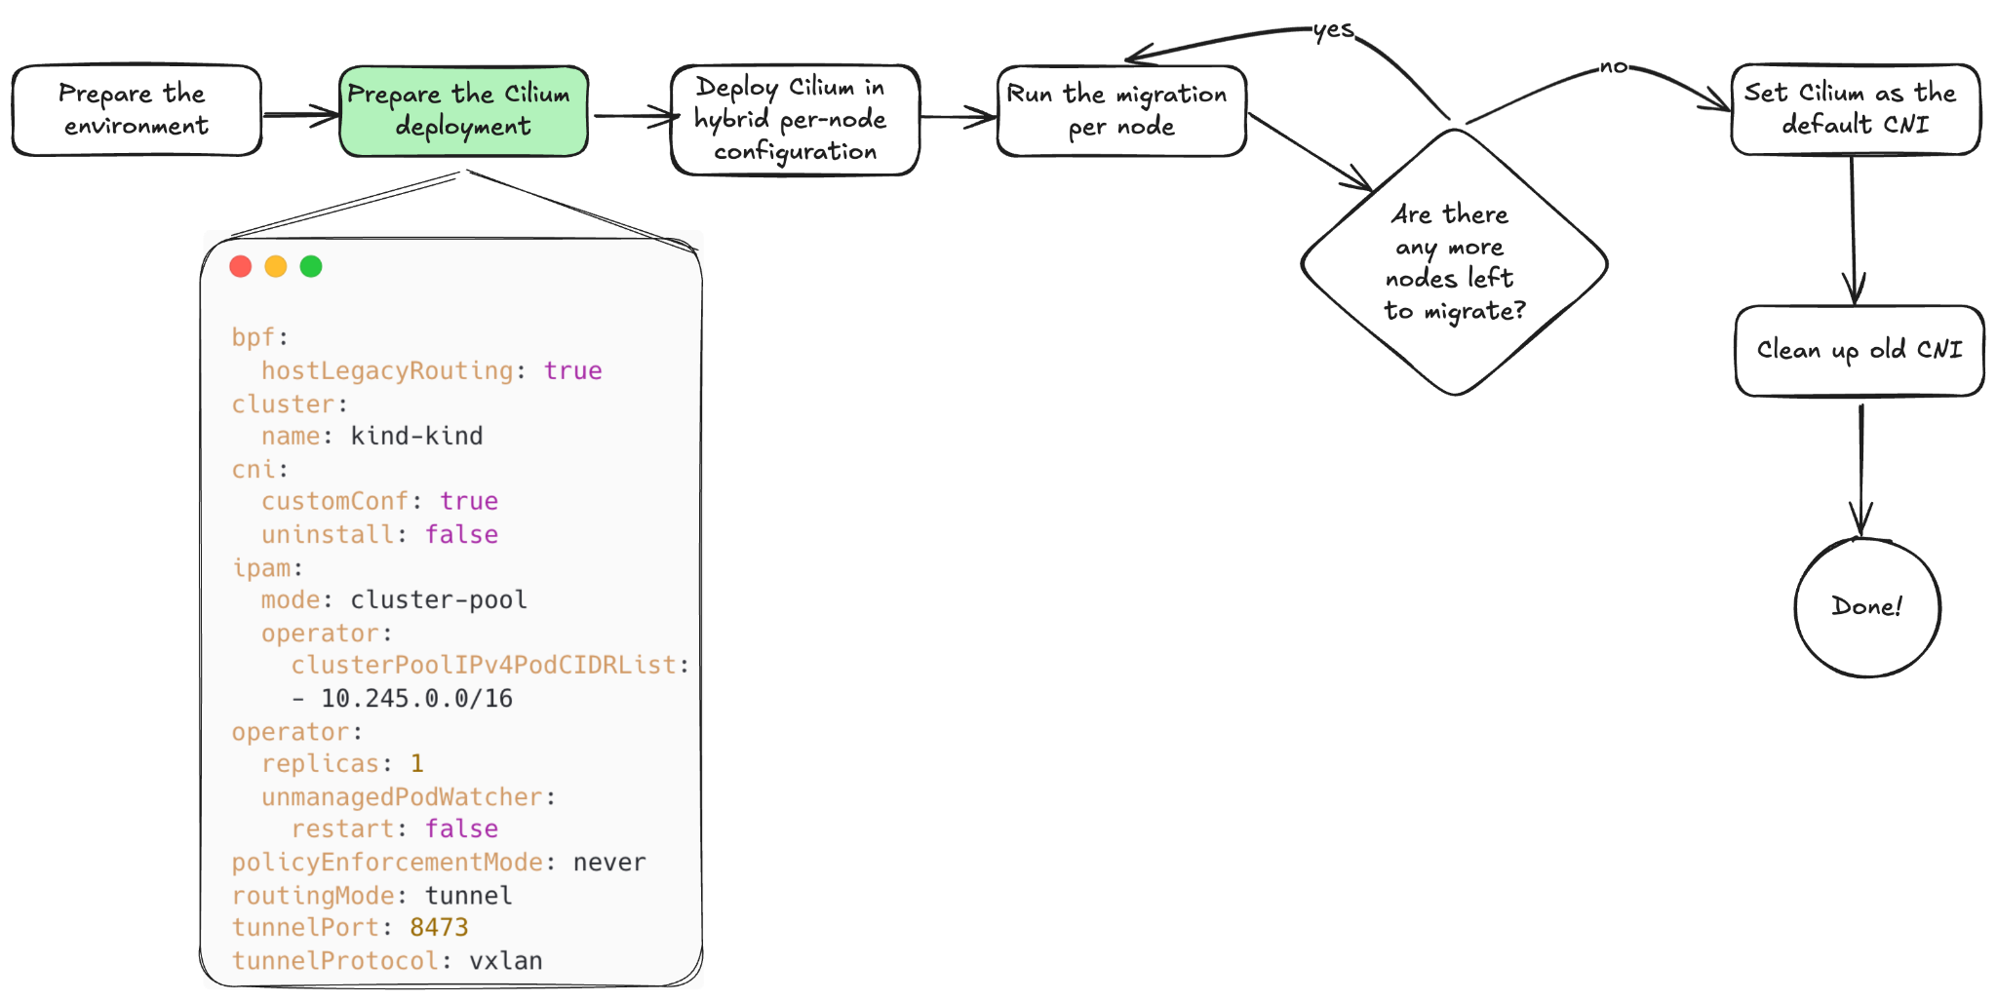
Running the Migration
Notes:
CNI uninstall: false (avoids Cilium taking over whole CNI config dir)
Non-overlapping CIDR with existing Calico CNI
PolicyEnforcementMode: never (not applying any firewalling/netpols until we’re swapped over)
Apply these as part of final step

Slide 17
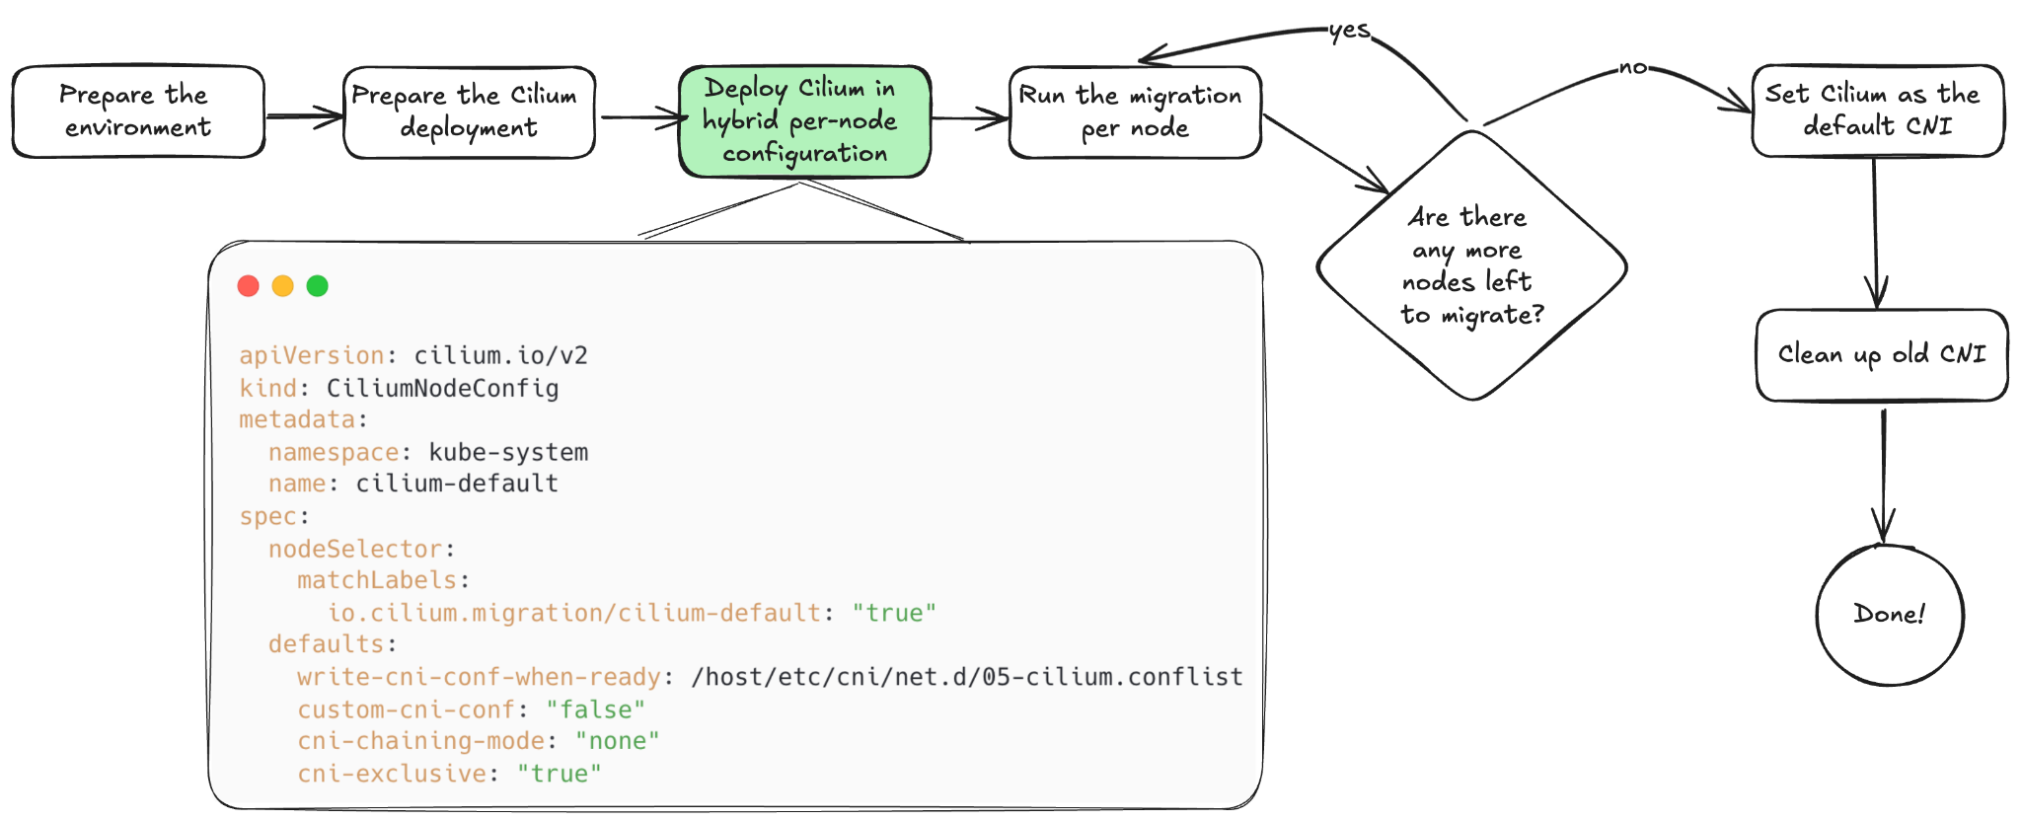
Running the Migration
Notes:
Explicitly, this is a CRD that we deploy into the cluster

Slide 18
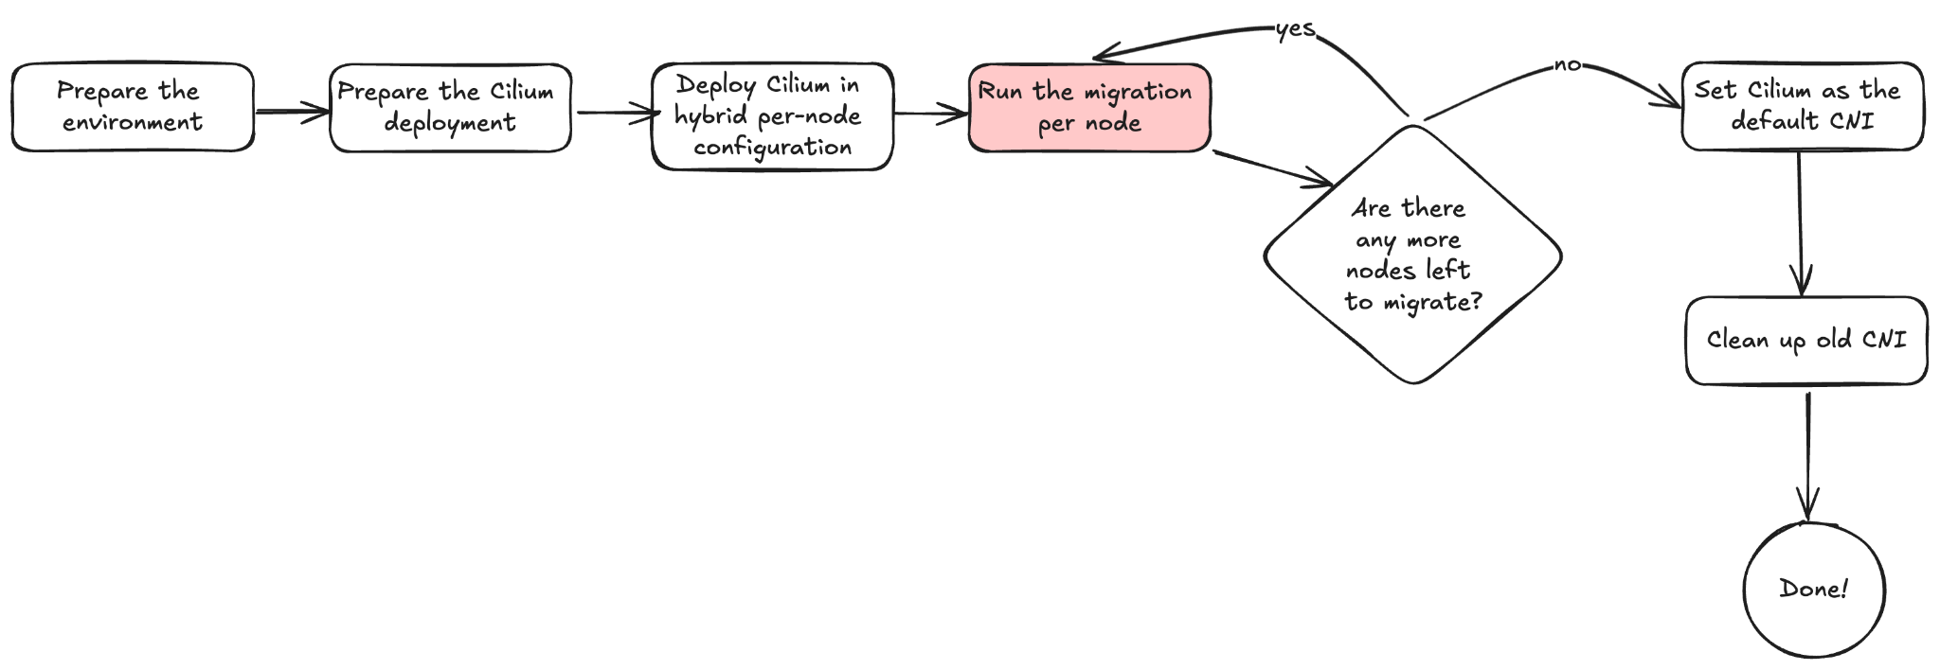
Running the Migration

Slide 19

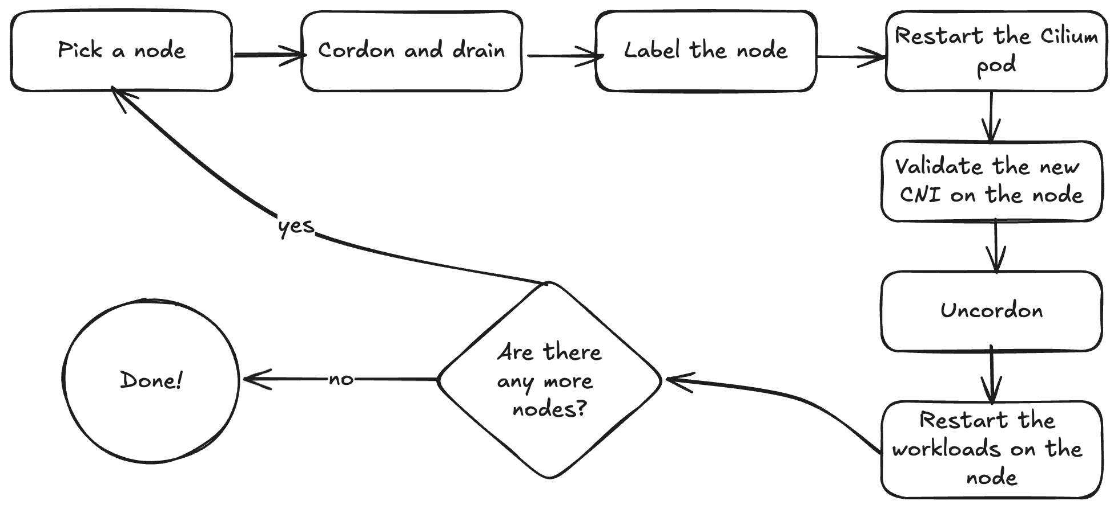
Notes:
Restart the workloads that wouldn’t be restarted by the drain, things like Daemonsets for example
If you’re in larger clusters with generic node groups, you can do this with more than 1 node in parallel.

Slide 20
Completing the migration

Slide 21
Demo

Slide 22
Some things to consider
Our clusters are running IPv4 only, your mileage may vary for IPv6
We were running an old version of Calico (v3.x), some extra clean up was required
We migrated to Cilium v1.13.x at the time
We didn’t enable Cilium’s kube-proxy replacement at the time of the migration to reduce complexity
We ended up using Portmap (hostPort) CNI chaining as we had an application using a host port
This was needed while the migration was happening until we could enable Cilium’s kube-proxy replacement post-migration
More details available on the blog post we published on this

Slide 23
Closing thoughts
We migrated ~20 clusters (development, staging, production)
Some clusters as small as 10 nodes, many with hundreds of nodes
Number of PRs needed to deploy a service with firewalling was reduced by 50%
New firewall rules are more readable and are based on identities rather than ports
CiliumNodeConfig is a very useful CRD
Re-used this to rollout our kube-proxy replacement configs
Thanks to strong best practices in the org, our critical systems have minimum levels of fault tolerance, allowing this migration to complete with no service interruptions
Notes:
Having good workflow testing for a change this big is critical. We ran and re-ran the migration on our own test clusters several times to identify potential failure modes, and recovery steps for each of them. Ensuring that the whole team is aware of the procedures and recovery steps is important, in case we have a significant issue and need to swarm, no need to waste time explaining the procedure
Batching became very important on large clusters
Certain stateful workloads were isolated in node groups, which meant we can treat the migration of those nodes with particular care and ensure safe rollout
Eg: in-memory database, Aerospike. Having this migration path allowed us to treat these special cases with the care required
Simplifying self-service usage goes a long way to reducing operational overhead. And having easy-to-audit IaC makes security happy
CiliumNodeConfig is really useful.
Best practices for workload on top of the platform (ENFORCED by policy) is also a critical component towards having strong fault-tolerance and nice behaviour when performing operational work on clusters

Slide 24
Thanks to
This was a team effort, with the migrations and troubleshooting done by everyone on the team, especially on large clusters
Alexander Ratte
Alexis Vanier
Benoit Caron
Thibaut Charry
Yann David
Vlad Paciu

Slide 25

Please rate and provide feedback
Notes:
https://colocatedeventsna2024.sched.com/event/1mFPd

