Slide 2
Building the Future of Your Project: How to Engage Students into Open Source
Zainab Husain, Corey Leong, Leo Li, Calum Murray, Ali Ok

Slide 3
Contributors are Key to OSS Projects

Slide 4
Students Want to Contribute

Slide 5
How Can We Grow Students Into Contributors?

Slide 6
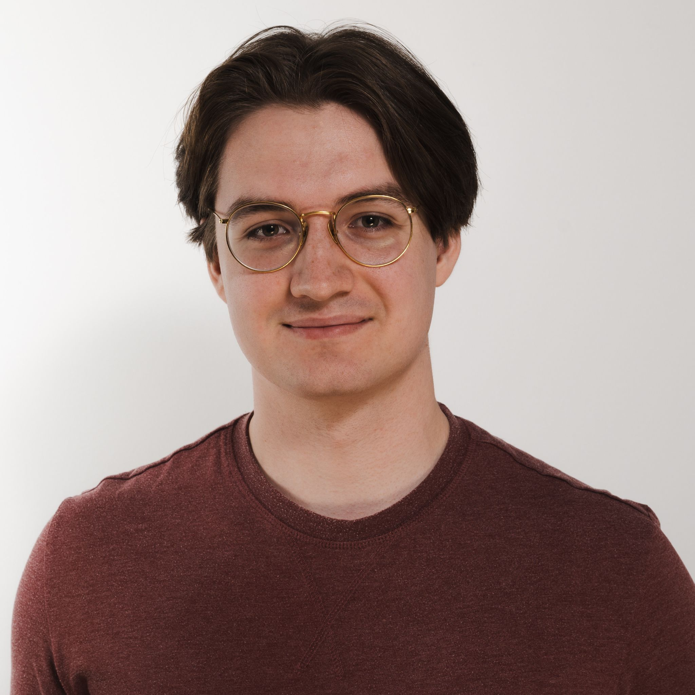
Who am I?
Calum Murray
Engineering Science, University of Toronto
Research in LLMs for SWE, and Event-Driven and Serverless Systems
Knative Eventing Maintainer and UX Lead, CloudEvents contributor
Incoming SWE @ Red Hat

Slide 7
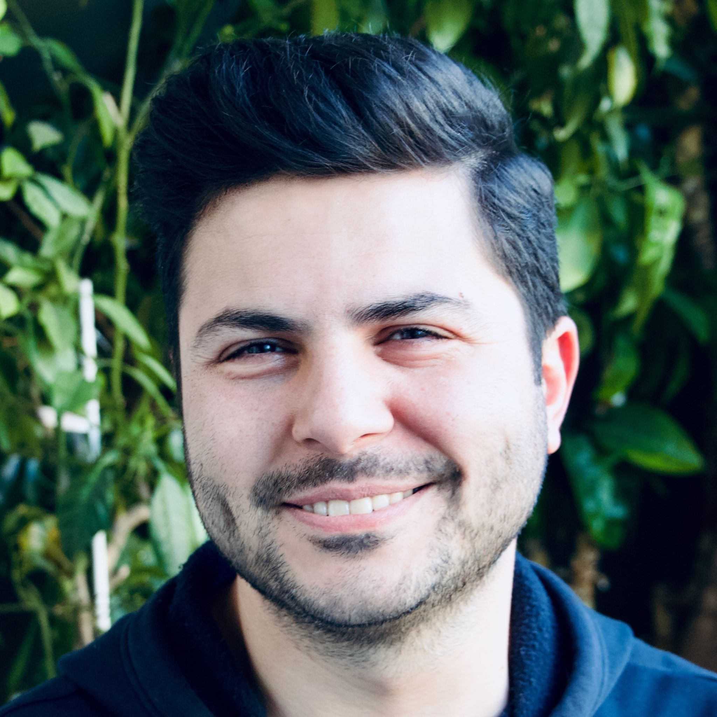
Who am I?
Ali Ok
Principal SWE @ Red Hat
Co Chair CNCF Mentoring WG
GSoC Mentee in 2010
CNCF Ambassador

Slide 8
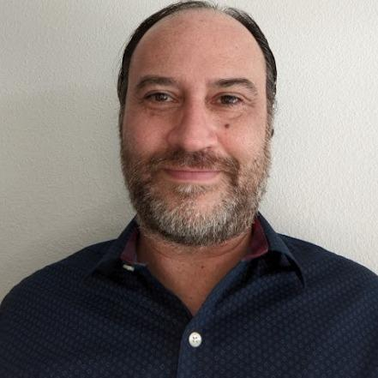
Who am I?
Dr. Corey Leong
Professor at Valencia College, Orlando FL
Teaches about Cloud Computing
Previously at Google, Oracle, and IBM
Member of the CNCF Higher Ed WG
Working on Mentorships and Internships for Students to Become OSS Contributors

Slide 9
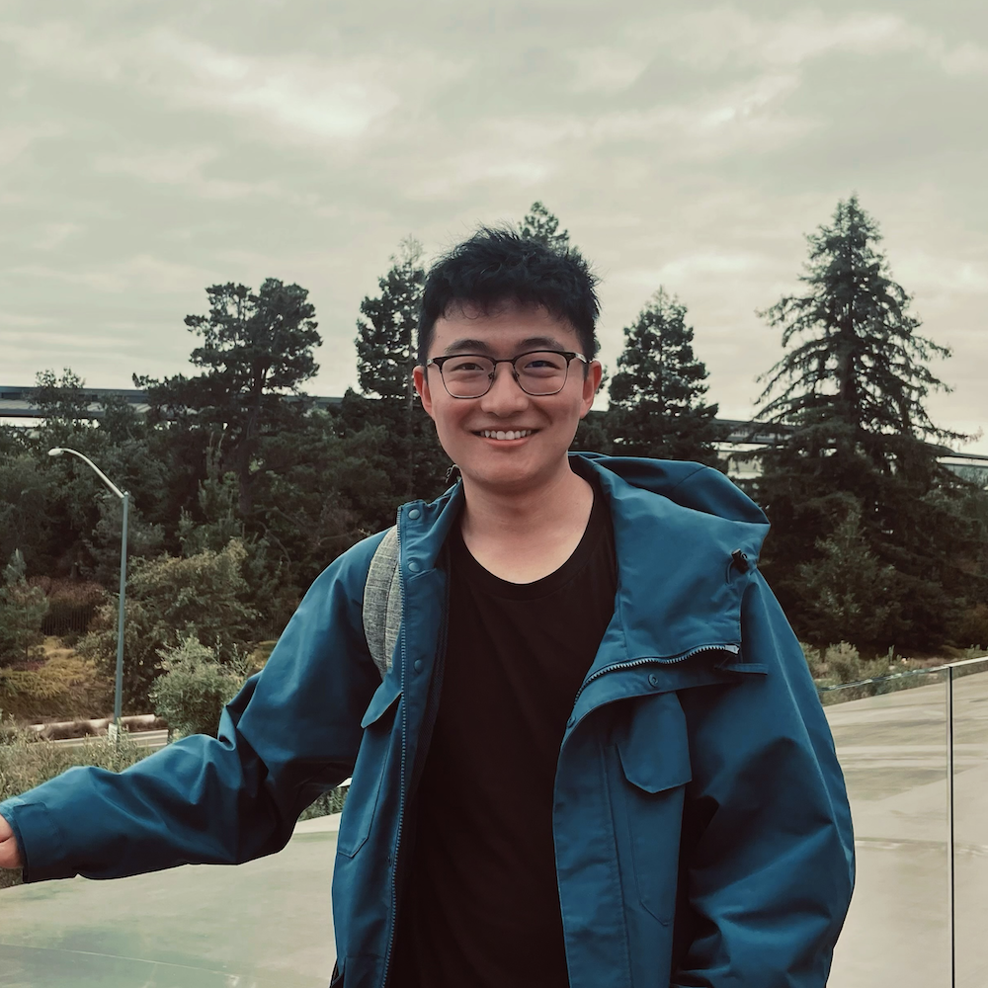
Who am I?
Leo Li
Computer Engineering, University of Toronto
Knative Eventing Maintainer and UX Tech Lead
Co Founder of University of Toronto Open Source Students Club
Prev IEEE Student Branch Co-Chair for University of Toronto

Slide 10
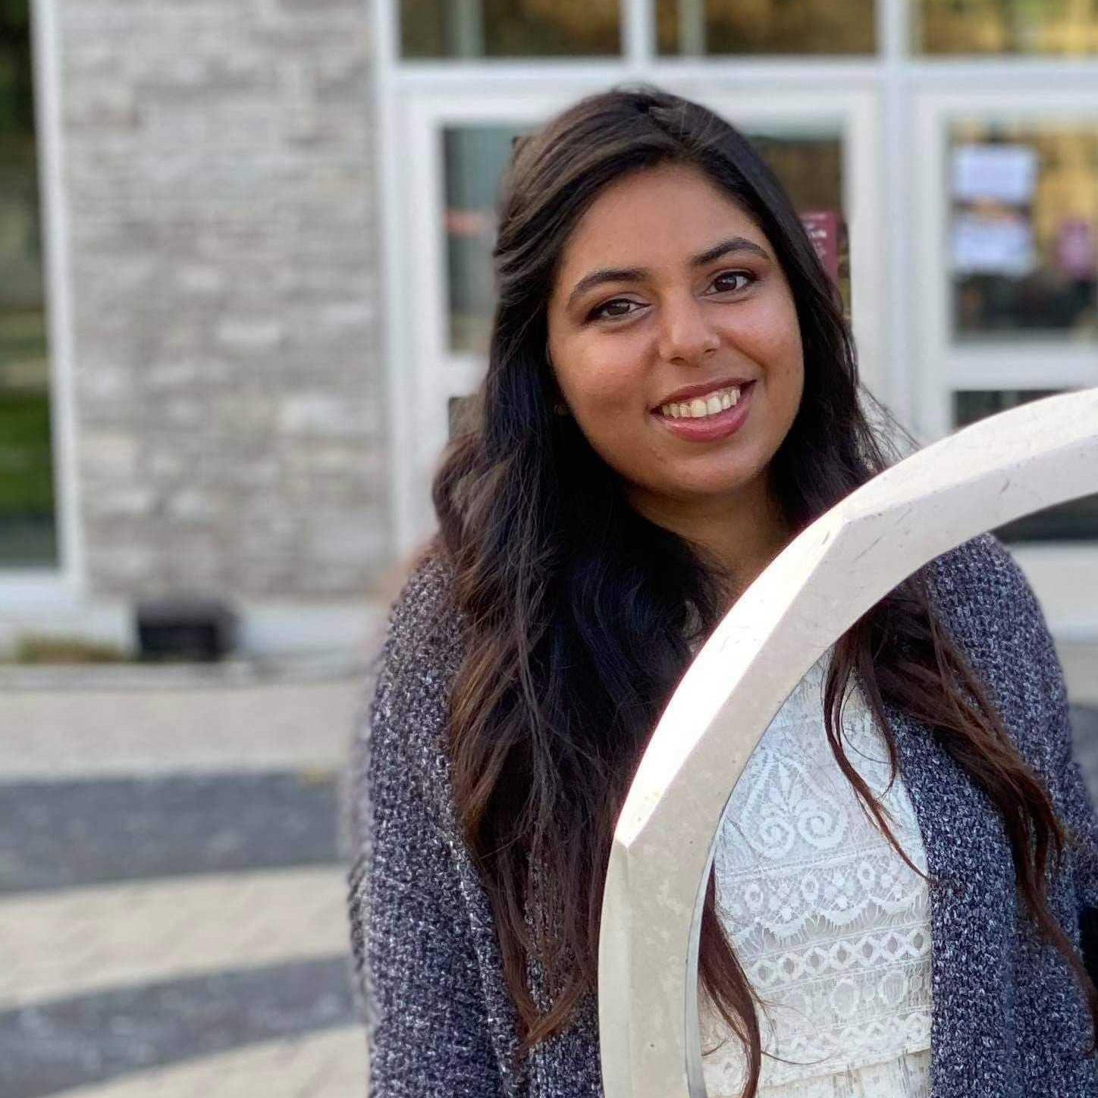
Who am I?
Zainab Husain
UX Researcher and Course Instructor @ OCAD University and Algoma University
Masters of Mechanical Engineering @ University of Toronto
Developed Communications Technology Recommendations for Accessibility Services Canada
UX Working Group Lead with Knative
LXF Mentor

Slide 11
How have you engaged students into open source?

Slide 12
What are some of the benefits of your approach? What are some of the disadvantages?

Slide 13
How can CNCF projects participate in your approach to engaging students? How can others replicate your approach?

Slide 14
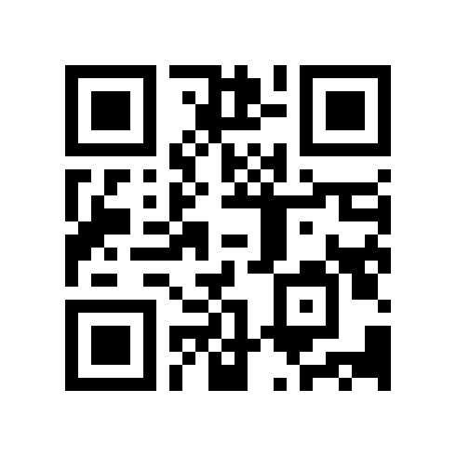
Q & A
Feedback

