Slide 1
Automated Multi-Cloud, Multi-Flavor Kubernetes Cluster Upgrades Using Operators
Ziyuan Chen, Software Engineer at Databricks

Slide 2
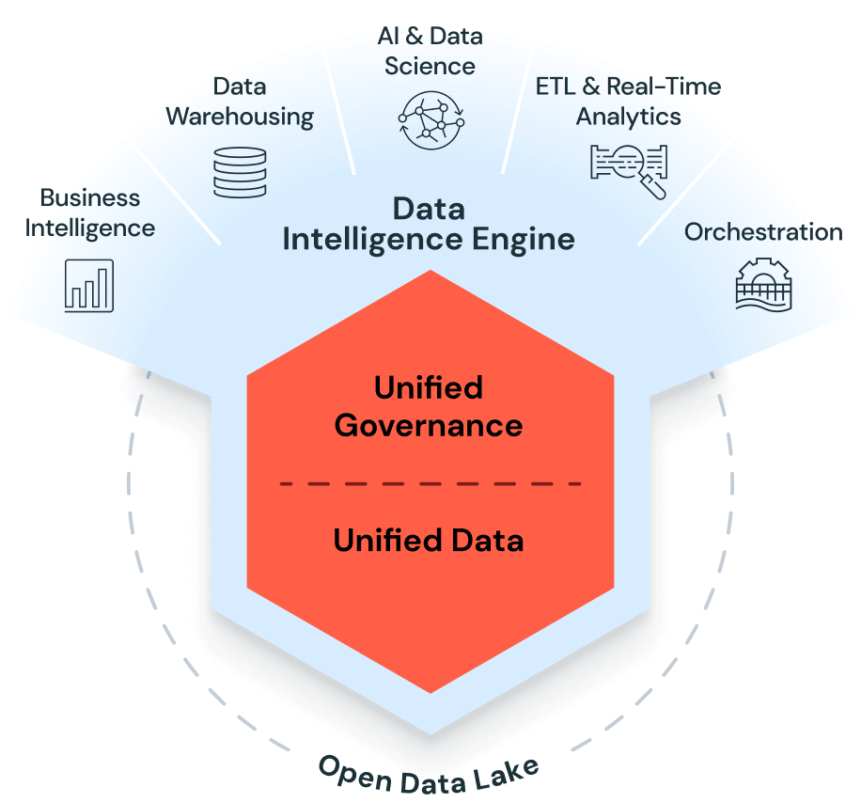
Who we are
Data Intelligence Platform
ETL
Data warehousing
Generative AI
All of them run on Kubernetes
Notes:
Databricks is a multi-cloud data intelligence platform that enables organizations to understand their data from ETL to Data Warehousing to Generative AI.

Slide 3
Need to upgrade all Kubernetes nodes monthly
Required, frequent OS security patches for Kubernetes nodes
Kubernetes version upgrades
Rolling out infrastructure changes
Node OS
Instance type
Node configuration
Launch template
Notes:
Infra updates = such as node operating system changes, instance type, taints / labels, userdata

Slide 4
Challenges
Notes:
We soon found that this seemingly simple ops work was challenging to us for many reasons

Slide 5
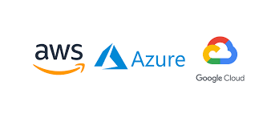
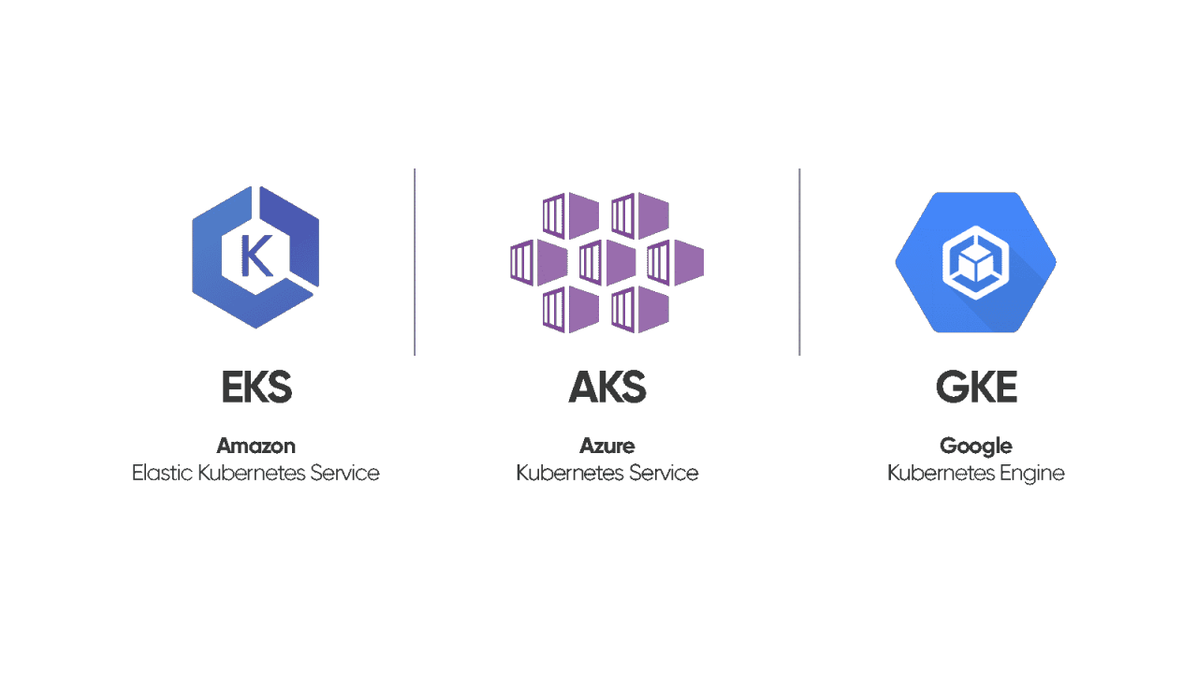
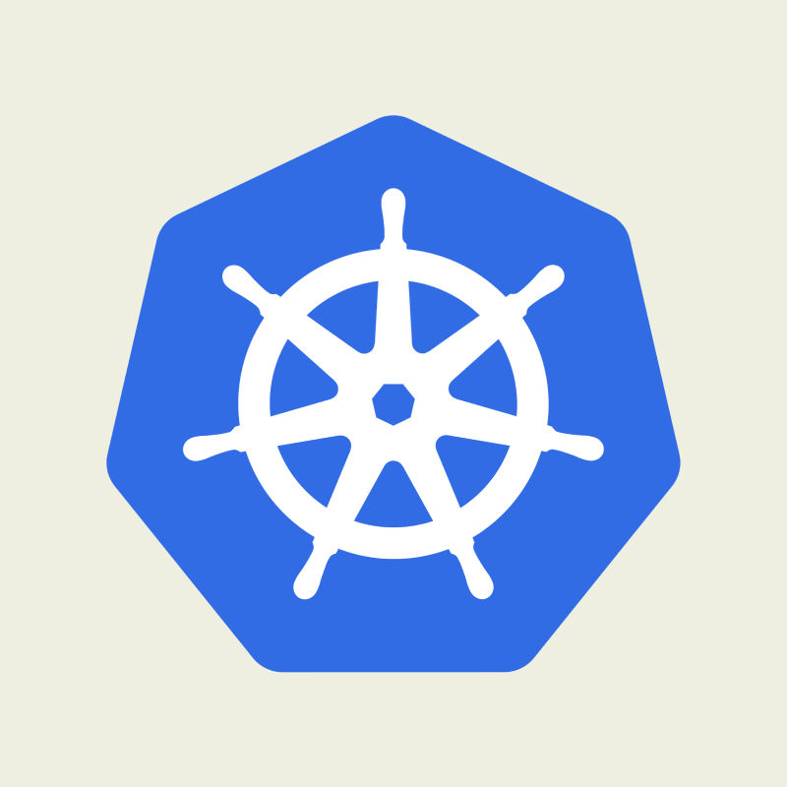
Heterogeneity
3 clouds (XX regions per cloud around the world)
4 Kubernetes flavors
Self-Managed Kubernetes

Slide 6

Variety of workloads
Kubernetes is the foundation of all Databricks products
Microservices
Serverless customer workloads (SQL, UDF, Databricks Notebooks, Jobs, etc.)
Machine Learning (both internal users and external customers)
Training and inference
Internal tools & systems
CICD, testing jobs, PKI, observability
Massive growth as a business -> large growth in workloads
Notes:
Grew from a “small startup” to a “medium-sized tech company”

Slide 7

Scale x Frequency
1000+ clusters, XXX,000 nodes
Monthly node upgrades for all nodes in all clusters
More frequent upgrades possible in case of hotfixes, rollbacks, etc
Assuming an engineer spends 2 minutes to manually upgrade 1 node with a script (an optimistic estimate): ~ 139 person-days to upgrade all nodes once at our current scale!
Notes:
139 days without rest
Scale was smaller back then, but still significant.
We wouldn’t have reached our current scaled without automating the upgrade process, and now I’m going to talk about how we solved this problem

Slide 8
Building an automated system to upgrade nodes …
Notes:
With the scale back then, and in anticipation of the larger scale, we needed to built automation

Slide 9
Requirements
No downtime / outage
Be able to roll back easily in case of a problem
Consistent upgrade flow on all 3 clouds and 4 Kubernetes flavors
Low effort for engineers

Slide 10
First version: Automation using off-the-shelf CICD
Spinnaker stages
Cluster A, node pool N1
Cluster A, node pool N2
Cluster A, node pool N3
Cluster B, node pool N1
Cluster B, node pool N2
…
Jenkins job
Target Kubernetes cluster’s API Server
Bring up new nodes, move workloads over, shut down old nodes
Python + Groovy scripts
Cloud APIs

Slide 11
Problems
Many outages due to
Hard to test (10k+ lines of poorly-tested Python + Groovy code)
Hard to make a change that behaves consistently on all clouds and Kubernetes flavors
Very high human operational cost (100 - 150 oncall pages a week)
Suffered from transient and temporary failures because of the complexity of upgrade steps
Thousands of mouse clicks restarting failed Jenkins jobs
Rollbacks were often blocked due the same issues
Often missed deadlines
Notes:
The way you auth to different k8s flavors was different; scale nodes up / down was also different Even worse, rollbacks were also affected by the same issues, causing mitigation of incidents caused by problems in new configurations very hard

Slide 12
Solution: Kubernetes operators
Notes:
After operating the first version of the system for more than a year, we finally took all of our learnings from it and moved on to a better solution: k8s operators

Slide 13
Node upgrade: “node pool rotation” process
Kubernetes cluster
Old master nodes (self-managed k8s only)
New master nodes (self-managed k8s only)
Node pool A
Node pool B
Old Nodes
New Nodes
Old Nodes
New Nodes
Node pool: a group of nodes with the same configuration
Old nodes: nodes in a node pool running an old configuration we’re moving away from
New nodes: nodes in a node pool running a new configuration
Notes:
Masters in self-managed k8s are not conceptually different from other node pools when it comes to upgrades except we need to upgrade them first

Slide 14
Key observations
Node upgrade is declarative:
Goal state: all nodes in a node pool are running the new configuration.
A “rollback” is just an upgrade in the reverse direction
As long as the goal state is clear, there is no additional logic needed to roll back, either in the middle of or after an upgrade

Slide 15
Thought process
Nobody wants to sit there and watch the upgrades, so upgrades should be a continuous, background process, rather than a job run by an engineer
Tolerate temporary failures and move gradually towards the goal state
Kubernetes operators are a good choice to implement such a process
Easy to write tests for with good ecosystem support (Golang, KubeBuilder)
Each Kubernetes cluster should be able to upgrade itself
Run operators as pods within each Kubernetes cluster
No dependency on external infrastructure - Kubernetes is the base layer of infrastructure

Slide 16
Architecture: 3 operators working together
Kubernetes cluster
All operators use the Controller-Runtime framework
Node-pool-rotation operator
Patch Custom Resources (CRs) and check their statuses
Node-drain operator
Node-pool-capacity operator

Slide 17
Node-drain operator
Node-drain CR: we need to drain the node with UID X (node names can be reused)
Evict
Pod
One CR per node; a garbage collection goroutine cleans up old CRs
Pod
Pod
Cordon
Node X
Requeue and retry if anything fails
When any of the 3 operators’ pods are evicted, because their declarative states are defined in their CRs, they are able to restart and continue reconciling.

Slide 18
Contract between node-drain operator & workloads
PodDistruptionBudgets (PDBs)
Most often, services are required to have PDBs
For services that do not have PDB, a “default internal PDB” with a maxUnavailable=1 is enforced (except for those that fall under one of the cases below)
Service-specific configurations
Maintenance Windows
“My service’s pod(s) can only be evicted on Fridays 9pm-10pm Pacific”
Often used by services that can’t tolerate any replica being down or are single-replica
Grace Periods
“Give my pod 8 hours to finish. If it’s not done by then, evict it”
Suitable for pods with a finite lifespan (e.g. jobs)
Custom Handler
A framework that teams can use to implement their own pod eviction logic
“I’d like my ML inference pods to not be evicted but re-deployed by making a request to its orchestrator based on application-level signals”

Slide 19
Node-pool-capacity operator
Interacts with cloud provider to add/delete VMs for nodes in a Kubernetes node pool
Requeue and retry if anything fails
Node pool capacity CR: tell me the desired size of a node pool (can only scale up but not down)
Cloud API to add VMs to a node pool
Update status based on reconciliation success / failure
Node termination CR: tell me which node’s VM you need to delete
Cloud API to terminate a VM
Notes:
The reason we don’t support scaling down a node pool via the node pool capacity CR is because we always want to terminate specific VMs that have been safely drained by the node-drain operator).

Slide 20
Hiding the differences between clouds / flavors
Different APIs to scale up a node pool / terminate VMs
Node-pool-capacity operator abstracts these differences from other operators
AWS EKS:
self-managed k8s on AWS:
EKS node group
ASG
Azure AKS:
self-managed k8s on Azure:
AKS node pool
VMSS
GCP GKE:
self-managed k8s on GCP:
GKE node pool
MIG

Slide 21
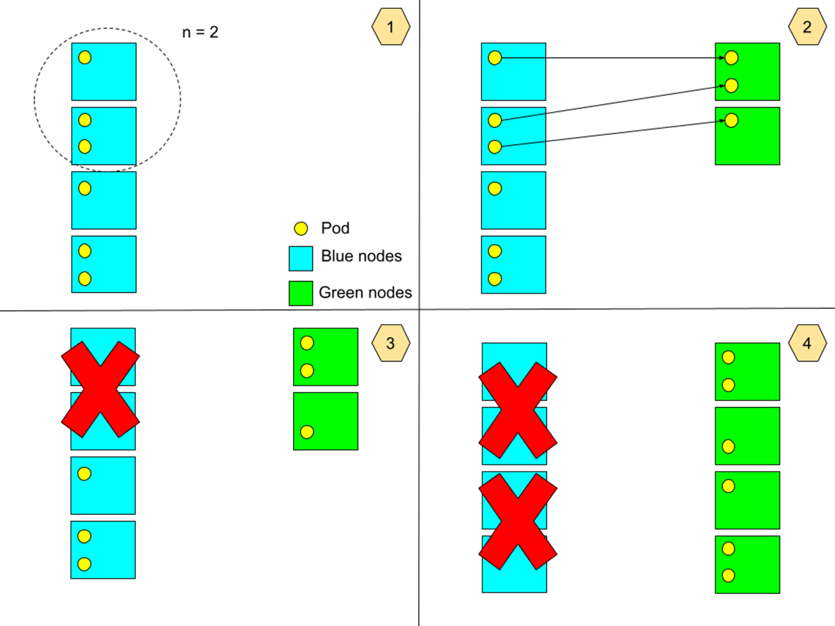
Node-pool-rotation operator: blue-green rolling upgrade
Old ASG / VMSS / MIG
New ASG / VMSS / MIG
Two cloud stacks (ASG/VMSS/MIG) mapping to the same logical node pool, rather than trying to do a surge upgrade within one stack. Enables reliable rollbacks.
Gradually replaces old nodes in small batches
Tunable batch size allows us to control the speed of node upgrades
Old nodes
New nodes
Old ASG / VMSS / MIG scaled down to 0 but not deleted

Slide 22
Node-pool-rotation operator
Acts as a coordinator to gradually move the state of a node pool towards the goal state where all nodes have been upgraded.
If it can’t make any progress for X hours, or encountered unrecoverable errors, or detects the cluster is unhealthy, then alert.
Node-pool-rotation CR: we need all nodes in a node pool to be running this configuration
Watch / list all nodes in the the node pool
Replace old nodes with new nodes in small batches
Perform some health checks
Requeue and retry if anything fails
Patch node-pool-capacity CR to add n new nodes
Create node-drain CRs to drain and cordon old nodes
Create node-termination CRs to kill these drained old nodes
Notes:
Runs the “blue-green rolling upgrade” algorithm

Slide 23
Key differences from cloud-managed k8s’ node auto-upgrade features
Works consistently with the same behavior across all 3 clouds and 4 Kubernetes flavors (both cloud- and self-managed)
Old nodes’ cloud stacks (ASG, VMSS, MIG) are kept for a while -> reliable rollbacks
In cloud-managed node auto-upgrades, a rollback may fail if a node group is in a broken state, causing prolonged disruptions
Supports customizing upgrade behavior for each workload based on application-level signals
Can continuously replace non-conformant nodes
E.g. nodes running an old configuration created by mistake

Slide 24
New SOP to upgrade nodes with operators
Upgrade orchestrator (Simple Spinnaker pipeline / Argo workflow / custom service)
Forget about the upgrades unless alerted
1 click
Done
Engineer
Patch
Alert when there’s a problem
Node-pool-rotation CRs in all clusters
Operators in each cluster doing the actual work to upgrade nodes
Triggering reconciliations
Automatically makes progress if a blocker is resolved
E.g. A problem on the Cloud Provider side causes node pool scale-up to fail
Rollback: just trigger an “upgrade” back to the old configuration

Slide 25
Results
Fully automated the upgrade process
Eliminated > 99% of workload outages caused by the upgrade process compared to the first version of automation using CICD
Consistently upgrading 1000+ clusters, XXX,000 nodes every month since late 2022 while the Kubernetes fleet scaled 5x
Using it to roll out most infrastructure changes
Can easily onboard new workloads that are protected during upgrades with the flexibility of the node-drain operator’s contract with workloads
Company blogpost with more details: https://www.databricks.com/blog/scalable-kubernetes-upgrade-using-operators

Slide 26
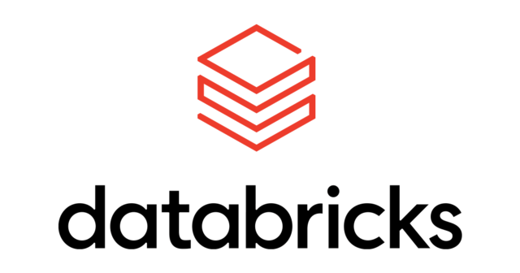
We’re hiring! https://www.databricks.com/company/careers/open-positions
https://www.linkedin.com/in/ziyuan-chen/

Slide 27

Q&A
Please scan the QR code above to leave feedback on this session

