Slide 2
Cash App's Journey Into a Multi-Cluster Ecosystem
Rachel Sheikh
Block [Cash App] - Platform Engineer

Slide 3
Cash App Kubernetes
Before Multi-Cluster
After Multi-Cluster
Clusters
Nodes
Clusters
Nodes
6
4,600
12
4,000
Cores
Services
Cores
Services
49,000
500
55,000
500
RAM
Disk
RAM
Disk
201 Gi
440 Ti
319 Gi
560 Ti

Slide 4
Why Multi-Cluster?
Removing a single point of failure
Platform Resiliency
Opening up new operational opportunities
Reducing per-cluster resource scope

Slide 5
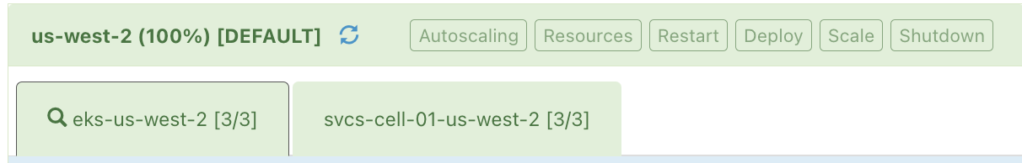
Multi-Cluster Challenges
Keeping service resources, like secrets, synced across clusters
Incremental traffic shifting/distribution, both in AWS and Square DC
Operating double the number of clusters without doubling effort
Providing service owners with an informed abstraction

Slide 6
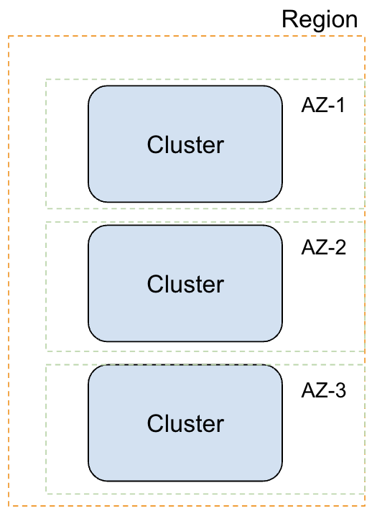
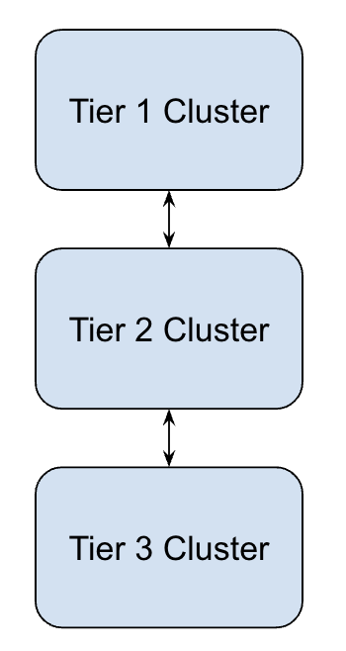
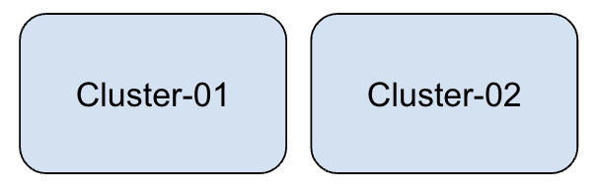
Types of Multi-Cluster we considered
Tiered Cluster
AZ Clusters
Clone Clusters
Notes:
Liam - we might be doing az clusters in 2025, i should look into this
Tiering - scaling/sharding, can lose if another cluster dies
Clone - low effort to get what we wanted, but not the final destination - explain more about “why”
AZ - potential next evolution

Slide 7







Rethinking how we Provision
Composable IaC modules
Simple node group orchestration
Runbooks & coordination sheets
Defining a cluster’s state:
Init
Gateway
Partial
Steady
Notes:
Now that we’re entering into a Multi-Cluster world, we need to be able to support more rapid and consistent cluster provisioning than we had before. We need runbooks, processes, and component overviews to ensure that we don’t miss something along the way that causes more headache to undo

Slide 8
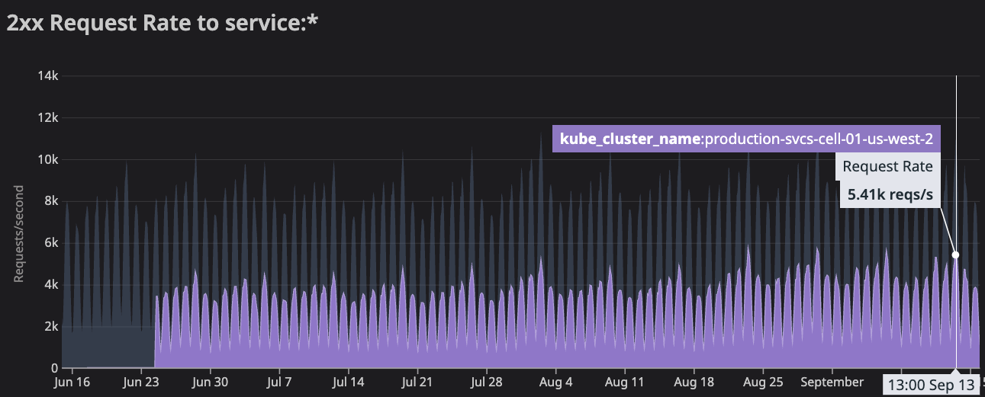
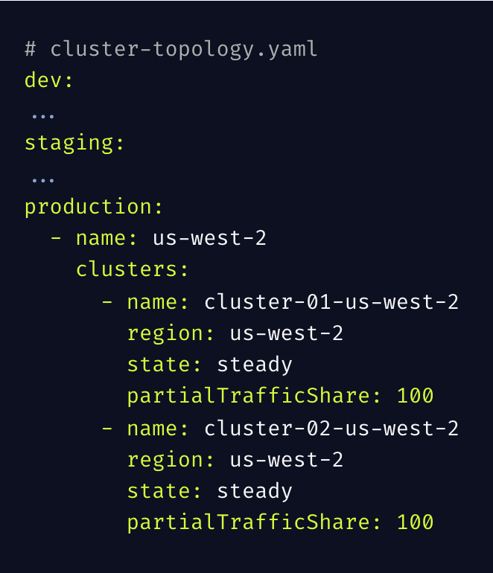


Getting our tooling right
Batch scripts for mirroring resource state:
Deployments
Secrets
Configmaps
Defining a global cluster topology source
Leveraging namespace scoped resources
Creating observability resources
External Secrets Operator
Notes:
Liam - mention istio in the setup to give clarity to virtualservice

Slide 9
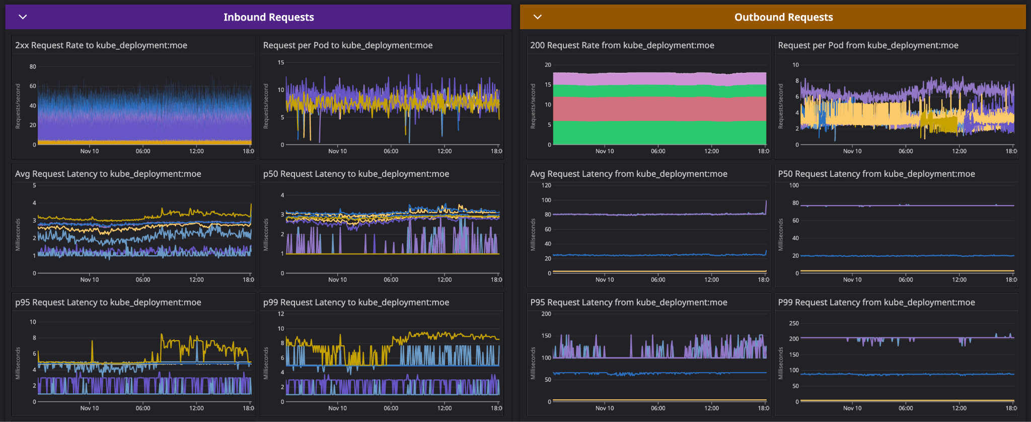
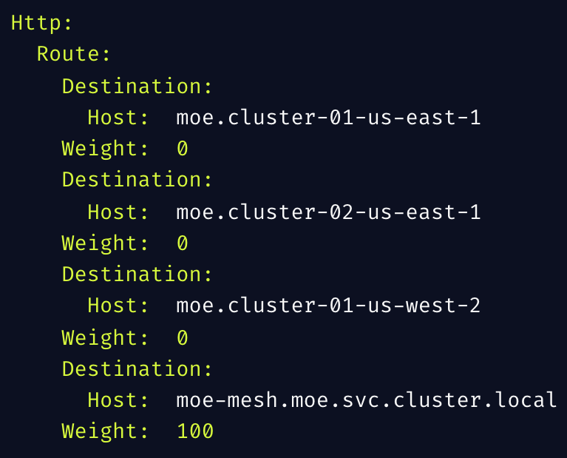
The flexibility of Istio’s VirtualService
Enables per-cluster service traffic weights
New Destination = New regional cluster
Weight across destinations = 100
Simplifies incremental traffic shifting
Exposes useful traffic telemetry metrics
Inbound / Outbound request metrics
Request spread across clusters
Notes:
Be more technical here
animate

Slide 10
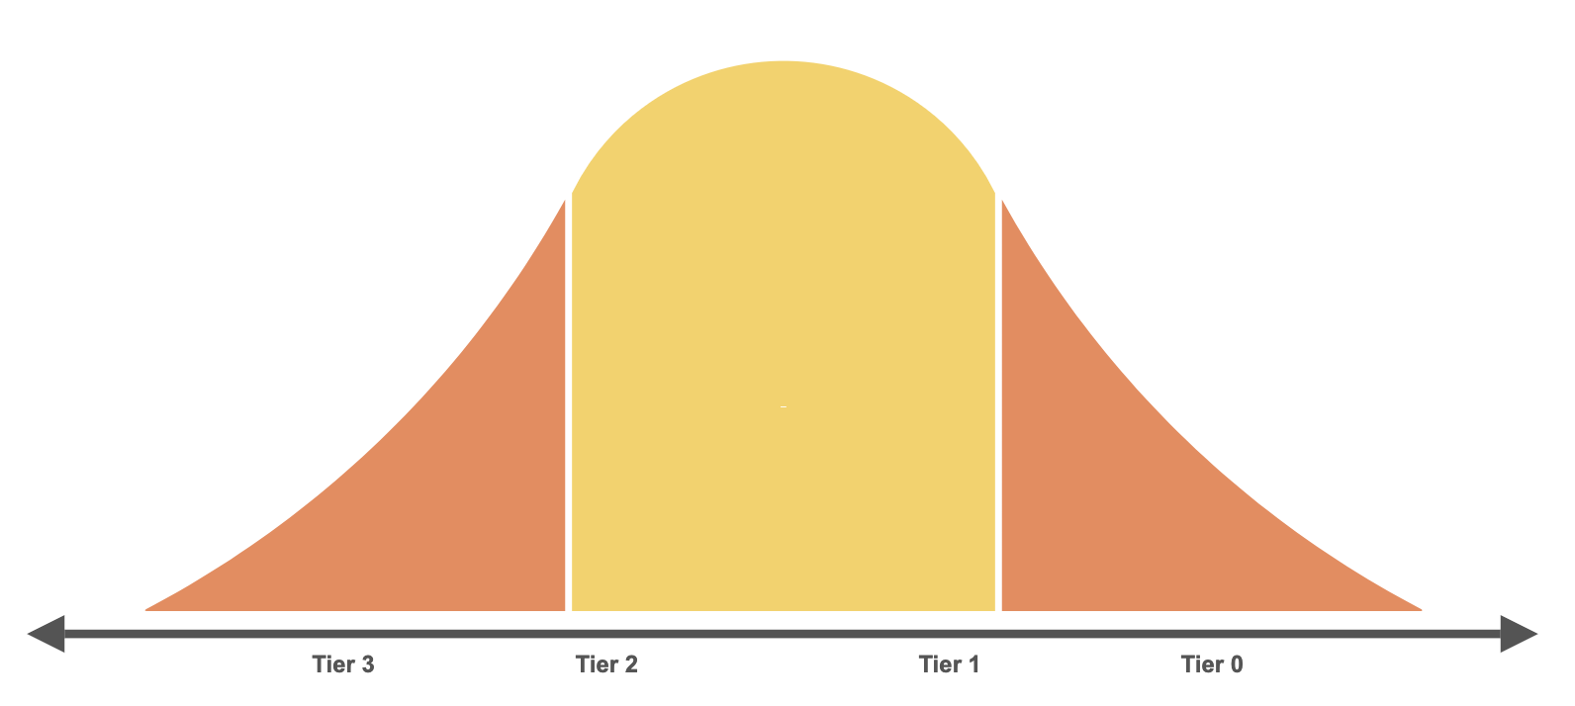
Tier partitioning our migrations
Tier 0
Four 9’s+
SEV 0
Tier 1
Three 9’s
<= SEV 0 / 1
Solidifying our process with non-critical services
Service owners define tier
Per-tier monitor requirements
Ideally, a bell curve of service distribution
Tier 2
Two 9’s+
<= SEV 2
Tier 3
< Two 9’s
<= SEV 3
Notes:
Noemie - more diagrams, etc
Fix boxes to use left most custom blue
Having service owners provide their own tiering insights (service a is highly critical and can’t suffer more than several of minutes of downtime, service b is just a background worker service that can catch back up if it experiences downtime) to help us step through changes slowly and safely

Slide 11
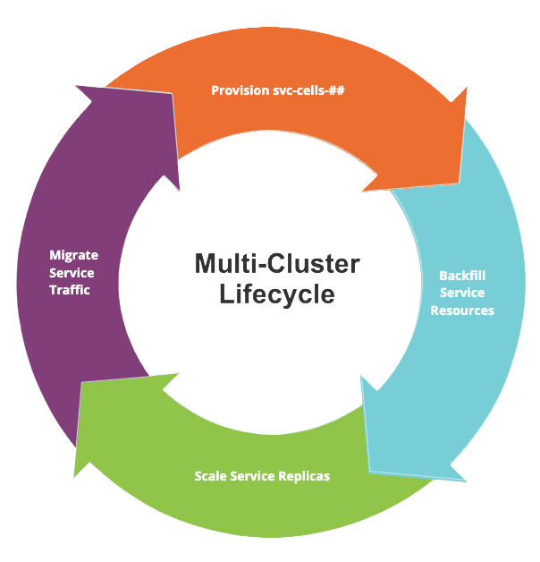
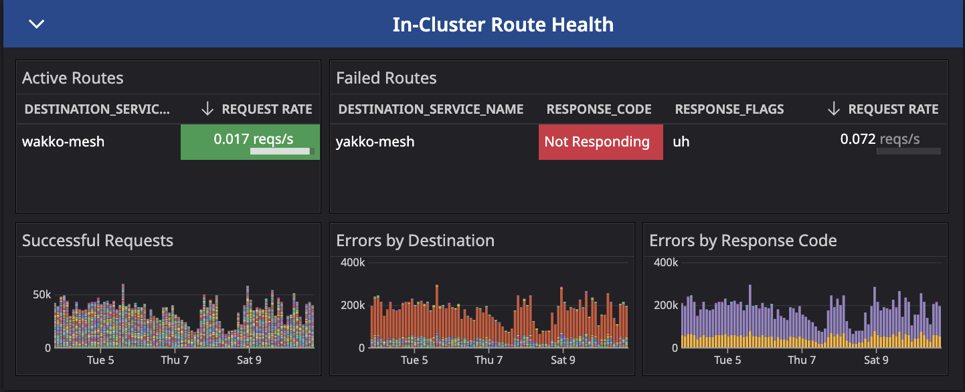
A zero-downtime migration
Service owner communications
Guardrails - Keda / Kuberhealthy / Kyverno
Observability:
Deployment errors
Route health
Request rates
Notes:
Noemie - maybe screenshot a dashboard to show metrics we viewed as important here

Slide 12
Pain points on the way to Multi-Cluster
Backfill tooling inconsistencies
.keep secrets / Deployment mounts
Continuing to keep track of cluster scope throughout migration
Tracking newly created services
resource changes causing desync between clusters
The “Weird” services
Unique service requirements (single-pod, requires resources from other services to be present, etc)
Notes:
Give an example - secret backfill inconsistency
Apf config missing
Working on a platform that’s still missing * secret could be related
Keeping scope of the world relevant throughout the migration as more resources/services are deployed
Hard to know everything in your cluster unless you were already tracking all of your services and their components somewhere, not all services are migration friendly (business requirements, relying on the presence of another resource in the namespace, stateless service configuration, overprovisioning during migration vs connection limits for resources)

Slide 13
Money, btw 💸
Intentionally keeping clusters at 100% until migration completion
Simplified fallback story via VirtualService weights if-needed
After coordinating and performing downscale, costs fell to ~even to single cluster
Operating n number of services has a baseline cost
Adding new clusters doesn’t significantly impact our spend beyond baseline cost
Important to consider migration timeline, business needs, etc when making this choice
Notes:
Reframe wording - we knew it was going to be 2x spend, “quickly pivot” sounds like it was a mistake
We purposefully didn’t scale down cluster A as we went, in order to have a simple undo option if anything went haywire in cluster B
This means at the end of the migration, we had roughly 2x’d cloud spend to operate these clusters
We needed to quickly pivot to rightsizing our clusters in a coordinated manner

Slide 14
Scaling down post-migration
Spinning up another batch tool
Fetch Autoscaling config (Keda / HPA / disabled)
Set replica floor to match # of AZs in a region
Modify a range of services based on overall traffic share
Open source
Karpenter compaction improvements
VPA resource recommender
Notes:
Now that we made it to the end of our migration, we’re able to leverage a combination of some simple scripting and deployment labels to create a powerful tool that can:
Define our replica floor to correspond with at least the number of AZs we use in a region
Gracefully modify HPAs and autoscaling-disabled services to work with half the pods as single cluster
We’re also looking into new improvements in Karpenter to see how we can better optimise our node usage via compaction

Slide 15
Platform vs Product Story
Platform Engineers
Scalability <> maintainability
Cloud spend
Operational automation
Product Engineers
Abstract k8s away
Business logic focused
Deployment simplicity

Slide 16
How we kept the Product story simple
Comms blasts to keep service owners in the loop
Power of batch tooling
Providing an FAQ and project channel for context sharing
No Incidents!!!

Slide 17
Improving the Platform story
Infra pipelines
Infra backup
Time to new cluster
GitOps
Game Days (FIS, chaos monkey, etc)

Slide 18
Looking ahead - cluster operations
Automating / streamlining cluster 0->1 and 1->0
Exploring Crossplane to compose multi-stage cluster provisioning workflows
Implementing tooling to simplify batch cluster tasks
Tooling: multi-cluster CLIs, upgrade cadences, and resource syncing
Practices: ArgoCD Gitops, IaC Pipelines
Expanding guardrails
More Kyverno policies, tested with Chainsaw
More Kuberhealthy checks
Notes:
We need to start treating clusters as cattle. As our scope increases with more clusters being added to our platform, we need to identify automations, optimisations, and guardrails that enable us to continue to be productive maintaining and improving these clusters. We’re exploring new cli tooling, guardrailing resources with Kyverno / Kuberhealthy / Chainsaw, and looking around the ecosystem to identify the easy optimisations to our current provisioning and operational workloads when it comes to dealing with k8s

Slide 19

Looking ahead - Game Days
Leveraging AWS Fault Injection Simulator (FIS)
Currently we can evaluate:
How fast can we recover from a datastore / AZ outage?
We want to extend this to cover:
How fast can we fully restore a cluster from scratch?
All components provisioned and initialised
All services serving traffic (restored via Gitops vs sync from a healthy cluster)
What’s the manual effort / what can we automate here?
Notes:
This brings us back to where we started. We have this concept of a Game Day, where we use tools like FIS, to purposefully take down resources in our cluster and cloud environment to identify gaps in our operational resiliency. We are planning on leveraging all of the work we’ve done with Multi-Cluster, at both the split traffic and provisioning improvements, in order to see how quickly can we bring a cluster back, with all of its services, after killing one

Slide 20


Q&A

