Slide 1
TO BE DELETED
Elevating Kubeflow Spark Operator's Future: Best Practices and Enhancements - Vara Bonthu, AWS & Chaoran Yu, Apple Inc
Click here to remove from My Schedule.
Thursday November 14, 2024 4:30pm - 5:05pm MST
Salt Palace | Level 1 | Grand Ballroom A
As Kubernetes becomes the leading platform for data processing, mastering the deployment and management of Apache Spark on it is crucial.
In this presentation, you'll hear from the new maintainers of the Kubeflow Spark Operator project, who will provide an overview of scaling the Spark Operator on Kubernetes, emphasizing best practices to optimize performance and efficiency.
Attendees will explore the migration of the Spark Operator repository from Google to Kubeflow, gaining insights into the roadmap and key takeaways.
The session will cover strategies for achieving multi-tenancy, managing multiple Spark Operator instances for large-scale deployments, ensuring robust security, and performing seamless upgrades.
Participants will learn advanced techniques to maximize their Spark on Kubernetes deployments, making their data processing pipelines more efficient, reliable, and secure.
This talk is for Data, ML, DevOps, and MLOps pros to enhance their Spark on Kubernetes skills.
Notes:
This is the Abstract for this talk and will ensure our talk covers all the points

Slide 2
Elevating Kubeflow Spark Operator
Best Practices and Enhancements
Chaoran Yu
Tech Lead, Solutions Engineering
Spark Operator Maintainer
Apple
Vara Bonthu
Principal OSS Specialist SA
Spark Operator Maintainer
AWS
Notes:
Vara and Chaoran: 3 Mins
Hi everyone! Thank you for joining us. I’m Vara Bonthu from AWS, and I’m here with Chaoran Yu from Apple. Today, we’re excited to talk about the future of the Kubeflow Spark Operator and share some best practices and enhancements. Let’s dive right in!"

Slide 3
Agenda
Introduction to Spark Operator on Kubernetes
Migration to Kubeflow: The Story Behind the Shift
New Features and Enhancements
Best Practices for Using Spark Operator
Join the Kubeflow Community
Notes:
Vara: 2 mins
"We'll cover the basics of Spark Operator, its history,
some best practices, and a quick look at its internals.
We'll wrap up with a call to action for joining the Kubeflow community.
Let’s get started with a quick introduction to Spark Operator.

Slide 4
Introduction to Spark Operator
Kubernetes Operator for Spark
Simplifies management of Spark apps on Kubernetes
Automates deployment, scaling, and monitoring
Optimized for data processing, batch jobs, streaming and ML
⭐ 2.8k Stars
🍴 1.4k Forks
🏢 45 Companies Using
Notes:
Vara: 2 mins
So, what is the Spark Operator? It’s a Kubernetes operator designed to make running Spark jobs easy and scalable.
With Spark Operator, users can define Spark jobs in a simple YAML file.
This file includes all the configurations, and the Operator handles the job’s entire lifecycle.
Spark itself is great for data processing—batch jobs, streaming analytics, and it’s even popular for machine learning.
Right now, Spark Operator is used by around 45 companies, though we think the real number is much higher.
It also has 2.8k stars on GitHub, showing its popularity in the community.

Slide 5
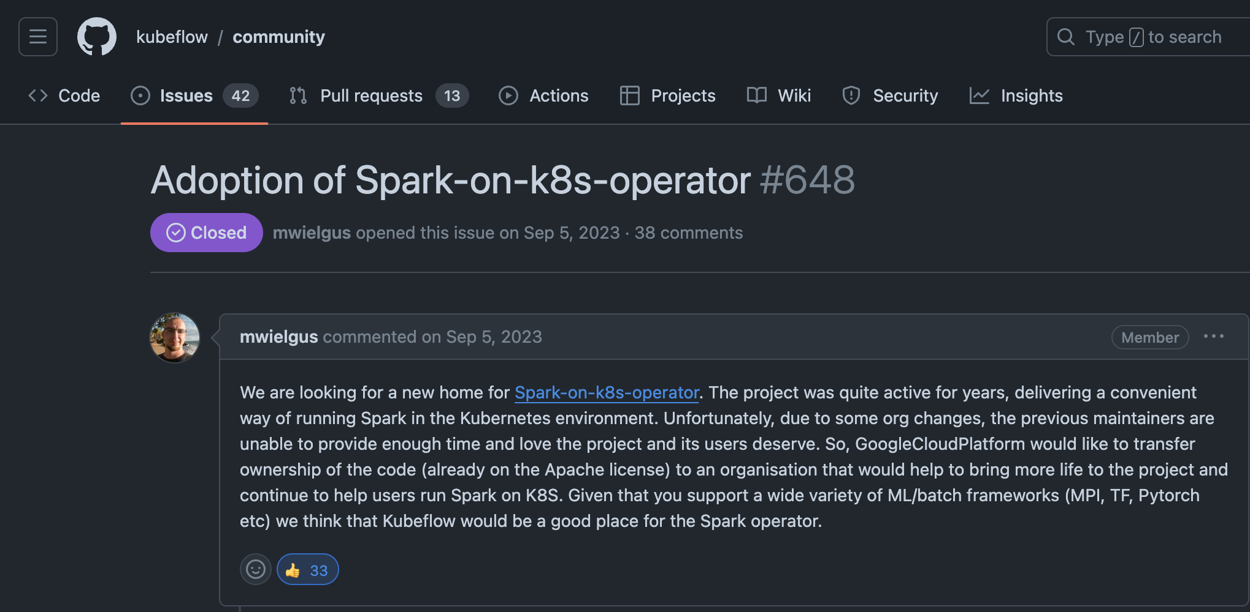

Spark Operator Migration to Kubeflow
Issue#648
QR Code
Notes:
- Vara: 1 minute
Now, let’s talk a bit about the backstory of the Spark Operator.
The Spark Operator was originally developed and maintained by the Google Cloud team.
But after a while, Google faced challenges maintaining it alone. That’s when AWS, Apple, and Google teamed up to move it to a new home in open source
Initially, we approached Apache Spark to host it, but they didn’t pick it up.

Slide 6
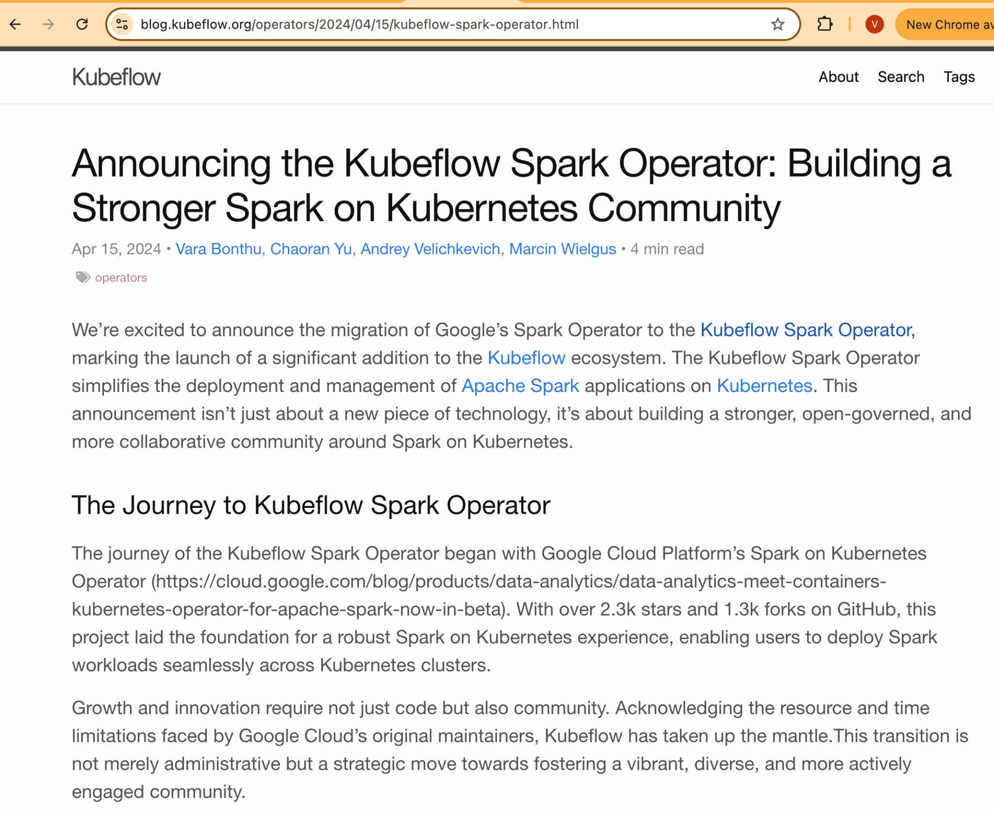

Announcing Kubeflow Spark Operator
Blog
QR Code
Notes:
Vara: 1 minute
Luckily, the Kubeflow community stepped up, and now they’re hosting and maintaining it.
This sparked a lot of interest from the community, and since then, the project has gained more contributors and maintainers.

Slide 7
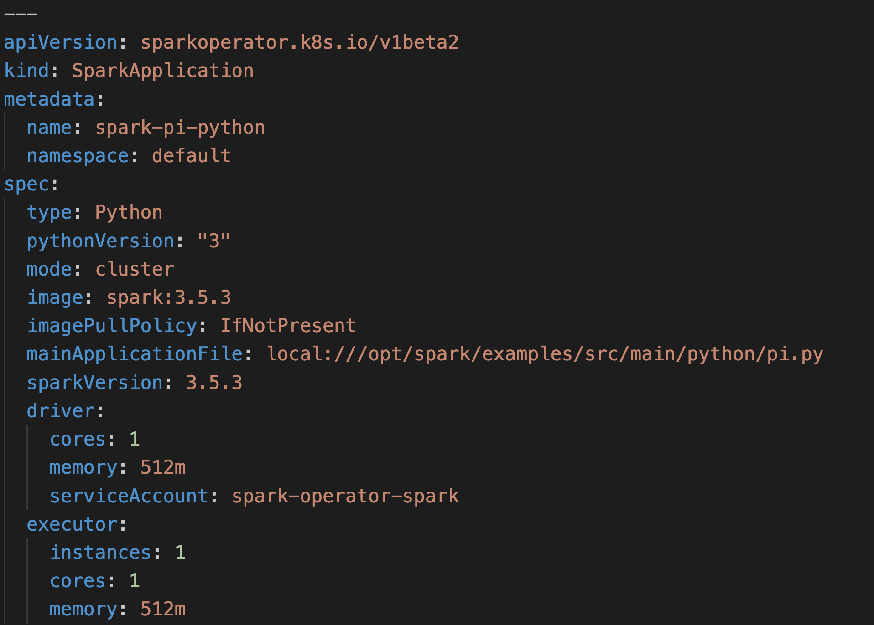
Spark Operator Manifest
Notes:
Vara: 1 minute
Alright, let's take a quick look at what a Spark Operator job definition actually looks like
Here’s a basic YAML manifest for a Spark job. With just a few lines, we define the driver and executor specs, making deployment on Kubernetes straightforward

Slide 8
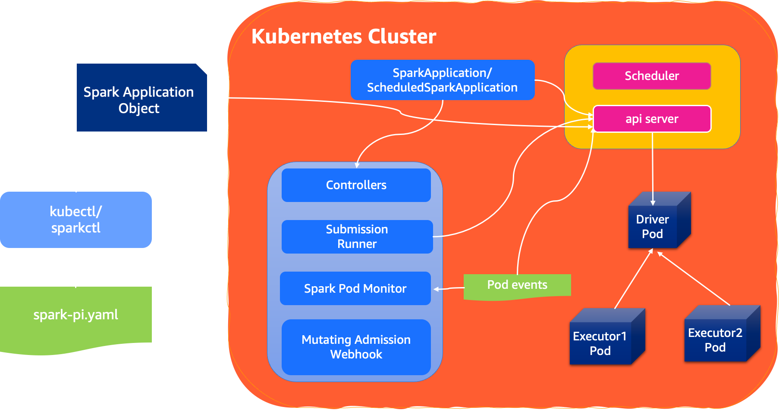
Spark Operator Internals
Notes:
Vara: 2 minutes
Now, let's look under the hood at the components that make the Spark Operator work
Spark Operator has two main custom resources: SparkApplication and ScheduledApplication. These allow you to define and schedule Spark jobs in Kubernetes.
There are four key components that make this all work:
Controllers: Manages job lifecycle, ensuring Spark jobs start, run, and terminate correctly.
Submission Runner: Executes spark-submit for job submission.
Spark Pod Monitor: Observes Spark pods, handling restarts or resubmissions if necessary.
Mutating Admission Webhook: Customizes Spark pods by injecting additional configurations, such as volumes or affinity rules, to meet specific environment needs.
End to End Flow:
1/ User creates a SparkApplication YAML manifest, specifying details such as the image, driver, executor settings, and any Spark configurations needed for the job.
2/ The Controller then processes this new job definition, validating the configurations and preparing to submit the job.
3/ Before the job starts, the Mutating Admission Webhook intercepts the SparkApplication request. It can modify the job definition by adding any required configurations, such as volume mounts, environment variables, or node affinity policies, based on predefined policies.
4/ After the job definition is finalized, the Submission Runner component is responsible for running the spark-submit command.
4.1/ It translates the job’s configurations from the SparkApplication YAML into the equivalent spark-submit parameters.
4.2/ The Submission Runner then submits the job to Kubernetes, launching the Driver Pod (which orchestrates the job) and Executor Pods (which handle the actual computations).
5/ During job execution, the Spark Pod Monitor continuously observes the health of both the Driver and Executor Pods.
6/ Once the job is complete, the Spark Operator detects the termination status of the SparkApplication.Spark Operator then cleans up resources associated with the job, like the Driver and Executor Pods, freeing up cluster resources.

Slide 9
New Feature and Enhancements
Container registry and doc website migrated to Kubeflow
Rewrite using controller-runtime
Pod Template support
YuniKorn batch plugin support
Security enhancements
Multi-tenancy
Metrics and monitoring
Notes:
Chaoran - 10 minutes
V2.0 refactoring
Benefits
V2.1 support for Pod Templates or Pod templates
Tighten the security
YuniKorn as additional batch scheduler support

Slide 10
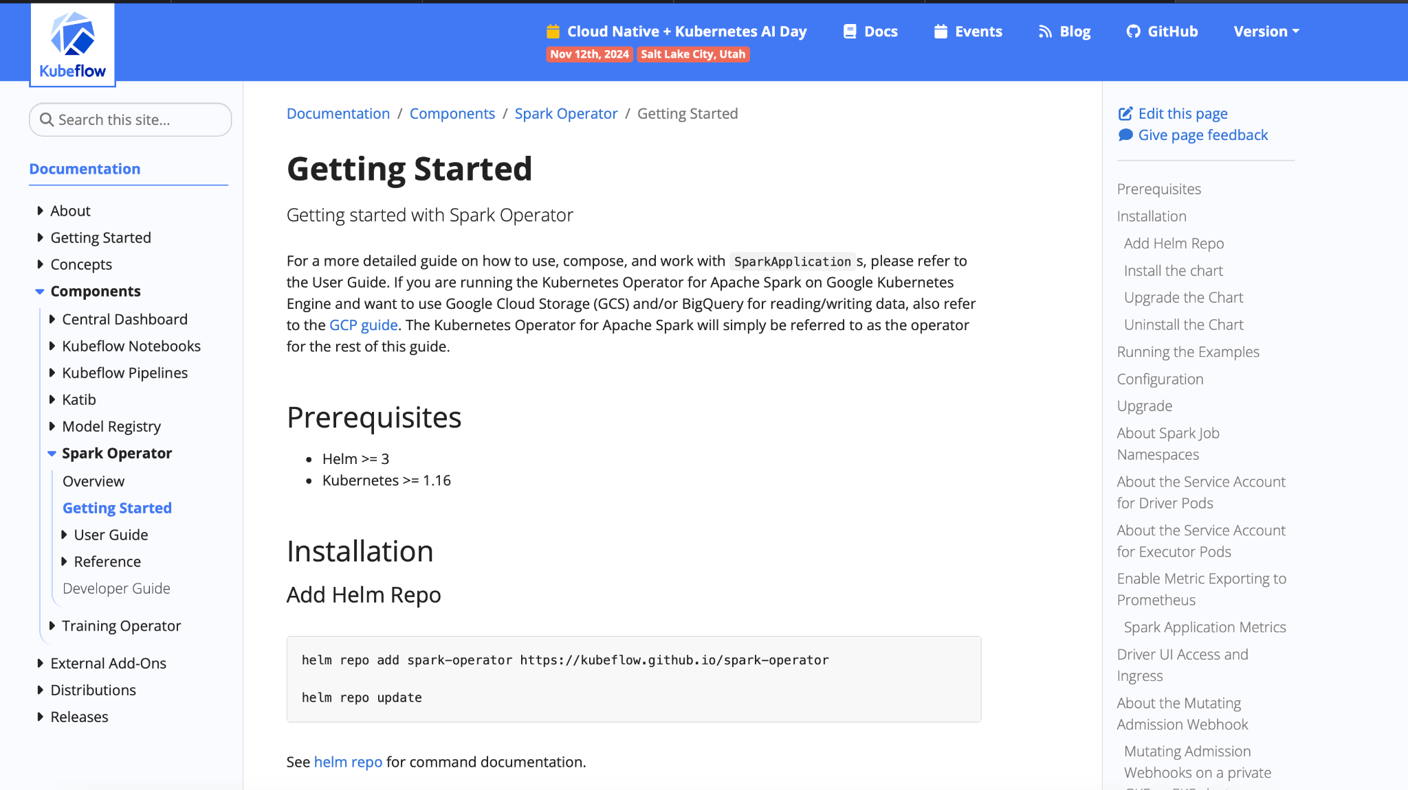
Container Registry and Doc Website Migration
Container registry migrated to Kubeflow (docker.io/kubeflow/spark-operator)
New documentation website hosted under Kubeflow
Notes:
Chaoran
V2.0 refactoring
Benefits
V2.1 support for Pod Templates or Pod templates
Tighten the security
YuniKorn as additional batch scheduler support

Slide 11
Controller-Runtime Rewrite
v2.0 https://github.com/kubeflow/spark-operator/pull/2072
Original implementation based on client-go
Low-level toolings required the operator to handle
CRUD operations on CRD objects
Management of informers, workqueues and listers
Controller-Runtime provides above features out of the box
KubeBuilder (https://github.com/kubernetes-sigs/kubebuilder) provides convenient scaffolding to quickly ramp up a new operator code base
Notes:
Chaoran
V2.0 refactoring
Benefits
V2.1 support for Pod Templates or Pod templates
Tighten the security
YuniKorn as additional batch scheduler support

Slide 12
Pod Template Support
v2.0 https://github.com/kubeflow/spark-operator/pull/2141
Operator has relied on webhook for the customizing spark pods (e.g. adding volumes, configmaps, init containers, node selectors etc)
Webhook proves to be challenging to operate and maintain
Pod template provides a Spark-native way of customizing pods that allows for more flexibility and lower maintenance
Notes:
Chaoran
V2.0 refactoring
Benefits
V2.1 support for Pod Templates or Pod templates
Tighten the security
YuniKorn as additional batch scheduler support
Code snippet

Slide 13
Apache YuniKorn scheduler support
v2.0 https://github.com/kubeflow/spark-operator/issues/2098
Apache YuniKorn is a resource scheduler that offers native support to batch workloads
Spark Operator already worked with YuniKorn for basic scheduling support
Now supports YuniKorn when its admission webhook is disabled
Also added support for gang scheduling
Notes:
Chaoran
V2.0 refactoring
Benefits
V2.1 support for Pod Templates or Pod templates
Tighten the security
YuniKorn as additional batch scheduler support

Slide 14
Security Enhancements
pull/2265: Updated default container security context
pull/2298: Allow setting automountServiceAccountToken
pull/2282: Allow controller to run with securityContext:readOnlyRootfilesystem:true
Notes:
Chaoran
V2.0 refactoring
Benefits
V2.1 support for Pod Templates or Pod templates
Tighten the security
YuniKorn as additional batch scheduler support

Slide 15
Spark Operator Best Practices
Multitenancy
A single operator deployment watches SparkApps in all namespaces when spark.jobNamespaces is empty
Consider having multiple operator deployments
Allows for tenant isolation
Flexibility with resource configuration
Notes:
Charaon - 5 mins

Slide 16
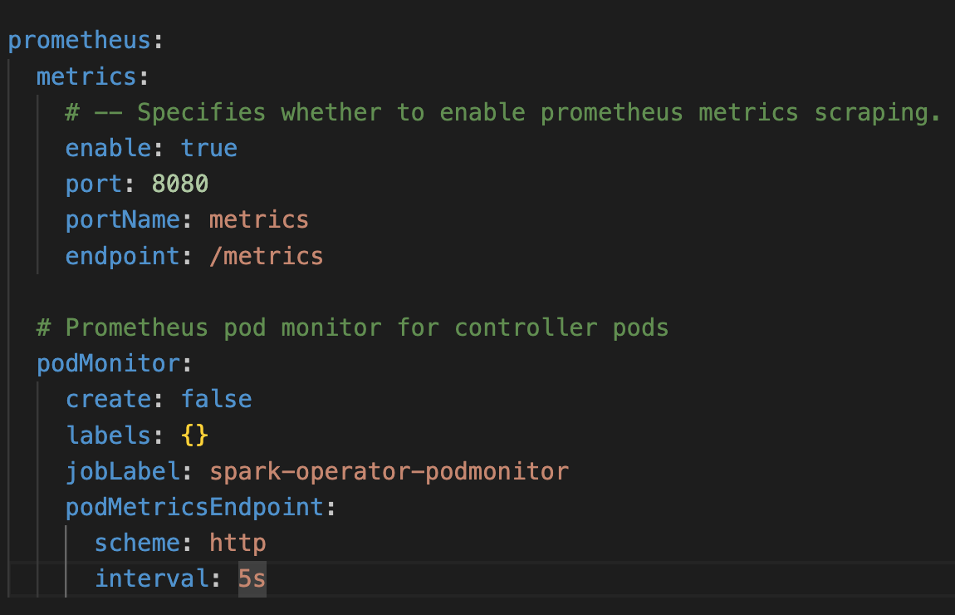
Observability - Spark Operator Metrics
Rich metrics for application monitoring
spark_application_count
spark_application_running_count
Operator itself needs monitoring too
spark_application_start_latency_seconds
Notes:
Vara - >1 Minute

Slide 17
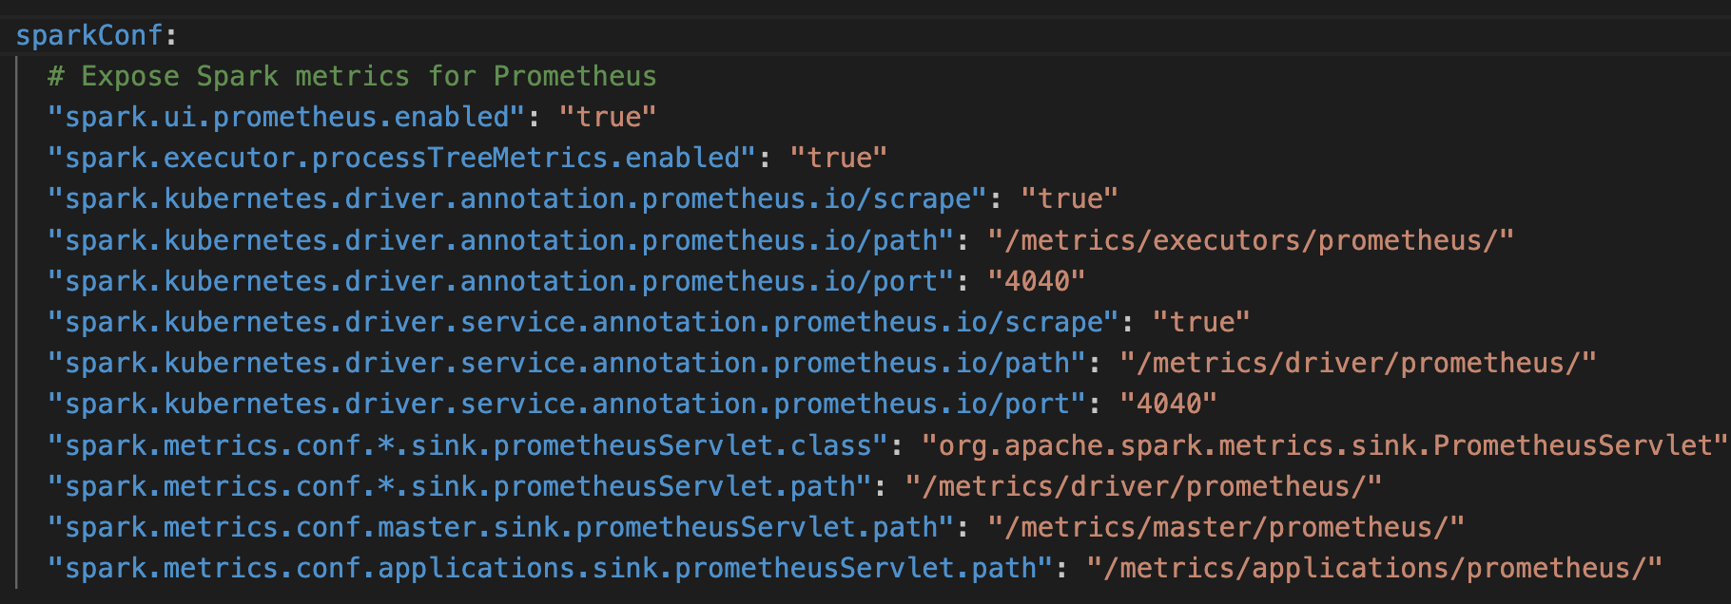
Observability - Spark Metrics
Notes:
Vara - >1 Minute
To monitor Spark application metrics in real time, Spark exposes them to Prometheus.
PrometheusServlet class as the sink for our Spark metrics. This means metrics are made available through specific paths, like /metrics/driver/prometheus/ for the driver, and similar paths for executors and applications.
With this configuration, Prometheus can scrape these metrics... giving us real-time visibility into important performance metrics like CPU usage, memory consumption, and more.

Slide 18
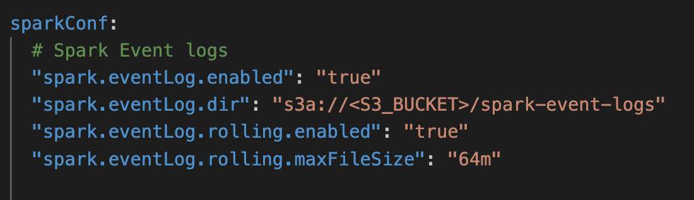
Spark Event Logs
Spark History Server
Notes:
Vara - >1 Minute
To monitor Spark jobs using the Spark History Server, we first need to enable Spark Event Logging... and set it up to write logs to an external storage layer.
This configuration is essential... because it allows the History Server to access those logs... and display detailed information about each job’s execution.

Slide 19


Join the Kubeflow community
Kubeflow Spark Operator
Github
Join CNCF Slack Channel for
Kubeflow Spark Operator
Notes:
Vara & Chaoran - 1 Minute

Slide 20
Q&A
Notes:
Chaoran and Vara - 3 to 4 mins

