Slide 1
The Node Tetris Rabbit Hole: why your binpacking is underperforming
Hannah Taub | Senior Engineer, Ethos Cost Efficiency

Slide 2




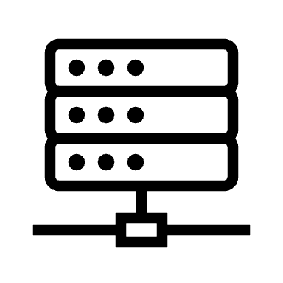



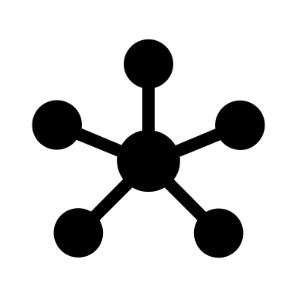
Introduction to Ethos
Adobe’s internal Kubernetes platform as a service
Multi-cloud, multi-region
Onboarding, deployment, integration testing, and monitoring
Both shared and dedicated clusters for different team needs
Different levels of guardrails for different client needs
Hundreds of clusters and thousands of nodes

Slide 3


Our Background
Tiny team with focus on cost efficiency
2020: only myself and my manager
2022+: slowly beginning to grow the team
Huge problem space
Unallocated space
Cost monitoring
Client resource management
Overhead spend reduction

Slide 4
Definitions
Client: an Adobe namespace owner running pods in our Kubernetes cluster(s)
Unallocated space: empty space on a Kubernetes node not reserved by any cluster resource
Pod disruption budget: Kubernetes object controlling how many pods with a certain label are allowed to be taken down at a time
Taint/toleration: pod and node properties that make tainted nodes only schedule pods with the corresponding toleration
Pod anti-affinity/topology spread: pod specifications controlling how many related pods can be on the same node

Slide 5
The Problem

Slide 6
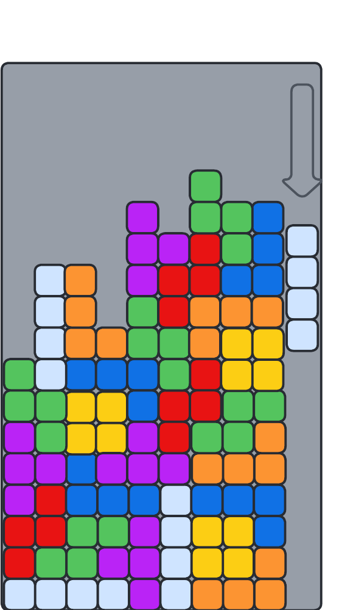
What Kubernetes clusters should look like
Nodes with a small and reasonably-even amount of empty space
Some variation expected, but overall unallocated stays within acceptable range
Maybe one or two nodes with extra empty space as pods are shuffled around the cluster

Slide 7
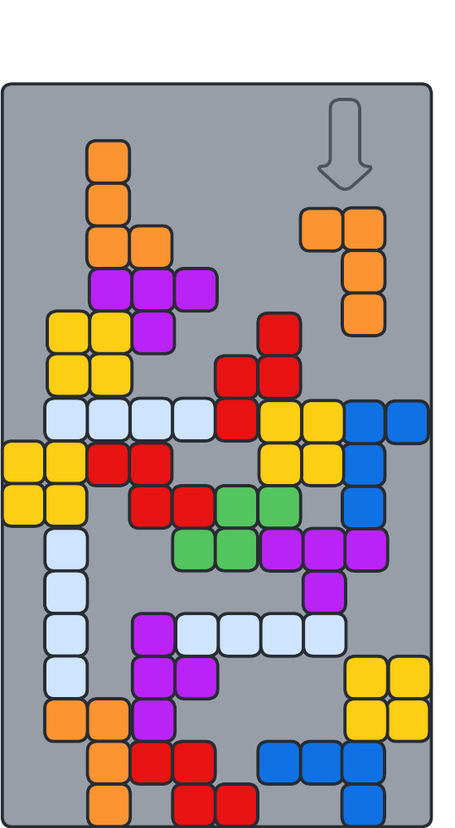
What our clusters looked like
Shared cluster chaos
Nodes that were more than half empty
An autoscaler that wasn’t properly consolidating nodes
A scheduler that spun up new nodes instead of packing pods onto old ones
Acceptable behavior for one or two small clusters, but financially unsustainable at our scale

Slide 8
The Rabbit Hole (The Investigation)

Slide 9
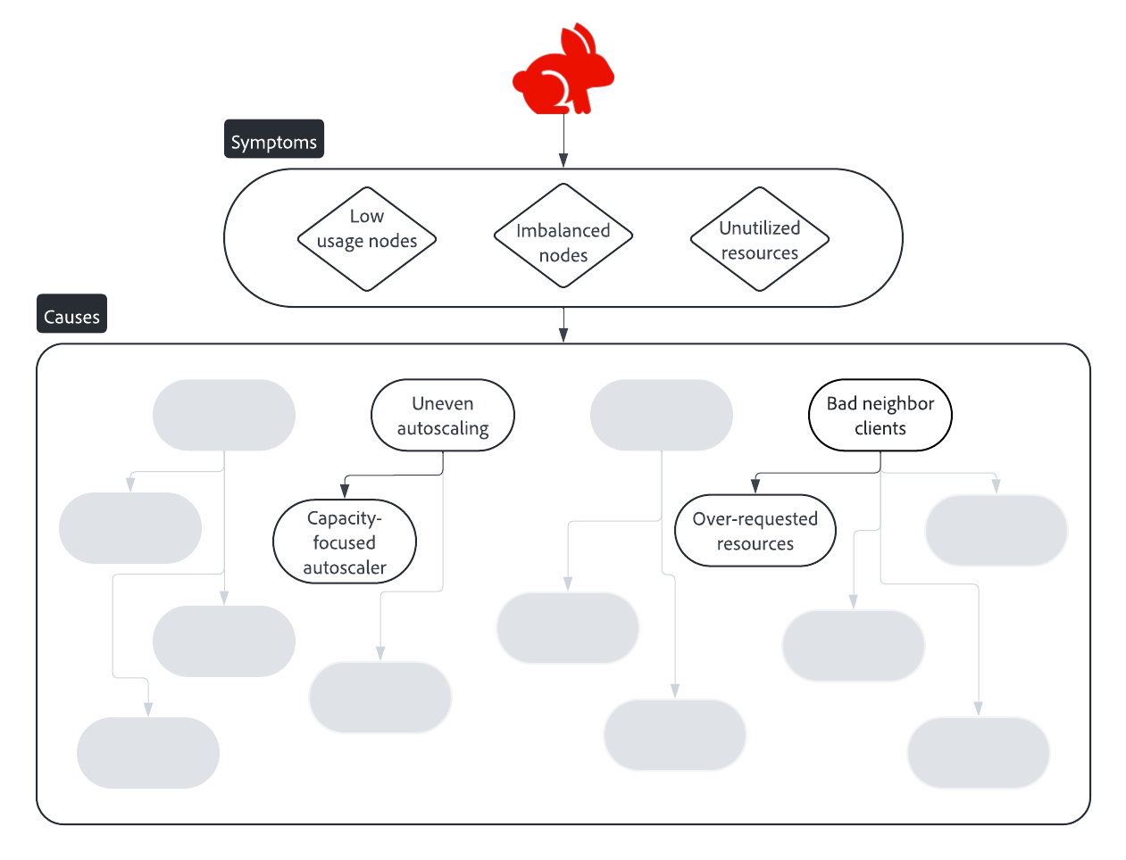
Full bleed image with red thread

Slide 10
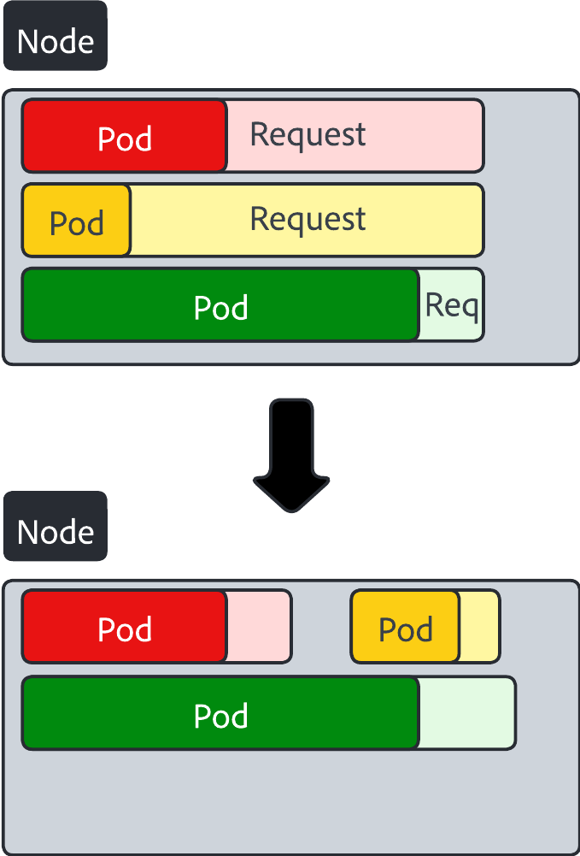
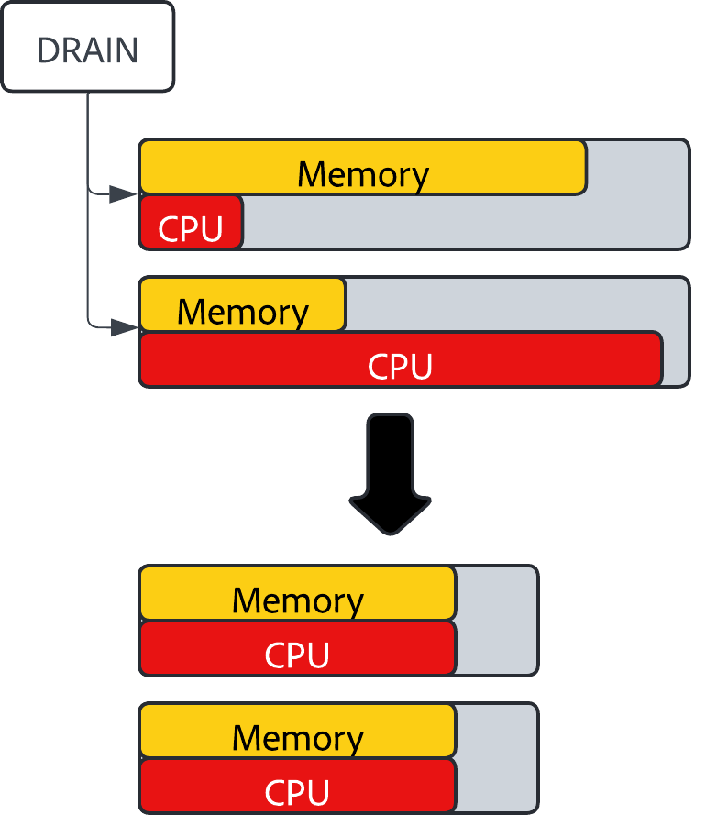
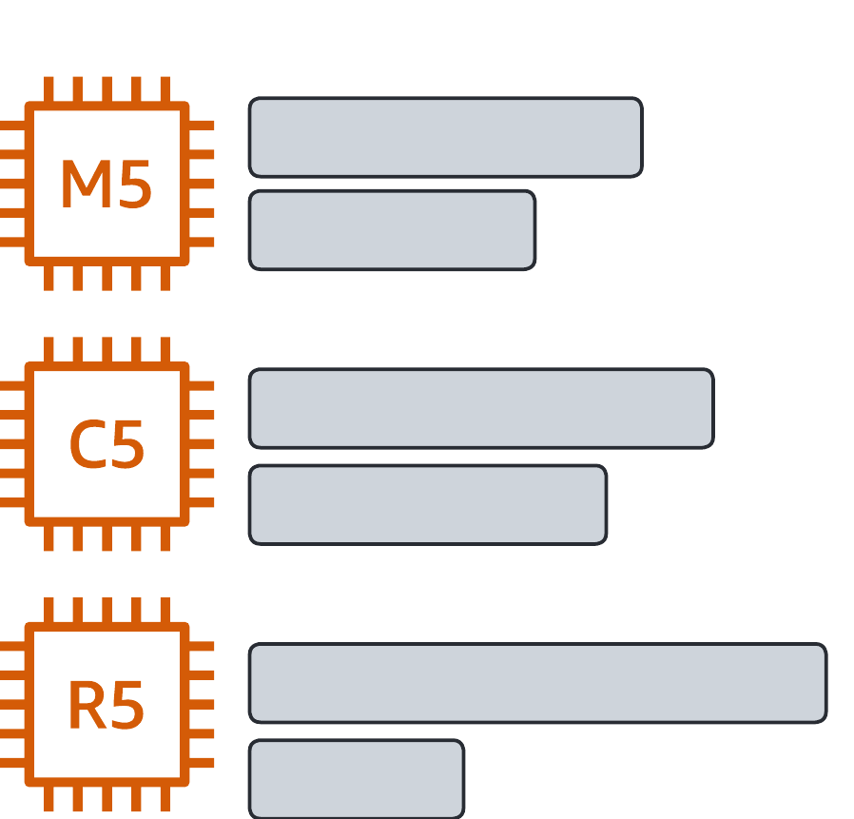
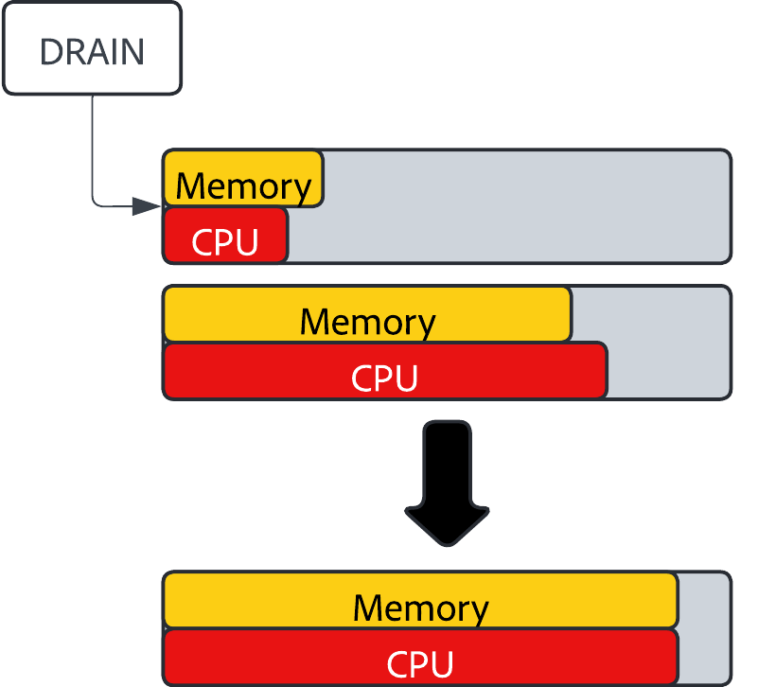
Platform Problems Need Platform Solutions
Drain and rebalance nodes
Look for nodes with >=30% discrepancy between CPU and memory and force drain them
Scheduler can then place pods on better node types
Drain low-usage nodes
Look for nodes that have less than 30% usage and force drain them
Scheduler can then place pods on existing nodes
Multi-tier node architecture
Different pools of nodes with different resource balances
Memory-optimized, CPU-optimized, GPUs, spot instances
Automatically adjust tenant resource requests
ARC (Automatic Resource Configuration)
Observe an application’s resource usage and set CPU/memory requests based on 95th percentile of usage

Slide 11
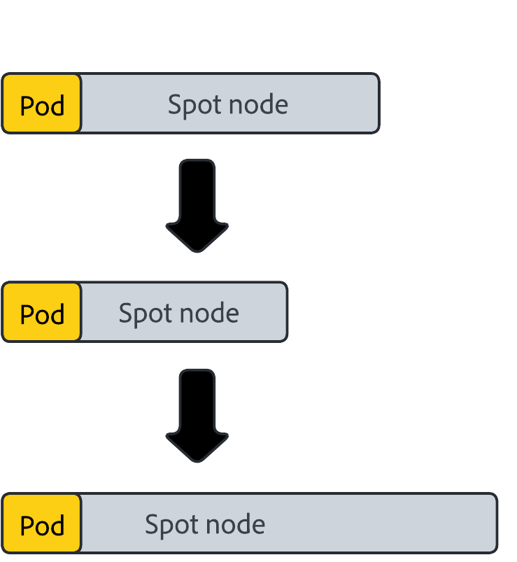
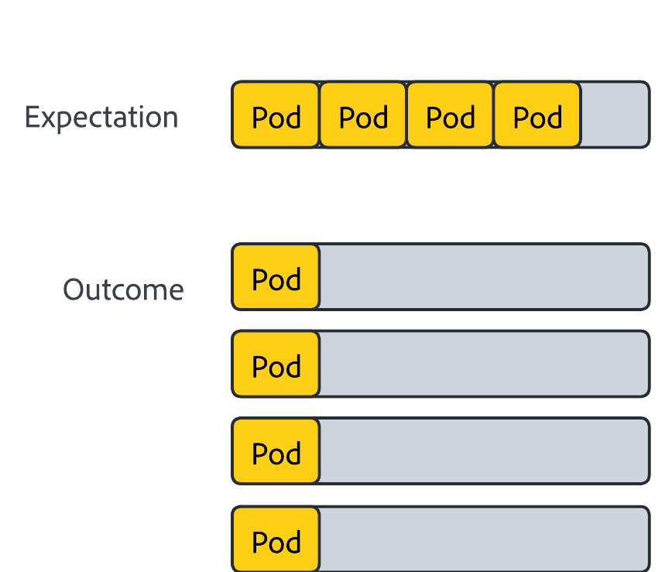
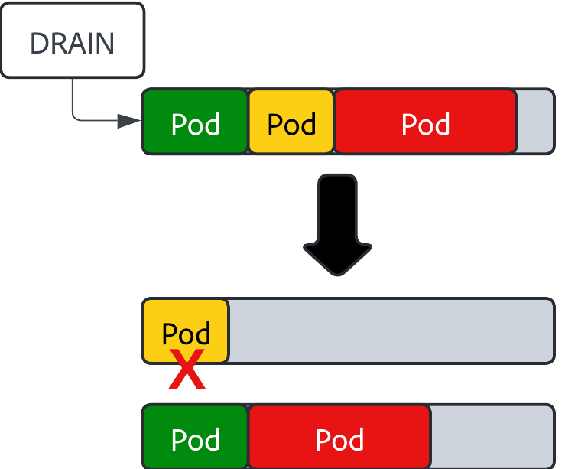
… Platform Solutions Cause Platform Problems
Scaled-down nodes pop right back up again
Topology spreads and anti-affinity configurations force node creation regardless of low binpacking
Force drains get blocked by PodDisruptionBudgets
PDBs allow few/no disruptions, making drains error or time out
Crashing services cause healthy PDBs to become unhealthy
Blocked drains stop most of the way through and create more low-usage, cordoned (“parked”) nodes
Some low usage node tiers run nearly empty
“Memory-optimized” tainted nodes underused and mostly empty
Spot instances are barely used, causing us to pay for empty space for 1 or 2 pods
Notes:
Note that ARC is a gem and one of our big successes, and that we’ve since moved all nodes to cri-o

Slide 12
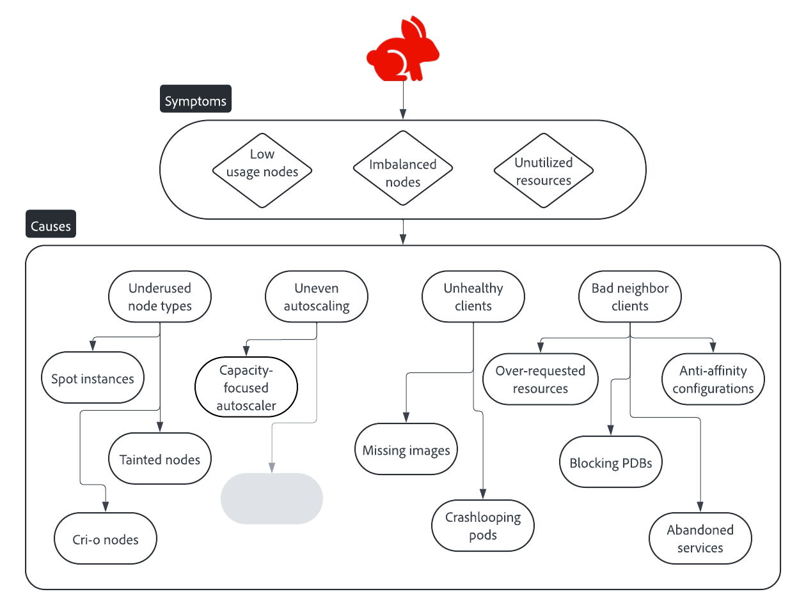
Full bleed image with red thread

Slide 13


Client Problems Need… Platform Solutions?
Mutate blocking PodDisruptionBudgets
Look for PDBs with disruptionsAllowed = 0
If no healthy pods, scale down completely and mutate PDB to allow 10% disruptions
If some healthy pods, add up to 10% allowed disruptions (for certain platform-managed apps)
Scale down broken and abandoned services
Kill services with all pods in CrashLoopBackOff or ImagePullBackOff
Scale down stage services with zero traffic over the past month

Slide 14

Uh-oh.

Slide 15

What happens when you ask engineers to let you change their existing stack?
Denial (“You’re not allowed to change this.”)
Anger (“We never had to do this before! We wouldn’t have migrated to your platform if we knew this was a requirement!”)
Bargaining (“We’re swamped and just don’t have the cycles to make these changes.”)
Do we force these changes through, changing our current users’ experience, and demand acceptance? Or do we pull back and try something else?

Slide 16
Back to the drawing board

Slide 17
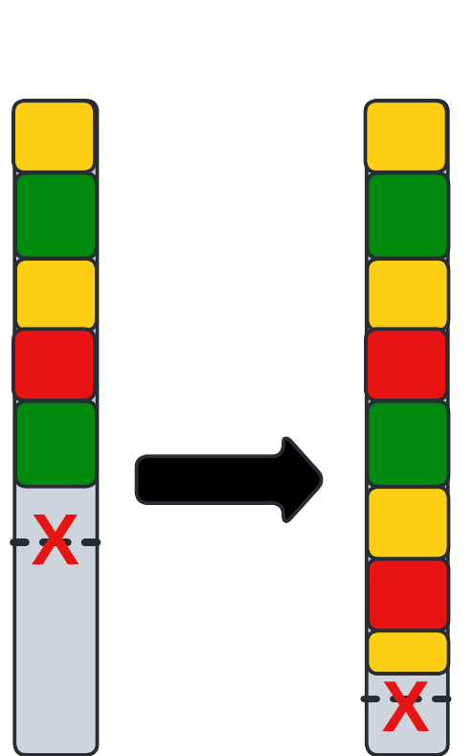



Current Endeavors
Karpenter rollout
Rolled out across all EKS cluster and into Azure
Scales with cost as a node selection criterion
MaxPods increase
Allows more pods to be packed onto the same node if space allows
Kubernetes default is much lower than what can properly binpack modern node types
Client education initiatives
Teach clients to be “good neighbors” on shared clusters
Monitor and expose undesired application behavior to clients and maintainers
Client config policy changes
What’s the best way to roll out restrictions?
What do we do with the clients who rely on this bad-neighbor behavior?

Slide 18




Full bleed image with red thread

Slide 19
After the rabbit hole

Slide 20
Lessons Learned
It’s much easier to build an efficient platform from the ground up than to make it efficient later.
Focusing on reliability and little else leads to paying for resources you might not need.
Clients give less pushback to preexisting platform restrictions rather than ones introduced later in the platform’s lifespan.
Cluster behaviors are more intertwined than is always apparent.
Fixing one problem may reveal or even cause two others.
Different tools can run headfirst into each other and cause issues.
Revisit your existing configs and figure out if any old approaches are now unnecessary.
Stability goes beyond single application health. A healthy application may still cause problems for other namespaces.
Scale brings chaos. The wider your scope, the more you have to handle.
The more freedom you give your clients, the more you rely on them to know how your platform works. Make sure they do.
Hyrum’s Law: regardless of what you promise in your contract, all observable behaviors of your system will be depended upon by somebody.

Slide 21
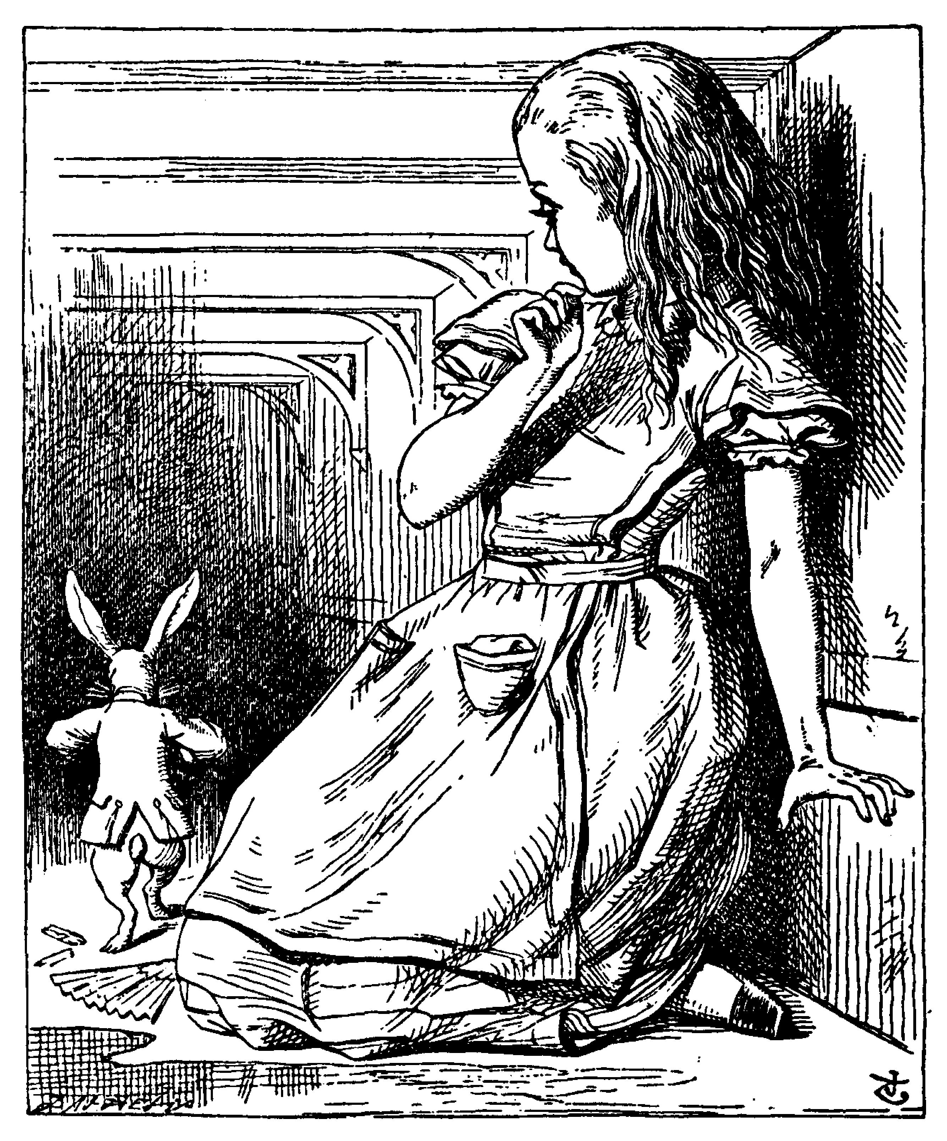

Slide 22
Closer Slide

