Slide 1
School Attendance and Dropout Patterns in Kakuma Refugee Camp
Student: Duelkuoth Joseph Gok Course: Data Analytics Project Type: Capstone Project Date: 22nd July 2025
Disclaimer: this project is based on a final dataset compiled strictly for academic and research purposes. While the data reflects real trends, it should not be used for strategic planning or policymaking without further validation and consultation with relevant authorities.

Slide 2
Introduction
This presentation shows how students in Kakuma Refugee Camp attend school and why some of them drop out. It looks at how many children are in school, why they stop going, and how boys and girls are affected differently. Many students leave school because of early marriage, family duties, or lack of money and support. Girls often face more problems than boys. We used real data to understand these issues and made charts to explain them clearly. This work helps schools, aid workers, and leaders find better ways to keep all children learning in Kakuma.

Slide 3
Methodology
Data Source:
Key Fields Analyzed:
Data Cleaning:
Analysis Tools Used:
Data Transformation:
Final project dataset named kakuma_education_access.csv containing 1,000+ student records from various schools in Kakuma Refugee Camp.
Gender
Age
Class Level Attendance
Rate Dropout Status
Reason
Handled missing values (e.g., attendance, age, dropout reason)
Standardized school names and dropout categories
Converted attendance rate to numeric format
Categorized age into groups (e.g., 6–9, 10–13, 14–17)
Calculated dropout rates per school
Grouped data by gender, age group, and class level
Microsoft Excel or Python for cleaning and preparation
Power BI for interactive visualizations and exploration

Slide 4
Key Metrics Overview
Total Student
1000
Total Enrolled
743
Total
Dropouts 257
Avg. Dropout Rate:
25.7%
Male: 24.9%
Female:
26.46%

Slide 5
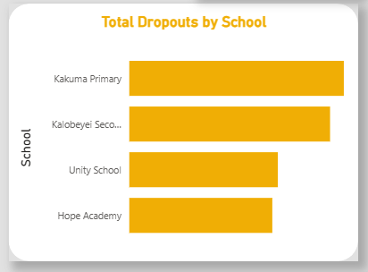
Dropouts by School
Highest dropouts observed in Kakuma Primary and Kalobeyei Secondary.

Slide 6
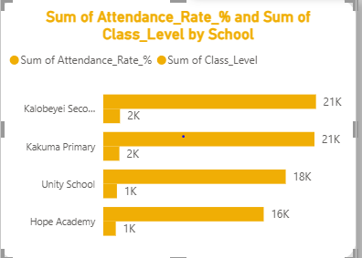
Attendance & Class Level by School
Attendance rates and class levels vary by school with Hope Academy showing lowest retention.

Slide 7
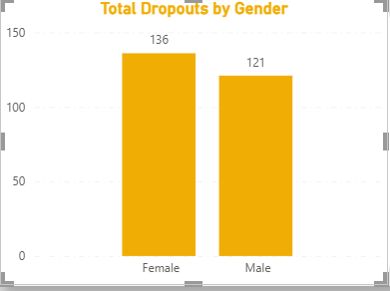
Dropout by Gender
The dropout rate is slightly higher among females.
Cultural and socio-economic factors like early marriage and responsibilities impact girls more.

Slide 8
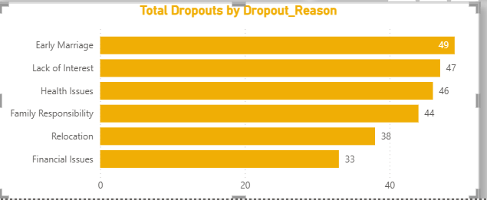
Reasons for Dropping Out
Top reasons include:
Early Marriage
Family Responsibilities
Financial Issues
Health Issues
Relocation

Slide 9
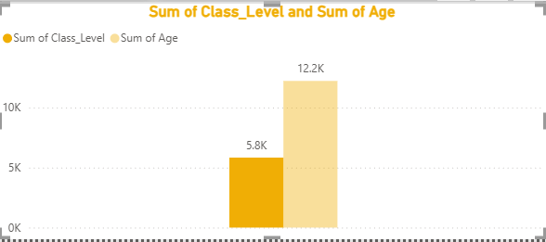
Class Level & Age Breakdown
Dropouts are more frequent in lower class levels.
Older students are more likely to drop out due to external responsibilities.

Slide 10
Summary of Findings
- Total dropout rate is 25.7%
- Female students are more affected
- Major reasons: Early Marriage, Financial Pressure
- School support systems are crucial.

Slide 11
Recommendations & Conclusion
- Implement counseling and mentorship programs
- Provide financial and material support
- Focus on keeping girls in school
- Work with families and communities

