Slide 1



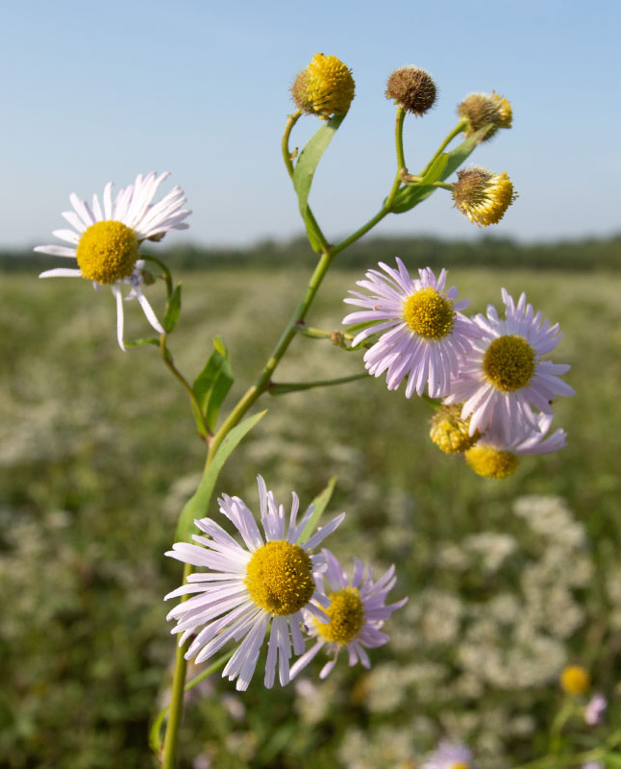
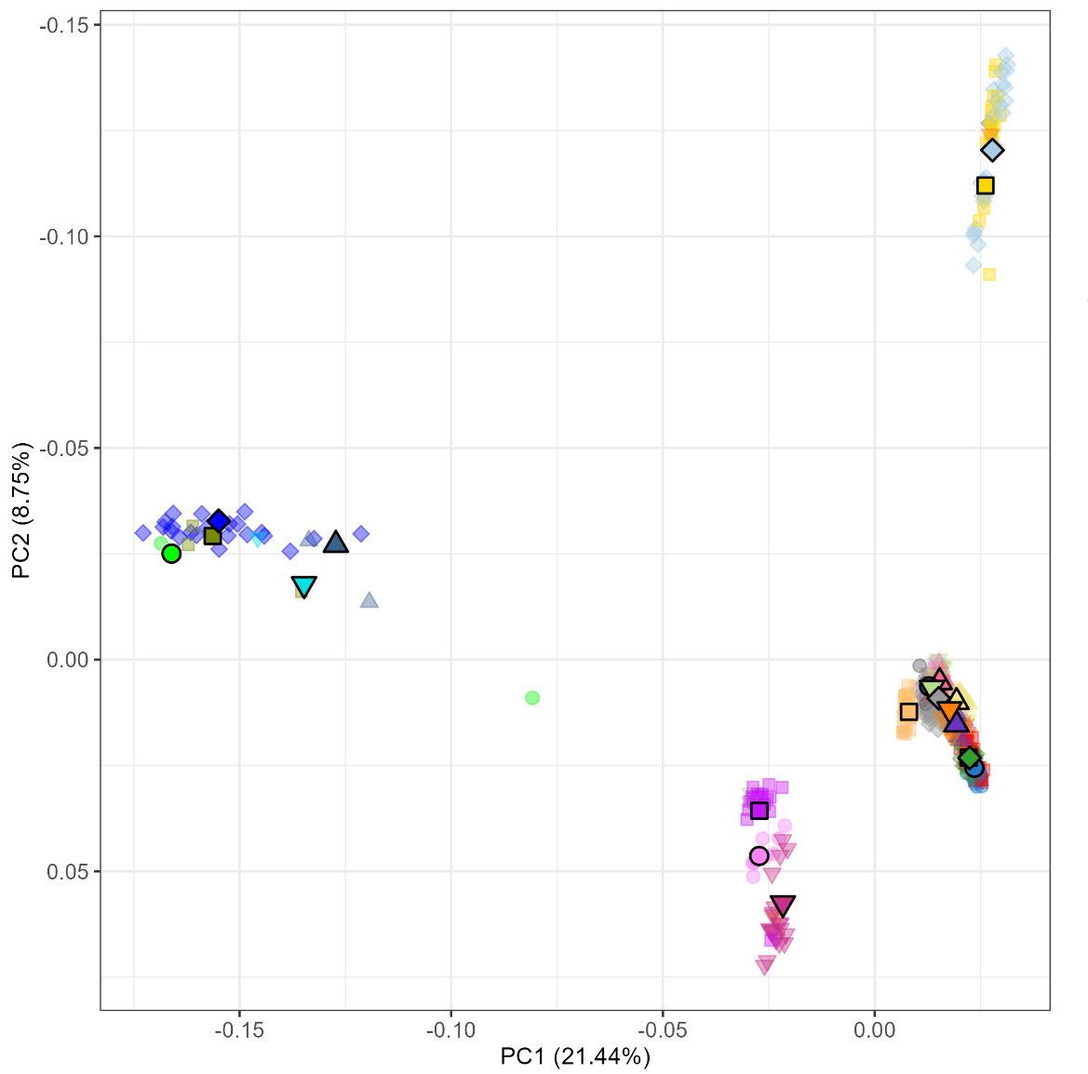
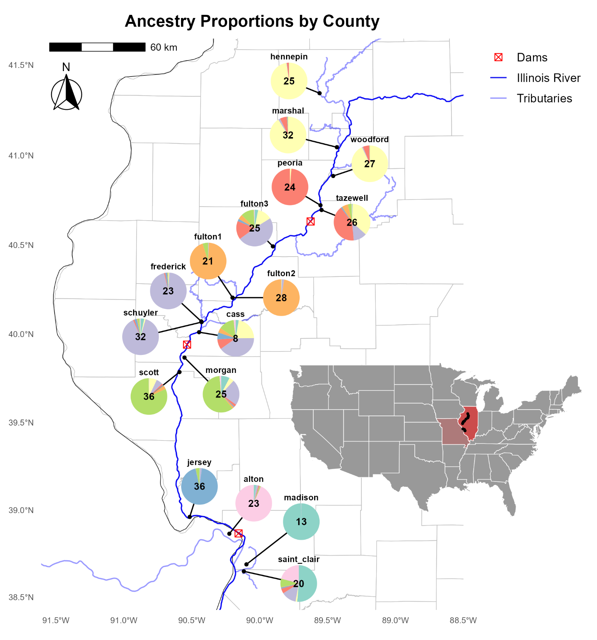
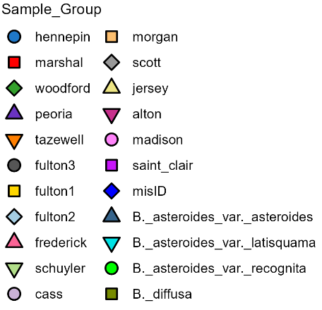
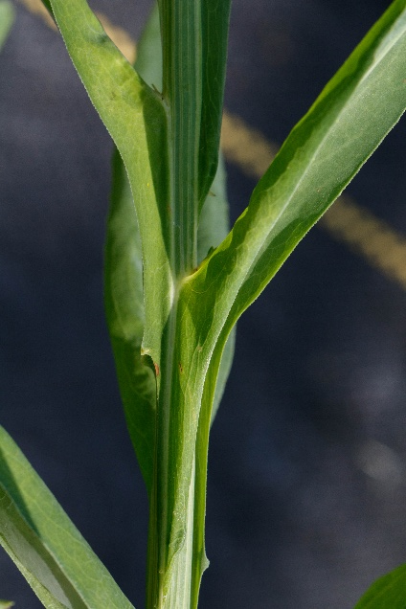
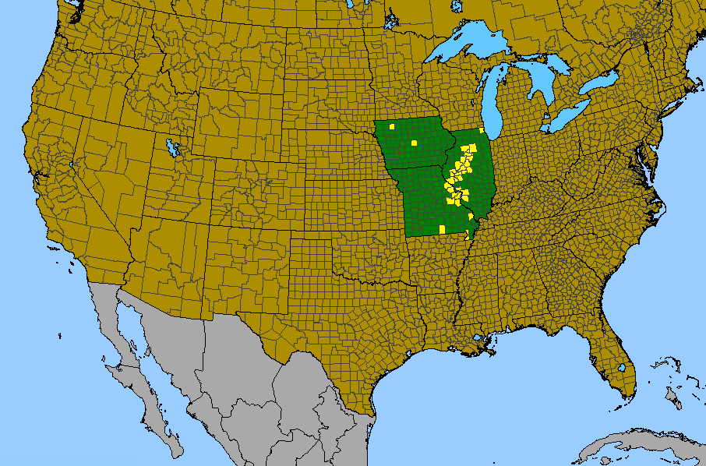
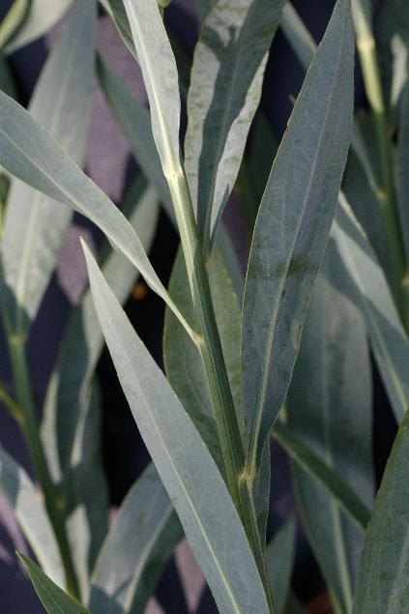
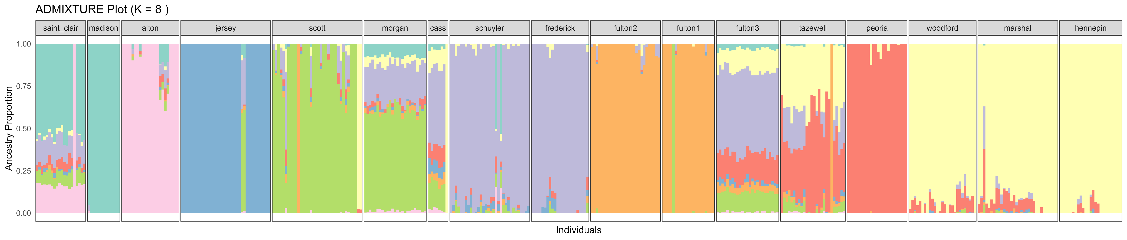
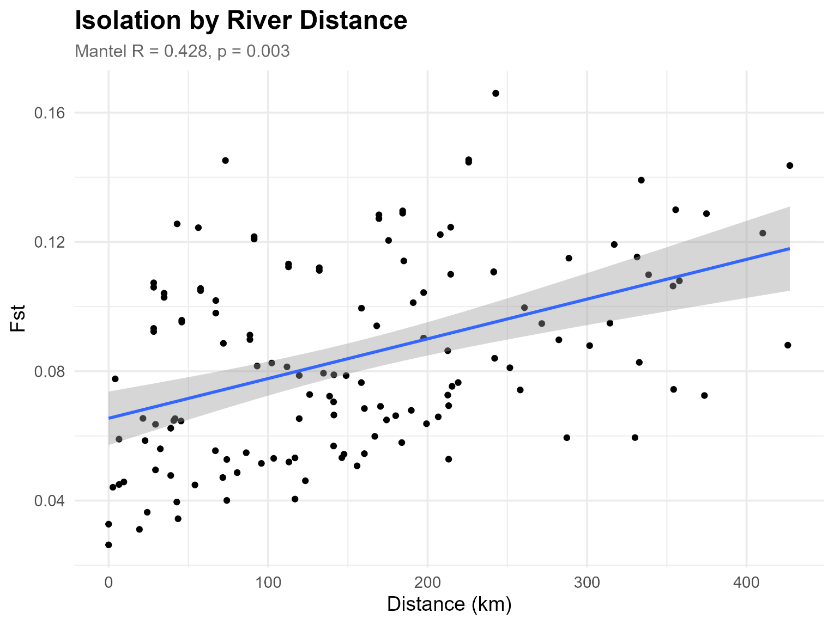
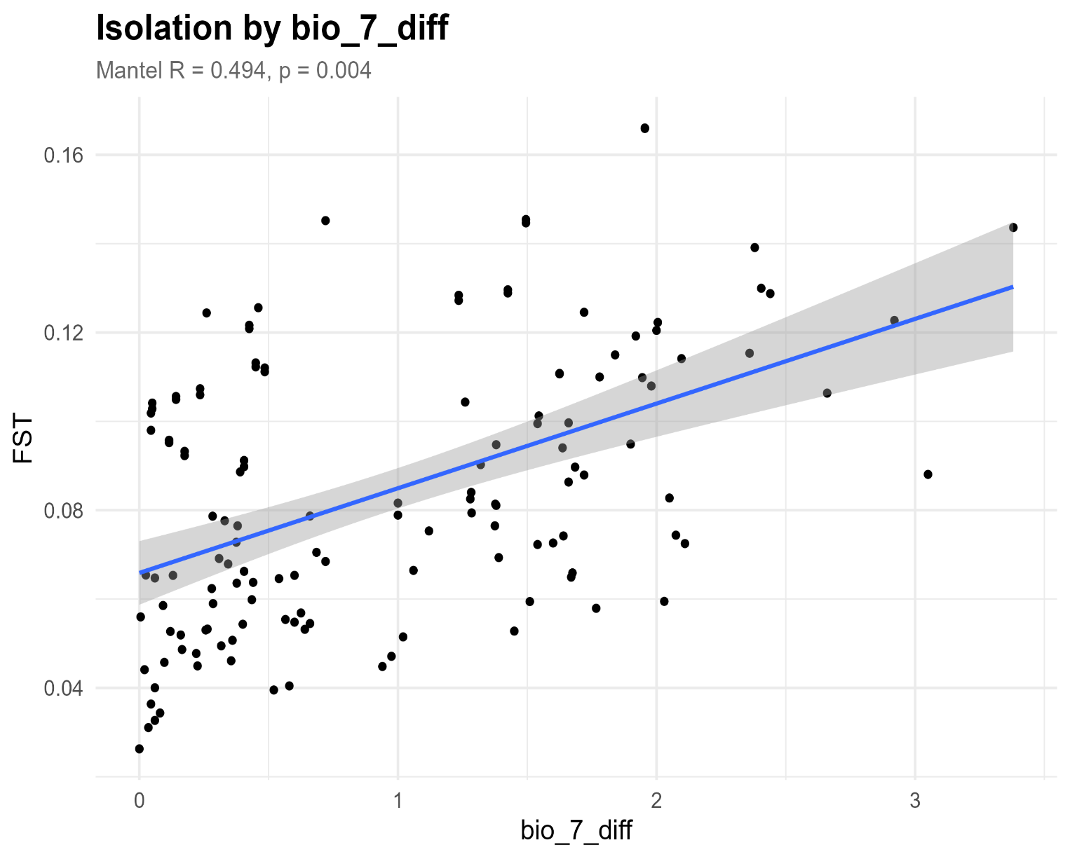
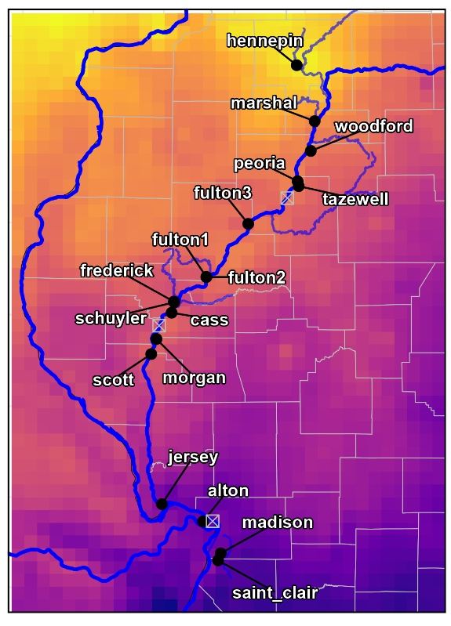
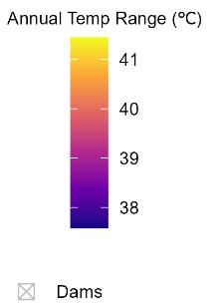


Using Genomic Data to Study Population Structure and Local Adaptation in Boltonia decurrens
Ethan Coble^{1, 2}, Wen-Hsi Kuo^{1, 3}, and Christine E. Edwards¹
¹Center for Conservation and Sustainable Development, Missouri Botanical Garden ;
²Department of Biology, Appalachian State University ; ³Department of Biology, Washington University in St. Louis
Introduction
Results
Discussion
Boltonia decurrens (Asteraceae) is a
federally threatened species endemic to
floodplains along the Illinois River. As an
early-successional species, it depends on
periodic flooding to create open, sandy,
saturated habitats for germination, with
seeds dispersed by the river. In the absence
of disturbance, suitable habitat can quickly
disappear, leading to local extinction within 3–5 years.
Major threats include habitat loss from urban development, agriculture, and flood control. Limited pollinator movement between small, isolated populations suggests that seed dispersal is the primary driver of gene flow. B. decurrens also co-occurs with B. asteroides, with a previous study (DeWoody, 2011) finding minor hybridization. This raises concerns about hybridization in our dataset.
In this study, we assess 1) species boundaries, 2) genetic structure, and 3) local adaptation to evaluate species vulnerability and inform conservation efforts.
Figure 1. (left) Principal component analysis (PCA) showing the grouping of genetically similar individuals based on the dataset including outgroups. The axes are labeled with the % of variance in the data explained by each PC. The circles indicate all outgroups and 24 misidentified plants from Cass.
Species Boundaries (Figure 1)
PCA (PC1: 21.44%, PC2: 8.75%) reveals four distinct clusters.
PC1 separates B. decurrens from outgroups and 24 of the specimens sampled from Cass County, which were likely misidentified.
We found no strong admixed genotypes in our sample of B. decurrens, indicating no hybridization within our dataset that required filtering.
Michael Budd/USFWS
Genetic Structure (Figures 2, 3 & 4)
Admixture shows high gene flow between close populations, but limited over distance; isolation by distance supports this (Mantel R = 0.428).
Populations from Fulton county form a distinct mid-range group, suggesting unique local ecology.
Southern populations are more genetically distinct, possibly due to barriers to gene flow resulting from the dam.
Figure 2. (right) Map with admixture results displayed as pie charts for each population along with sample sizes.
Local Adaptation (Figures 4 & 5)
Genetic differentiation is more strongly correlated with environmental differences (Mantel R = 0.494) than with distance (Mantel R = 0.428), suggesting that local environmental adaptation may play a stronger role in population structure than distance alone. More work is needed to establish if this pattern reflects actual local adaptation.
Implications for Conservation
B. decurrens
B. asteroides
Gene flow occurs mainly among nearby populations, so preserving populations across the range is key to capturing genetic diversity.
The local adaptation revealed in the study suggest that reintroduction efforts should use material from suitable nearby populations to ensure they are well adapted to their environment
Further research is needed to identify and assess candidate genes for local adaptation.
Materials / Methods
Figure 3. Results of ADMIXTURE analysis showing ancestral populations for B. decurrens. Each line represents an individual and the colors represent the genetic groups to which the individuals are assigned. Individuals are grouped by geographic population from south to north. Number of populations defined by K = 8 (lowest CV error).
Sample Collection 468 seeds collected from 18 wild B. decurrens populations were germinated and grown in controlled conditions. Outgroup samples came from herbarium specimens at the Missouri Botanical Garden.
DNA Processing We extracted DNA, conducted whole genome sequencing on 448 samples using NEBnext Ultra FS II kits with Illumina NovaSeq sequencing, and filtered for high-quality SNPs.
Population Structure & Hybridization Analyzed with PCA, ADMIXTURE, and phylogenetic trees.
Genetic Differentiation We assessed pairwise F_{ST} and isolation-by-distance patterns.
Adaptive Variation Tested using isolation-by-environment, LFMM, and PCAdapt.
Data Analysis & Visualization Performed in R and genetic analysis software.
A. Isolation by Environment
B.
F_{ST}
F_{ST}
Acknowledgements
Funding provided by the 2025 REU program (NSF-DBI-2243824) and the IMLS (MG-253252-OMS-23).
Thanks to members of the Conservation Genetics Lab at MBG for sample collection, and Megan Connor for support with analysis.
Special thanks to Mónica Carlsen-Krause and
Wendy Applequist
for program
coordination.
Difference in Annual Temp. Range (°C)
Figure 4. Pairwise F_{ST}, a measure of genetic difference between pairs of populations, plotted against distance along river between pairs of populations. Mantel R, a measure of correlation, and p-value displayed.
Figure 5. A) The relationship between pairwise F_{ST} and difference in the annual temperature range (°C) between pairs of populations. Mantel R, a measure of correlation, and p-value displayed. B. Climatic map for annual temperature range in the sampling locations.

