Slide 1
Computer Organization Homework 1

Slide 2
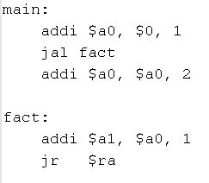
Procedure Calling
Steps required
Place parameters in registers
Transfer control to procedure
Acquire storage for procedure
Perform procedure’s operations
Place result in register for caller
Return to place of call

Slide 3
Register Usage
$a0 – $a3: arguments (reg 4 – 7 )
$v0, $v1: result values (reg 2 and 3)
$t0 – $t9: temporaries (reg 8 – 15, reg 24 and 25)
$s0 – $s7: saved (reg 16 – 23 )
$gp: global pointer for static data (reg 28)
$sp: stack pointer (reg 29)
$fp: frame pointer (reg 30)
$ra: return address (reg 31)
0x4005
$sp
0x4004
0x4003
0x4002
0x4001
0x4000

Slide 4
Procedure Call Instructions
Procedure call: jump and link
jal Procedure Label
Put address of following instruction in $ra
Jumps to target address
Procedure return: jump register
jr $ra
Put the value of $ra in program counter
Can also be used for computed jumps
e.g., for case/switch statements

Slide 5
Recursive Procedure Example
C code:
int fact (int n) { if (n < 1) return f; else return n * fact(n - 1); }
Argument n in $a0
Result in $v0

Slide 6
Recursive Procedure Example
MIPS code:
fact: addi $sp, $sp, -8 # adjust stack for 2 items sw $ra, 4($sp) # save return address sw $a0, 0($sp) # save argument slti $t0, $a0, 1 # test for n < 1 beq $t0, $zero, L1 addi $v0, $zero, 1 # if so, result is 1 addi $sp, $sp, 8 # pop 2 items from stack jr $ra # and return L1:
addi $a0, $a0, -1 # else decrement n jal fact # recursive call lw $a0, 0($sp) # restore original n lw $ra, 4($sp) # and return address addi $sp, $sp, 8 # pop 2 items from stack mul $v0, $a0, $v0 # multiply to get result jr $ra # and return

Slide 7
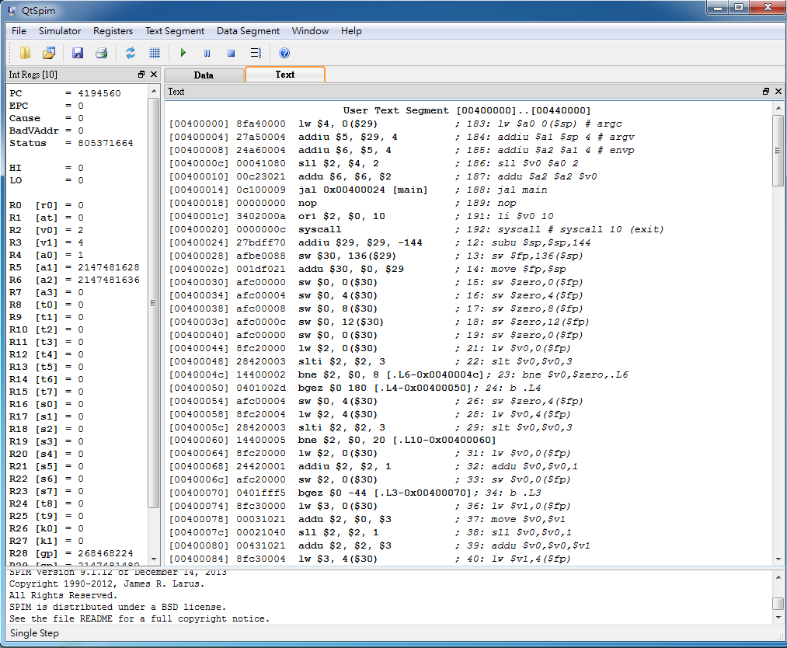
QtSpim
Run
Load file
Single Step
Register
Assembly
7
下載網址:http://sourceforge.net/projects/spimsimulator/files/ 版本 9.1.20

