Slide 1
Covid-19 and Suicide Rates
Melike Kupen
16030411054 - mıs

Slide 2

From the earliest days of the pandemic there was concern that suicide would increase. It wasn’t hard to see where the risks might come from: anxiety about infection, isolation, disrupted care, domestic violence, alcohol, recession. Actual figures, though, took months to appear.
It remains unclear whether the coronavirus disease 2019 (COVID-19) pandemic is having an impact on suicide rates (SR). Economic insecurity and mental disorders are risk factors for suicide, which may increase during the pandemic.

Slide 3
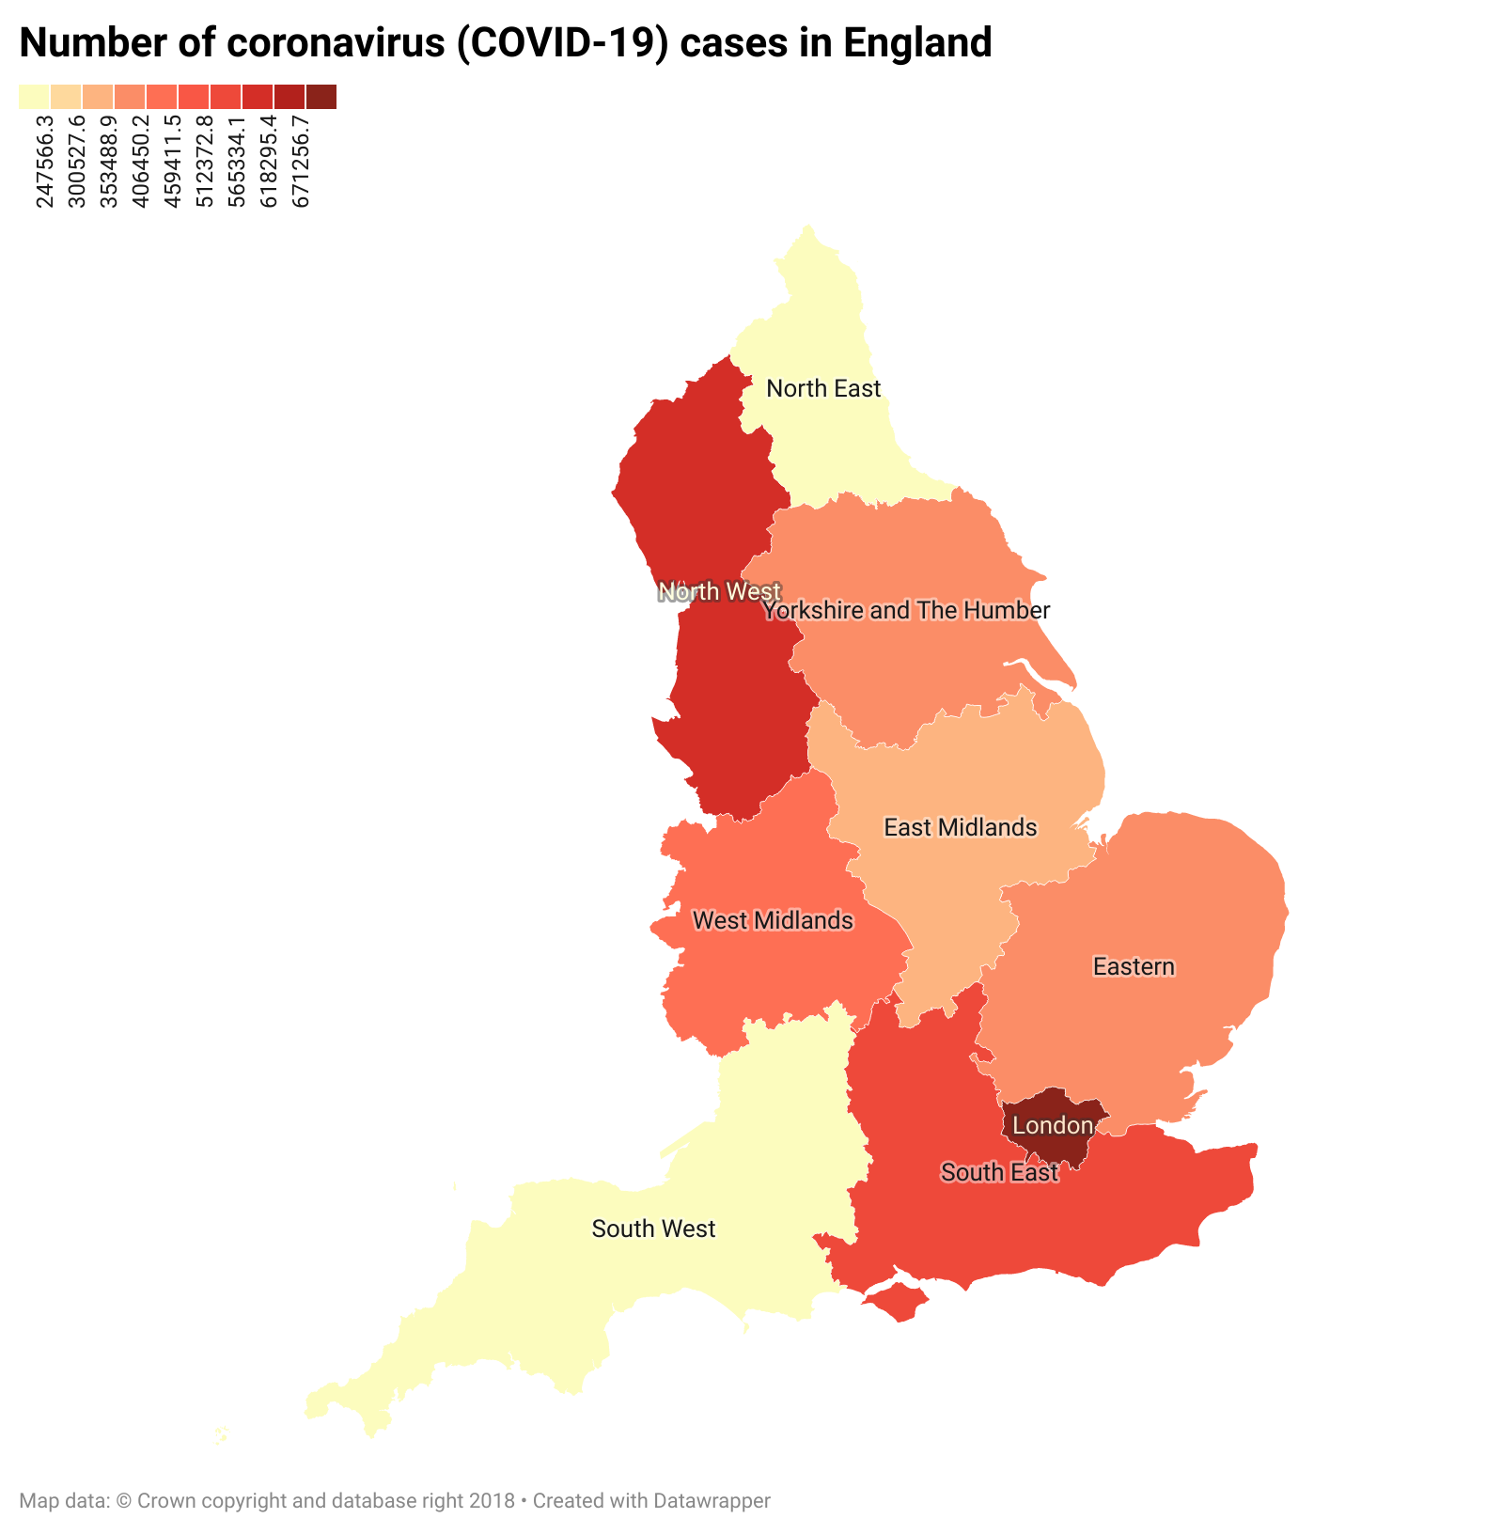

Slide 4
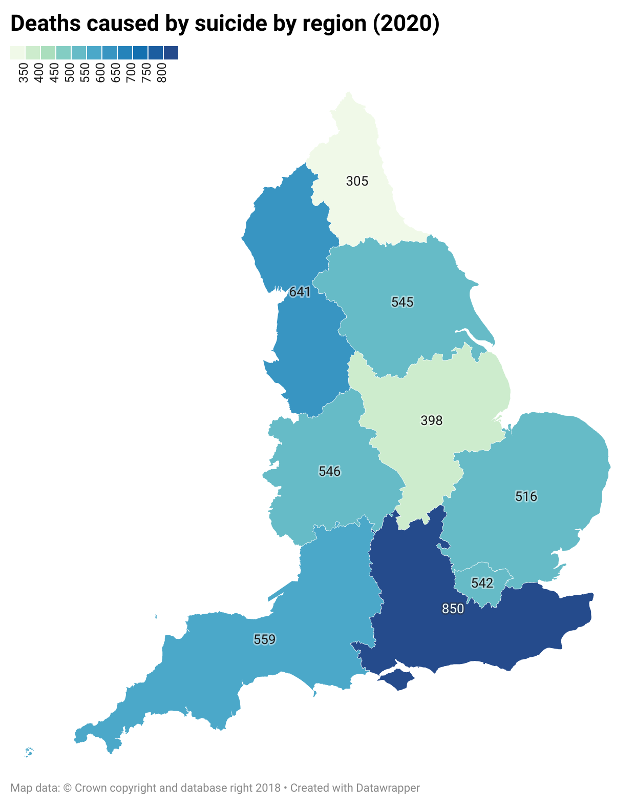

Slide 5
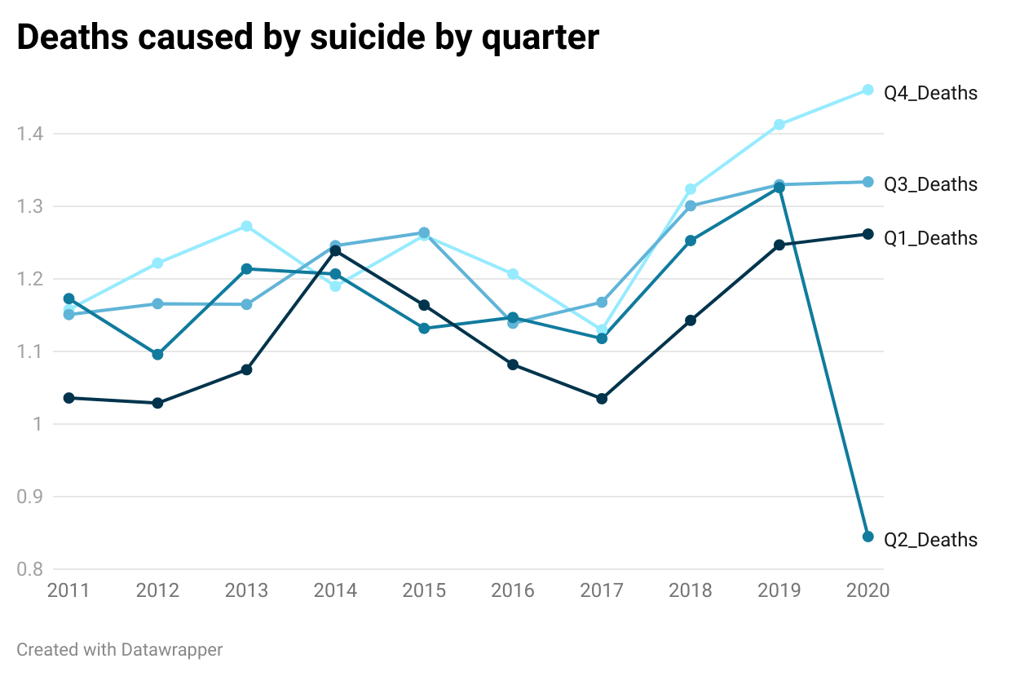

Slide 6
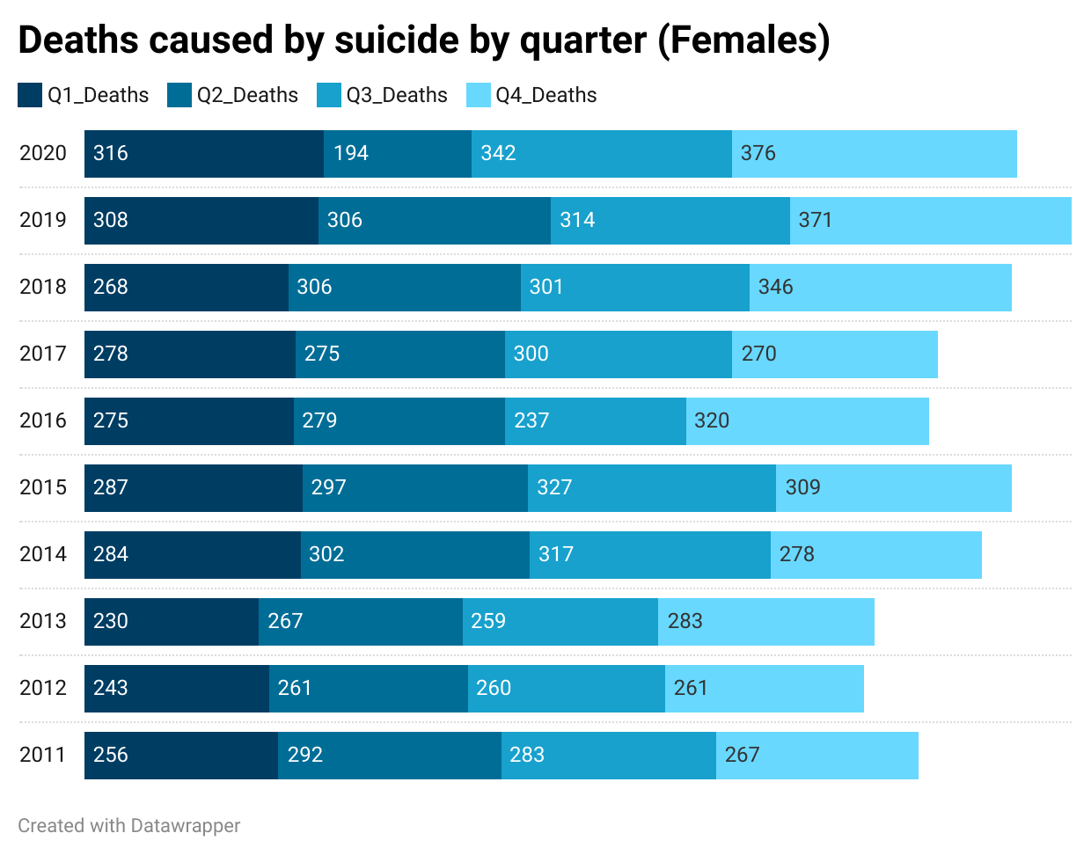

Slide 7
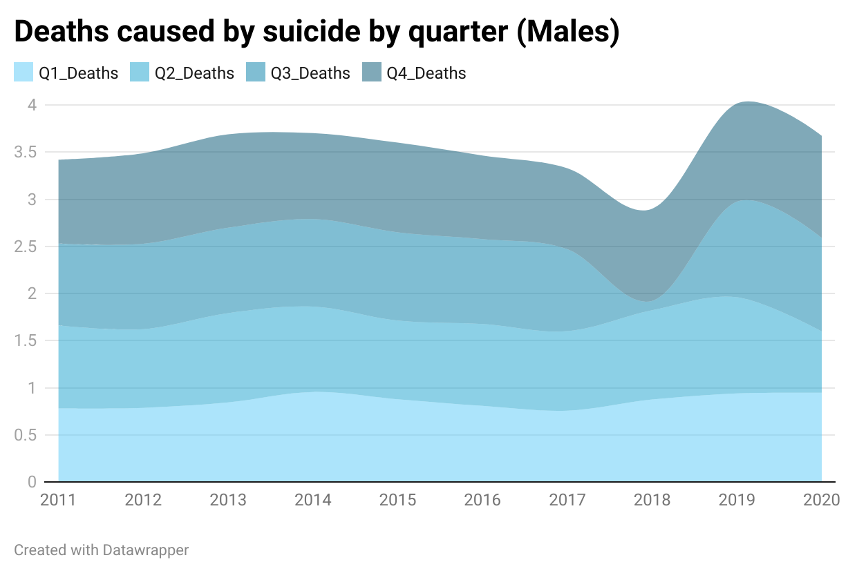

Slide 8
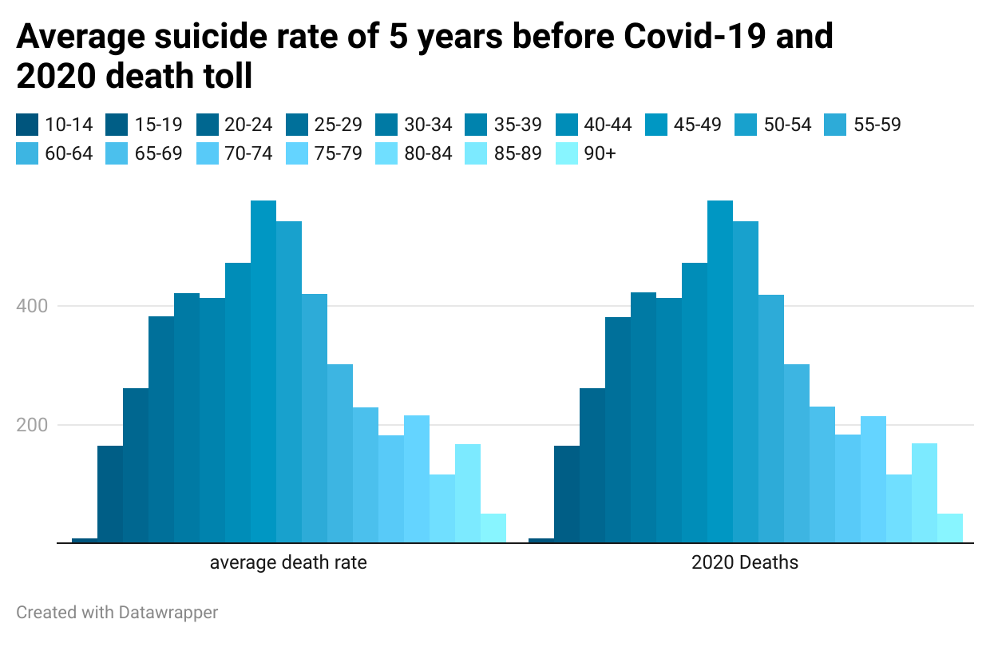

Slide 9
To reduce suicides during the COVID-19 crisis it is imperative to decrease stress, anxiety, fears and loneliness in the general population. There should be traditional and social media campaigns to promote mental health and reduce distress. Active outreach is necessary, especially for people with a history of psychiatric disorders, COVID-19 survivors, and older adults. Research studies are needed of how mental health consequences can be mitigated during and after the COVID-19 pandemic.

