Slide 1
Data Storytelling & Statistical Validation
Online Retail Analysis
J Kupendra Reddy

Slide 2
Objective
• Analyze retail sales data
• Identify key revenue drivers
• Understand customer behavior
• Provide business recommendations

Slide 3
Dataset Overview
• Online Retail Dataset
• Key Features:
Country
CustomerID
Quantity
UnitPrice
InvoiceDate
• Created Feature:
Sales = Quantity × UnitPrice

Slide 4
Analysis Performed
• Country-wise sales analysis
• Top product analysis
• Monthly sales trends
• Customer contribution analysis

Slide 5
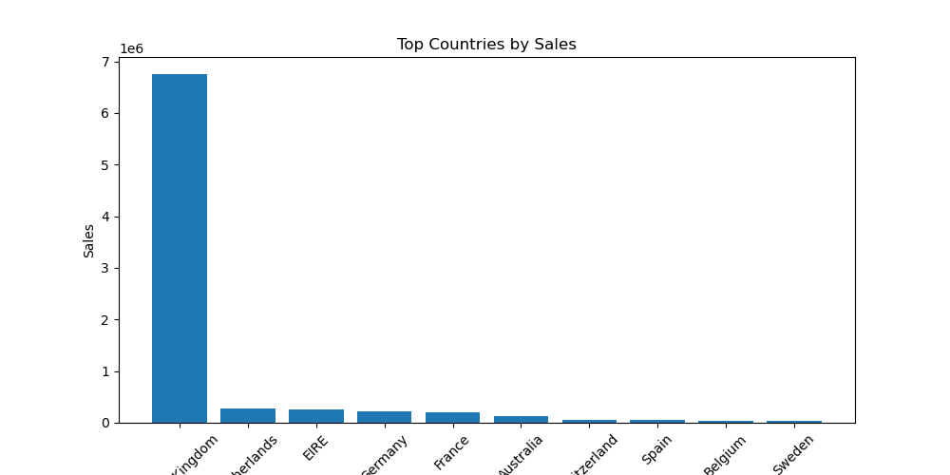
Top Countries by Sales
United Kingdom dominates overall sales performance

Slide 6
Key Insights
• United Kingdom generates highest sales
• Few products dominate total revenue
• Sales show monthly fluctuations
• Small group of customers drives majority revenue

Slide 7
Business Problems
• High dependency on limited countries
• Revenue concentrated among few customers
• Uneven sales distribution

Slide 8
Hypothesis
High-value customers spend more than low-value customers

Slide 9
Statistical Test
• Test Used: Independent T-Test
• Significance Level: 0.05
• P-Value: 8.73e-38

Slide 10
Result
• Reject Null Hypothesis
• High-value customers spend significantly more than low-value customers

Slide 11
Recommendations
• Focus on high-value customers
• Expand business to new countries
• Promote top-selling products
• Apply seasonal marketing strategies

Slide 12
Conclusion
• Data-driven insights improve decision making
• Statistical validation strengthens analysis
• Business can increase revenue using insights

