Slide 1
Comparison of Feature Selection Techniques for Gene Expression Data
April 20, 2009
Group Members:
Karan Uppal, Yungyeong Lee, Abhishek Bhatkhande

Slide 2
Outline
Background
Goal
Implementation
Results
Conclusion

Slide 3
Microarray
Human genome contains ~ 25,000 genes
The goal of a microarray experiment is to simultaneously measure the expression levels of thousands of genes in a collection of cells
Two channels for different experimental groups (normal vs. cancer)

Slide 4
Gene selection
Number of genes >> Number of samples
The goal is to identify minimum number of genes that highlight difference between experimental groups (Normal vs. Cancer) for diagnostic purposes, or future studies
Only a fraction of genes are significant
  Different genes are expressed in different cells
  Some genes produce proteins that are critical for survival so their expression level does not change
  The level of gene expression may not change if other cellular mechanisms can alter the amount of protein in a cell
How to identify statistically significant genes?

Slide 5
General Methodology
Microarray
Data
Pre-processing
Training data
Feature Selection
Trained Model
Model evaluation&
Interpretation
Test data
Cancer Classification

Slide 6
Feature Selection
Feature Selection is the technique, commonly used in machine learning, of selecting a subset of relevant features for building robust learning models.
There are 3 categories of feature selection:
  Filter: t-test, F-test, kruskal- test, etc
  Wrapper: Binary Particle Swarm Optimization, Genetic Algorithms, etc
  Embedded – recursive feature elimination SVM, random forest (trees), elastic net, lasso, etc

Slide 7
Feature selection schemes
a) Filter:
Feature Selection and
evaluation
Learning
Model evaluation
b) Wrapper
Learning
Feature Selection and evaluation
Subset generation
Learning
Model evaluation
c) Embedded
Learning
Model evaluation
Feature Selection and evaluation

Slide 8
Goal
Compare the performance of different feature selection algorithms based on the number of genes selected (minimum) and classification accuracy (maximum)

Slide 9
Datasets
Dataset | Description | Number of Samples | Number of genes | Classes | Source
NCI60 –RNA HU6800 | Gene expression data of 9 cell lines obtained from 60 cancer patients. Already processed and filtered. | Train: 60 | 6112 | 9 | Staunton et al. Chemosensitivity Prediction by Transcriptional Profiling Proc Natl Acad Sci USA 2001 Sep 11;98(19):10787-92 http://discover.nci.nih.gov/cellminer/loadDownload.do
Leukemia | Acute myeloid leukemia (AML) and acute lymphoblastic leukemia (ALL) gene expression data. Processed, but not filtered. | Train: 38 Test: 34 | 7130 | 2 | Golub et al. Molecular Classification of Cancer: Class Discovery and Class Prediction by gene expression profiling Science 15 October 1999: Vol. 286. no. 5439, pp. 531 - 537 http://www.broad.mit.edu/cgi-bin/cancer/publications/pub_paper.cgi?mode=view&paper_id=43
Small round blue cell tumors (SRBCT) | Gene expression data of four kinds of tumors (neuroblastoma, rhabdomyosarcoma, hodgkin lymphoma, and the Ewing family tumors) that are similar histologically. | Train: 63 Test: 20 | 2098 | 4 | Khan et al. Classification and diagnostic prediction of cancers using gene expression profiling and artificial neural networks http://stat.ethz.ch/%7Edettling/bagboost.html

Slide 10
Pre-processing (Leukemia Dataset)
Original number of genes: 7130
Steps followed according to Golub et al.
  Thresholding:
    Upper limit: 16000
    Lower limit: 100
  Filtering:
    Genes were excluded if they varied by less than 5-fold and 500 units across training cell lines
  Log (base 10) transformation
Result: 3051 genes selected

Slide 11
Implementation in R
CAM package
  Classification for Microarrays – a comprehensive Bioconductor package for supervised classification with high dimensional data [4]
Binary Particle Swarm Optimization algorithm
  Cheng et al. A two-stage feature selection method for gene expression data Journal of Integrative Biology Volume 13 Number 2 2009

Slide 12
RESULTS: Leukemia Dataset (affect of number of genes on CV accuracy)
Num genes | T-test | F-test | Kruskal | Elasticnet | Lasso | rfeSVM | Random Forest
1 | 92.1 | 92.1 | 94.7 | 89.5 | 86.8 | 92.1 | 76.3
3 | 84.2 | 84.2 | 100 | 92.1 | 94.7 | 86.8 | 100
5 | 94.7 | 94.7 | 100 | 94.7 | 97.4 | 92.1 | 100
10 | 94.7 | 94.7 | 97.4 | 94.7 | 94.7 | 92.1 | 100
15 | 94.7 | 94.7 | 97.4 | 94.7 | 94.7 | 92.1 | 97.4
25 | 97.4 | 97.4 | 100 | 94.7 | 94.7 | 92.1 | 97.4
50 | 97.4 | 97.4 | 97.4 | 94.7 | 94.7 | 97.4 | 94.7
100 | 97.4 | 97.4 | 100 | 94.7 | 94.7 | 100 | 97.4
150 | 97.4 | 97.4 | 100 | 94.7 | 94.7 | 100 | 97.4

Slide 13
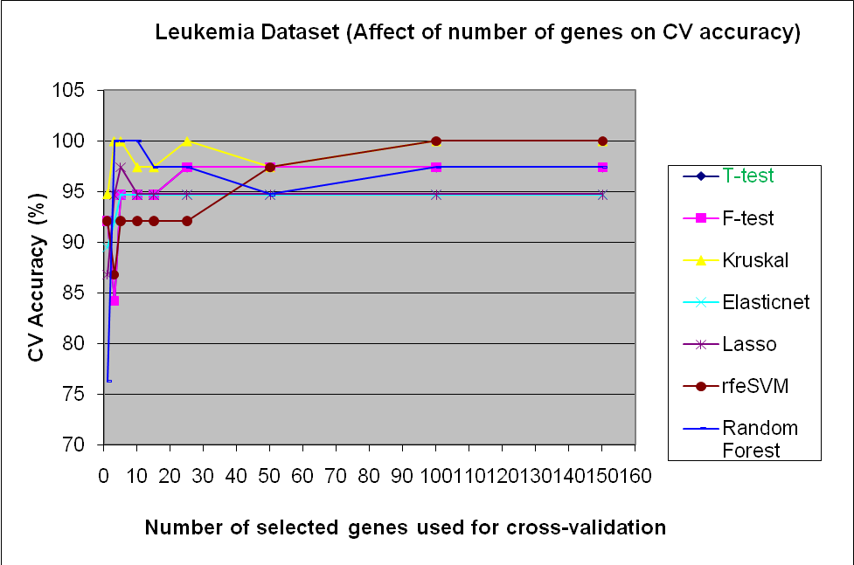

Slide 14
Leukemia test results
Feature Selection Algorithm | Accuracy (%) using the top n=3 genes | Accuracy (%) using the top n=5 genes | Accuracy (%) using the top n=10 genes | Accuracy (%) using the top n=25 genes | Accuracy (%) using the top n=100 genes
Elasticnet | 58.83 | 58.83 | 58.83 | 41.2 | 41.2
T-test | 58.83 | 58.83 | 58.83 | 64.7 | 41.2
Rfe- SVM | 58.83 | 58.83 | 58.83 | 85.3 | 58.8
Random Forest | 58.83 | 58.83 | 58.83 | 61.8 | 38.3
F-test | 58.83 | 58.83 | 58.83 | 70 | 41.2
Kruskal | 58.83 | 58.83 | 58.83 | 58.83 | 41.2
Lasso | 58.83 | 58.83 | 61.8 | 41.2 | 41.2

Slide 15
SRBCT Dataset (affect of number of genes on CV accuracy)
Num genes | T-test | F-test | Kruskal | Elasticnet | Lasso | rfeSVM | Random Forest
1 | 85.7 | 63.5 | 39.7 | 87.3 | 90.5 | 79.4 | 60.3
3 | 100 | 77.8 | 82.5 | 87.3 | 90.5 | 96.8 | 100
5 | 100 | 81 | 79.4 | 87.3 | 90.5 | 96.8 | 100
10 | 100 | 98.4 | 93.7 | 87.3 | 90.5 | 100 | 100
15 | 100 | 98.4 | 96.8 | 87.3 | 90.5 | 100 | 100
20 | 100 | 100 | 98.4 | 87.3 | 90.5 | 100 | 100
25 | 100 | 100 | 98.4 | 87.3 | 90.5 | 100 | 100
50 | 100 | 100 | 100 | 87.3 | 90.5 | 98.4 | 100
100 | 98.4 | 100 | 100 | 87.3 | 90.5 | 100 | 98.4
150 | 98.4 | 100 | 100 | 87.3 | 90.5 | 98.4 | 98.4
200 | 98.4 | 100 | 100 | 87.3 | 90.5 | 98.4 | 98.4

Slide 16
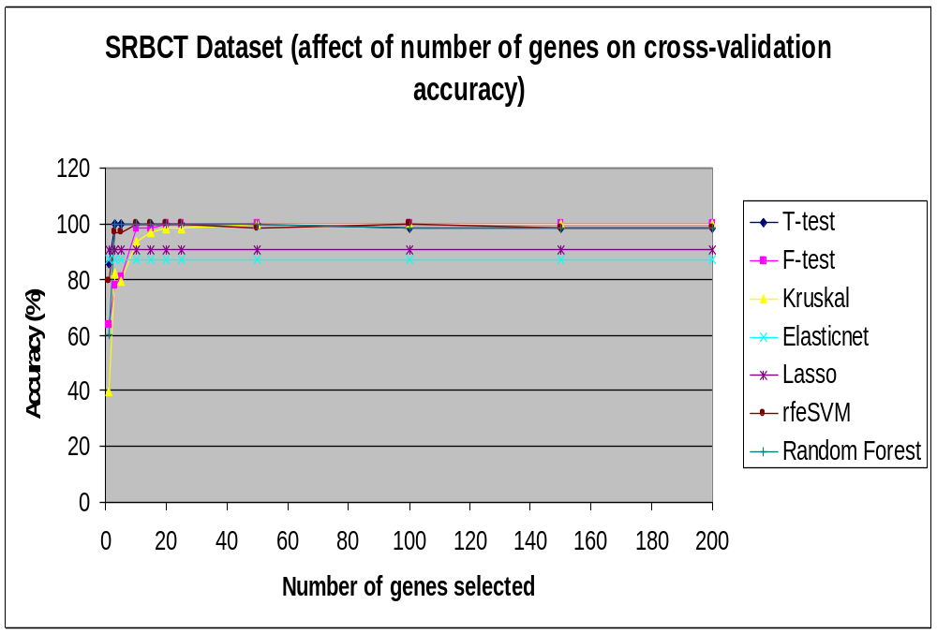

Slide 17
Test results for SRBCT Dataset
Feature Selection Algorithm | Accuracy (%) using the top n=3 genes | Accuracy (%) using the top n=5 genes | Accuracy (%) using the top n=10 genes | Accuracy (%) using the top n=15 genes | Accuracy (%) using the top n=25 genes | Accuracy (%) using the top n=50 genes
Elasticnet | 50 | 60 | 55 | 60 | 60 | 65
T-test | 60 | 50 | 50 | 65 | 60 | 60
Rfe-SVM | 40 | 35 | 55 | 70 | 50 | 50
Random Forest | 50 | 45 | 60 | 75 | 55 | 70
F-test | 50 | 50 | 70 | 68 | 55 | 55
Kruskal | 50 | 50 | 40 | 60 | 60 | 65
Lasso | 70 | 75 | 50 | 60 | 60 | 65

Slide 18
NCI60 Dataset (affect of number of genes on CV accuracy)
Num genes | T-test | F-test | Kruskal test | Rfe-SVM | Random Forest
1 | 50 | 33.3 | 18.3 | 45 | 46.7
3 | 48.3 | 23.3 | 26.7 | 61.7 | 61.7
5 | 48.3 | 25 | 38.3 | 66.7 | 56.7
10 | 55 | 28.3 | 35 | 60 | 61.7
15 | 51.7 | 33.3 | 45 | 65 | 56.7
20 | 65 | 60 | 65 | 65 | 65
25 | 63.3 | 56.7 | 61.7 | 68.3 | 63.3
50 | 66.7 | 58.3 | 68.3 | 66.7 | 68.3
100 | 65 | 60 | 65 | 65 | 65
150 | 65 | 58.3 | 66.7 | 63.3 | 63.3
200 | 65 | 58.3 | 66.7 | 63.3 | 63.3
Note: Elasticnet and Lasso could not be implemented for this dataset due to large dimensionality

Slide 19
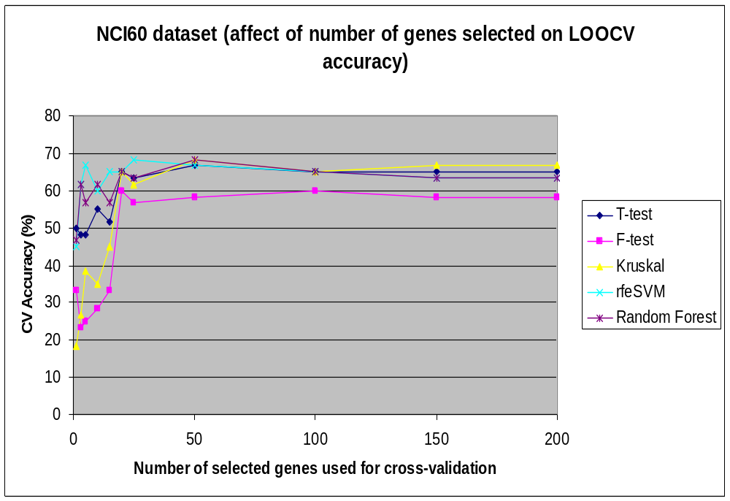

Slide 20
Results Summary
Dataset | Best algorithm and model
Leukemia | Best algorithm: rfe-SVM
 | Best model: N=25 genes Test Accuracy= 85.3%
SRBCT | Best algorithm: Lasso
 | Best model: N=5 genes Test Accuracy= 75%
NCI60 | Best algorithm: rfe-SVM
 | Best model: N=25 genes CV Accuracy= 68.3%

Slide 21
Conclusion
Most feature selection algorithms (mainly the filter and wrapper methods) generate models that over-fit to the training data, and thus generalize poorly
Recursive Feature Elimination- SVM method achieves better performance for all the three datasets.
  Removes features that cause minimal changes in the cost function
  SVM trained and tested again on the new smaller dataset
  Repeats the process until the feature set is small enough, or the
  performance starts degrading
  Minimizes over-fitting
More samples and better classification algorithms are required for building robust models for large-class datasets
Other classification algorithms should be considered for building the trained model

Slide 22
References
Guyon et al. An introduction to variable and feature selection Journal of Machine Learning Research 2003 (3): 1157-1182
Staunton et al. Chemosensitivity Prediction by Transcriptional Profiling Proc Natl Acad Sci USA 2001 Sep 11;98(19):10787-92 http://discover.nci.nih.gov/cellminer/loadDownload.do
Khan et al. Classification and diagnostic prediction of cancers using gene expression profiling and artificial neural networks Nature Medicine June 2001: Volume 7 no. 6, pp 673-679 http://stat.ethz.ch/%7Edettling/bagboost.html
Golub et al. Molecular Classification of Cancer: Class Discovery and Class Prediction by gene expression profiling Science 15 October 1999: Vol. 286. no. 5439, pp. 531 - 537
http://www.broad.mit.edu/cgi-bin/cancer/publications/pub_paper.cgi?mode=view&paper_id=43
Slawski et al. Classification for Microarrays – a comprehensive Bioconductor package for supervised classification with high dimensional data BMC Bioinformatics 2008 Vol. 9 pp439
Cheng et al. A two-stage feature selection method for gene expression data Journal of Integrative Biology Volume 13 Number 2 2009

