Slide 1
Empirical Green’s function method to estimate large earthquake
02/04/2019
Kurama OKUBO

Slide 2
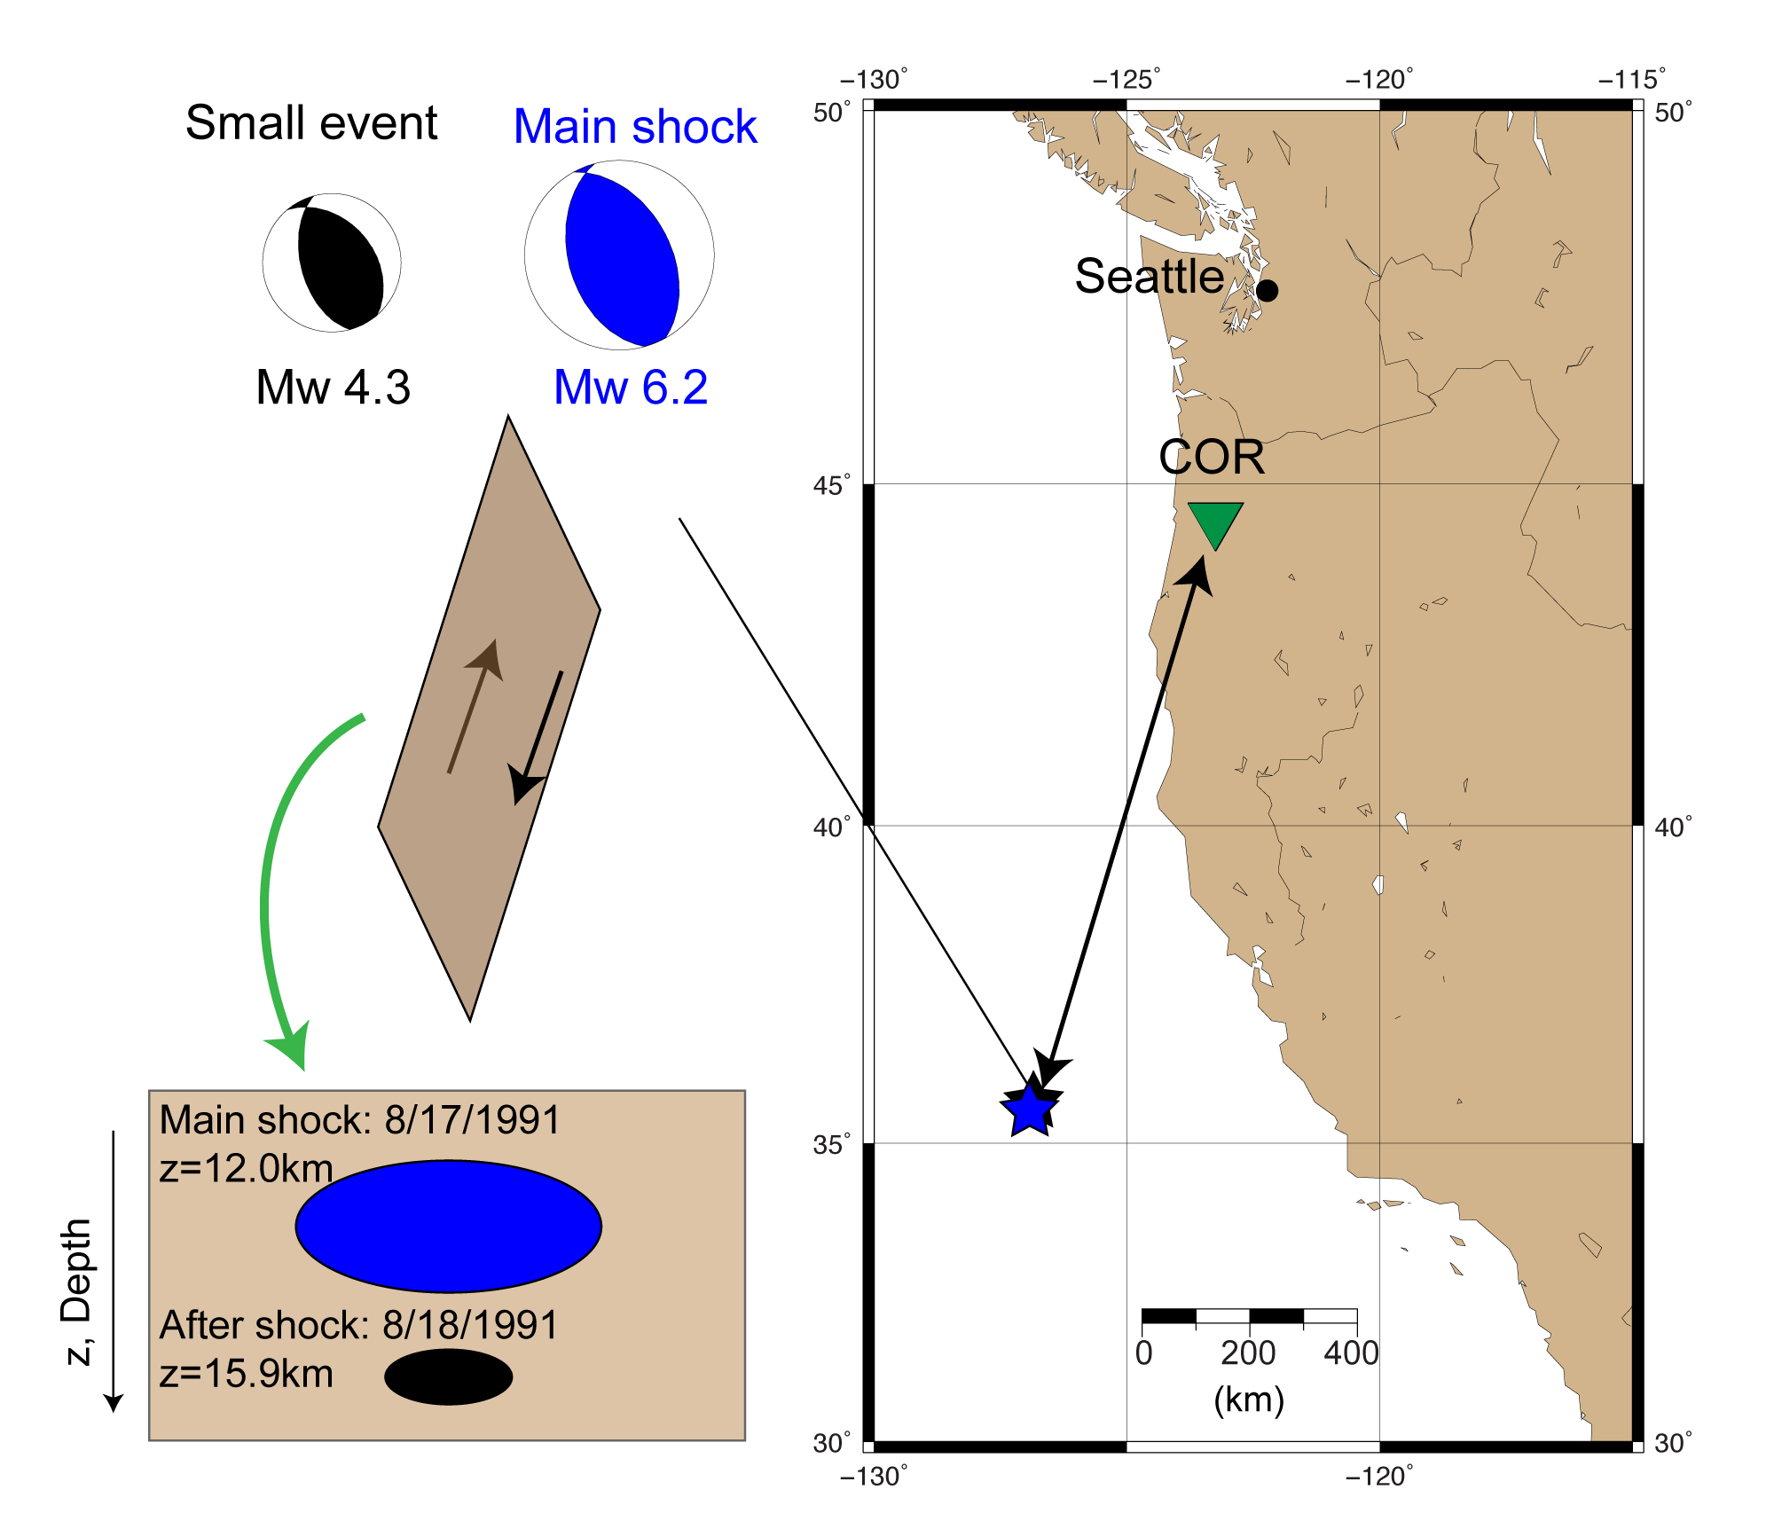
Couple of earthquake events at 1991 North California.
Condition of good eGF to estimate large event:
Close with each other. (to cancel out path effect.)
Similar focal mechanism. (to cancel out radiation pattern)
Not too small. (Mw 3.0 ~ due to the assumption with element faults. )

Slide 3
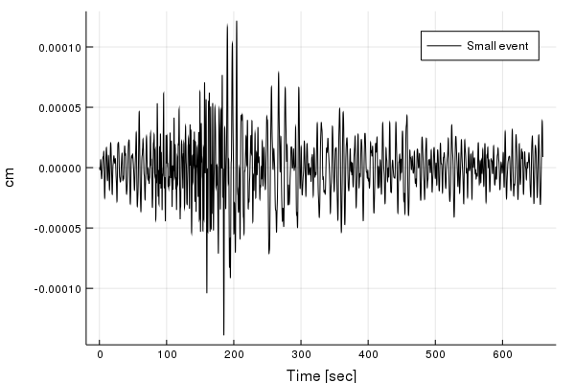
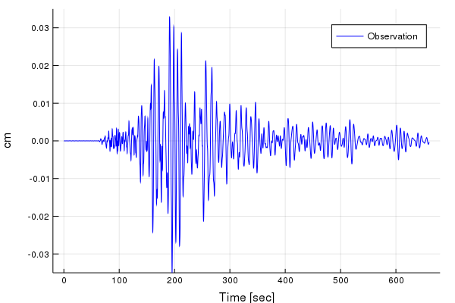
Comparison of two events
Small event Mw 4.3
Large event Mw6.2

Slide 4
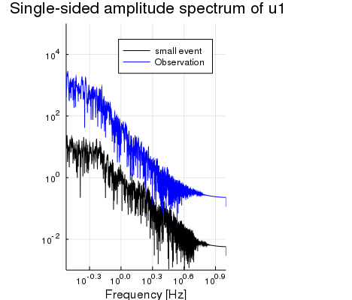
Comparison of two events
P(f)

Slide 5
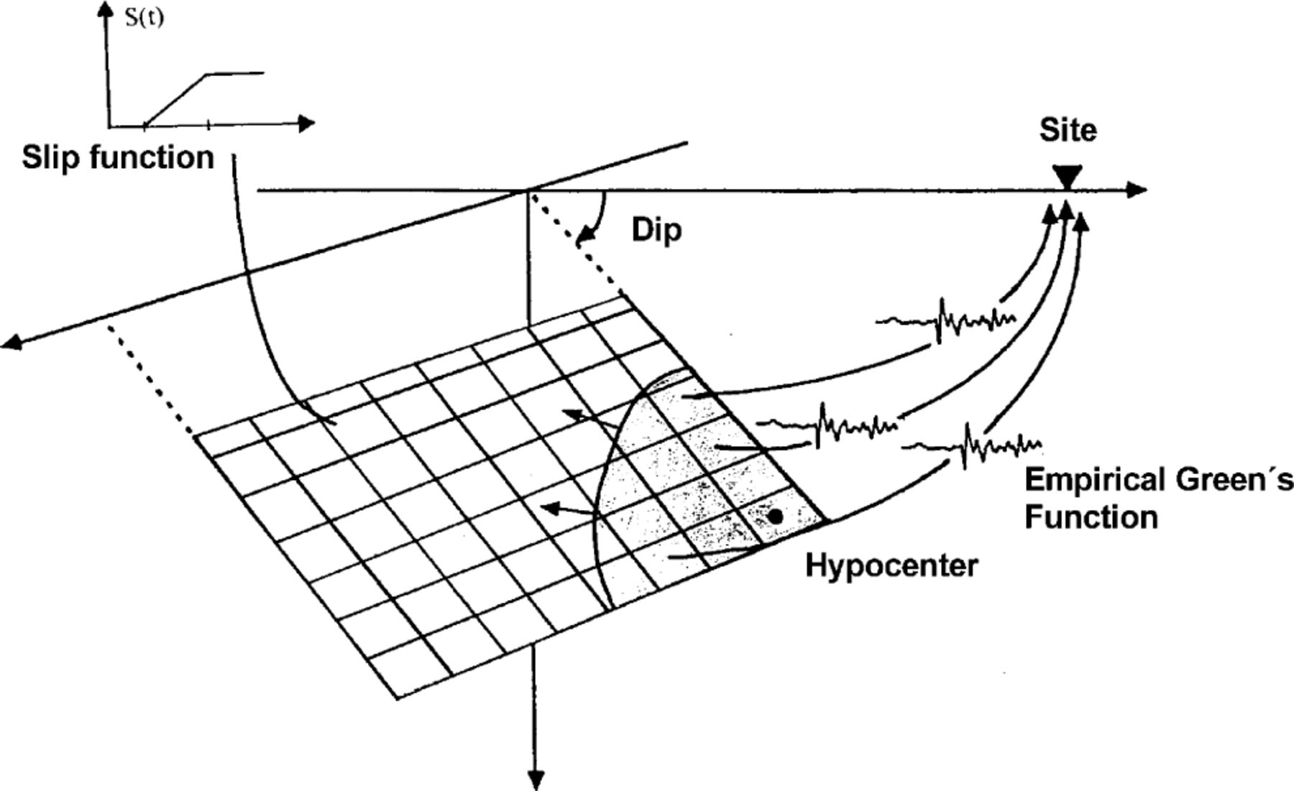
Methodology
We use a waveform of small Event (e.g. after shocks) as Empirical Green’s function.
Thus we assume that every element fault radiates in a same way with small event.
Compute time delay due to the rupture propagation and rise time.
Wössner et al. (2002)
Seismic moment on an element fault

Slide 6
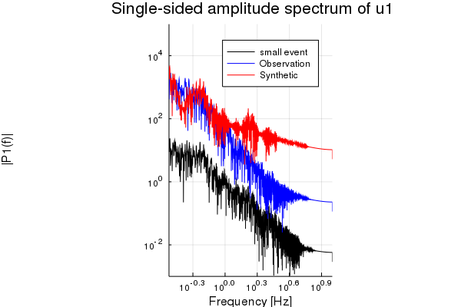
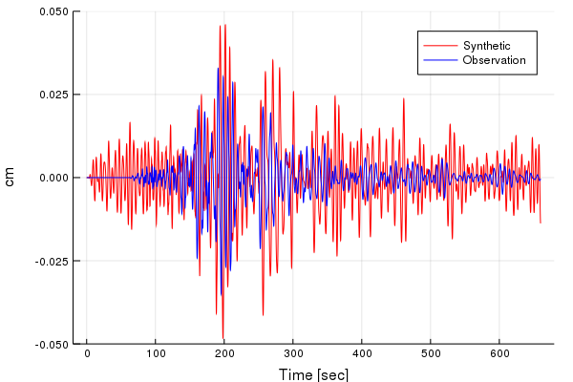
Synthetic result: No filtering
P(f)

Slide 7
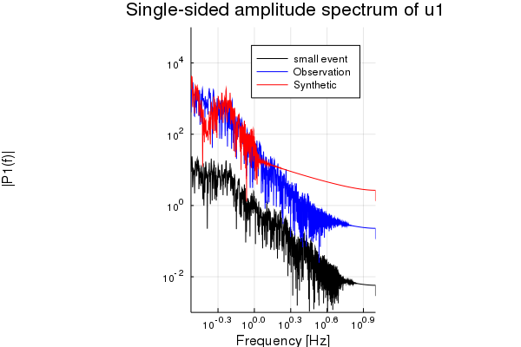
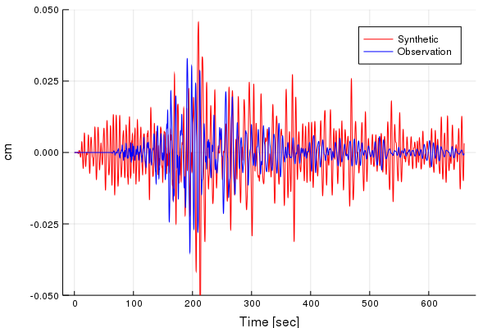
Synthetic result: Bandpass filtering
P(f)

Slide 8
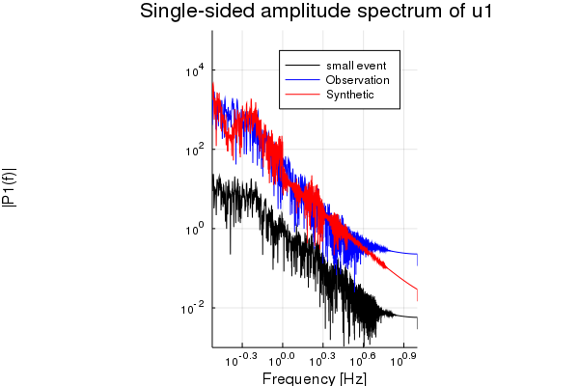
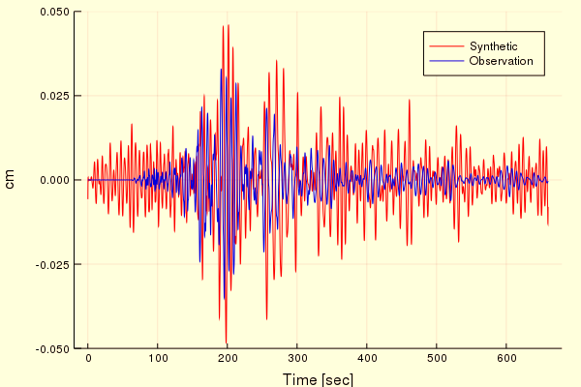
Synthetic result: Imposing Omega square model
P(f)
Bug with FFT and IFFT

