Slide 1
Kurakani
Developing a chatting application as Minor Project II
By
Bibek Bhattarai
Dipesh Gautam
Ajit Baniya
Supervisor : Er. Krishna Khadka

Slide 2
Introduction
Communication has become an integral part of our daily lives, and social media and messaging apps have revolutionized the way we connect with others.
The app aims to combine the features of Messenger's simplicity and ease of use with Instagram's visual and social features.
The app will include private messages, group chats, and a news feed to browse content from friends and followers.

Slide 3
Problem Statement
Existing messaging apps have some issues that need to be addressed, such as the lack of features to meet changing user needs and privacy and security concerns.
Many existing apps lack the features needed to meet the changing needs and expectations of mobile users.
Some users may find it difficult to navigate the cluttered interfaces and complex settings of existing messaging apps.

Slide 4
Objectives
Allow sharing of messages with a limited audience or with the public.
Allow users to post content with friends.

Slide 5
Literature Review
This system has various providing an easy and accessible way to connect with friends and family (Hampton et al., 2016).
This project focuses on privacy and security issues related to chat apps (Stieger et al., 2017).
A study found that social media users are more likely to consume ads that are personalized and relevant to their interests (Krasnova et al., 2017).

Slide 6
Required Tools
To develop our system, the following tools will be used accordingly:
React Native – For mobile app development
Node Js - For backend development
MongoDB – For storing the data
VIM - For coding
Visual Studio Code – For coding
MS-PowerPoint – For preparing the presentation

Slide 7
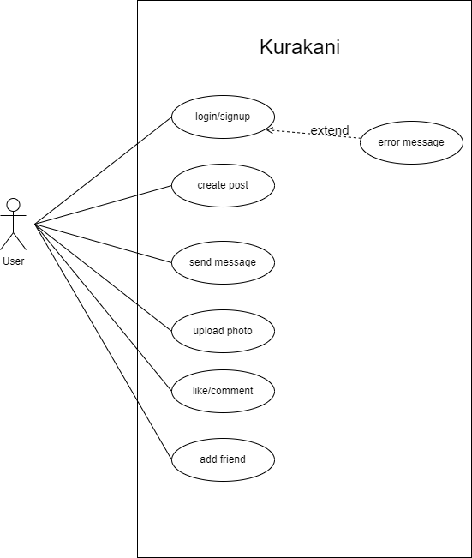
Use Case Diagram

Slide 8
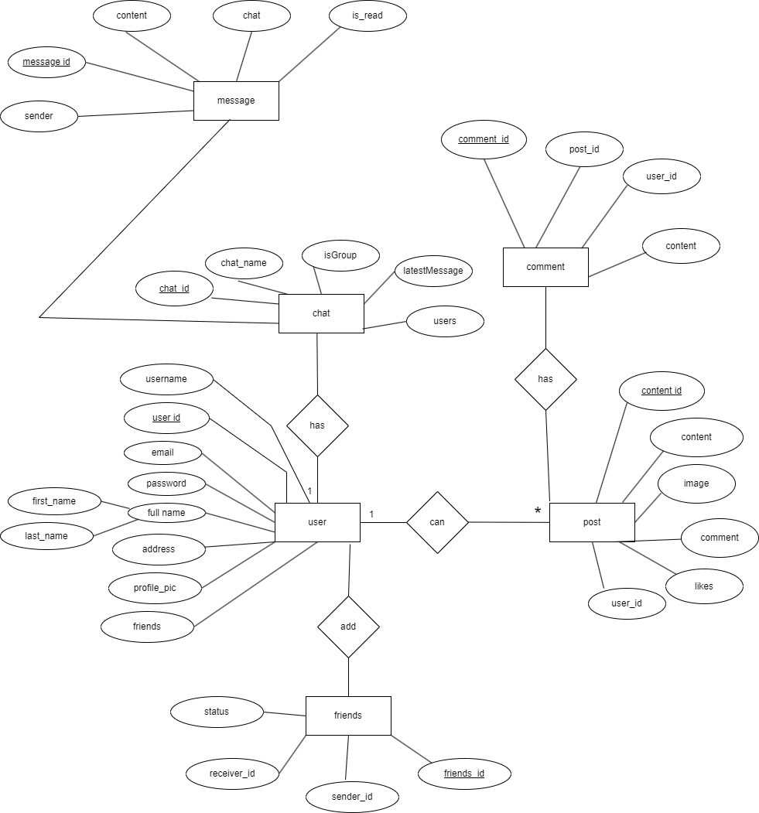
Entity Relationship Diagram (ER Diagram)

Slide 9
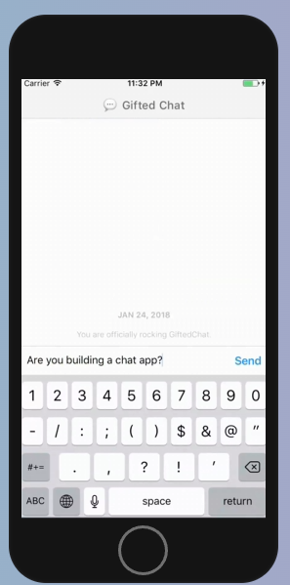
Wireframe
Figure :Message UI

Slide 10
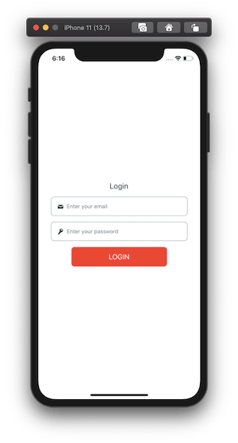
Figure : Login UI

Slide 11
Bibliography
Node.js Documentation: https://nodejs.org/en/docs/
Facebook for Developers. (n.d.). Messenger Platform Overview. Retrieved from https://developers.facebook.com/docs/messenger-platform
Socket IO: https://socket.io/
DrawIO: https://draw.io

Slide 12
Thank You
Any Queries?

