Slide 1
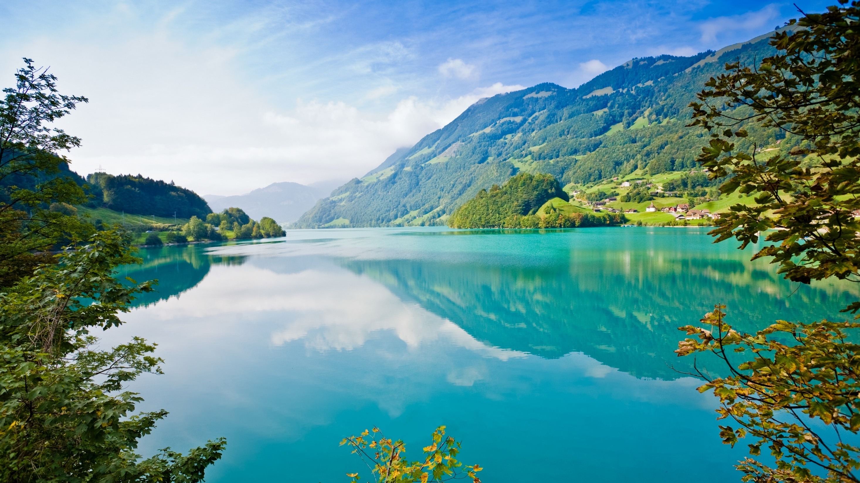
WELCOME
YOU
ALL

Slide 2

TOUR
GUIDE

Slide 3



T E C H N O L O G I E S

Slide 4


BACK END

Slide 5
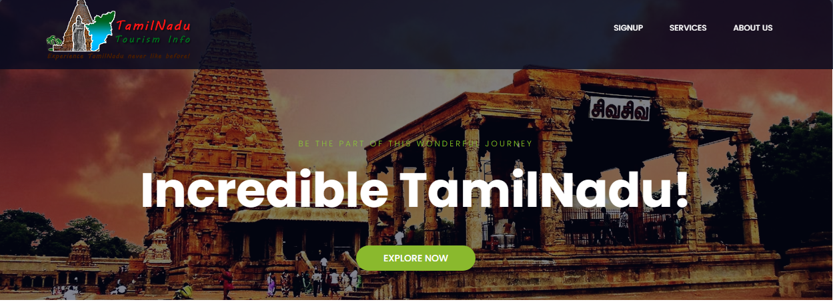

Slide 6
EASE OF NAVIGATION
Interactive Images to view for Customers
Rating of Places by the Tourist already visited
Newsletter
Tourist Place Geographic Segregation
5 Star Rating by Consumers

Slide 7
USER ENGAGEMENT
People like to View Images
We the consumer’s like to know our friends review(Rating System).
This will allow potential customer to look forward for further trip.
Iconic Places will make user stick to website for long
Places offered for Tourism will jingle in User’s mind.

Slide 8
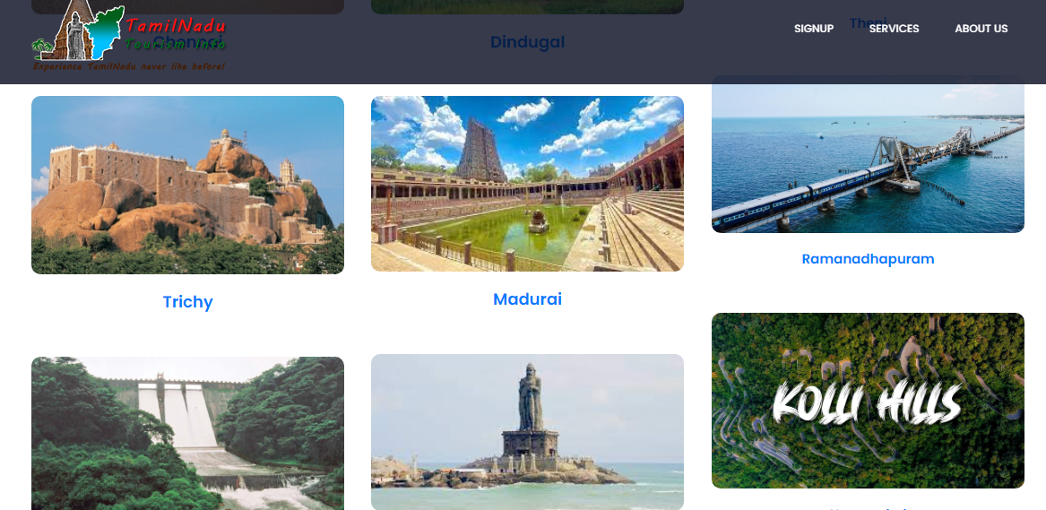

Slide 9

Power by:
BHRATHKUMAR.S
MITHUNKARTHIK.K
KURALARASAN.T
NARAENTHIRAN

