Slide 1

PHASE II – SYSTEM PROTOTYPE
BY
KURALOVIYAN SENTHILNATHAN

Slide 2
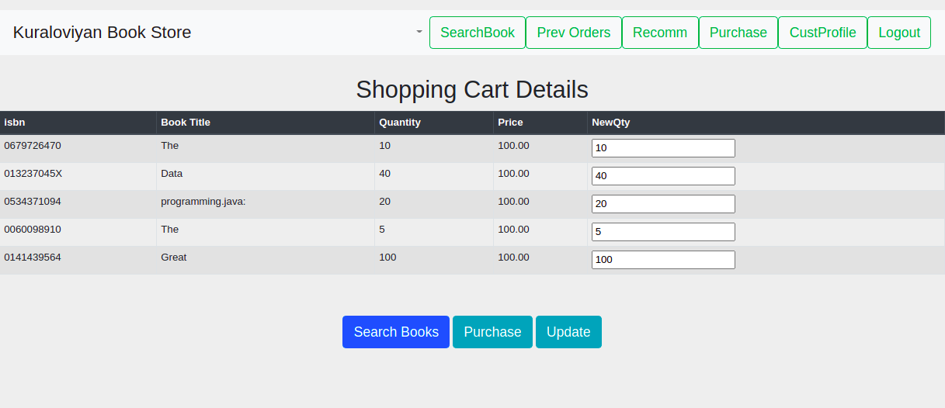
Online Bookstore
I have designed, implemented, documented, and present a database-backed Web application for an Online bookstore.
This online bookstore is implemented using MySQL Database as a Back end and using Django for functionalities(Business logic) and Front end.
All tables with the data used in the Online bookstore is stored in the MySQL Database.
The Bookstore Application prototype implemented using Django (Python , HTML).
In Django, we used Models, Forms, queue and View modules.
In the online bookstore, we can utilize a total of 14 different functionalities.

Slide 3
Online Bookstore Functionalities ______________ For Customers
A customer can register themselves and login to their own account to utilize functionalities like:
(a)Searching for a book based on author/publisher/title/subject.
(b)Checking their previous orders and their Delivery status.
(c)Checking recommended books for them based on their previous purchases.
(d)Checking comments placed for books by multiple users.
(e)Checking other customer profiles to view basic information and their comments so that they can choose how useful a comment was and also rate the customer as trusted or non-trusted.
(f) Purchasing books by placing them in a shopping cart and ordering them based on their desired quantity of books.

Slide 4
(a)Searching for a book based on author/publisher/title/subject
(b) The manager can perform book administration functionalities like Adding a new book
(c) The manager can also perform book administration functionalities like changing existing book details like the Stock level and delete books if discontinued.
(d) The manager can check all the pending orders of all customers
(e) Only a Manager can add another manager and can use the Add manager Functionality.
(f) A manager can review statistics like top 5 customers by invoice amount and top 5 books by sales quantity of that year.
Online Bookstore Functionalities ______________ For Managers

Slide 5
Overcoming Challenges
One of the main challenges I faced at the beginning was downloading MySQL database client library as it took me more than 2 hours to understand what I was missing.
Another major challenge I faced was learning and implementing the application using database views.
Last but not the least was implementing the shopping cart for extra credit in a limited timeframe.

Slide 6
Differences from Phase-I
One of the main differences from Phase-1 was that a Manager has to have another separate customer account to purchase books.
Logic used in the functionality for recommending books for Customers.

Slide 7
Thank you!

