Slide 1
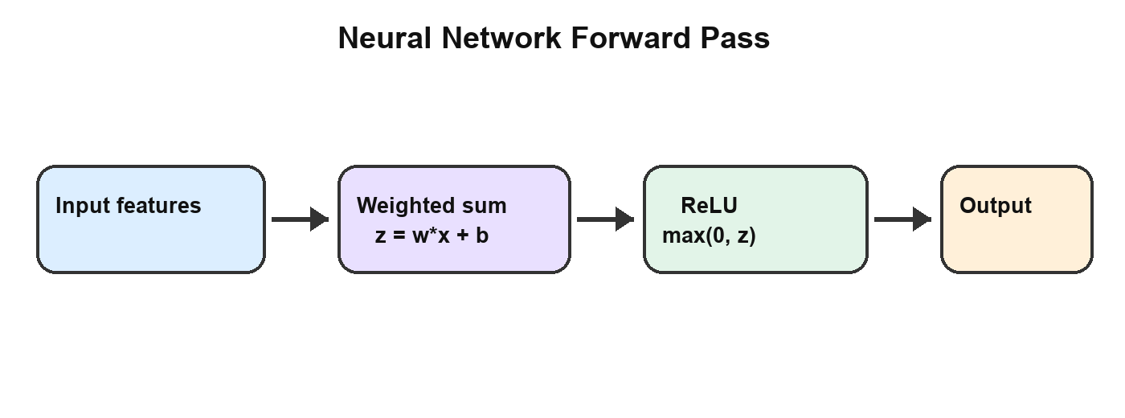
Neural Network Forward Pass
[Slide 1] A neuron combines input values using learned weights and a bias.

Slide 2
Activation and example
[Slide 2] ReLU returns max(0, z).
For z = -2, the output is 0. For z = 5, the output is 5.
Check: identify the operation that occurs before activation.

