Slide 1
GPPU Experiment P1
(2025)
2026/2/24 – 2/26
RCNS I-03
Name: 倉田 綸太郎
E-mail:kurata.rintaro.s7@dc.tohoku.ac.jp
Finish date/time : 2026/2/26 :

Slide 2
Rule
Do not rewrite program codes used in your laboratory or written by your senior students.
Please write your code by yourself or using the base codes in the laptop PC.

Slide 3
1.1 Considering Compton scattering, show E’γ and E’e using Eγ, me and θ .
E’γ
Eγ
θ
e-
me
E’e
1.2 Calculate E’γ and E’e when Eγ =1.0[MeV], me =0.511 [MeV/c²] and θ =180º.

Slide 4
Calculation page

Slide 5
2.1 Basic detector design z-x view
(@ y=0)
z
70cm
30cm
20cm
90cm
50cm
40cm
x

Slide 6
2.2 Basic detector design y-x view
(@ z=0)
y
70cm
30cm
20cm
1 LeadShilding
(G4_Pb)
2 CupperShilding
(G4_Cu)
70cm
30cm
20cm
x
3 MeasurementArea
(G4_Air)

Slide 7
3 Ge detector design
Φ80mm
Al case (G4_Al)
thickness 0.8mm
Φ75mm
z
5mm
Φ70mm
Vacuum case
(G4Galactic)
Φ8mm
Kapton window
(G4_Kapton)
thickness 0.1mm
Cu case (G4_Cu)
thickness 0.8mm
60mm
45mm
Ge crystal
(G4_Ge)
80mm
Vacuum Core
(G4Galactic)
100mm
Vacuum Space
(G4Galactic)

Slide 8
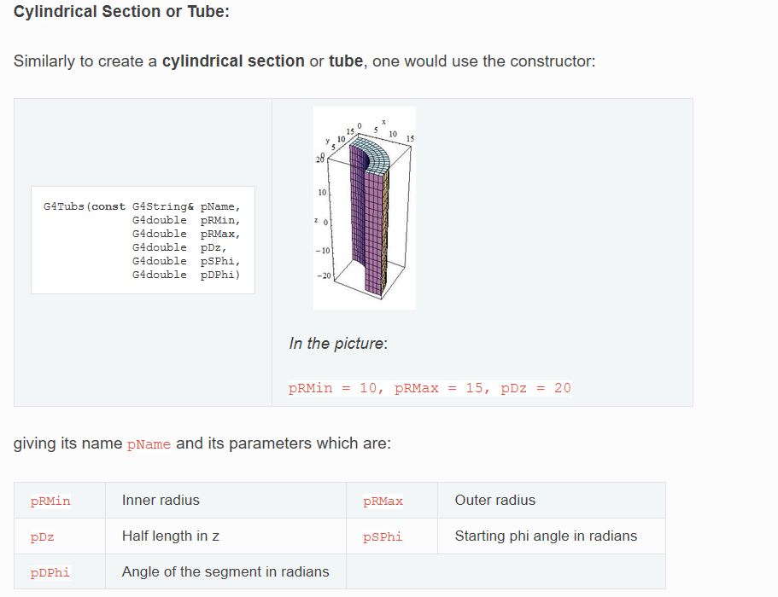

Slide 9
3.2 Ge detector Position
z
y
x
x
Set top-center part of Al case to (0,0,0)

Slide 10
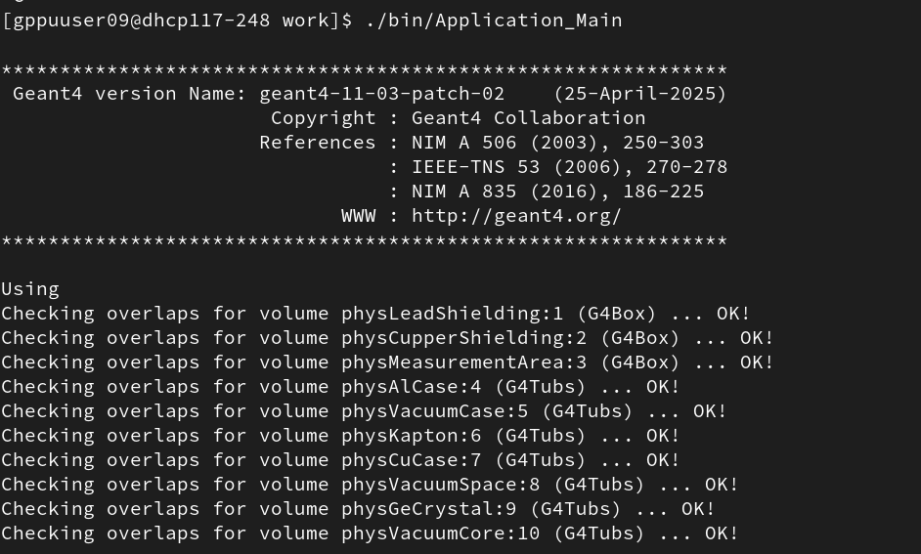
4 Check Geometry using geantino
4.1 Check overlap
[Past your output]

Slide 11
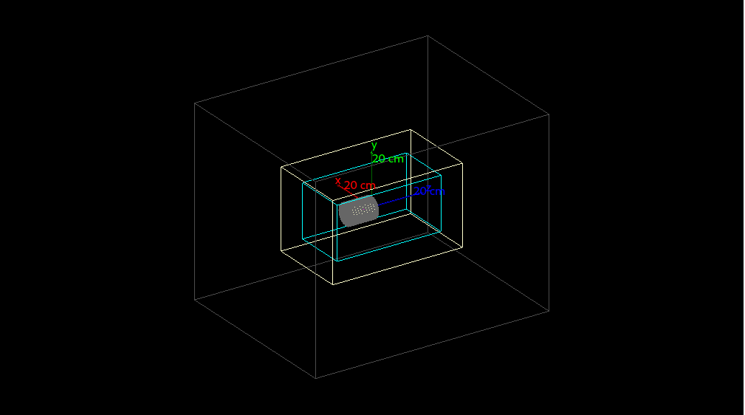
[Past your screen capture of Qt viewer]

Slide 12
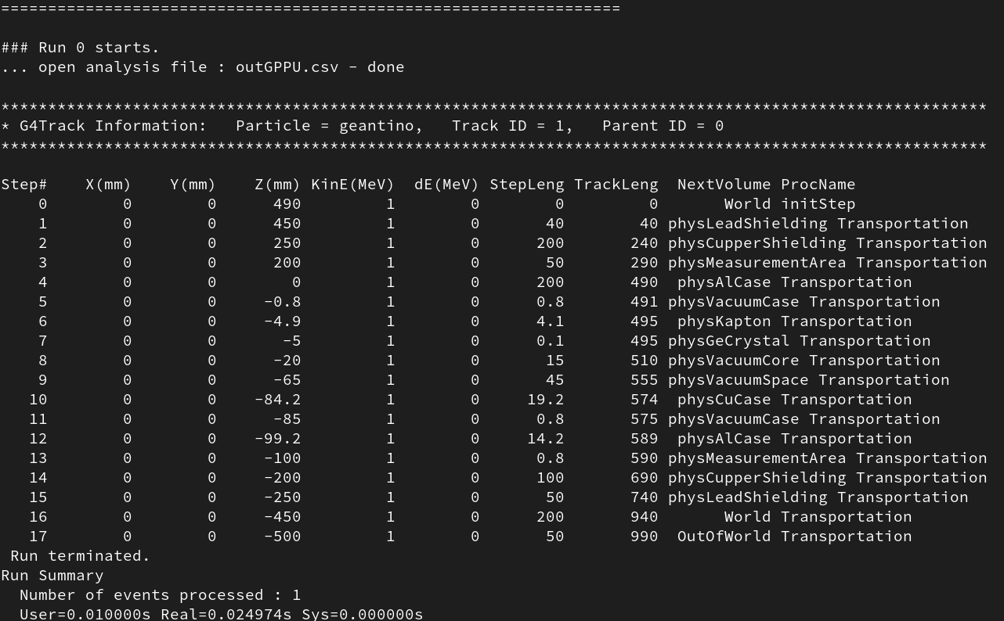
4.2 Show trajectories output of running geantino from position (0,0,490mm)
and direction (0,0,-1). [Past your output /tracking/verbose 1]
Check crossing positions of each geometrical elements are same as your expectations.
[Past your output]

Slide 13
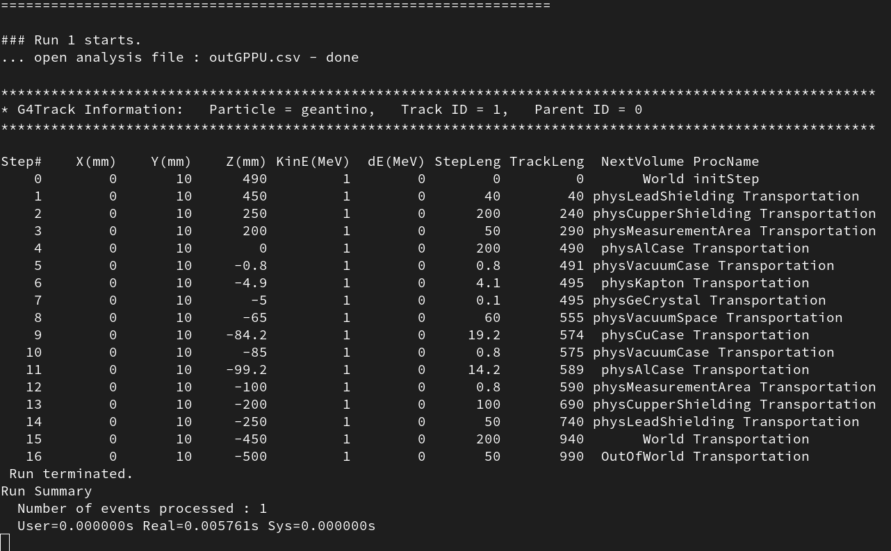
4.3 Show trajectories output of running geantino from position (0,10mm,490mm)
and direction (0,0,-1).
Check crossing positions of each geometrical elements are same as your
expectations.
[Past your output]
The geantino did not pass through the Vacuum Core.

Slide 14
5.1 Activate Ge detector as a sensitive detector and record the energy deposition of each events and primary vertex information into root/csv file with tuple format .
Tuple formant
Name : Edep
0th column : Event number (integer)
1st column : Total energy deposit in Ge crystal (double)
2nd column : Primary vertex position x [mm] (double)
3rd column : Primary vertex position y [mm] (double)
4th column : Primary vertex position z [mm] (double)
5th column : Primary particle direction vector x (double)
6th column : Primary particle direction vector y (double)
7th column : Primary particle direction vector z (double)

Slide 15
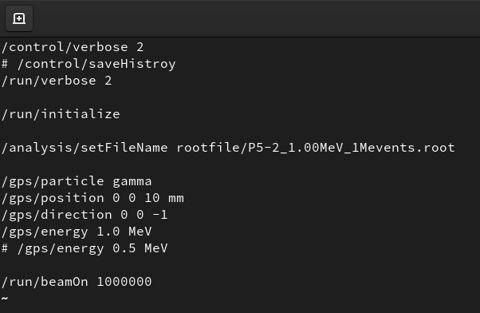
5.2 Generate 1000000 event of 1.0 MeV gamma position(0,0,10mm) and direction (0,0,-1) . Make a histogram of energy deposition in Ge crystal and calculate the efficiency of detecting full energy deposition (gamma events shown as 1.0 MeV).
[Past your macro file]

Slide 16
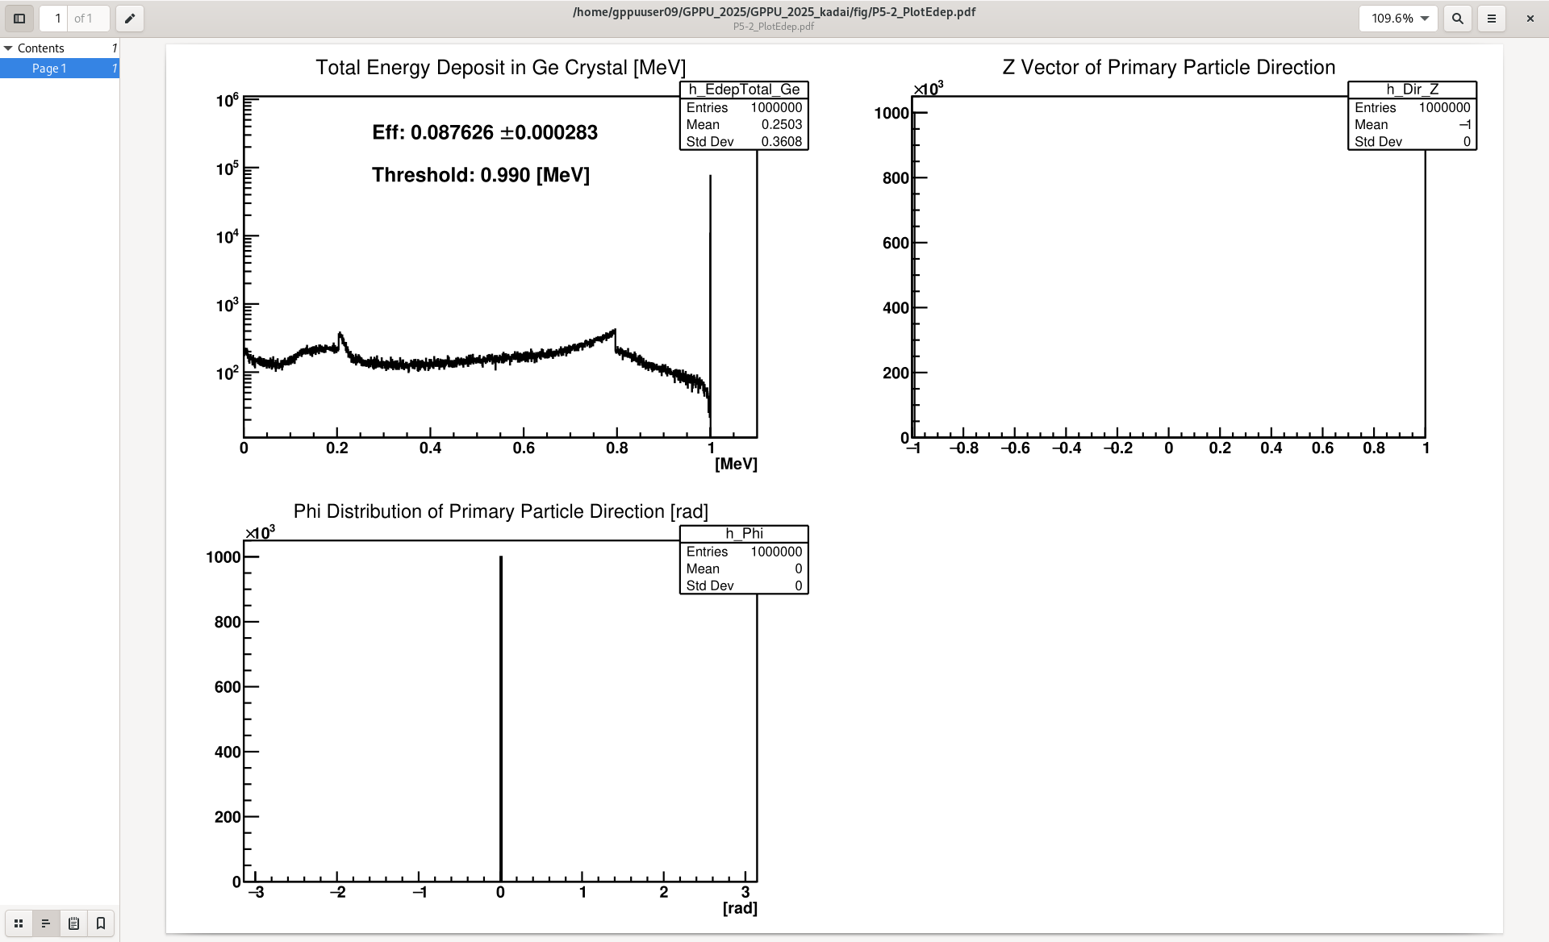
[Figure of Total energy deposit in Ge crystal ]
Detection efficiency of 1 MeV gamma event: 0.087626±0.000283 [stat.]

Slide 17

5.3 Generate 1000000 event of 1.0 MeV gamma position(0,0,10mm) and uniformed direction . Make a histogram of energy deposition in Ge crystal and calculate the efficiency of detecting full energy deposition (gamma events shown as 1.0 MeV). Make figures of primary particle directions (φ and cosθ distribution )
[Past your macro file]

Slide 18
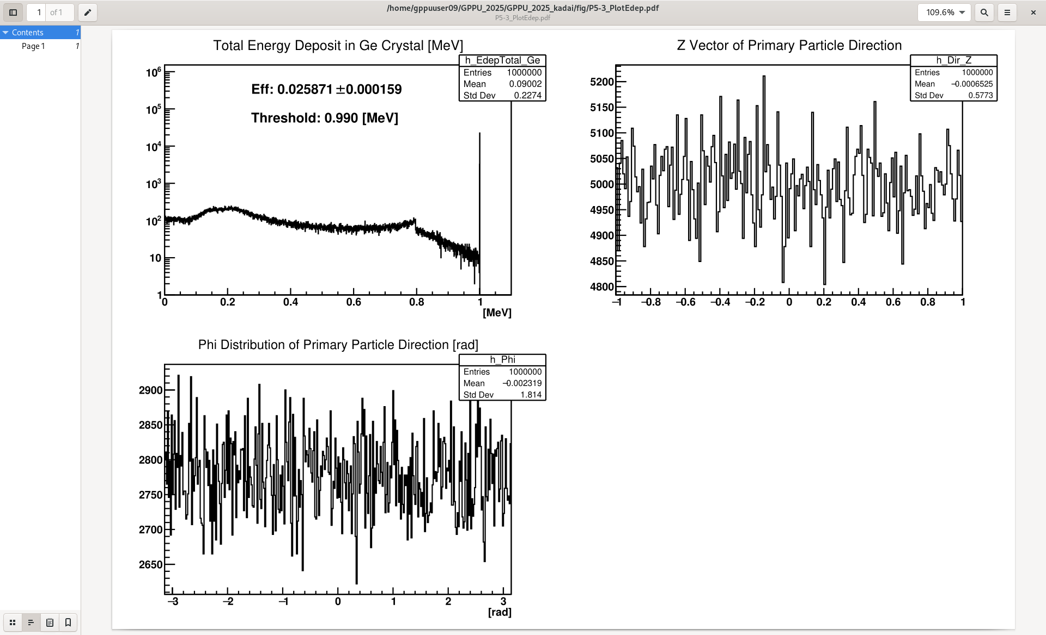
[Figure of Total energy deposit in Ge crystal ]
Detection efficiency of 1 MeV gamma event: 0.025871± 0.000159[stat.]

Slide 19
[φ distribution of primary particle direction vector figure]

Slide 20
[cosθ distribution of primary particle direction vector figure]

Slide 21
5.4 Do 5.3 as different gamma energies [0.25MeV, 0.5MeV, 0.75MeV, 1.25MeV, 1.5MeV,2.0MeV,2.5MeV]. Make histograms of each energies and calculate detection efficiency.
Make table and figure of detection efficiency as a function of gamma energy.
Gamma Energy | Detection Efficiency (w/ stat. error)
0.25 | 0.039323±0.000194362
0.5 | 0.03407±0.000181409
0.75 | 0.028909±0.000167551
1.0 | 0.025871±0.00015875
1.25 | 0.023601±0.000151802
1.5 | 0.021483±0.000144988
2.0 | 0.01808±0.000133241
2.5 | 0.015326±0.00012249

Slide 22
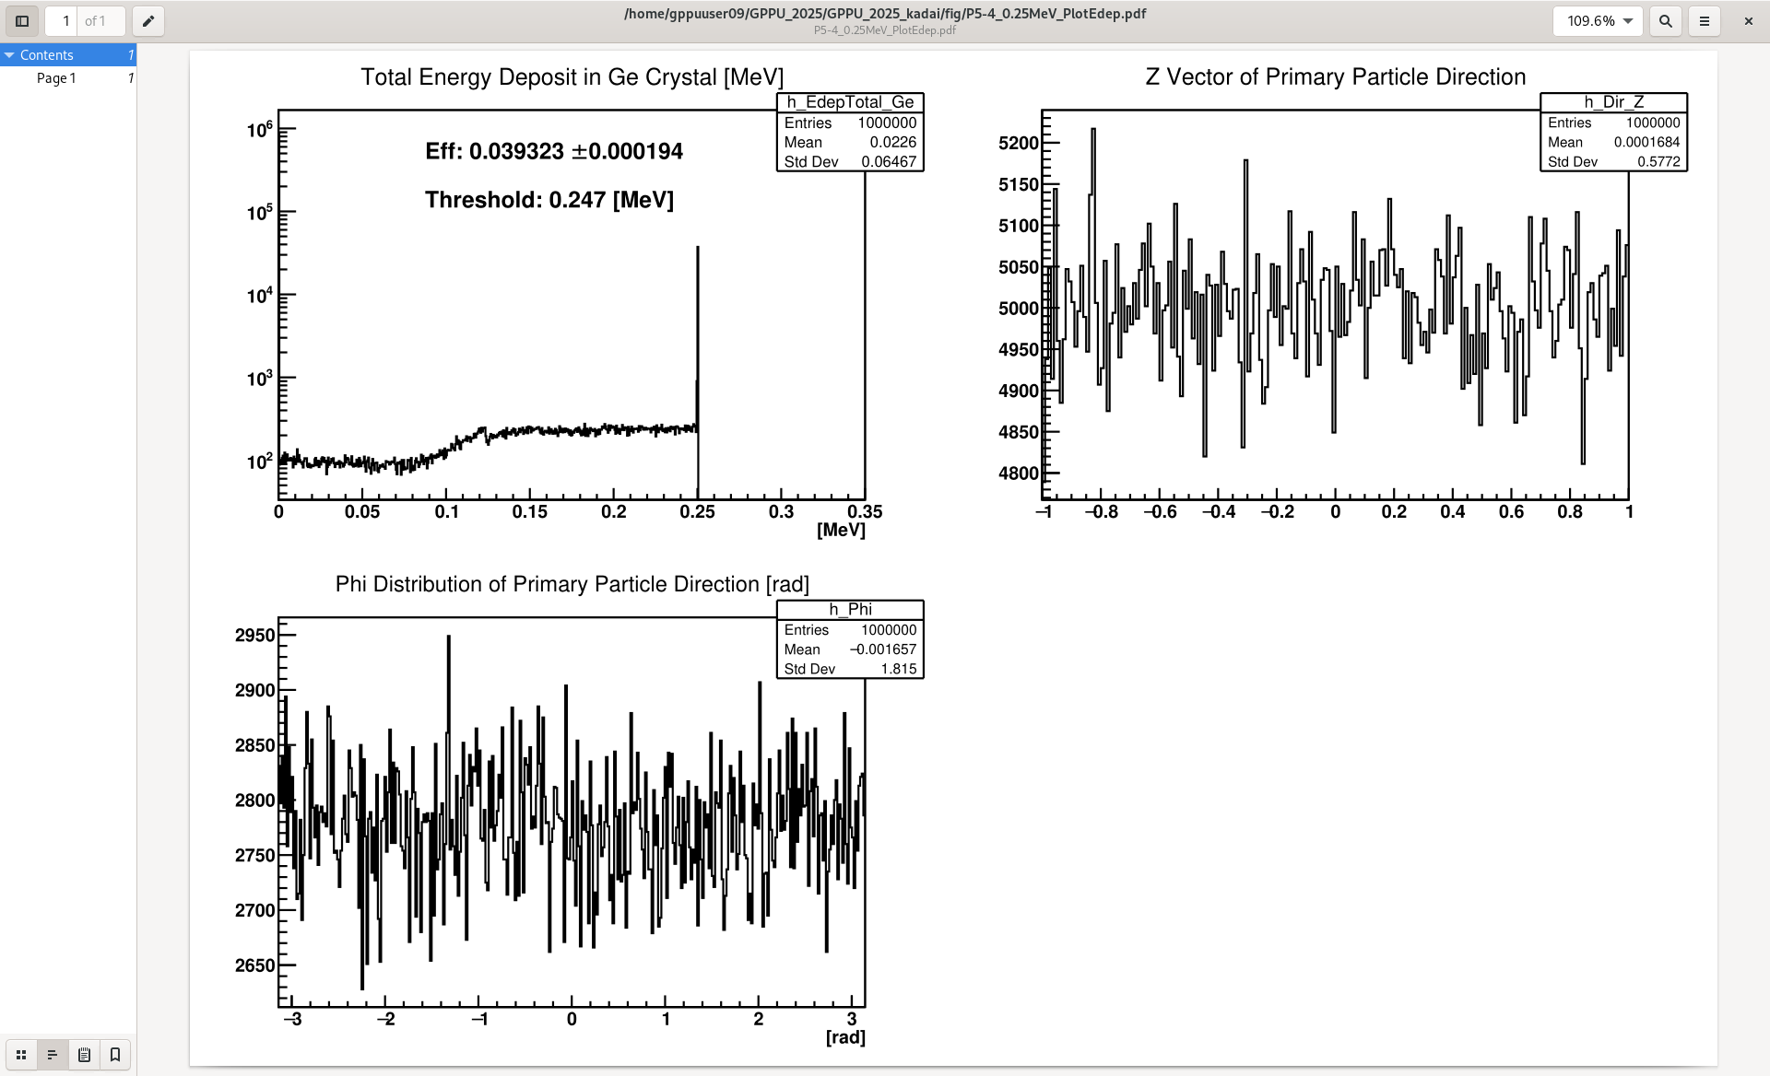
0.25MeV

Slide 23
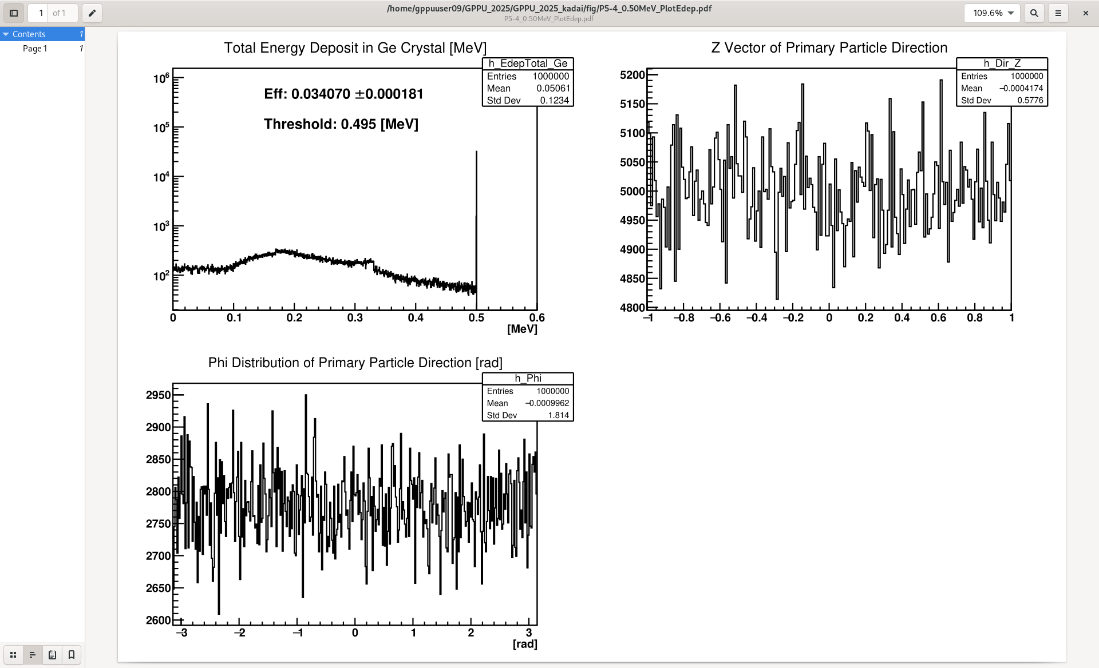
0.5MeV

Slide 24
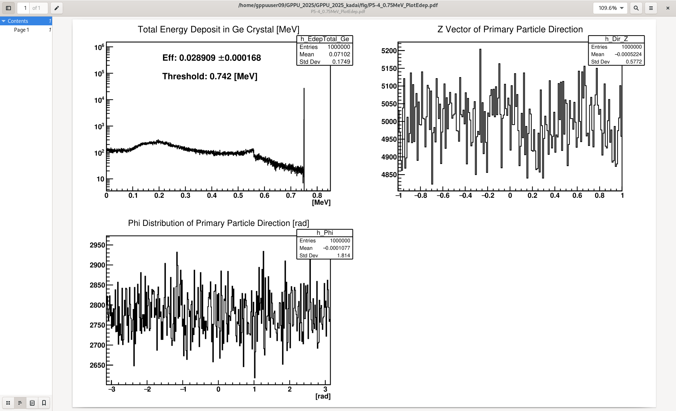
0.75MeV

Slide 25
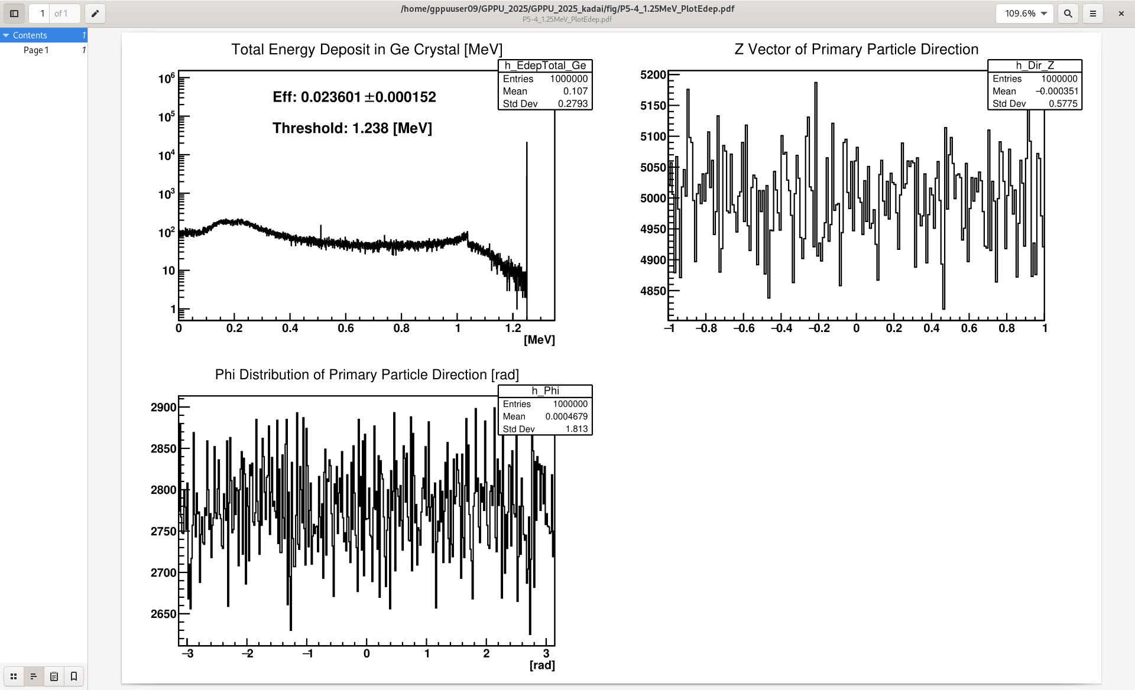
1.25MeV

Slide 26
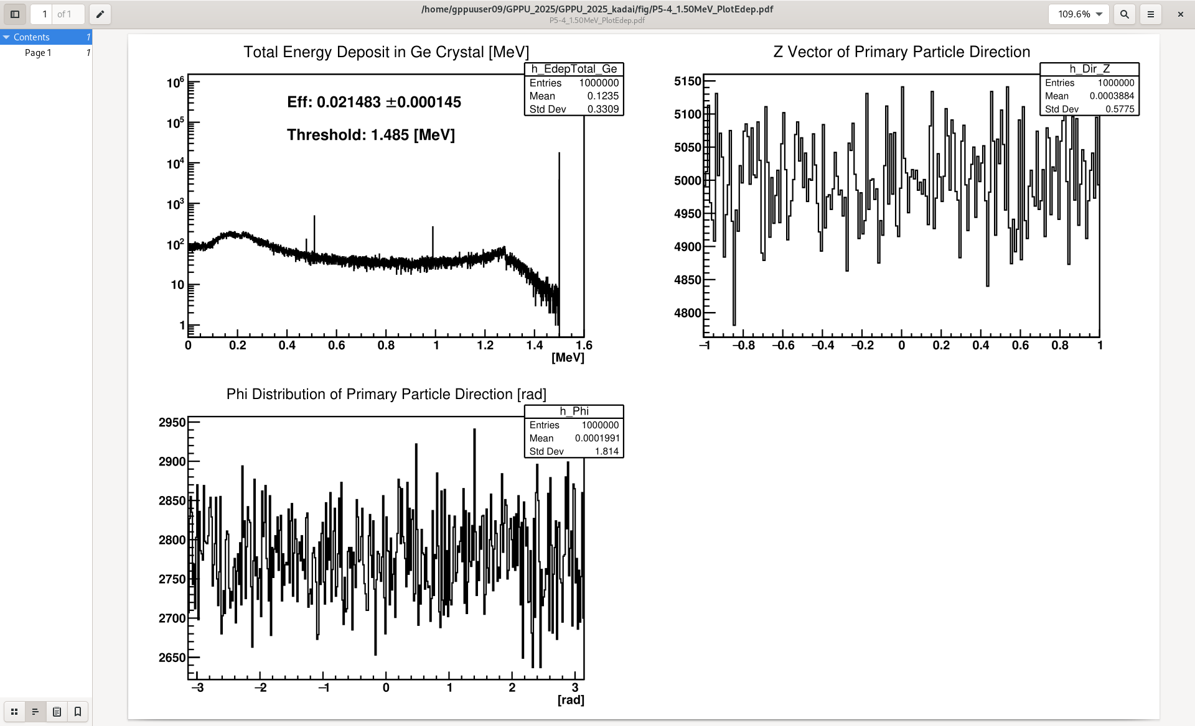
1.5MeV

Slide 27
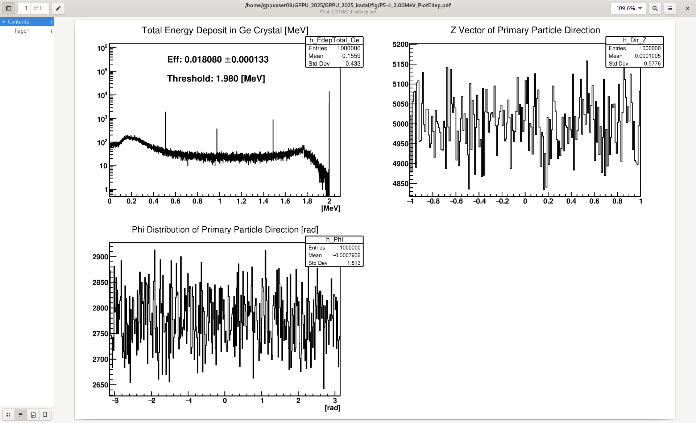
2.0MeV

Slide 28
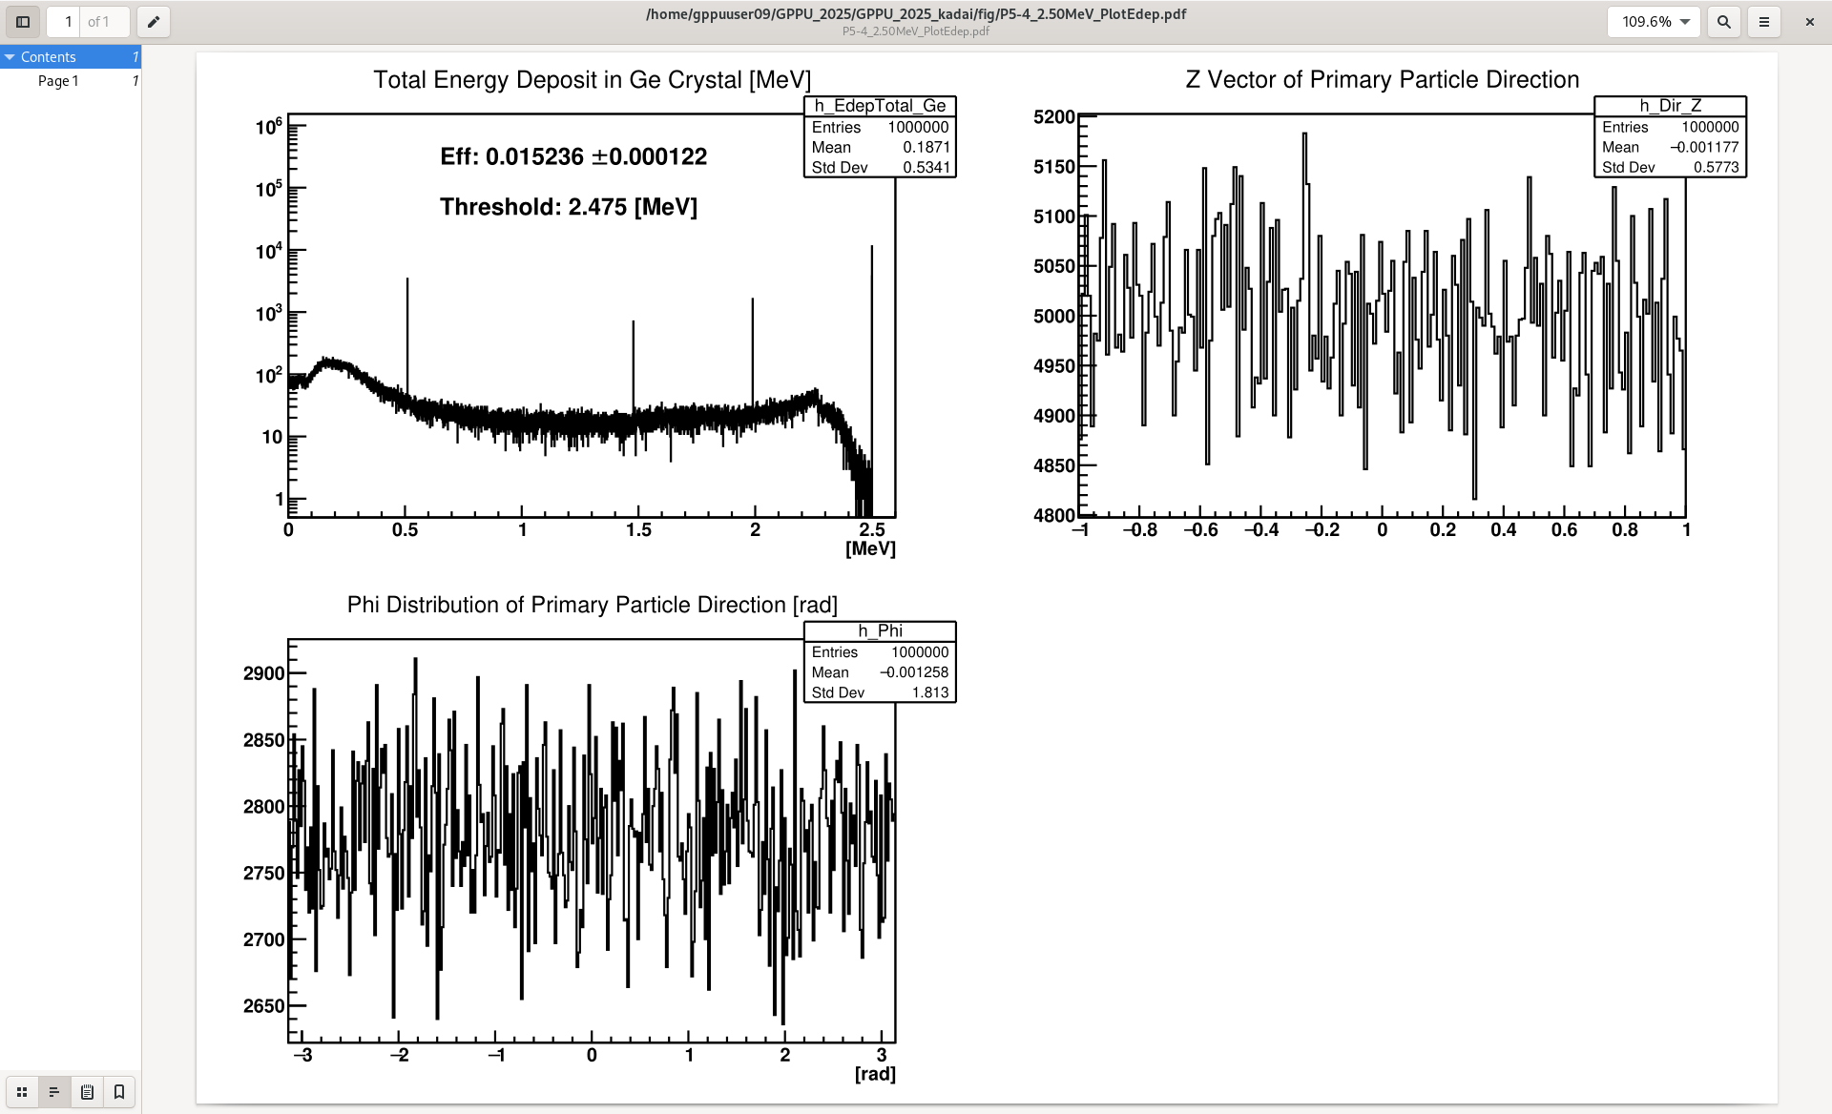
2.5MeV
Add comment for each peaks and edges shown in this figure

Slide 29
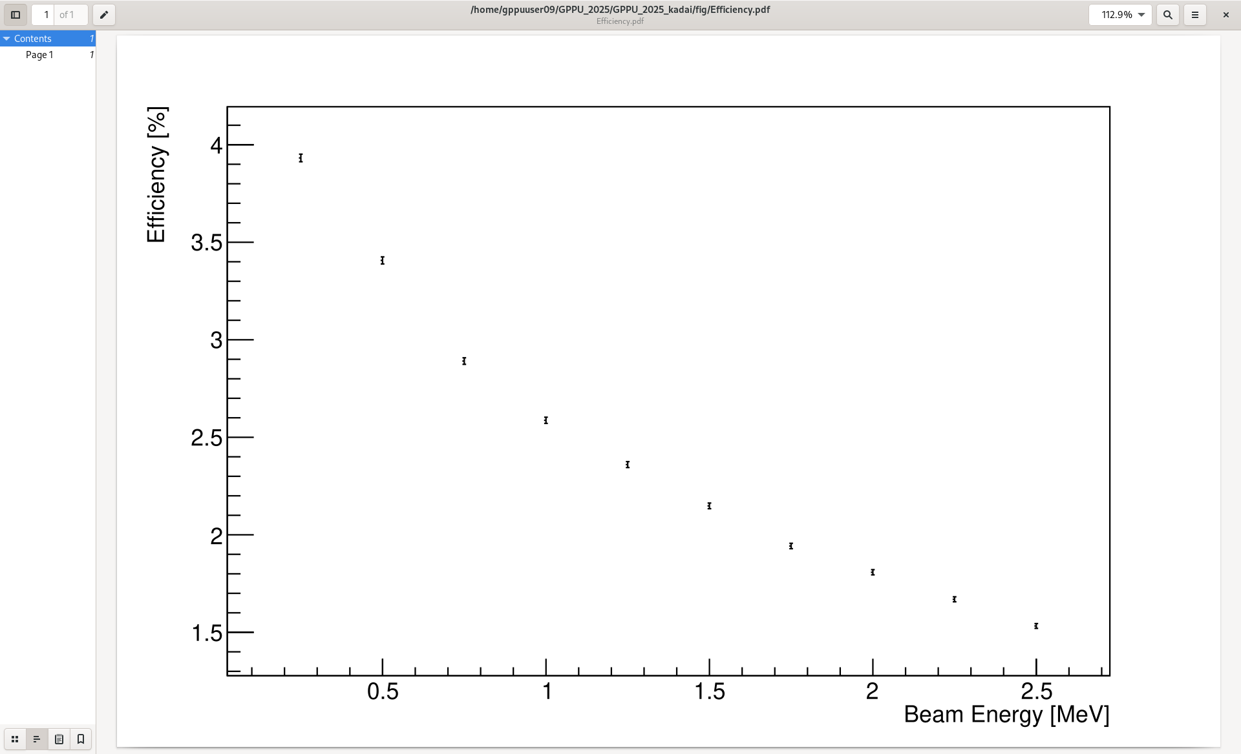
Energy vs Detection efficiency
Add comments
光電効果の断面積がエネルギーのべき乗に反比例すること、またエネルギーが上がるほどコンプトン散乱の影響でガンマが逃げていく効果が見えている

Slide 30
6. Extra
6.1 Set cupper square plate xwidth=20mm, ywidth=20mm, zwidth=5mm on the Ge detector top-center.
Check overlaps.
Al case (G4_Al)
thickness 0.8mm
Cu plate
Vacuum case
(G4Galactic)
Kapton window
(G4_Kapton)
thickness 0.1mm
Cu case (G4_Cu)
thickness 0.8mm
Ge crystal
(G4_Ge)
Vacuum Core
(G4Galactic)
Vacuum Space
(G4Galactic)

Slide 31
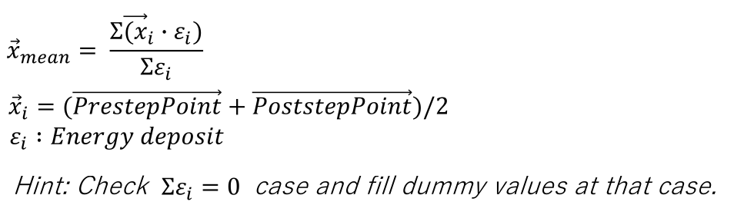
6.2 Add record the mean energy deposition point of each event into root/csv file with tuple format .
Tuple formant
Name : Edep
0th column : Event number (integer)
1st column : Total energy deposit in Ge crystal (double)
2nd column : Primary vertex position x [mm] (double)
3rd column : Primary vertex position y [mm] (double)
4th column : Primary vertex position z [mm] (double)
5th column : Primary particle direction vector x (double)
6th column : Primary particle direction vector y (double)
7th column : Primary particle direction vector z (double)
8th column : Mean energy deposition point x [mm] (double)
9th column : Mean energy deposition point y [mm] (double)
10th column : Mean energy deposition point z [mm] (double)

Slide 32
6.3 Generate 1000000 event of 1.0 MeV gamma inside the cupper plate uniformly and uniformed direction . Make a histogram of energy deposition in Ge crystal and calculate the efficiency of detecting full energy deposition (gamma events shown as 1.0 MeV). Make figure of primary vertex positions and mean energy deposit positions.
[Past your macro file]

Slide 33
[Figure of Total energy deposit in Ge crystal ]
Detection efficiency of 1 MeV gamma event: ± [stat.]

Slide 34
[Figure of Primary Positions ]

Slide 35
[Figure of Mean energy deposit Positions ]

Slide 36
6.4 Generate 1000000 event of 1.0 MeV gamma from the cupper plate surface uniformly and uniformed direction . Make a histogram of energy deposition in Ge crystal and calculate the efficiency of detecting full energy deposition (gamma events shown as 1.0 MeV). Make figure of primary vertex positions and mean energy deposit positions
[Past your macro file]

Slide 37
[Figure of Total energy deposit in Ge crystal ]
Detection efficiency of 1 MeV gamma event: ± [stat.]

Slide 38
[Figure of Primary Positions ]

Slide 39
[Figure of Mean energy deposit Positions ]

Slide 40
6.5 Describe the difference of observed energy spectra between from inside the material and surface. Describe how these spectra can be distinguished?

Slide 41
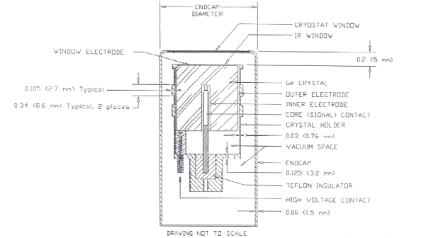
Appendix. Precise Ge detector

