Slide 1

Sprocket Central Pty Ltd
Data analytics approach
Nurlan Kurbanov

Slide 2
Agenda
Introduction
Data Exploration
Model Development
Interpretation

Slide 3

Introduction
Top 1000 Customers for targeting
Question: From datasets analyze which of 1000 should be targeted to drive the most value for the “Sprocket Central”

Slide 4
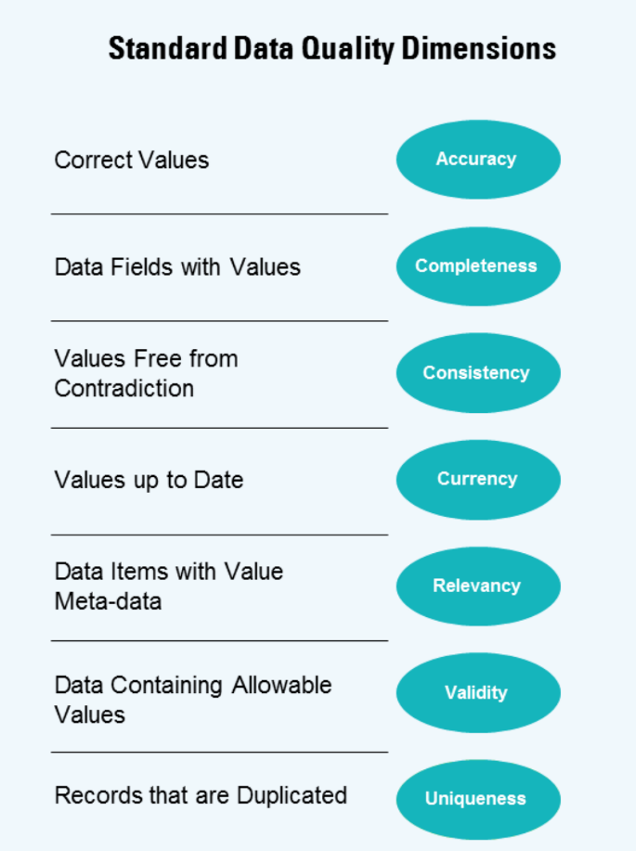
Data Exploration
Data Quality Assessment
Dataset Transaction:
online_order - incompleteness; brand – incompleteness; order_status – “Cancelled”; product_first_sold_date – invalidity; New column profit added for further analysis
Dataset Customer Address:
state – Inonsistency
Dataset Customer Demographic:
gender – Inonsistency; DOB – Inonsistency; Default – Column was too complicated to understand. Deleted

Slide 5
Data Exploration
Customer Age Distribution
Customers were divided into age groups based on decades.
Highest distribution point for “New” and “Old” customer is 40-49
In “Old” customers age distribution shows between 30-69 is majority. For New customers majority contains between 30-69. Beside the age group 30-39

Slide 6
Data Exploration
Gender Distribution
Bike Related purchases past 3 year
“F” females have higher purchase rate
Females have 10806 units more purchase than males, accordingly 198151.1 USD more profit

Slide 7
Data Exploration
Wealth Segmentation
OLD Customer
In both old and new customer “Mass Customer” has biggest share.
NEW Customer

Slide 8
Model Development
Job industry distribution
Main Industries our customers are from Manufacturing, Finance Services, and Health. For both group of customers.
Decrease in the share of customers from Retain industry.

Slide 9
Model Development
RFM analysis
RFM analysis done to make precise further targeting of customers.
By ranking customers: Premium, gold, silver, bronze.
In further analysis we will work with “Premium” and part of “Gold” customers

Slide 10
Model Development
Targeting customers segmentation
Top 1000 customers from RFM analysis. The customers creating most value to company by frequency, recency, monetary variables

Slide 11
Data Exploration
RFM analysis
More recently visited customers generates more revenue than distant past.
Higher profits generated from recent customers

Slide 12
END

