Slide 1
OOP (Object Oriented Programming)

Slide 2
OOP (Object Oriented Programming)
Class
Object or Instance
Initializer or Constructor
Attribute
Method

Slide 3
OOP (Obýekte gönükdirilen programmirleme)
OOP – de klas, obýekt düşünjesi örän möhüm. Sebäbi, OOP-däki ähli işler klas bilen baglanyşykly. Meselem, bir topar obýekt bar we olary synplandyrmaly bolsa, onda obýektleriň meňzeş aýratynlyklaryna görä, olary synplandyrmaly bolýar.
Programmirlemekdäki klas(synp) düşünjesi hem bu ýagdaýda işlär. Ýagny, meňzeşlikleri bar bolan obýektleri bir topar edip düşnükli programma eýe bolmak;

Slide 4
Class Customer Name Surname Age Email Id
Object, Instance (Example) Customer_1 Anna Gurbanov 33 anna_g@gmail.com 17

Slide 5
Class Product Name Stock code Price
Object, Instance (Example) Product_1
Keyboard
ABC12
400

Slide 6
Class Employee Name Surname Salary Department
Object, Instance (Example) Employee_1
Chary
Geldiyev
6000
“IT”

Slide 7
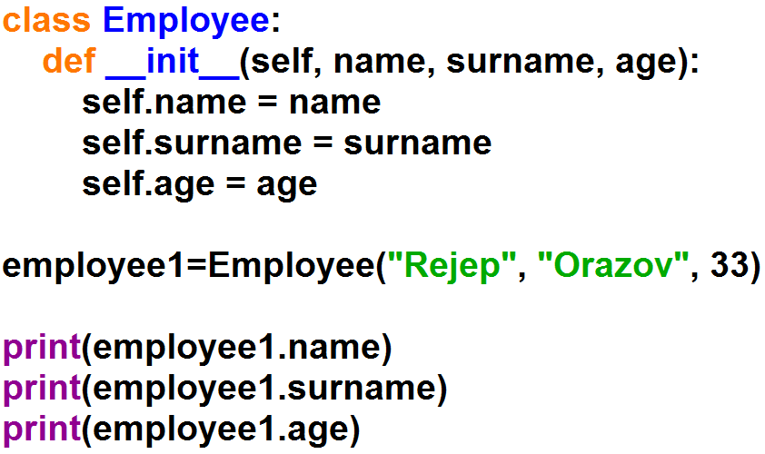
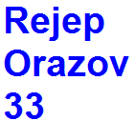
OOP (Object Oriented Programming)

Slide 8
