Slide 1
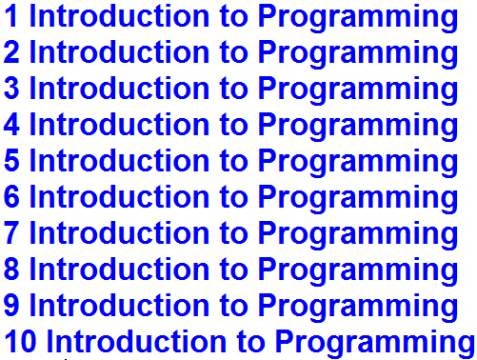
1. Write the code for the following application.
Output

Slide 2
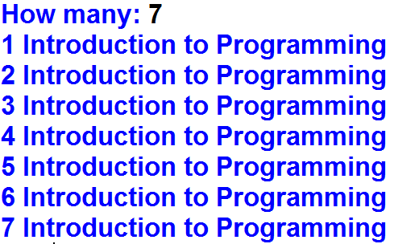
2. Write the code for the following application.
Output

Slide 3
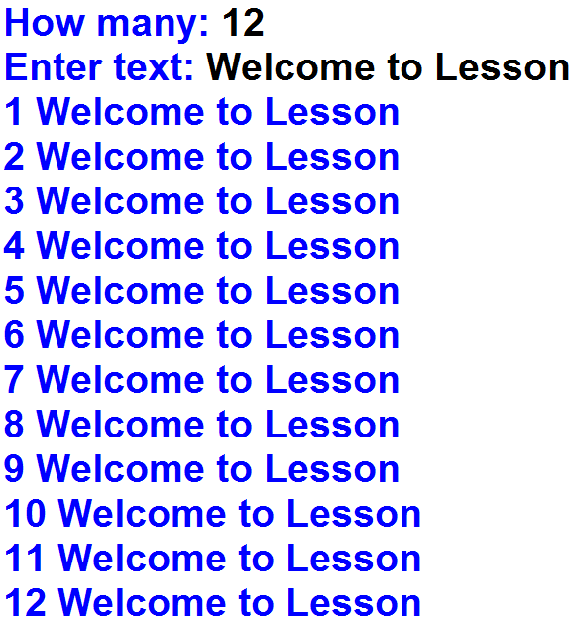
3. Write the code for the following application.
Output

