Slide 1
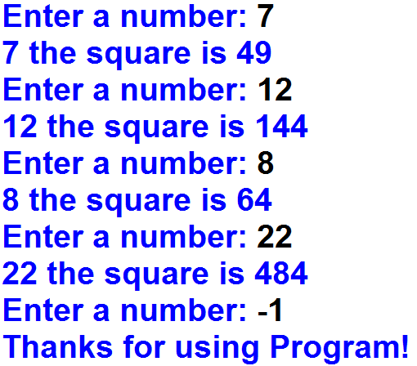
1. Calculate the squares of all inputted numbers until the user inputs -1.
Output

Slide 2
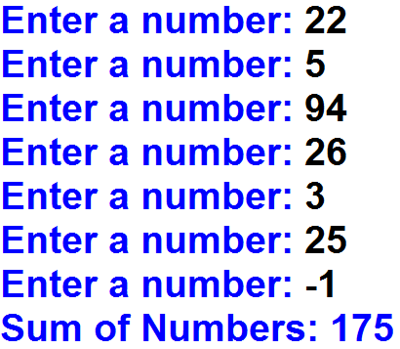
2. Calculate the sum of all inputted numbers until the user inputs -1.
Output

Slide 3
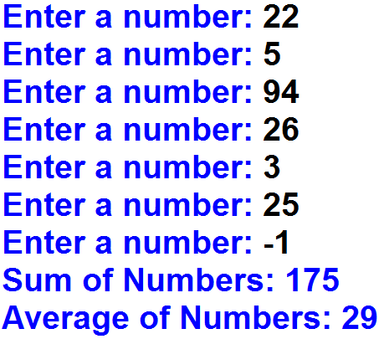
3. Calculate the sum and average of all inputted numbers until the user inputs -1.
Output

Slide 4
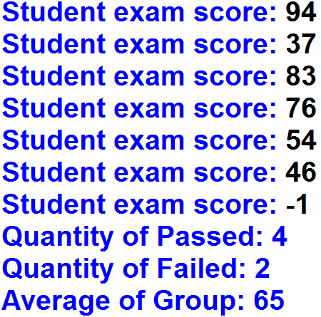
4. The teacher wants to know the quantity of students that passed and failed exam and average of group. Get and calculate inputted exam scores until the teacher inputs -1.
Output

Slide 5
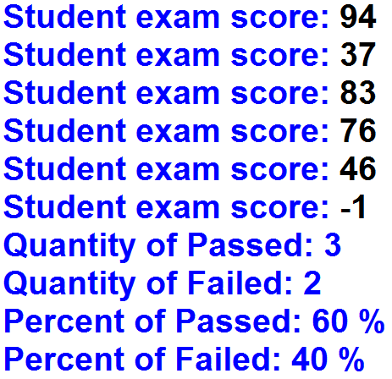
5. The teacher wants to know the quantity and percent of students that passed and failed exam. Get and calculate inputted exam scores until the teacher inputs -1.
Output

