Slide 1

String Methods

Slide 2
Data Types
Data Type | Examples
integer | 22, 5, 94, -30, -24
float | 0.5, 1.25, 3.14, -4.5, -2.7
string | “hello”, “4 cats”, “a”, “aa”
boolean | True, False

Slide 3


String Length
To get the length of a string, use the len() function.

Slide 4


String Length
To get the length of a string, use the len() function.

Slide 5
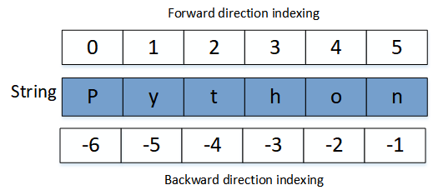
Slicing String
Index
String

Slide 6
Slicing String
String
Index

Slide 7
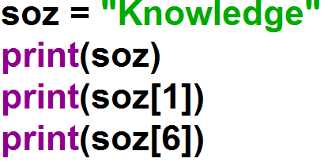
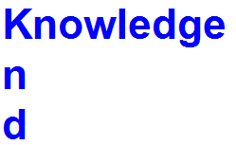
Slicing String

Slide 8
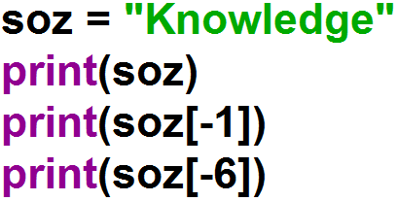
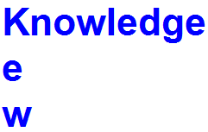
Slicing String

Slide 9
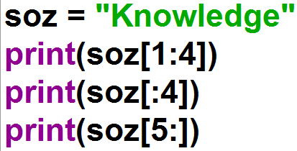

Slicing String

Slide 10
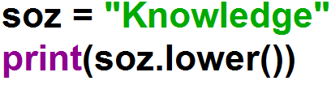

lower() Method
Converts a string into lower case

Slide 11
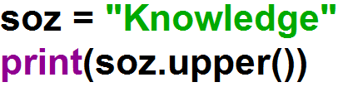

upper() Method
Converts a string into upper case

Slide 12
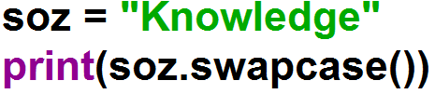

swapcase() Method
Swaps cases, lower case becomes upper case and vice versa

Slide 13
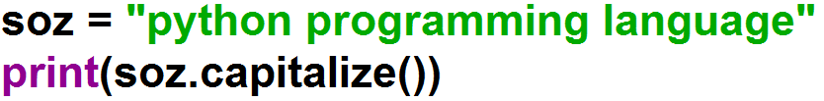
capitalize() Method
Converts the first character to upper case

Slide 14
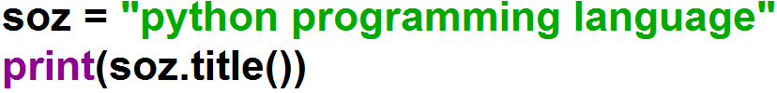
title() Method
Converts the first character of each word to upper case

Slide 15
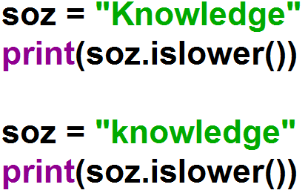
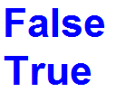
islower() Method
Returns True if all characters in the string are lower case

Slide 16
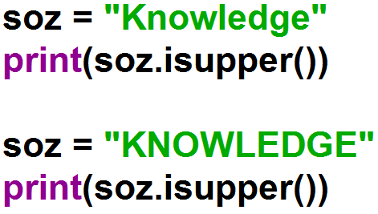
isupper() Method
Returns True if all characters in the string are upper case

Slide 17
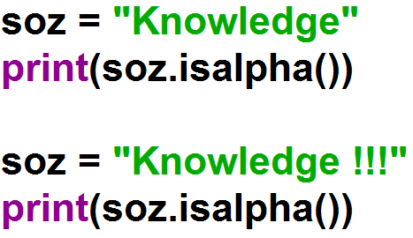
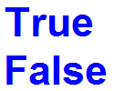
isalpha() Method
Returns True if all characters in the string are in the alphabet

Slide 18
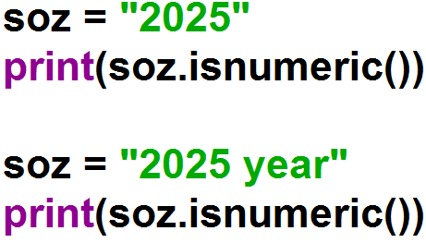
isnumeric() Method
Returns True if all characters in the string are numeric

Slide 19
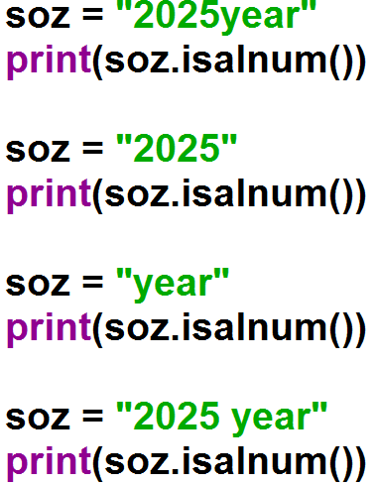
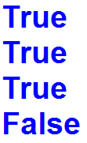
isalnum() Method
Returns True if all characters in the string are alphanumeric

Slide 20
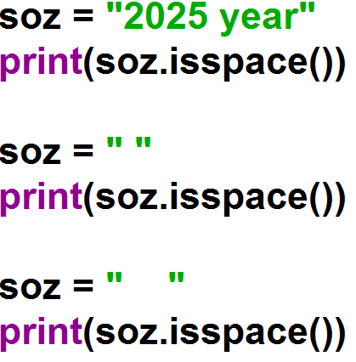
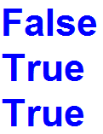
isspace() Method
Returns True if all characters in the string are whitespaces

Slide 21
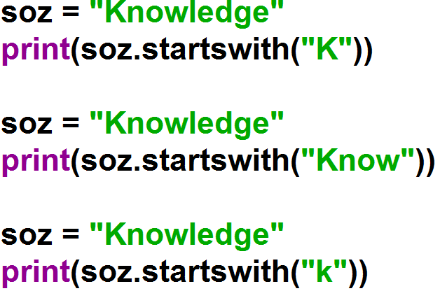
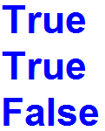
startswith() Method
Returns true if the string starts with the specified value

Slide 22
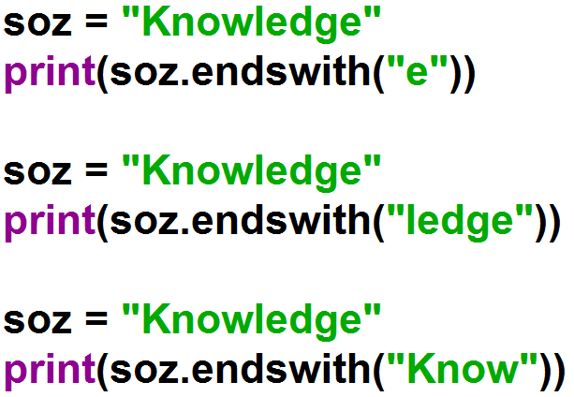
endswith() Method
Returns true if the string ends with the specified value

Slide 23
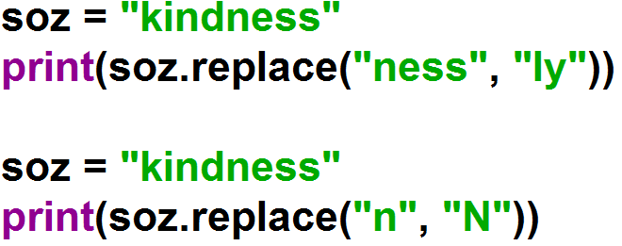

replace() Method
Returns a string where a specified value is replaced with a specified value

Slide 24
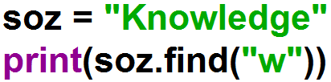

find() Method
Searches the string for a specified value and returns the position of where it was found

Slide 25
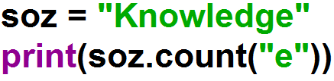

count() Method
Returns the number of times a specified value occurs in a string

Slide 26
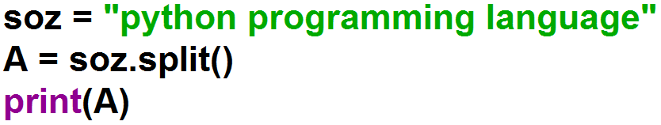
split() Method
Splits the string at the specified separator, and returns a list

Slide 27
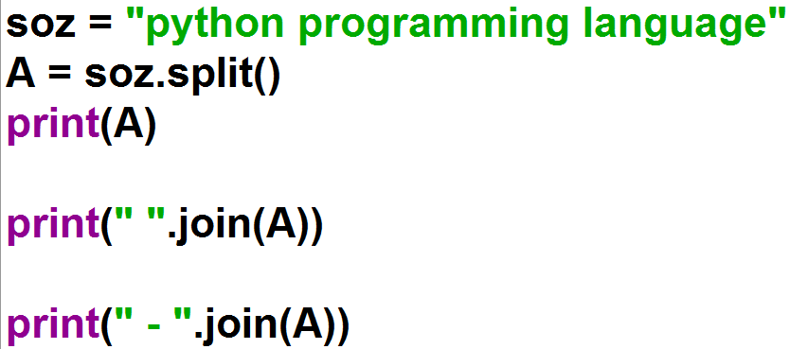
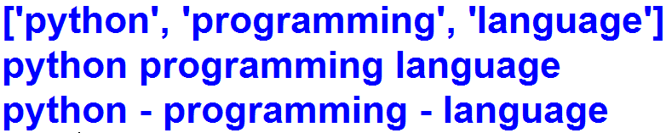
join() Method
Joins the elements of an iterable to the end of the string

Slide 28
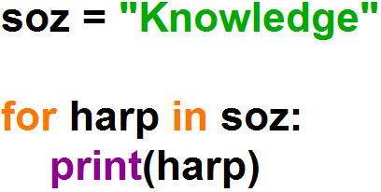
String with for Loop

Slide 29
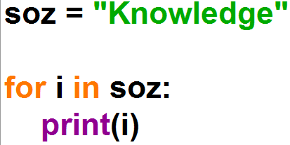
String with for Loop

Slide 30
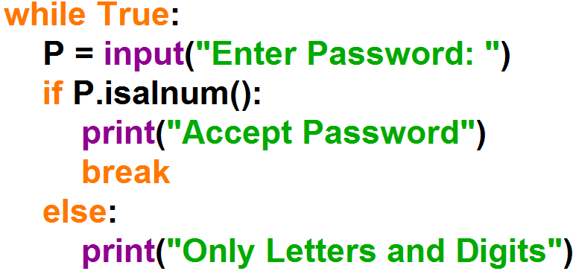
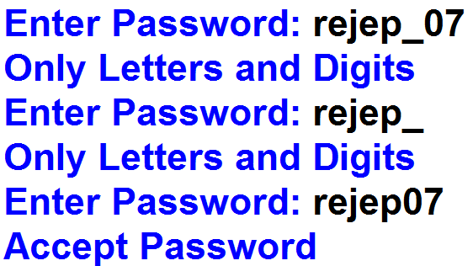
Example

Slide 31


