Slide 1

String Methods

Slide 2
Data Types
Data Type | Examples
integer | 22, 5, 94, -30, -24
float | 0.5, 1.25, 3.14, -4.5, -2.7
string | “hello”, “4 cats”, “a”, “aaa”, “7”
boolean | True, False

Slide 3
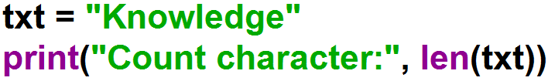

String Length
To get the length of a string, use the len() function.

Slide 4


String Length
To get the length of a string, use the len() function.

Slide 5
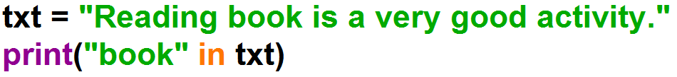

Check String
To check if a certain phrase or character is present in a string, we can use the keyword in.

Slide 6


Check String
To check if a certain phrase or character is present in a string, we can use the keyword in.

Slide 7
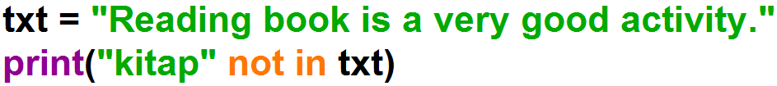
Check String
To check if a certain phrase or character is NOT present in a string, we can use the keyword not in.

Slide 8
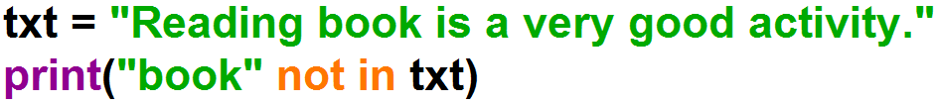
Check String
To check if a certain phrase or character is NOT present in a string, we can use the keyword not in.

Slide 9
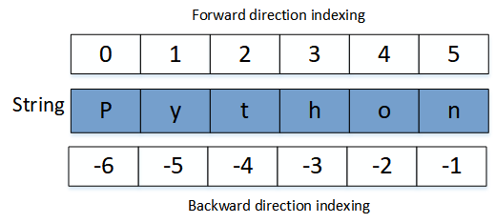
Slicing String
index
txt

Slide 10
Slicing String
txt
index

Slide 11
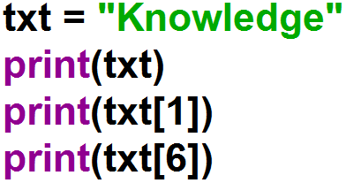
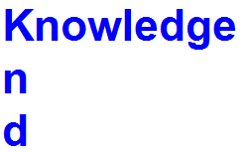
Slicing String

Slide 12
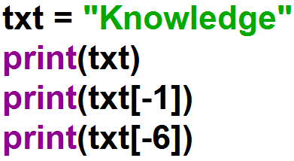
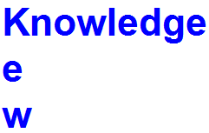
Slicing String

Slide 13
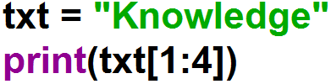

Slicing String
Get the characters from position 1 to position 4 (not included):

Slide 14
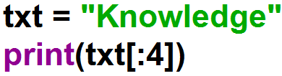

Slicing String
Get the characters from the start to position 4 (not included):

Slide 15
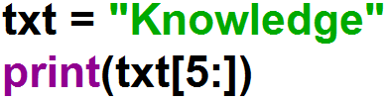

Slicing String
Get the characters from position 5, and all the way to the end:

Slide 16
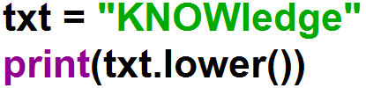

lower() Method
Converts a string into lower case.

Slide 17
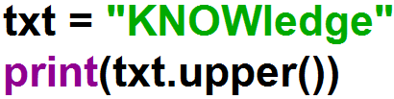

upper() Method
Converts a string into upper case.

Slide 18
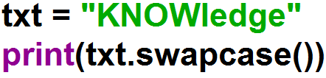

swapcase() Method
Swaps cases, lower case becomes upper case and vice versa.

Slide 19
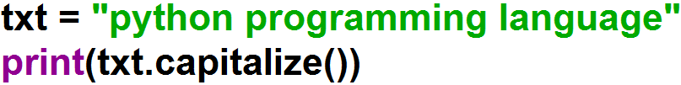
capitalize() Method
Converts the first character to upper case.

Slide 20
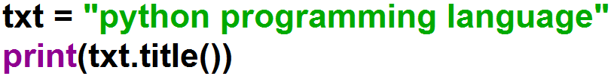
title() Method
Converts the first character of each word to upper case.

Slide 21
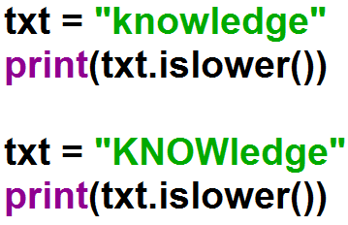
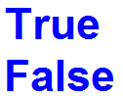
islower() Method
Returns True if all characters in the string are lower case.

Slide 22
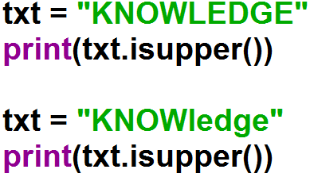
isupper() Method
Returns True if all characters in the string are upper case.

Slide 23
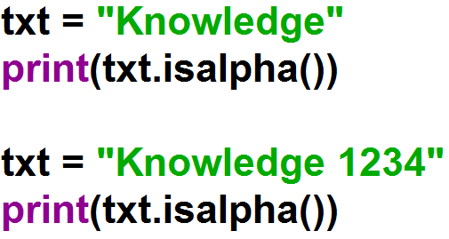
isalpha() Method
Returns True if all characters in the string are in the alphabet.

Slide 24
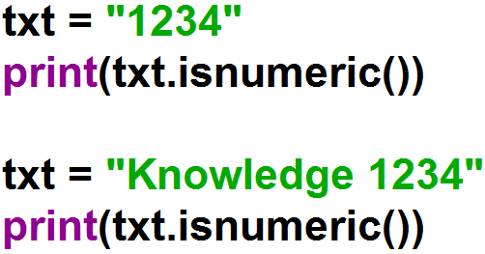
isnumeric() Method
Returns True if all characters in the string are numeric.

Slide 25
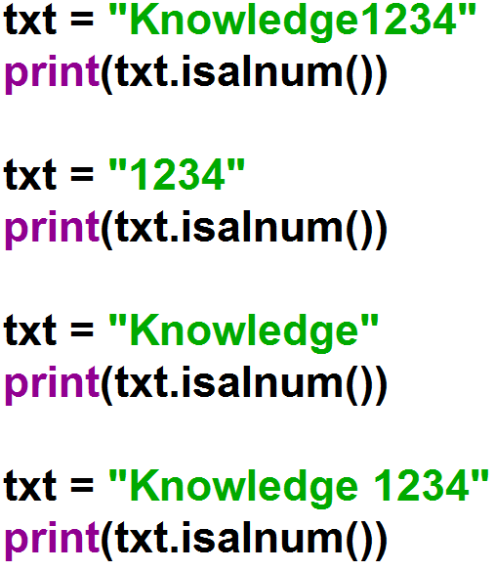
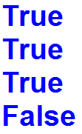
isalnum() Method
Returns True if all characters in the string are alphanumeric.

Slide 26
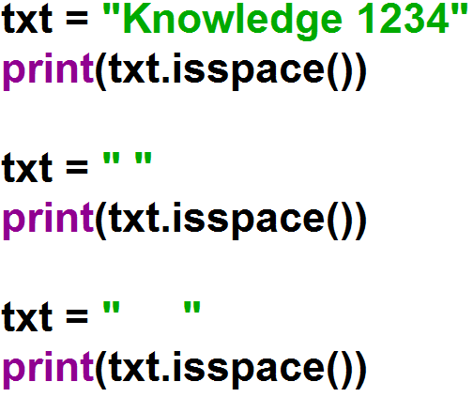
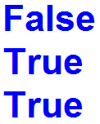
isspace() Method
Returns True if all characters in the string are whitespaces.

Slide 27
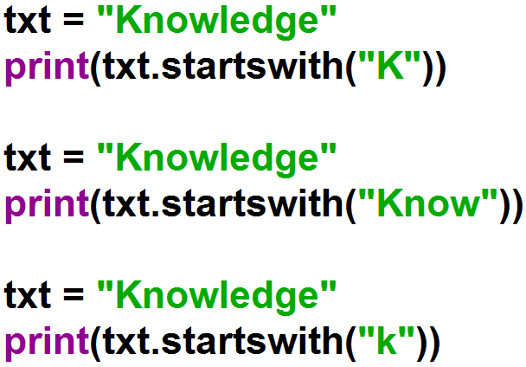
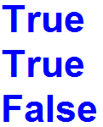
startswith() Method
Returns true if the string starts with the specified value.

Slide 28
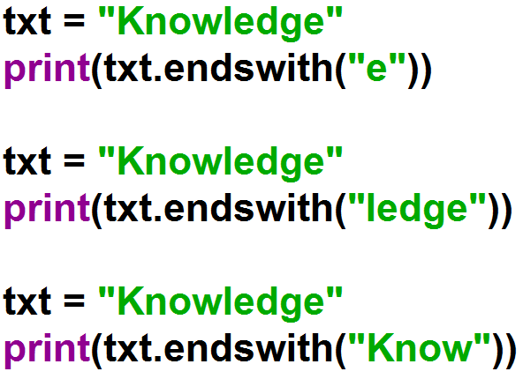
endswith() Method
Returns true if the string ends with the specified value.

Slide 29
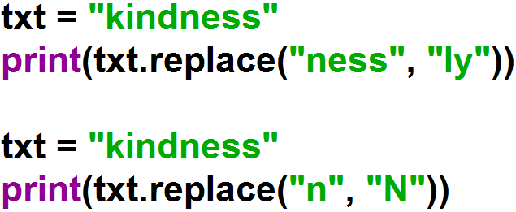

replace() Method
Returns a string where a specified value is replaced with a specified value.

Slide 30
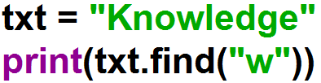

find() Method
Searches the string for a specified value and returns the position of where it was found.

Slide 31
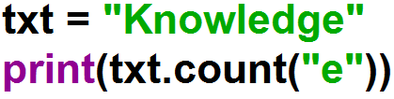

count() Method
Returns the number of times a specified value occurs in a string.

Slide 32
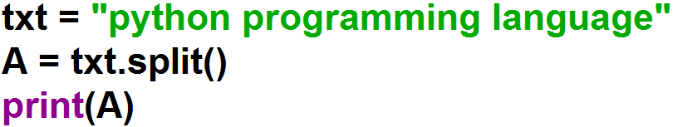
split() Method
Splits the string at the specified separator, and returns a list.

Slide 33
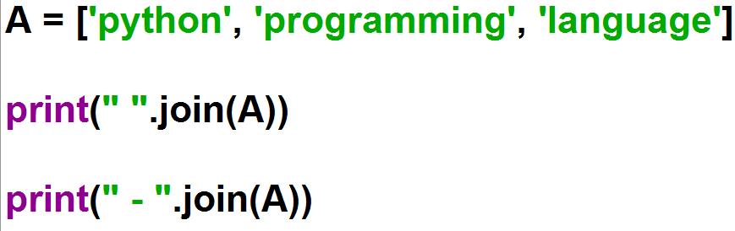
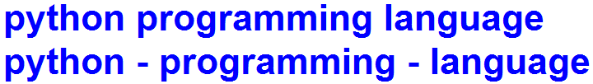
join() Method
Joins the elements of an iterable to the end of the string.

Slide 34


Example: for Loop

Slide 35
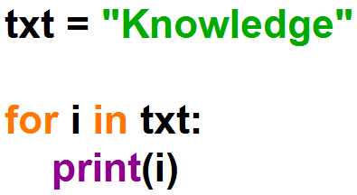
Looping Through a String
Loop through the letters in the text.

Slide 36
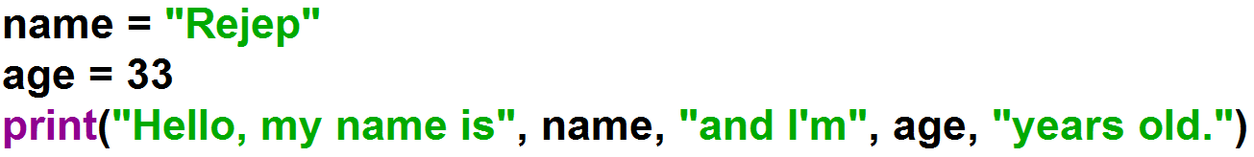
String format

Slide 37
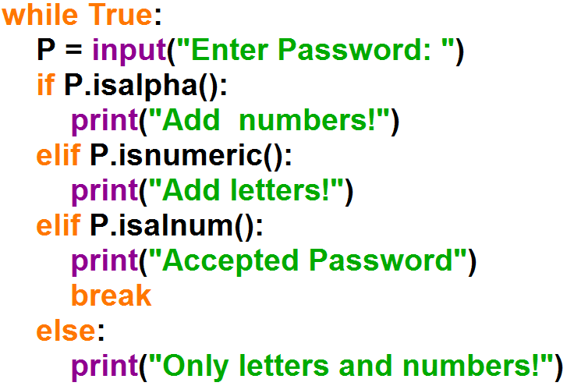
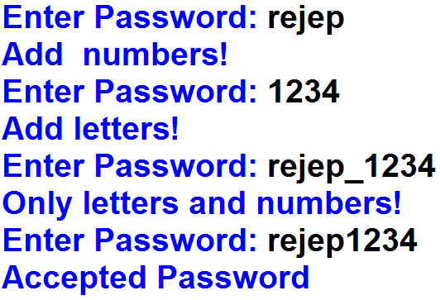
Example: Get a password from the user until write the correct password . The password must consist of only letters and numbers.

