Slide 1
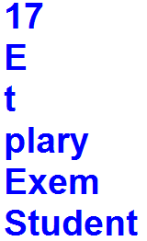
1. Create a string variable and assign with "Exemplary Student".
Get the length of a string.
Get the first character of a string.
Get the last character of a string.
Get the characters from position 4 to position 9 (not included).
Get the characters from the start to position 4 (not included).
Get the characters from position 10, and all the way to the end.
Output

Slide 2
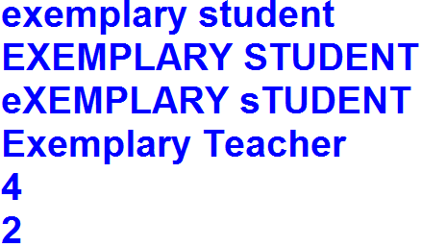
2. Create string variable and assign with "Exemplary Student".
Convert a string into lower case.
Convert a string into upper case.
Convert a string from lower case to upper case and vice versa.
Replace the word "Student" to "Teacher“ in string.
Find the position of the letter p in string.
Count the letter e in string.
Output

Slide 3
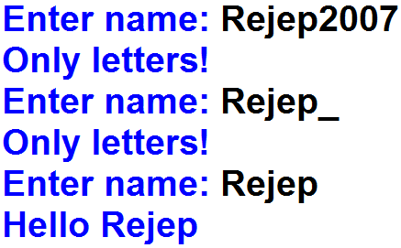
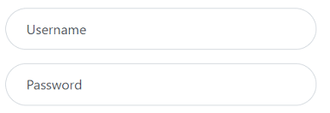
3. Get a name from the user until write the correct name. The name must consist of only letters.
Output

Slide 4
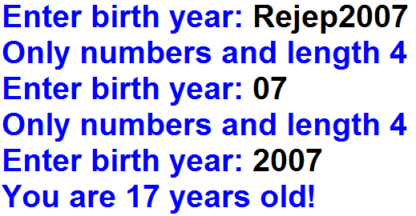
4. Get a birth year from the user until write the correct birth year and calculate user’s age. The birth year must consist of only numbers and its length 4.
Output

Slide 5
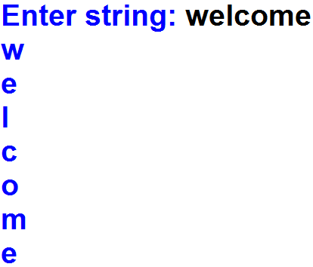
5. Get a string from the user and print letters.
Output

Slide 6
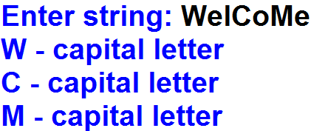
6. Get a string from the user and print only the capital letters.
Output

Slide 7
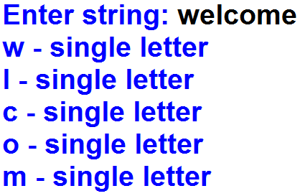
7. Get a string from the user and print the letters that do not repeats.
Output

Slide 8
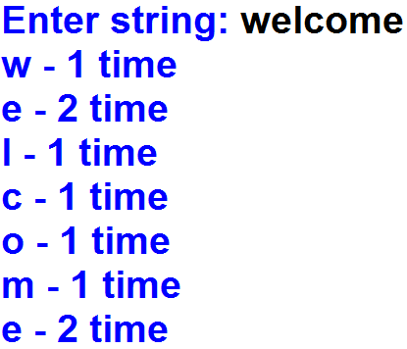
8. Get a string from the user and print letters and count of each letter in the string.
Output

Slide 9
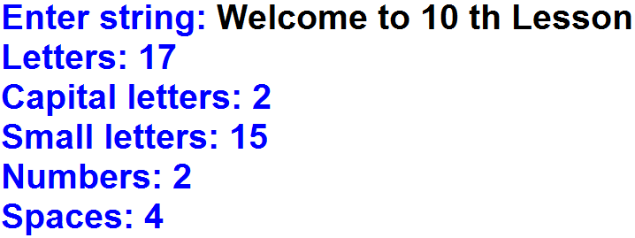
9. Get a string from the user and calculate quantity of letters, quantity of capital letters, quantity of small letters, quantity of numbers and quantity of spaces.
Output

Slide 10
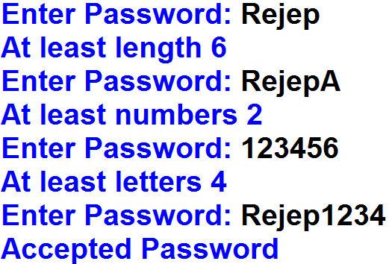
10. Get a password from the user until write the correct password. The password must be at least length: 6, at least quantity of letters: 4, at least quantity of numbers: 2.
Output

Slide 11


Extra: Lottery ticket numbers usually consist of an even number of digits. A lottery ticket number is considered lucky if the sum of the first half of the digits is equal to the sum of the second half. Given a lottery ticket number n, determine if it's lucky or not.
Output
Output

