Slide 1
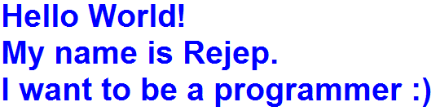
1.Write the code for the following text.

Slide 2
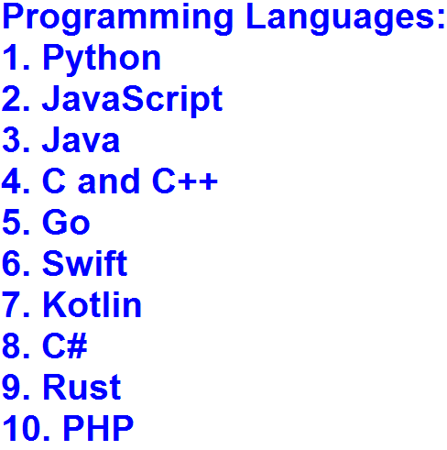
2.Write the code for the following text.

Slide 3

3.Write the code for the following text.

Slide 4
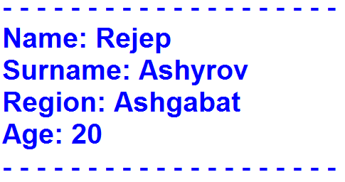
4.Write the code for the following text.

Slide 5
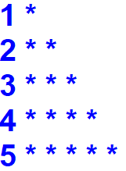
5.Write the code for the following text.

Slide 6

6.Write the code for the following text.

Slide 7
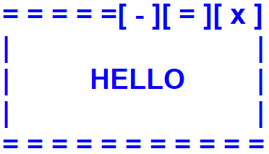
7.Write the code for the following text.

Slide 8

8.Write the code for the following text.

Slide 9
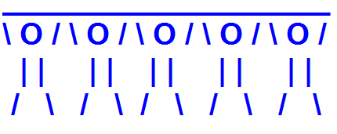
9.Write the code for the following text.

Slide 10

10.Write the code for the following text.

