Slide 1

Variables

Slide 2
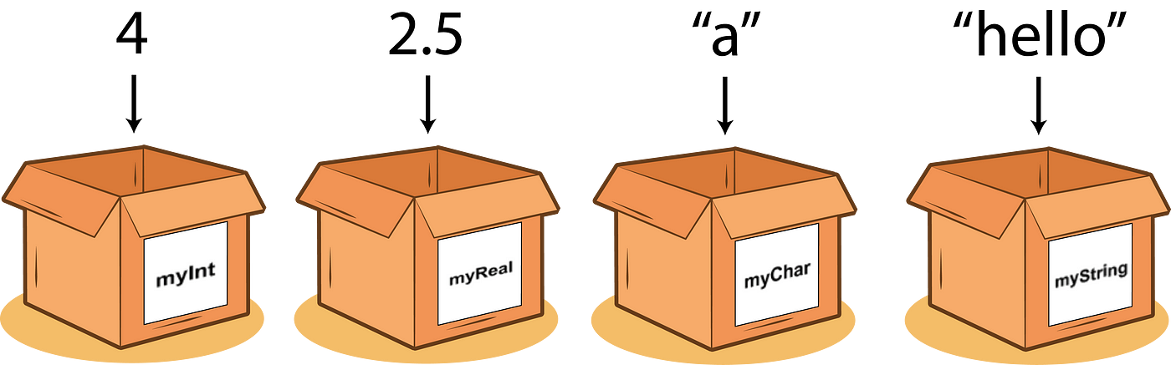
Variables
A variable is like a box in the computer’s memory where you can store a single value. Variables are containers for storing data values.

Slide 3
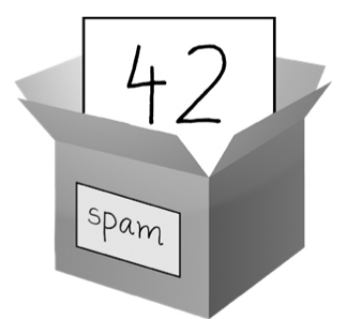
Creating Variables
Python has no command for declaring a variable. A variable is created the moment you first assign a value to it.
spam = 42

Slide 4
Creating Variables
a = 4 b = 2.5 c = “a” d = “hello”

Slide 5
Creating Variables
Variables do not need to be declared with any particular type, and can even change type after they have been set.
Python
a = 4
b = 2.5
c = “a”
d = “hello”
Other
int a = 4
flot b = 2.5
char c = “a”
string d = “hello”

Slide 6


Creating Variables and Print

Slide 7


Creating Variables and Print

Slide 8


Creating Variables and Print

Slide 9

Creating Variables and Print

Slide 10

Creating Variables and Print

Slide 11
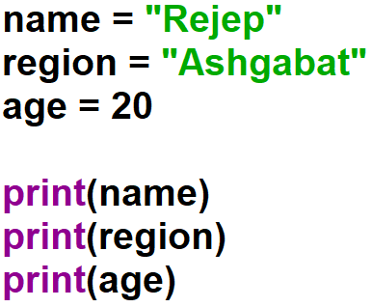
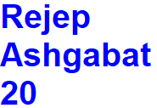
Creating Variables and Print

Slide 12
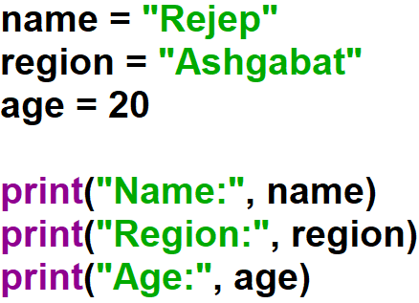
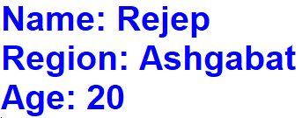
Creating Variables and Print

Slide 13
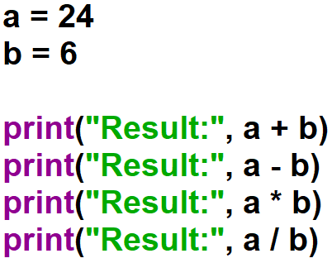
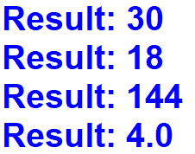
Creating Variables and Print

Slide 14
Rules for Python Variables
A variable name can only contain alpha-numeric characters and underscores (A-z, 0-9, and _ );
A variable name must start with a letter or the underscore character;
A variable name cannot start with a number;
Variable names are case-sensitive (age, Age and AGE are three different variables).

Slide 15

Example:
This will create two variables:
a = “Rejep”
A = “Meret”
a
A

Slide 16
Example:
Legal variable names:
myname = “Rejep”
my_name = “Rejep”
_my_name = “Rejep”
myName = “Rejep”
MYNAME = “Rejep”
myname2 = “Rejep”
Illegal variable names:
2myname = “Rejep”
my-name = “Rejep”
my name = “Rejep”

Slide 17
Multi Words Variable Names
Variable names with more than one word can be difficult to read. For example,
myvariablename = “Rejep”
There are several techniques you can use to make them more readable:
Camel Case
Pascal Case
Snake Case

Slide 18

Camel Case
Each word, except the first, starts with a capital letter:
myVariableName = “Rejep”

Slide 19
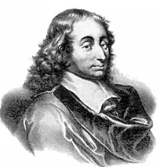
Pascal Case
Each word starts with a capital letter:
MyVariableName = “Rejep”

Slide 20

Snake Case
Each word is separated by an underscore character:
my_variable_name = “Rejep”

Slide 21
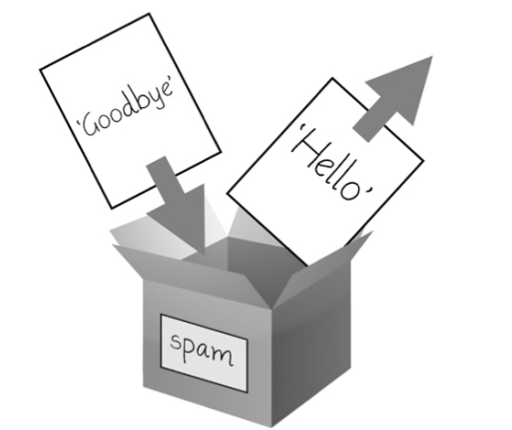
Creating Variables
When a variable is assigned a new value, the old value is forgotten.
spam = “Hello”
spam = “Goodbye”

Slide 22
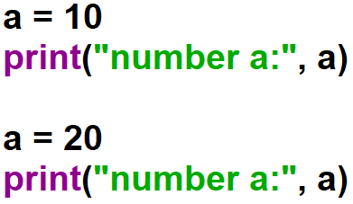

Example:
a

Slide 23
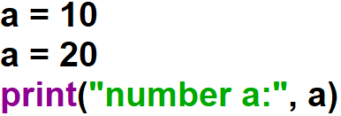

Example:
a

Slide 24
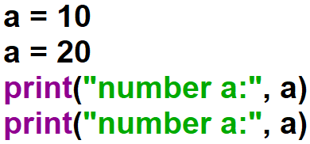

Example:
a

Slide 25
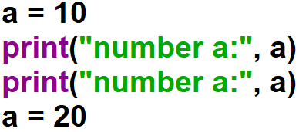

Example:
a

