Slide 1

1. Print the numbers from 1 to 10.
Output:

Slide 2

2. Print the numbers from 10 to 1.
Output:

Slide 3

3. Print the even numbers from 1 to 20.
Output:

Slide 4

4. Print the odd numbers from 20 to 1.
Output:

Slide 5
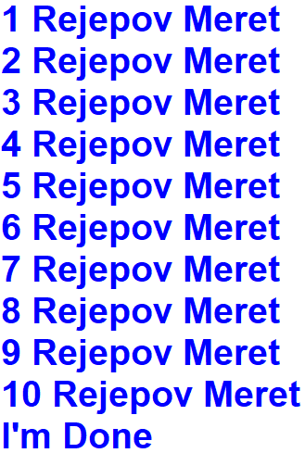
5. Print your name and surname 10 times.
Output:

Slide 6
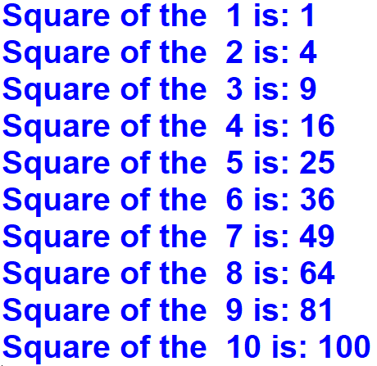
8. Print the square of the numbers from 1 to 10.
Output:

Slide 7
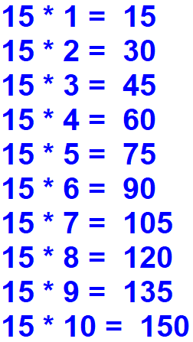
9. Print the multiplication table of number 15.
Output:

Slide 8
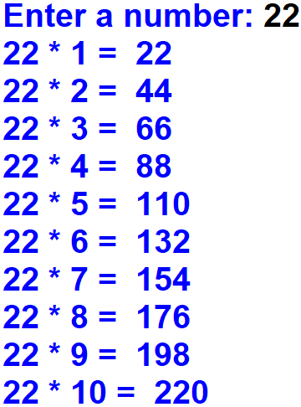
10. Ask a number from the user. Print the multiplication table of the number.
Output:

Slide 9
