Slide 1

List

Slide 2
Data Types
Data Type | Examples
integer | 22, 5, 94, -30, -24
float | 0.5, 1.25, 3.14, -4.5, -2.7
string | “hello”, “4 cats”, “a”, “aa”, “7”
boolean | True, False
list | [“Rejep”, “Meret”, “Oraz”, “Gurban”]

Slide 3
What is the List?
Lists are used to store multiple items in a single variable.
Lists are one of 4 built-in data types in Python used to store collections of data, the other 3 are Tuple, Set, and Dictionary, all with different qualities and usage.

Slide 4
Create a List
Lists are created using square brackets.

Slide 5

Create a List
A list can contain different data types.

Slide 6
Create a List
Lists allow duplicate values:

Slide 7

List Length
To determine how many items a list has, use the len() function:

Slide 8
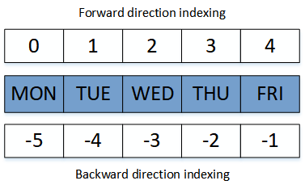
Access List Items
Index
List
Index

Slide 9

Access List Items
Print the first item of the list:

Slide 10

Access List Items
Print the last item of the list:

Slide 11

Access List Items
Get the items from position 1 to position 4 (not included):

Slide 12


Access List Items
Get the items from the start to position 3 (not included):

Slide 13


Access List Items
Get the items from position 2, and all the way to the end:

Slide 14
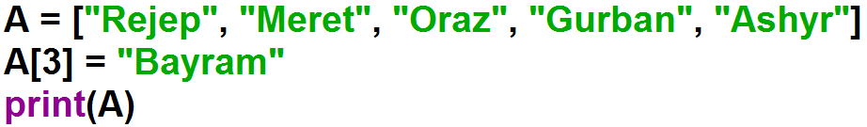
Change List Items
To change the value of a specific item, refer to the index number:

Slide 15
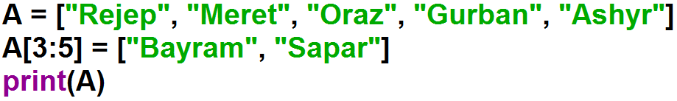
Change List Items
To change the value of a specific items, refer to the index numbers:

Slide 16
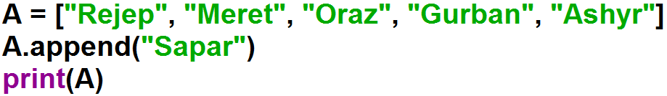
Add List Items
To add an item to the end of the list, use the append() method:

Slide 17
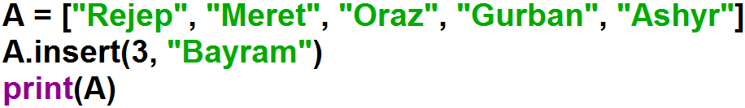
Add List Items
To insert a list item at a specified index, use the insert() method.

Slide 18
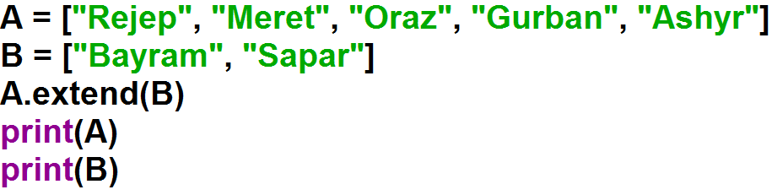
Add List Items
To append elements from another list to the current list, use the extend() method.

Slide 19
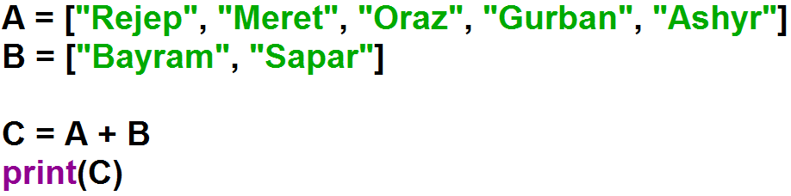
Add List Items

Slide 20
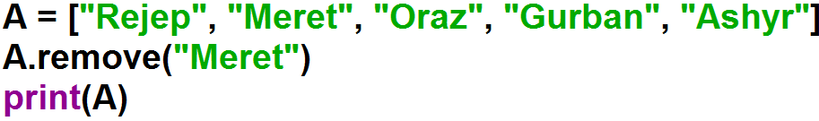
Remove List Items
The remove() method removes the specified item.

Slide 21
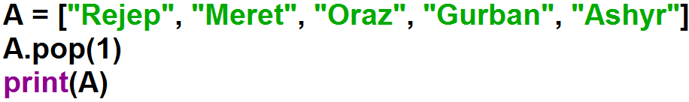
Remove List Items
The pop() method removes the specified index.

Slide 22
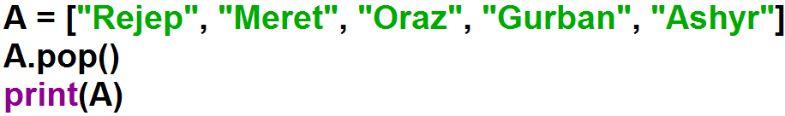
Remove List Items
If you do not specify the index, the pop() method removes the last item.

Slide 23
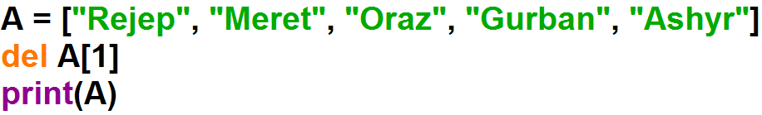
Remove List Items
The del keyword also removes the specified index:

Slide 24
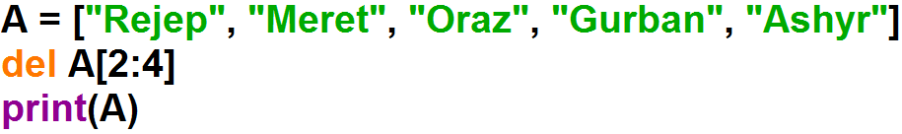

Remove List Items
The del keyword also removes the specified index:

Slide 25
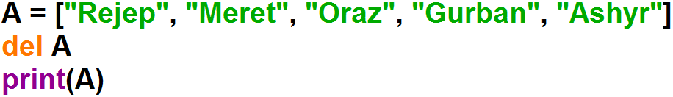
Remove List Items
The del keyword also removes the specified index:

Slide 26
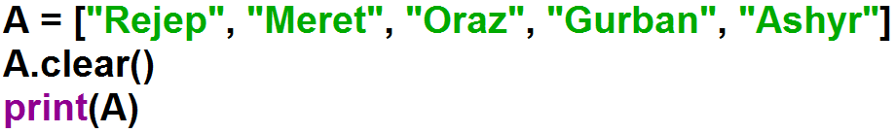

Clear the List
The clear() method empties the list. The list still remains, but it has no content.

Slide 27
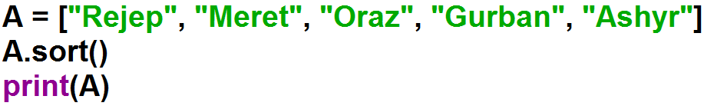
Sort List
List objects have a sort() method that will sort the list alphanumerically, ascending, by default:

Slide 28
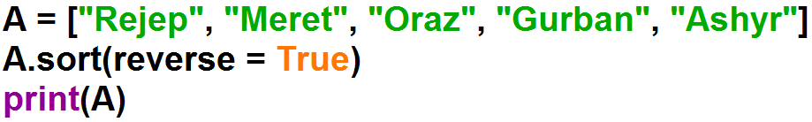
Sort List
To sort descending, use the keyword argument reverse = True:

Slide 29
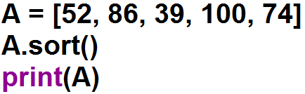

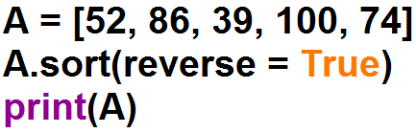

Sort List

Slide 30
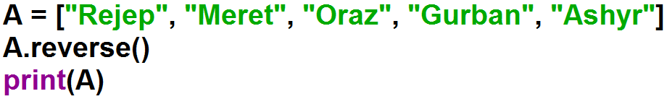
Reverse Order
The reverse() method reverses the current sorting order of the elements.

Slide 31
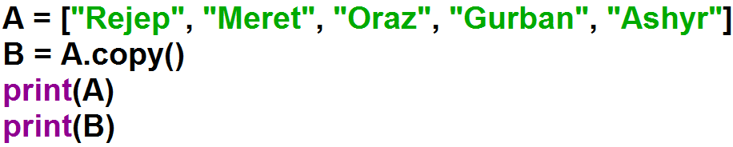

Copy List
There are ways to make a copy, one way is to use the built-in List method copy().

Slide 32

List index() Method
The index() method returns the position at the first occurrence of the specified value.

Slide 33

List count() Method
The count() method returns the number of elements with the specified value.

Slide 34
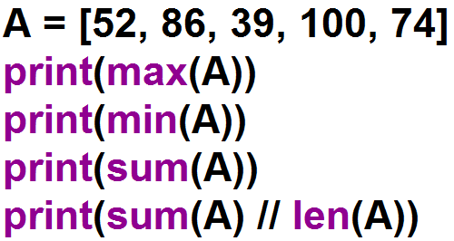

max, min, sum functions

Slide 35
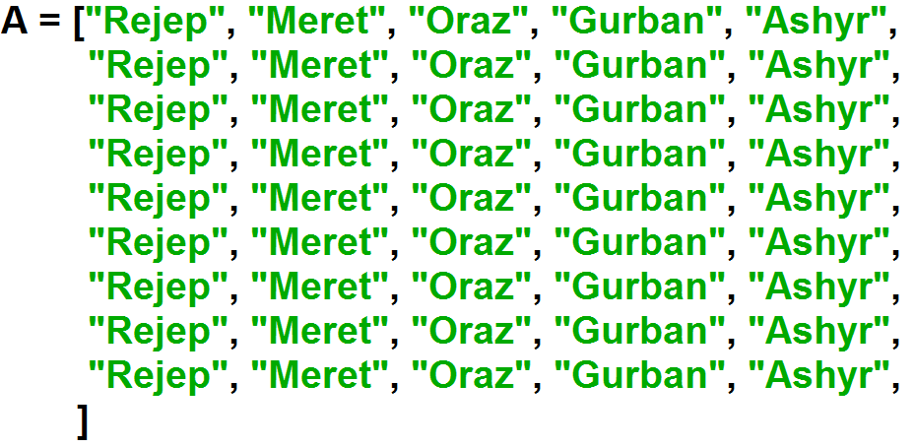

List with for Loop

Slide 36
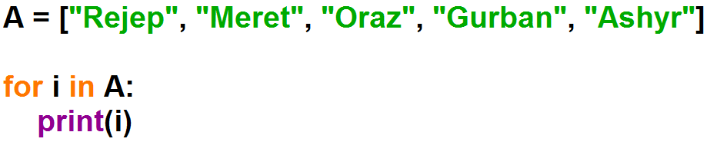
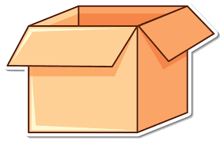
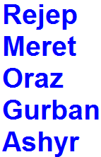
Loop Through a List
Print all items in the list, one by one:
A
i

Slide 37
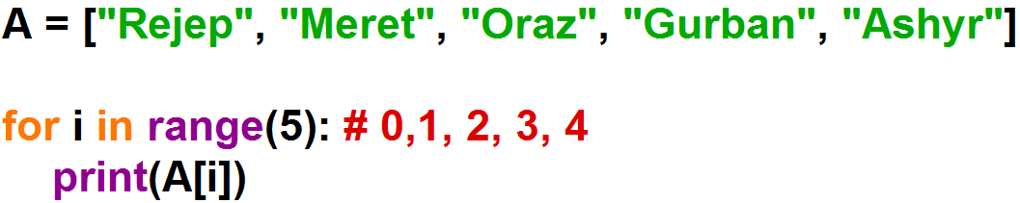
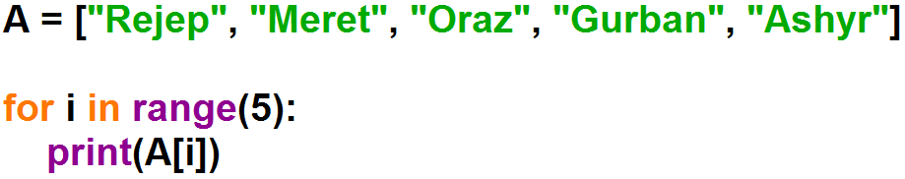
Loop Through the Index Numbers
Print all items by referring to their index number:
A
i

Slide 38
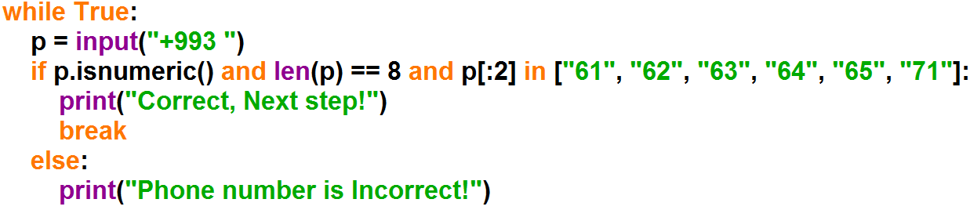
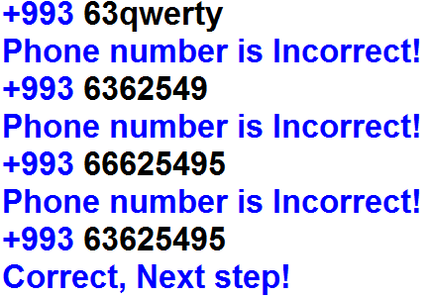
Example: Get a phone number from the user until write the correct phone number. The phone number must consist of only numbers, be length : 8, and be first 2 digits: 61, 62, 63, 64, 65, 71.

