Slide 1

Cryptography Cryptography is the study of secure communications techniques that allow only the sender and intended recipient of a message to view its contents. The term is derived from the Greek word kryptos, which means hidden.

Slide 2
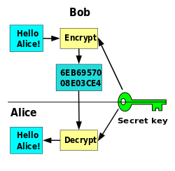
Cryptography

Slide 3
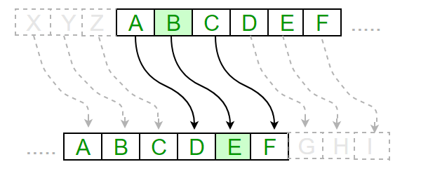
Caesar cryptography
Plain text => Cipher text

Slide 4
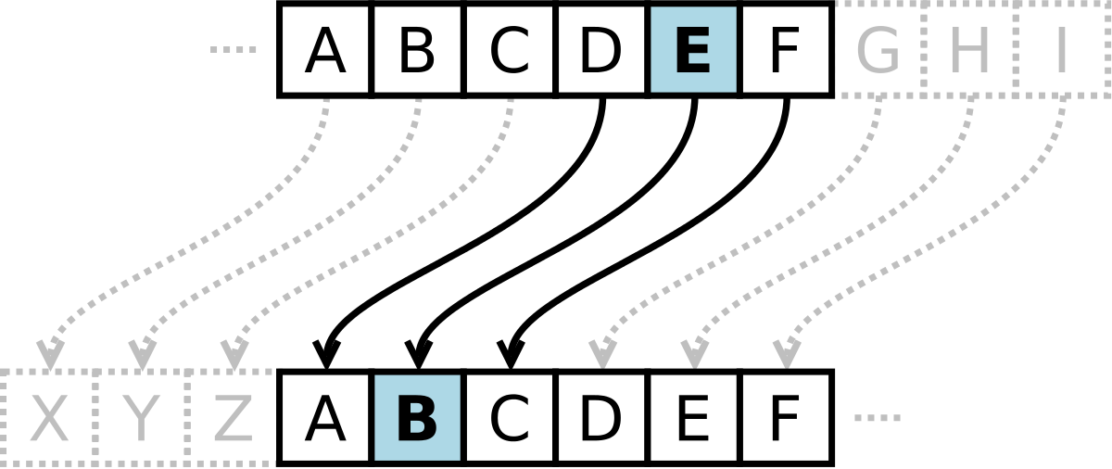
Caesar cryptography
Cipher text => Plain text

Slide 5

Caesar cryptography
Plain text => Cipher text
Plain text: ALGORITHM
Key: 3
Cipher text: DOJRULWKP
Cipher text => Plain text
Cipher text: DOJRULWKP
Key: 3
Plain text: ALGORITHM

Slide 6
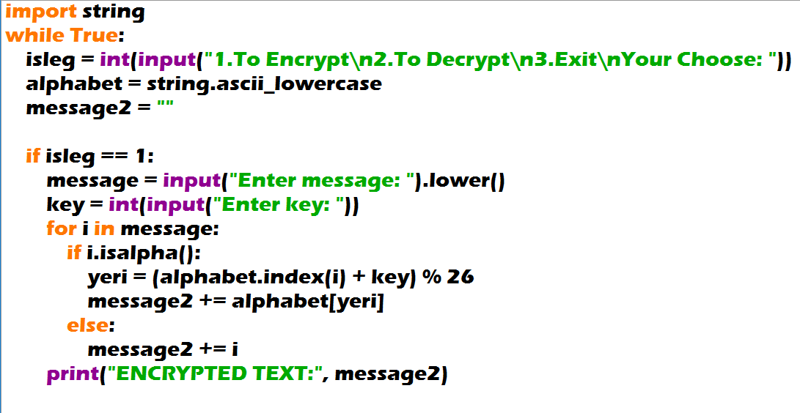
Caesar cryptography

Slide 7
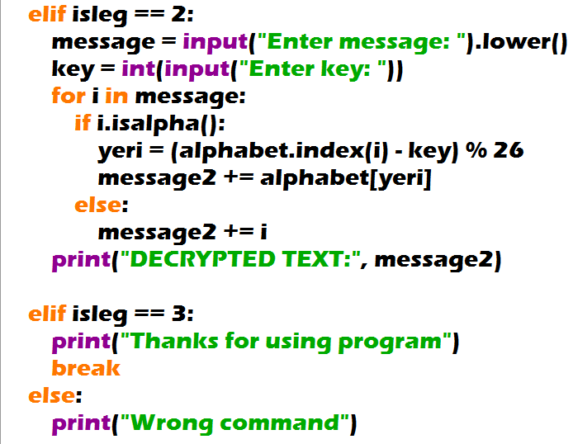
Caesar cryptography

Slide 8
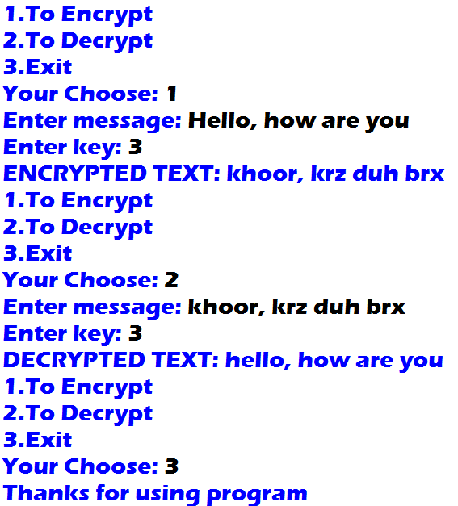
Output:
Caesar cryptography

