Slide 1
3.
Library = { 101 : { "name" : "Perman",
"author" : "A.Govshudov",
"quantity" : 8 },
102 : { "name" : "Saylanan eserler",
"author" : "G.Ezizov",
"quantity" : 12 },
103 : { "name" : "Ykbal",
"author" : "H.Deryayev",
"quantity" : 6 },
104 : { "name" : "Leyli Mejnun",
"author" : "N.Andalyp",
"quantity" : 4 },
105 : { "name" : "Oylanma bayry",
"author" : "K.Gurbannepesov",
"quantity" : 9 } }

Slide 2
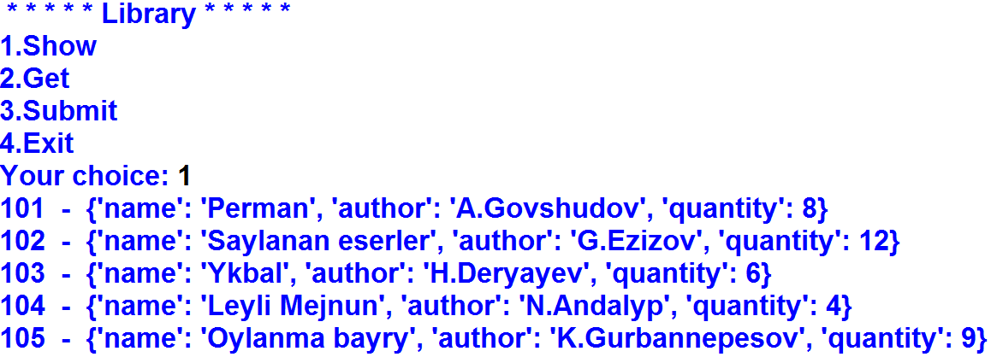
3. a)
Output:

Slide 3
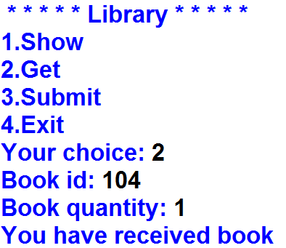
3. b)
Output:

Slide 4
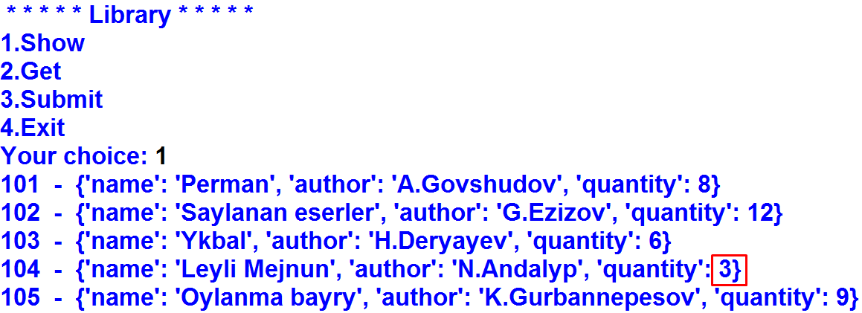
3. b)
Output:

Slide 5
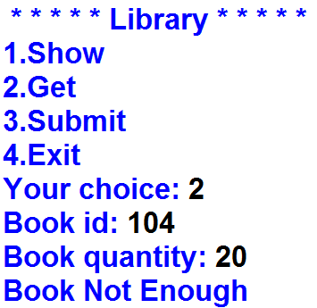
3. b)
Output:

Slide 6
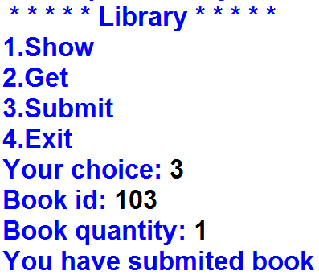
3. c)
Output:

Slide 7
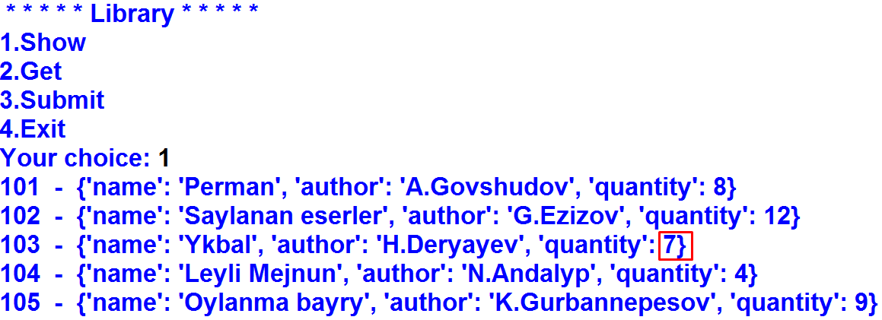
3. c)
Output:

Slide 8
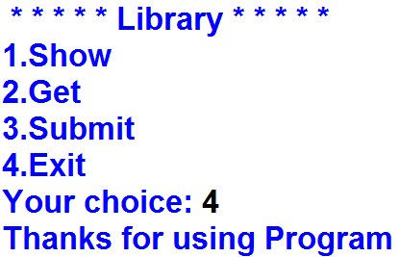
3. d)
Output:

Slide 9
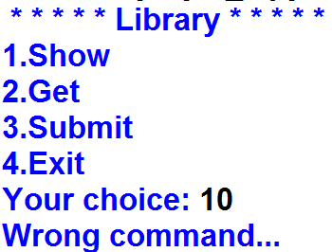
3. d)
Output:

