Slide 1

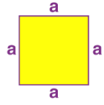
1. Given the side a of a square, find the perimeter P of the square: P = 4·a.
Output:

Slide 2

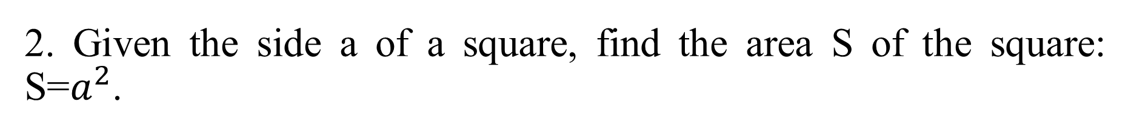
2. Given the side a of a square, find the area S of the square: S=$a^{2}$.
Output:

Slide 3
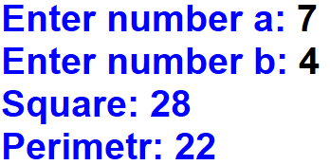
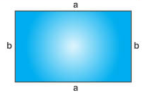
3. The sides a and b of a rectangle are given. Find the area S = a·b and the perimeter P = 2·(a + b) of the rectangle.
Output:

Slide 4
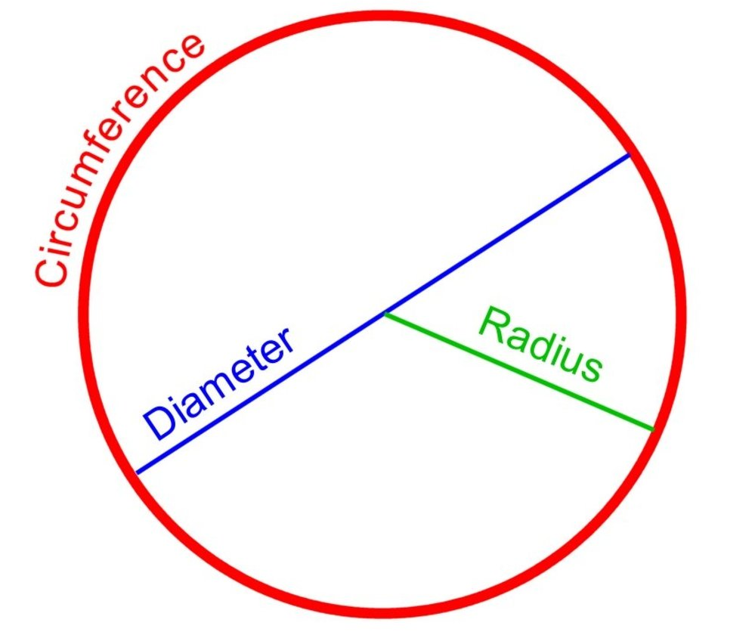

4. Given the diameter d of a circle, find the length L of the circle: L = π·d. Use 3.14 for a value of π.
Output:

Slide 5
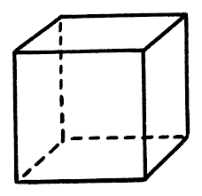
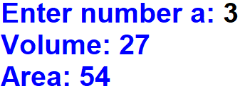
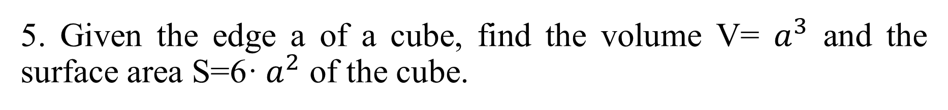
5. Given the edge a of a cube, find the volume V= $a^{3}$ and the surface area S=6· $a^{2}$ of the cube.
Output:

Slide 6
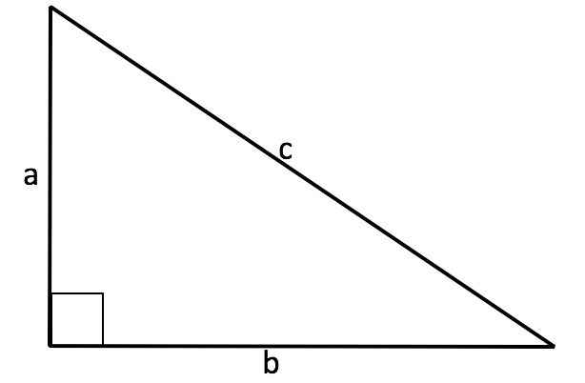
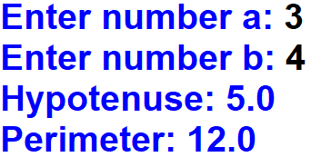
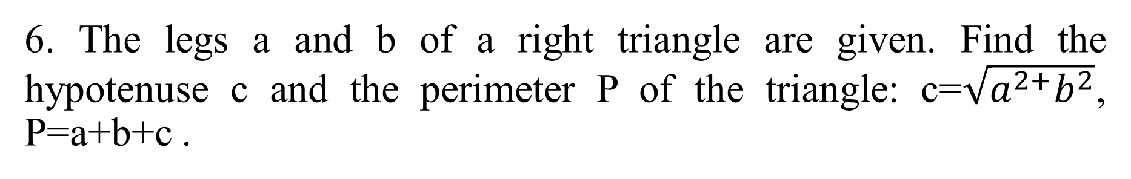
6. The legs a and b of a right triangle are given. Find the hypotenuse c and the perimeter P of the triangle: c=$\sqrt{a^{2+}b^{2}}$, P=a+b+c .
Output:

Slide 7
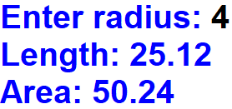
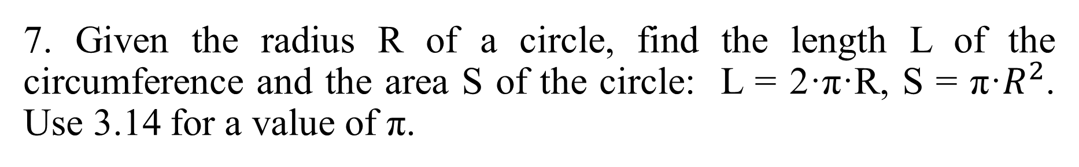
7. Given the radius R of a circle, find the length L of the circumference and the area S of the circle: L = 2·π·R, S = π·$R^{2}$. Use 3.14 for a value of π.
Output:

Slide 8

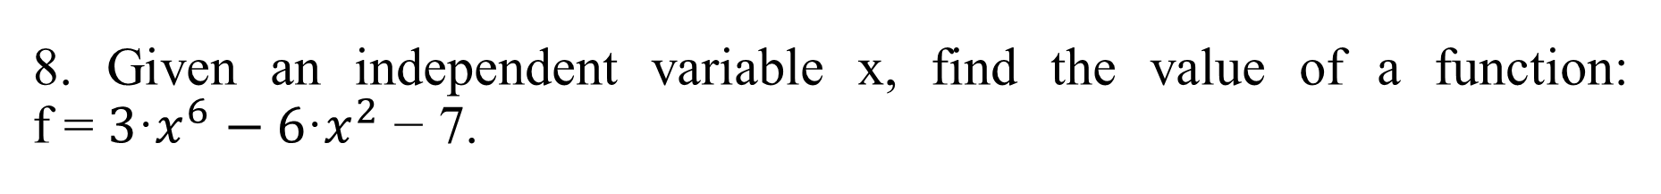
8. Given an independent variable x, find the value of a function: f = ${3\text{·}x}^{6}−{6\text{·}x}^{2}$ − 7.
Output:

Slide 9

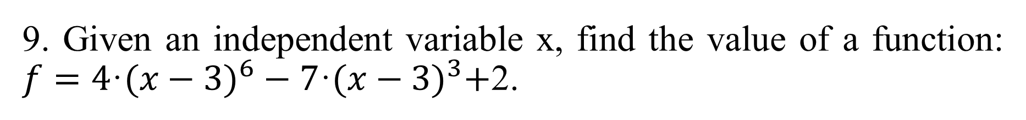
9. Given an independent variable x, find the value of a function: $f={4\text{·}(x−3)}^{6}−7\text{·}{(x−3)}^{3}+$2.
Output:

