Slide 1
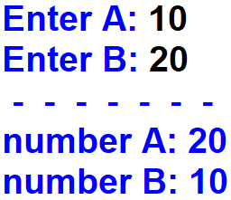
1. Write a python program. Exchange the values of two given variables A and B. Output the new values of A and B.
Output:
A
B

Slide 2
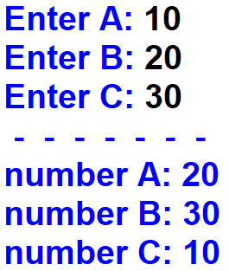
2. Write a python program. Variables A, B, C are given. Change values of the variables by moving the given value of A into the variable C, the given value of C into the variable B, and the given value of B into the variable A. Output the new values of A, B, C.
Output:
A
B
C

Slide 3
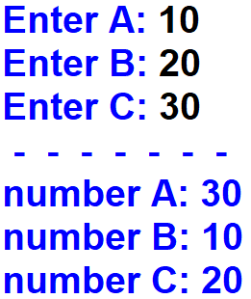
3. Write a python program. Variables A, B, C are given. Change values of the variables by moving the given value of A into the variable B, the given value of B into the variable C, and the given value of C into the variable A. Output the new values of A, B, C.
Output:
A
B
C

Slide 4
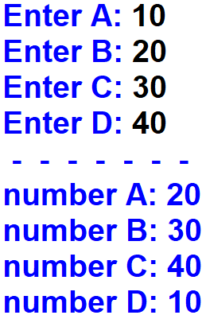
4. Write a python program. Variables A, B, C, D are given. Change values of the variables by moving the given value of A into the variable B, the given value of B into the variable C, the given value of C into the variable D, and the given value of D into the variable A. Output the new values of A, B, C, D.
Output:
A
B
C
D

Slide 5
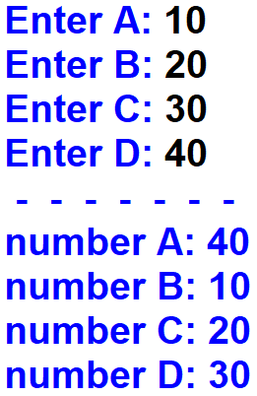
5. Write a python program. Variables A, B, C, D are given. Change values of the variables by moving the given value of A into the variable B, the given value of B into the variable C, the given value of C into the variable D, and the given value of D into the variable A. Output the new values of A, B, C, D.
Output:
A
B
C
D

