Slide 1
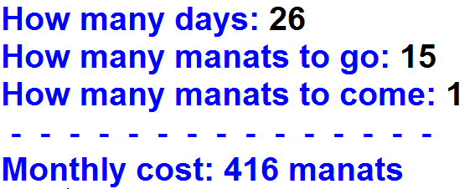
1.Write the code for the following application.
Output:

Slide 2
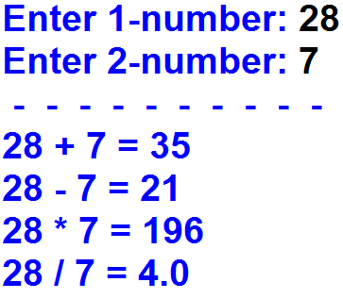
2.Write the code for the following application.
Output:

Slide 3
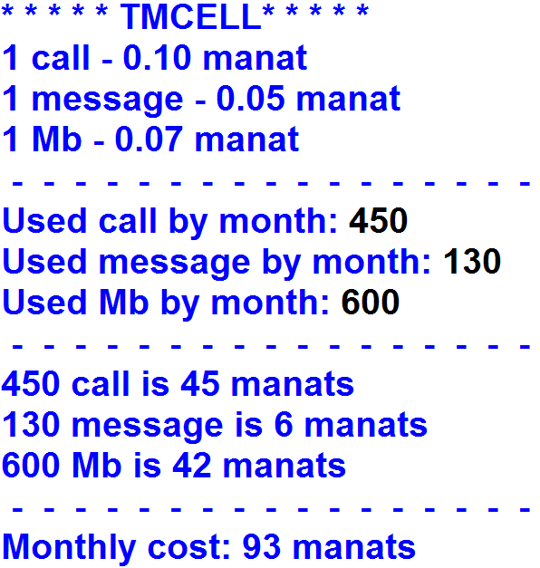
3.Write the code for the following application.
Output:

